Slide 1
Introduction to HCI
HCI & Web Design
Rosanne Birney

Slide 2
Overview
What is HCI/Interaction Design?
Why is it important?
What are the goals of interaction design?
Good vs. bad designs

Slide 3
What is HCI/Interaction Design?
HCI (Human Computer Interaction) seeks to provide an understanding of the human user and the computer system, in an effort to make the interactions between the two easier, more efficient and more satisfying
Designing interactive products to support the way people communicate and interact in their everyday and working lives
Sharp, Rogers and Preece (2011)

Slide 4
Why is it important?
Increased productivity
For example:
20 users
x 240 days (5 days a week, 48 weeks a year)
x 100 screens per day
x 10 seconds per screen savings
= 1278 hours or 32 weeks saved each year

Slide 5
Why is it important?
Reduced training costs
For example:
20 employees
x 2 systems/applications per year
x 2.5 days per application (saved)
= 100 days or 20 working weeks saved each year

Slide 6
Why is it important?
Preventable user errors
For example:
500 users
x 20 errors per year
x 15 minutes per error
= 2500 hours lost (or 63 weeks)

Slide 7
Goals of interaction design
Develop usable products
Usability means easy to learn, effective to use and provide an enjoyable experience
Involve users in the design process
Need to take into account:
Who the users are
What activities are being carried out
Where the interaction is taking place

Slide 8
Good vs. Bad design
Can you think of some examples of good design?
How about some examples of bad design?

Slide 9
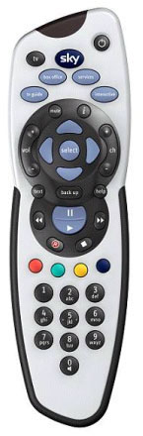
Good vs. Bad Designs

Slide 10
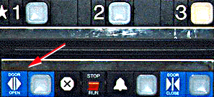
Bad designs
Elevator controls and labels on the bottom row all look the same, so it is easy to push a label by mistake instead of a control button
People do not make same mistake for the labels and buttons on the top row. Why not?
From: www.baddesigns.com

Slide 11
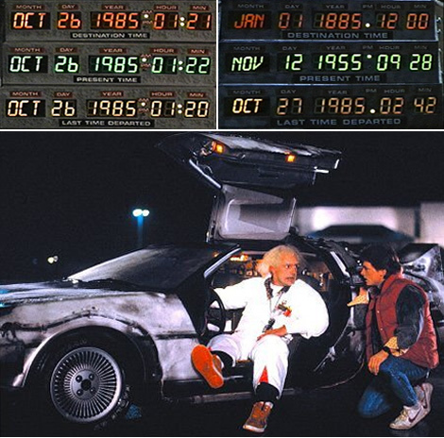
Design problem: Displays that are too similar
Can you think of a better design for this dashboard?
Need to show:
Current date/time
Destination date/time (where you are going)
Last date/time departed (where you have come from)
Notes:
Things to think about:
Type of interface – desktop type setup with mouse/keyboard? touchscreen? Something totally different e.g. gesture-based?
How will the user input information?
What size is the interface? Large/small screen?
Several screens or all info on one screen?
Take care with the concepts of ‘back’ and ‘forward’ in relation to past and future – where you have come from could be in the future, and vice versa!

Slide 12
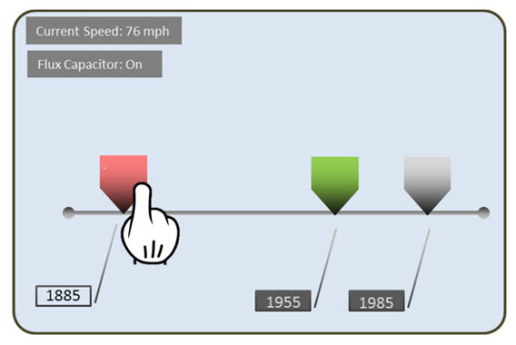
Design problem: (possible solution) Displays that are too similar
Use a touchscreen with sliders for different points in time:
Red = destination
Green = current date/time
Grey = last departed date/time
Source: https://jackskchang.wordpress.com/2012/11/30/re-designing-the-time-machine-in-back-to-the-future/

Slide 13
Good vs. Bad website design
In groups of 2/3, compare two websites:
Choose one example of good design, and another that is an example of bad design – or compare two competing websites
List the characteristics of the well-designed website
Also, list the reasons that the other website has a poor design

