Slide 1
Cognitive Science (ATTENTION)
HCI & Web Design – Rosanne Birney

Slide 2
Overview
Attention
Visual attention
Auditory attention
Divided attention: multi-tasking
Notes:
2

Slide 3
Attention
Selecting things to concentrate on at a point in time from the mass of stimuli around us
Allows us to focus on information that is relevant to what we are doing
Involves audio and/or visual senses
Focussed and divided attention enables us to be selective in terms of the mass of competing stimuli but limits our ability to keep track of all events
Notes:
3

Slide 4
Information-processing ‘bottlenecks’
Our perceptual systems can process many pieces of information in parallel
However, there are ‘bottlenecks’ in our information-processing system, where serial processing (one thing at a time) rather than parallel processing occurs
Our cognitive processes must decide which piece of information to attend to

Slide 5
Visual attention
Visual search:
Consists of two stages
Feature processing
Feature combination

Slide 6
Visual attention
Primitive features:
Identification of features occurs early in the process of visual form perception
These features include:
Colour
Orientation
Curvature
Line intersection

Slide 7
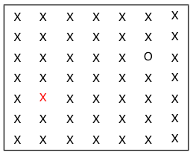
Find the red ‘x’ and the black ‘o’

Slide 8
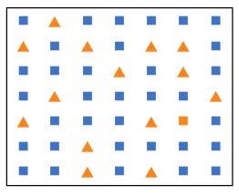
Find the orange square

Slide 9
Visual attention
Attentional engagement theory (Duncan & Humphreys, 1992)
Objects compete for attention and entry into short-term memory
If search target is too similar to other objects, competition is increased
This slows response times in a visual search

Slide 10
Activity: Find the price of a double room at the Holiday Inn in Bradley
Notes:
10

Slide 11
Activity: Find the price for a double room at the Quality Inn in Columbia
Notes:
11

Slide 12
Activity
Tullis (1987) found that the two screens produced quite different results
1st screen - took an average of 5.5 seconds to search
2nd screen - took 3.2 seconds to search
Why, since both displays have the same density of information (31%)?
Spacing
In the 1st screen the information is bunched up together, making it hard to search
In the 2nd screen the characters are grouped into vertical categories of information making it easier
Notes:
12

Slide 13
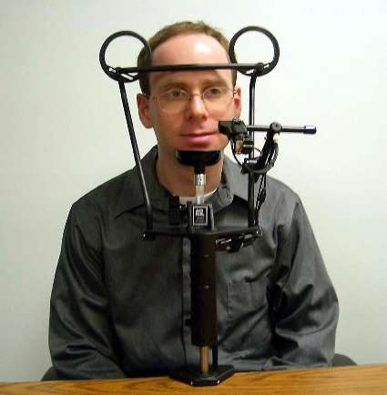
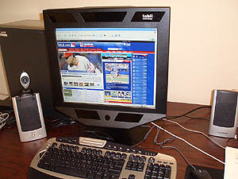
Eye-tracking equipment
Eye-tracking technology can show where our visual attention is focused
Here are some examples – old vs. new!

Slide 14
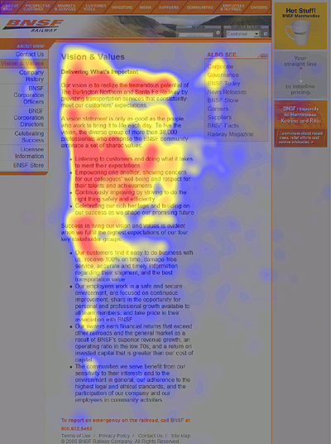
Eyetracking ‘heatmap’
The red areas are those that were given the most visual attention – this is known as the ‘F’ pattern

Slide 15
Auditory Attention
Our auditory system uses selective attention to focus on one auditory message at a time
How do we deal with listening to two things at one time?
In a “dichotic” listening task different sounds/messages are played into the left and right ears
Listeners are asked to focus on the sound being played into a particular ear and can usually repeat back that message easily
However, even the ignored message undergoes some processing

Slide 16
Auditory attention
Cocktail-party phenomenon
We can instantly tune into a ‘background’ conversation if we hear our name mentioned
In the dichotic listening task, listeners sometimes follow the meaningful message when it switches ears
Left: dogs six fleas
Right: eight scratch two
Response: dogs scratch fleas

Slide 17
Auditory Attention
In a dichotic listening task, listeners were able to identify some characteristics of the ‘ignored’ message (e.g. whether the speaker was male or female)
An example of a dichotic listening task:
http://www.linguistics.ucla.edu/people/schuh/lx001/Dichotic/dichotic.html

Slide 18
Divided attention
Dual task performance:
Our ability to divide attention between concurrent tasks
Some tasks are combined easily (e.g. eating and watching TV)
Others are difficult to combine as they involve similar stimuli (e.g. reading and watching TV)

Slide 19
Dual task performance
Low-level tasks that require short-term storage of stimuli can interfere with each other
For example, processing two different sets of letters or numbers simultaneously
High-level tasks are also difficult to combine
For example planning or retrieval from long-term memory
There is a small detrimental effect when combining any two tasks, even if they are processed differently from each other

Slide 20
Automaticity
Automatic processes:
Are fast and require little attention
Are unavailable to conscious inspection
Are hard to modify
Occur inevitably when triggered by an appropriate stimulus
Controlled processes:
Are slower, and make greater demands on cognitive resources
Are flexible, and associated with conscious experiences (deciding, choosing, etc.)

Slide 21
Automaticity and Practice
Schneider & Shiffrin (1977) showed that automaticity develops with practice
Everyday actions become ‘second-nature’ when performed often enough
For example:
Driving
Walking
Speaking
Reading

Slide 22
Multitasking and attention
Is it possible to perform multiple tasks without one or more of them being detrimentally affected?
Ophir et al (2009) compared heavy vs light multi-taskers
heavy were more prone to being distracted than those who infrequently multitask
heavy multi-taskers are easily distracted and find it difficult to filter irrelevant information

Slide 23
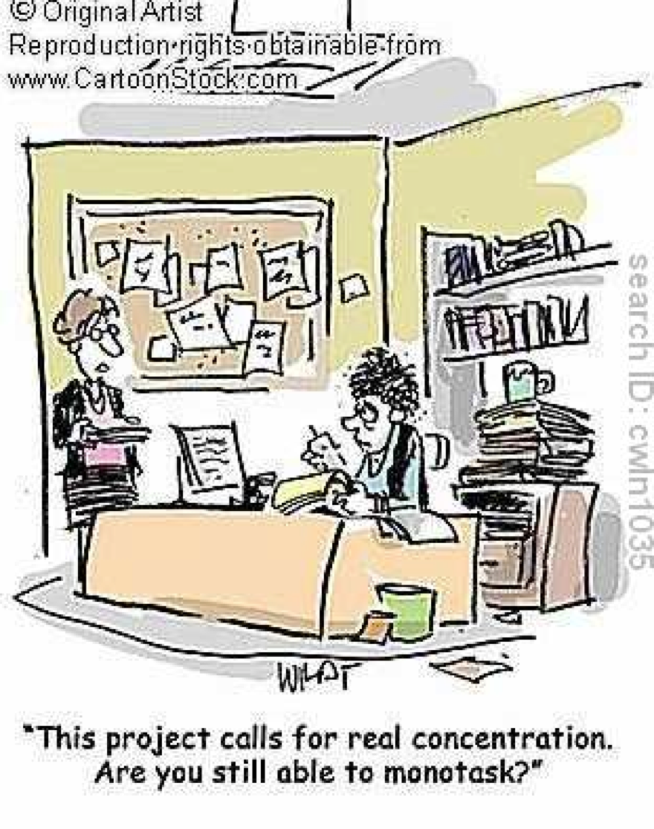

Slide 24
Design implications for attention
Make information salient when it needs attending to
Use techniques that make things stand out like colour, ordering, spacing, underlining, sequencing and animation
Avoid cluttering the interface with too much information
Avoid using too much because the software allows it
Notes:
24

Slide 25
Cognitive Science and Design
A talk by Alex Faaborg (Designer @ Android) given at the Google I/O 2013 conference discusses how cognitive science theories are applied in the design of Google products
https://www.youtube.com/watch?v=z2exxj4COhU
First 20 minutes relates to perception and attention

