Slide 1
Responsive Web Design
HCI & Web Design

Slide 2
Overview
What is responsive design?
Why do it? Advantages/disadvantages
Examples of responsive design
How does it work?
Approaches to layout
Wireframing for responsive design
Notes:
2

Slide 3
What is responsive website design?
Responsive websites adapt to their environment; the content is resized or repositioned depending on the screen size
Responsive websites use:
Fluid grid layouts
CSS media queries

Slide 4
Why do it?
Since Nov 2016, mobile web usage overtook desktop usage; and it’s still growing
http://www.telegraph.co.uk/technology/2016/11/01/mobile-web-usage-overtakes-desktop-for-first-time/
Mashable reported that in one month, its website was accessed on 2,500 different types of devices
http://mashable.com/2012/12/11/responsive-web-design/

Slide 5
Benefits
A single website to build, maintain and promote.
Support for a variety of screen sizes, not just the extreme cases of large desktop monitors and small handheld devices.
Future-friendly, because the layout will reflow based on screen size and not just the size of today’s popular devices.
Source: Jeremy Girard, Envision (writing for Smashing Magazine, 2013)
http://mobile.smashingmagazine.com/2013/03/05/building-a-better-responsive-website/

Slide 6
Drawbacks
Content meant only for large-screen devices is often delivered to small screens and simply “turned off” with CSS media queries, creating unnecessary downloads.
Because the markup is a one-size-fits-all solution, we are unable to change the source order of that markup (or eliminate unnecessary elements from the markup completely) based on the device or screen size.
Source: Jeremy Girard, Envision (writing for Smashing Magazine, 2013)
http://mobile.smashingmagazine.com/2013/03/05/building-a-better-responsive-website/

Slide 7
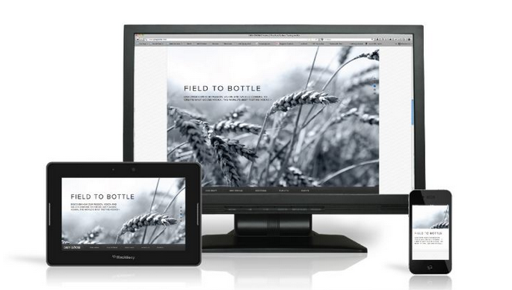
Examples of responsive design: Grey Goose

Slide 8
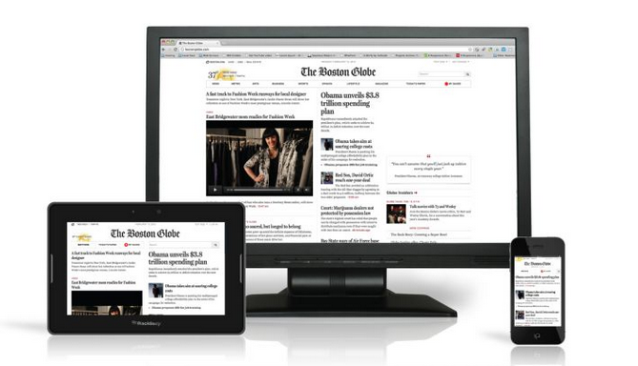
Examples of responsive design: The Boston Globe

Slide 9
Examples of responsive design
You can try these out in your browser:
http://resizemybrowser.com/
http://greygoose.com/
http://www.bostonglobe.com

Slide 10
How does it work?
Different ‘breakpoints’ are created in the layout that dictate when the layout will change
These should be designed around your content rather than designing for ‘common’ screen sizes
Then, in the website’s CSS file, the @media element is used to define different styles for different media
The min-width and max-width properties are used to set breakpoints at which the appearance of the site should change

Slide 11

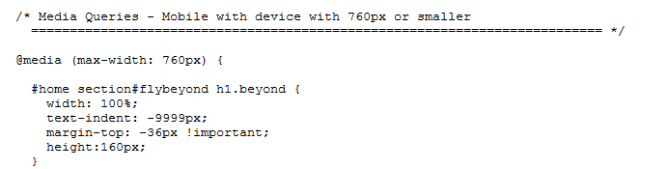
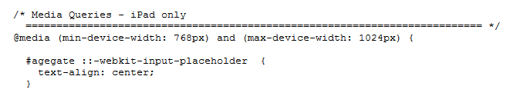
Grey Goose examples

Slide 12
Approaches to layout
Luke Wroblewski categorises responsive design layouts:
Mostly fluid
Column drop
Layout shifter
Tiny tweaks
Off canvas
http://www.lukew.com/ff/entry.asp?1514

Slide 13
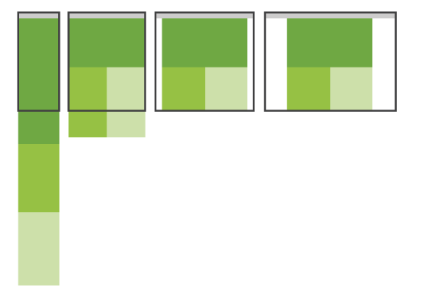
Mostly fluid
Example: http://www.antarcticstation.org/

Slide 14
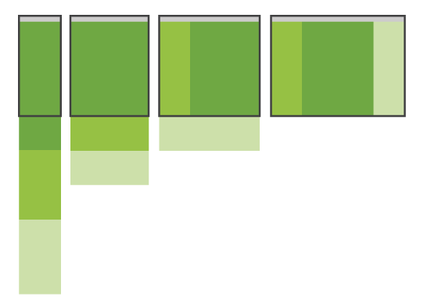
Column drop
Example: http://modernizr.com/

Slide 15
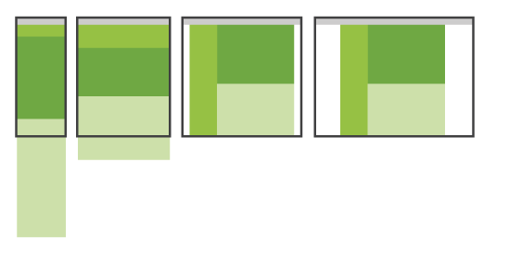
Layout shifter
Example: http://foodsense.is/

Slide 16
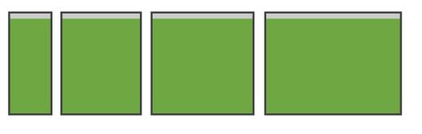
Tiny tweaks
Example: http://www.lycos.com/

Slide 17
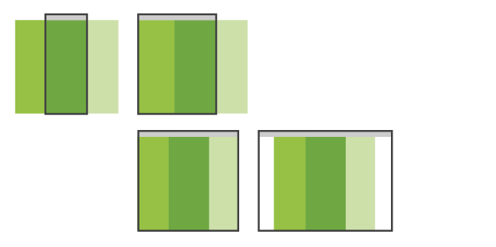
Off canvas
Example: https://dbushell.com/Responsive-Off-Canvas-Menu/step2.html

Slide 18
Responsive wireframe
Designers must design a website’s layout for multiple different screen sizes
This means creating multiple wireframes

Slide 19
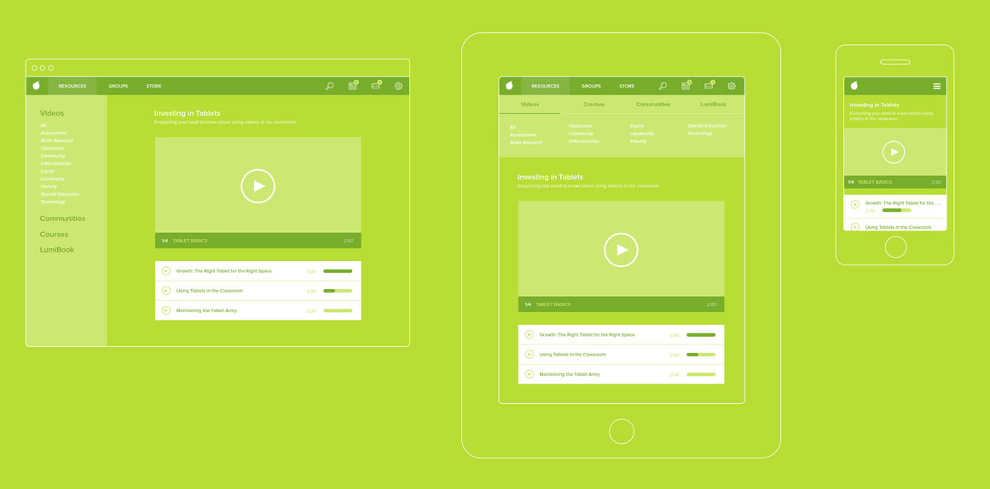
One website, three device types

Slide 20
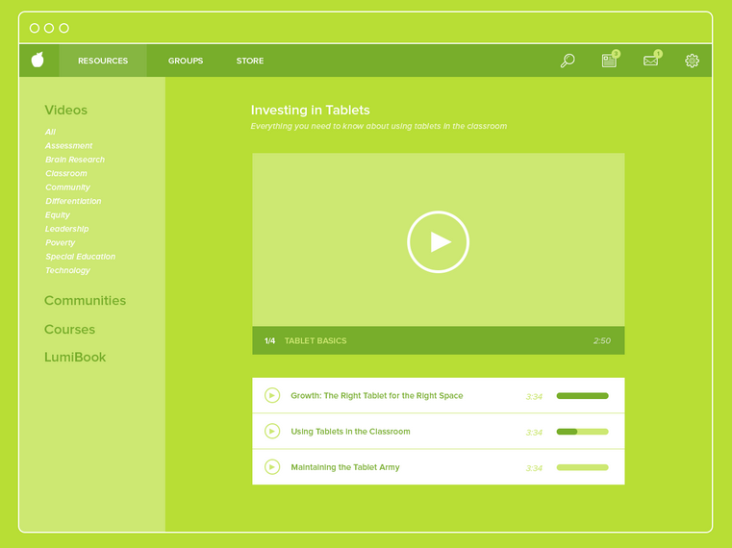
Desktop

Slide 21
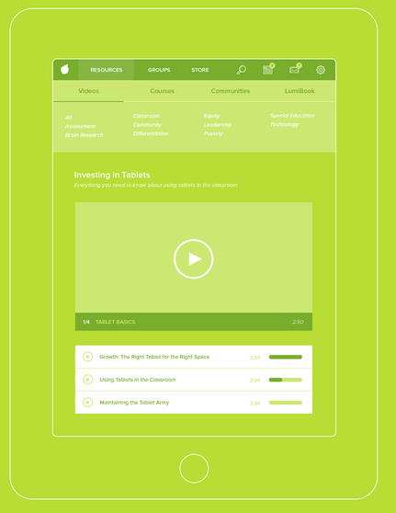
Tablet

Slide 22
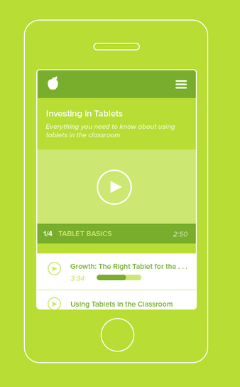
Smartphone

Slide 23
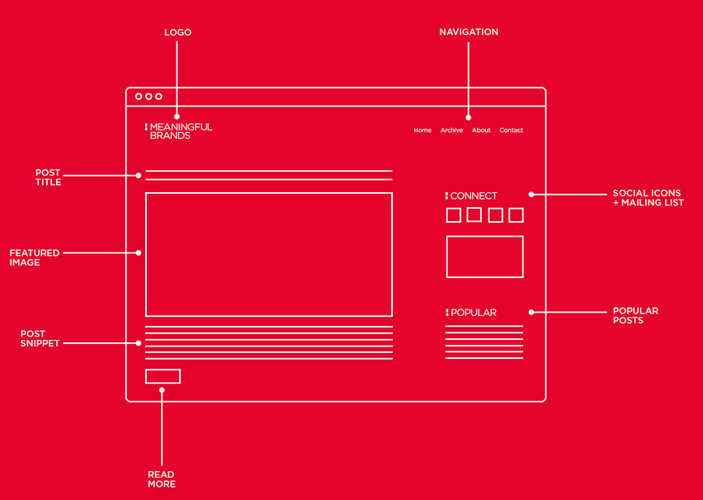
Desktop

Slide 24
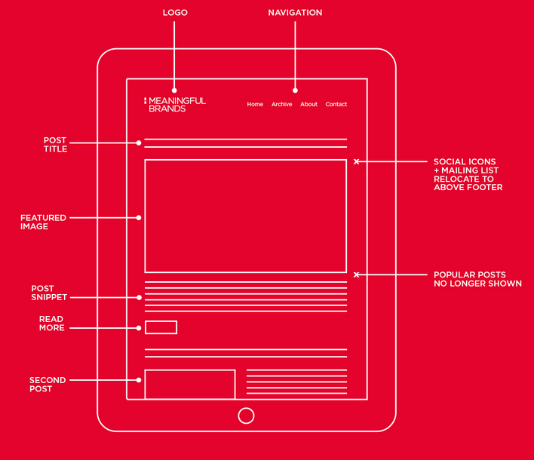
Tablet, portrait

Slide 25
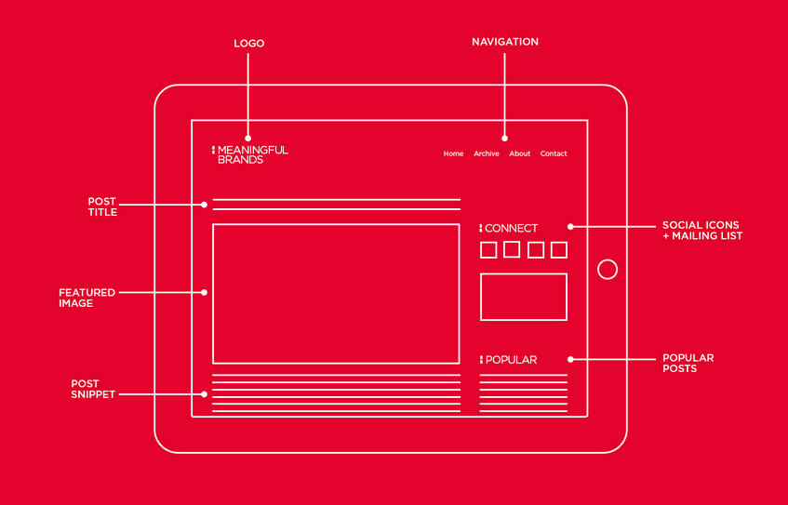
Tablet, landscape

Slide 26
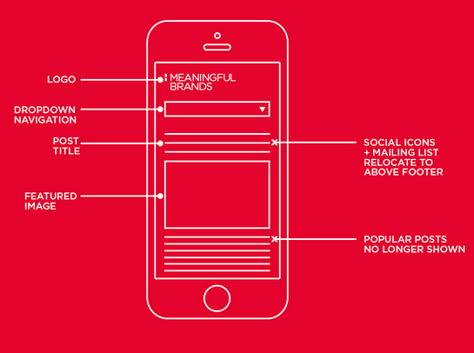
Smartphone, portrait

Slide 27
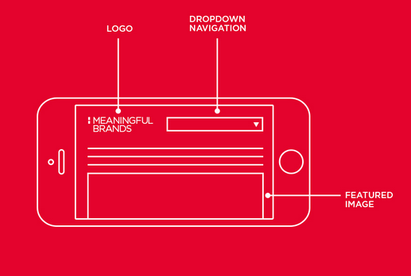
Smartphone, landscape

Slide 28
Responsive wireframe exercise
Design a responsive news website; it should include the following:
The site’s logo/branding
Navigation menu
Articles
Featured articles
Sidebar feature
Social media links
Footer with company details
Advertisement
Draw a wireframe of the homepage for this site on desktop, tablet and smartphone

