Slide 1
Web accessibility
HCI & Web Design

Slide 2
Accessibility
Design for different groups of users, e.g.:
Provide option to change text size for visually impaired users
Use relative measurements so that content on the page resizes with the user’s settings
Provide alternate text for images, for those using a screen reader

Slide 3
Screen readers
Try out an online screen reader, here:
https://webanywhere.cs.cmu.edu/wa/webanywhere/
Web accessibility – through the eyes of a screen reader:
https://www.youtube.com/watch?v=d5oZf9ULAyw

Slide 4
Web Content Accessibility Guidelines (WCAG)
Web Content Accessibility Guidelines (WCAG) 2.0 defines how to make Web content more accessible to people with disabilities.
At a glance:
https://www.w3.org/WAI/WCAG20/glance/
Full specification
https://www.w3.org/TR/WCAG20/

Slide 5
Wcag 2.0
Perceivable
1.1 Provide text alternatives for non-text content.
1.2 Provide captions and alternatives for audio and video content.
1.3 Make content adaptable; and make it available to assistive technologies.
1.4 Use sufficient contrast to make things easy to see and hear.
Operable
2.1 Make all functionality keyboard accessible.
2.2 Give users enough time to read and use content.
2.3 Do not use content that causes seizures.
2.4 Help users navigate and find content.

Slide 6
Wcag 2.0
Understandable
3.1 Make text readable and understandable.
3.2 Make content appear and operate in predictable ways.
3.3 Help users avoid and correct mistakes.
Robust
4.1 Maximize compatibility with current and future technologies.

Slide 7
Conformance Levels
A: ‘must fix’ problems that seriously affect a page’s usability
e.g. no alternate text provided for image
AA: ‘should fix’ problems that are important for access
e.g. insufficient contrast
AAA: other problems to consider
e.g. provide explanations for jargon

Slide 8
Accessibility testing
AChecker is a tool that checks compliance with the WCAG guidelines.
http://achecker.ca/checker/index.php

Slide 9
Accessible websites: examples
https://www.usa.gov/
Can use the tab key to navigate content; option to skip to main content is provided
http://www.bbc.com/
Provide a link to an accessibility help section with several guides

Slide 10
Designing accessible websites
https://www.digitalartsonline.co.uk/features/interactive-design/how-design-websites-for-disabled-people-in-2017/
Article discusses how designing for disability benefits everyone
Links to six posters designed by Home Office Digital, which provide useful do’s and don’ts for accessible design

Slide 11
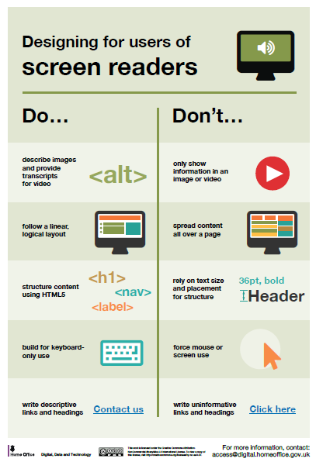
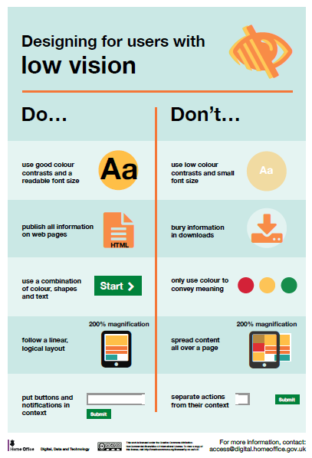

Slide 12
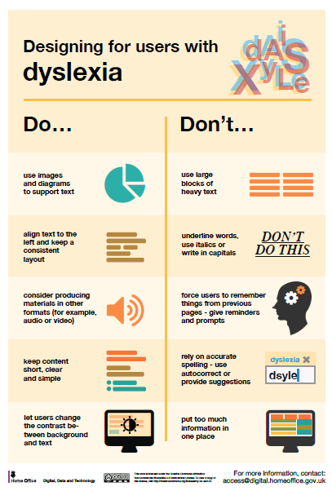
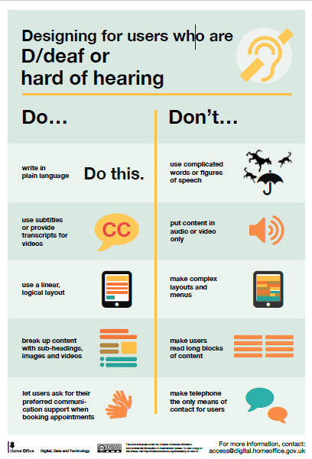

Slide 13
