Slide 1
user interfaces
HCI & Web Design – Rosanne Birney

Slide 2
Overview
Types of user interfaces
highlight the main design and research issues for each of the different interfaces
Notes:
2

Slide 3
Types of User Interface
Command-based
WIMP
GUI
Multimedia
Web
Mobile
Touch
Collaborative
Information Visualisation
Augmented reality
Gesture-based
Haptic
Intelligent
Organic
Shareable
Tangible
Virtual reality
Voice
Wearable

Slide 4
Command-based
Commands such as abbreviations (e.g. ls) typed in at the prompt to which the system responds (e.g. listing current files)
Some are hard wired at keyboard, others can be assigned to keys
Efficient, precise, and fast
Large overhead to learning set of commands
Notes:
4

Slide 5
WIMP
Xerox Star first WIMP (gave rise to GUIs)
Windows
could be scrolled, stretched, overlapped, opened, closed, and moved around the screen using the mouse
Icons
represented applications, objects, commands, and tools that were opened when clicked on
Menus
offering lists of options that could be scrolled through and selected
Pointing device
a mouse controlling the cursor as a point of entry to the windows, menus, and icons on the screen
Notes:
5

Slide 6
GUIs (Graphical User Interfaces)
Same basic building blocks as WIMPs but more varied
Color, 3D, sound, animation,
Many types of menus, icons, windows
New graphical elements, e.g.
toolbars, docks, rollovers
Notes:
6

Slide 7
Multimedia
Combines different media within a single interface with various forms of interactivity
graphics, text, video, sound, and animations
Users click on links in an image or text
another part of the program
an animation or a video clip is played
can return to where they were or move on to another place
E.g. Encarta
Notes:
7

Slide 8
Web
Early websites were largely text-based, providing hyperlinks
Concern was with how best to structure information at the interface to enable users to navigate and access it easily and quickly
Nowadays, more emphasis on making pages distinctive, striking, and pleasurable
Original and innovative web layouts:
http://www.smashingmagazine.com/2013/08/innovative-appraoches-web-layout/
Notes:
8

Slide 9
Mobile
Handheld devices intended to be used while on the move
Have become pervasive, increasingly used in all aspects of everyday and working life
Applications running on handhelds have greatly expanded, e.g.
used in restaurants to take orders
car rentals to check in car returns
supermarkets for checking stock
in the streets for multi-user gaming
in education to support life-long learning
Notes:
9

Slide 10
Research and design issues
Mobile interfaces can be tricky and cumbersome to use for those with poor manual dexterity
Key concern is designing for small screen real estate and limited control space
e.g. mobile browsers allow users to view and navigate the internet, magazines etc., in a more streamlined way compared with PC web browsers
Notes:
10
Mobile interfaces typically have a small screen and limited control space. Designers have to think carefully about what type of dedicated controls (i.e. hard wired) to use, where to place them on the device, and then how to map them onto the software. Applications designed for mobile interfaces need to take into account that navigation will be restricted and text input entry slow, whether using touch, pen or keypad input. The use of vertical and horizontal scrolling provides a rapid way of scanning though images, menus and lists. A number of mobile browsers have also been developed that allow users to view and navigate the internet, magazines or other media, in a more streamlined way compared with how it is typically viewed via PC-based web browsers. For example, Edge Browser was one the first mobile phone browser apps to not have an address bar or navigation buttons. The trade-off, however, is it makes it less obvious how to perform the functions that are no longer visible on the screen.

Slide 11
Touch
Touch screens, such as walk-up kiosks, detect the presence and location of a person’s touch on the display
Multi-touch support a range of more dynamic finger tip actions, e.g. swiping, flicking, pinching, pushing and tapping
Now used for many kinds of displays, such as Smartphones, iPods, tablets and tabletops
Notes:
11

Slide 12
Research and design issues
More fluid and direct styles of interaction involving freehand and pen-based gestures
Core design concerns include whether size, orientation, and shape of touch displays effect collaboration
Much faster to scroll through wheels, carousels and bars of thumbnail images or lists of options by finger flicking
More cumbersome, error-prone and slower to type using a virtual keyboard on a touch display than using a physical keyboard
Notes:
12

Slide 13
Collaborative
Much research on how to support conversations when people are ‘at a distance’ from each other
Many applications have been developed
e.g., email, videoconferencing, videophones, videoconferencing, instant messaging, chatrooms
Do they mimic or move beyond existing ways of conversing?
Notes:
13

Slide 14
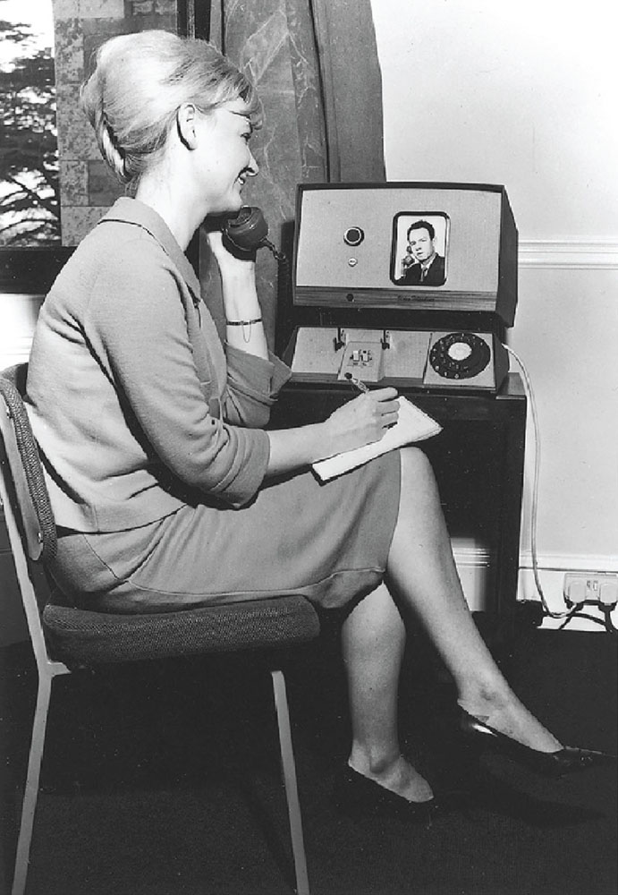
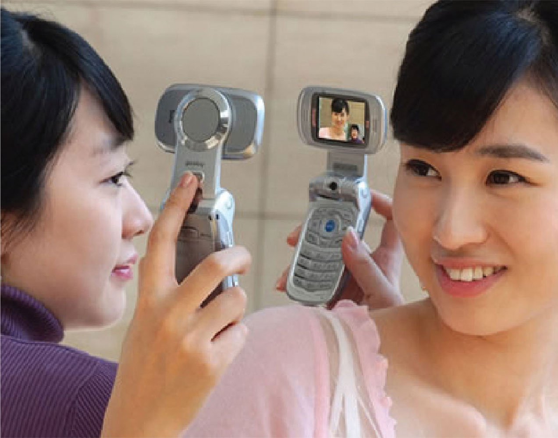
Early videophone and visualphone
Notes:
Figure 4.1

Slide 15
Telepresence
New technologies designed to allow a person to feel as if they were present in the other location
projecting their body movements, actions, voice and facial expressions to the other location or person
e.g. superimpose images of the other person on a workspace

Slide 16
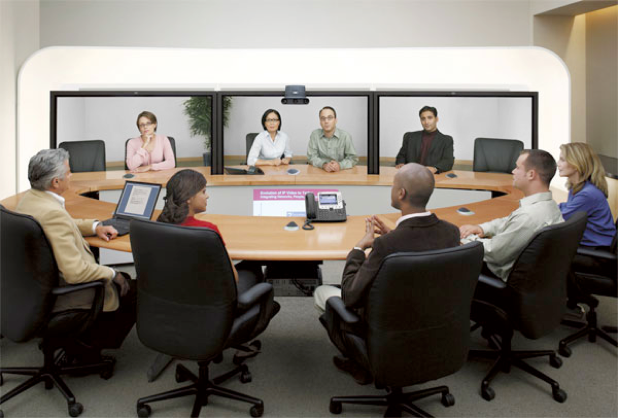
A telepresence room

Slide 17
Information visualization
Computer-generated interactive graphics of complex data
Amplify human cognition, enabling users to see patterns, trends, and anomalies in the visualization (Card et al, 1999)
Aim is to enhance discovery, decision-making, and explanation of phenomena
Techniques include:
3D interactive maps that can be zoomed in and out of and which present data via webs, trees, clusters, scatterplot diagrams, and interconnected nodes
http://www.gapminder.org/world/

Slide 18
Research and design issues
whether to use animation and/or interactivity
what form of coding to use, e.g. color or text labels
whether to use a 2D or 3D representational format
what forms of navigation, e.g. zooming or panning,
what kinds and how much additional information to provide, e.g. rollovers or tables of text
What navigational metaphor to use

Slide 19
Assignment topics
Augmented reality
Gesture-based
Haptic
Intelligent
Organic
Shareable
Tangible
Virtual reality
Voice
Wearable

Slide 20
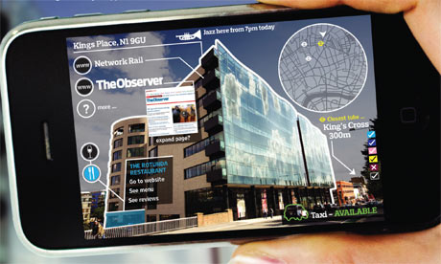
Augmented reality
Augmented reality (AR) is a live direct or indirect view of a physical, real-world environment whose elements are "augmented" by computer-generated or extracted real-world sensory input such as sound, video, graphics or GPS data.

Slide 21
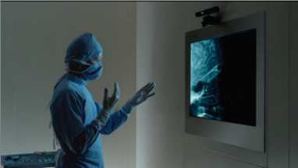
Gesture-based
Uses camera recognition, sensor and computer vision techniques
can recognize people’s body, arm and hand gestures in a room
systems include Kinect and EyeToy

Slide 22
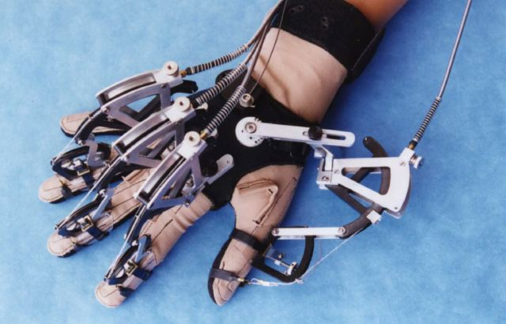
Haptic
Tactile feedback
applying vibration and forces to a person’s body, using actuators that are embedded in their clothing or a device they are carrying, such as a cell phone
Can enrich user experience or nudge them to correct error

Slide 23
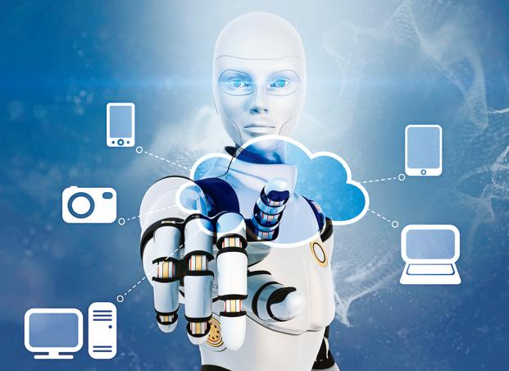
intelligent
An intelligent user interface (Intelligent UI, IUI, or sometimes Interface Agent) is a user interface (UI) that involves some aspect of artificial intelligence (AI or computational intelligence).
Examples include Alexa, Siri and Cortana.

Slide 24
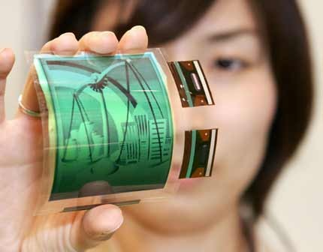
organic
In human–computer interaction, an organic user interface (OUI) is defined as a user interface with a non-flat display.
OUI displays are multi-shaped and flexible.

Slide 25
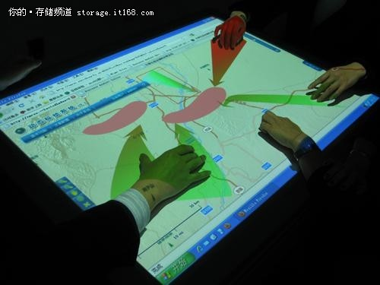
Shareable
Shareable interfaces are designed for more than one person to use
provide multiple inputs and sometimes allow simultaneous input by co-located groups
e.g. DiamondTouch, Smart Table and Surface
Notes:
25

Slide 26
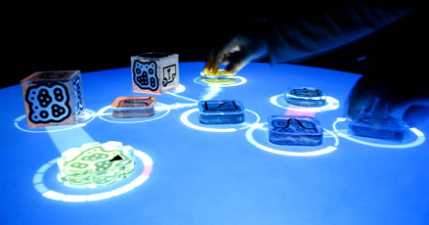
Tangible
Type of sensor-based interaction, where physical objects, e.g., bricks, are coupled with digital representations
When a person manipulates the physical object/s it causes a digital effect to occur, e.g. an animation
Digital effects can take place in a number of media and places or can be embedded in the physical object
Notes:
26

Slide 27
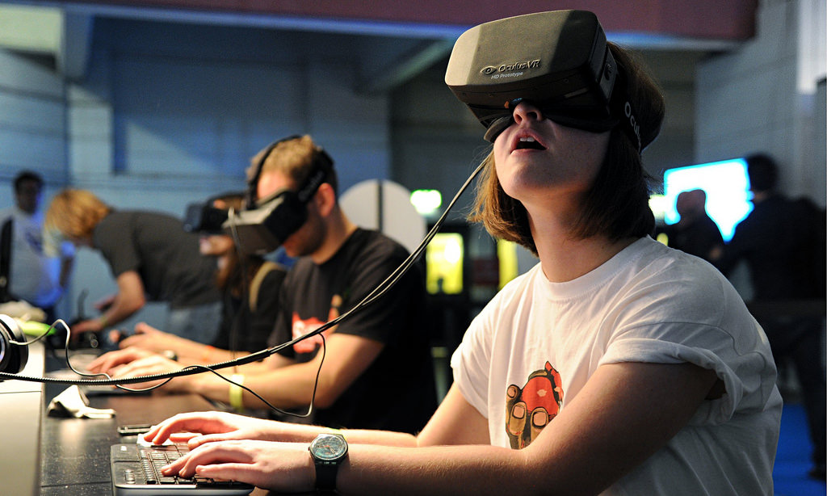
Virtual reality
Computer-generated graphical simulations providing:
“the illusion of participation in a synthetic environment rather than external observation of such an environment” (Gigante, 1993)
provide new kinds of experience, enabling users to interact with objects and navigate in 3D space
Create highly engaging user experiences
Notes:
27

Slide 28
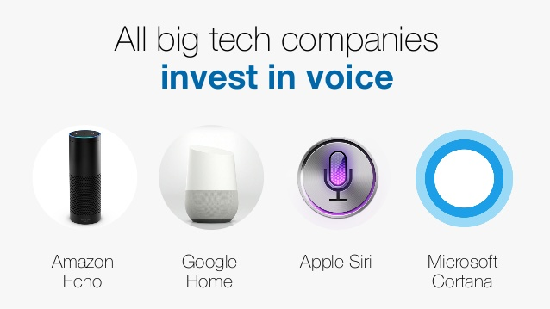
voice
Where a person talks with a system that has a spoken language application, e.g., timetable, travel planner
Also used by people with disabilities
e.g. speech recognition word processors, page scanners, web readers, home control systems
Notes:
28

Slide 29
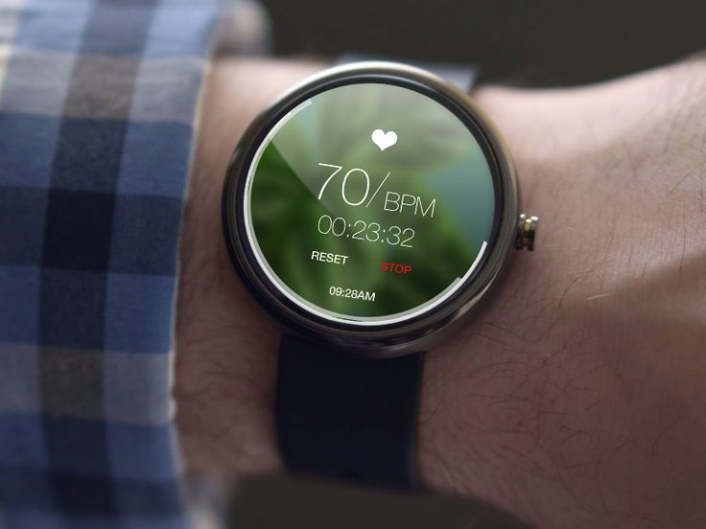
Wearable
First developments were head- and eyewear-mounted cameras that enabled user to record what was seen and to access digital information
Since, jewellery, head-mounted caps, smart fabrics, glasses, shoes, and jackets have all been used
provide the user with a means of interacting with digital information while on the move
Notes:
29
Imagine being at a party and being able to access the Facebook of a person whom you have just met, while or after talking to her to find out more about her. The possibility of having instant information before one’s very own eyes that is contextually relevant to an ongoing activity and that can be viewed surreptitiously (i.e. without having to physically pull out a smartphone) is very appealing.

Slide 30
Assignment topics
Augmented reality
Gesture-based
Haptic
Intelligent
Organic
Shareable
Tangible
Virtual reality
Voice
Wearable
For the assignment, consider:
Applications
Design considerations
Benefits
Challenges

