Slide 1
Cognitive Science (Perception)
HCI & Web Design – Rosanne Birney

Slide 2
Overview
What is cognitive science?
Cognitive processes
Perception
Examining the relationship between understanding of cognitive processes and interaction design
Notes:
2

Slide 3
Cognitive science
Introduction – what is Cognitive Science?
Information Processing Theory
Basic cognitive processes

Slide 4
What is cognition?
Cognition is the process of receiving, processing, storing and using information
The mental processes underlying our ability to perceive the world, remember, talk about and learn from our experiences.
It includes functions such as perception, memory, language and thought.
Cognitive Science is the scientific study of cognition – it examines what cognition is, what it does and how it works.

Slide 5
Information-Processing Approach
The information-processing approach was suggested by Sternberg in 1966
This approach suggests that the human mind processes information in a series of steps (in a similar manner to a computer)
The ‘information’ being processed refers to any input we receive from our external environment

Slide 6
Early version of Information Processing System
Stimulus
Attention
Perception
What are the
problems with this
model of cognition?
Thought Processes
Decision
Diagram reproduced from Cognitive Psychology: A Student’s Handbook by Eysenck & Keane, 5th Edition, p.2
Response/Action

Slide 7
Information Processing Model
As well as stimuli, cognitive processing is affected by an individual’s past experiences, expectations etc.
Also, this model only represents serial processing – parallel processing and cascade processing can also occur

Slide 8
Information Processing Model
Bottom-up processing:
Stimulus driven
Top-down processing:
Concept driven
Both can occur at the same time
Updated versions of the information processing model take this into account

Slide 9
Cognitive processes
Attention
Perception and recognition
Memory
Learning
Reading, speaking and listening
Problem-solving, planning, reasoning and decision-making
Notes:
9
It is important to note that many of these cognitive processes are interdependent: several may be involved for a given activity. It is rare for one to occur in isolation. For example, when you try to learn material for an exam, you need to attend to the material, perceive and recognize it, read it, think about it, and try to remember it. Below we describe the various kinds in more detail, followed by a summary box highlighting core design implications for each. Most relevant for interaction design are attention and memory which we describe in greatest detail.

Slide 10
Why do we need to understand users?
Interacting with technology is cognitive
Need to take into account cognitive processes involved and cognitive limitations of users
Provides knowledge about what users can and cannot be expected to do
Identifies and explains the nature and causes of problems users encounter
Supply theories, modelling tools, guidance and methods that can lead to the design of better interactive products
Notes:
10

Slide 11
Perception
Visual perception
Scene perception
Object recognition
Facial recognition

Slide 12
Perception
Perception involves the intake, analysis and integration of sensory information to guide thought and action.
There are several processes at work:
Sensation
Visual form perception
Visual depth perception
Auditory perception
Object recognition
Face recognition

Slide 13
Sensation
Sensation is the first stage of perception
Sensation is the transduction of energy (e.g. light or sound) into neural impulses
Perception is the interpretation of these impulses to create meaningful representations of our environment

Slide 14
Sensation
Direct perception
We perceive information directly from our environments
Stimulus-based or bottom-up processing
Information processing approach
There may be elements of top-down processing involved also
For example, our expectations or previous experiences may have an impact

Slide 15
Sensation
Filtering occurs in the early stages of sensation and perception – the amount of incoming information is reduced
The most important information is retained
There are many factors at play in how we decide which information to pay attention to and which to ignore

Slide 16
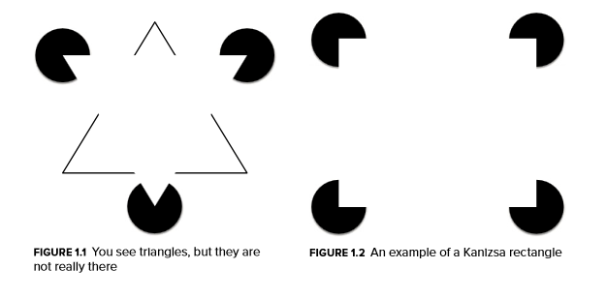
Visual perception: What you see isn’t (always) what your brain gets

Slide 17
Visual Depth Perception
In order to perceive where an object is, we must know its distance or depth
There are a number of cues that combine to determine perceived distance
These are known as Monocular or Binocular, depending on whether they use one or two eyes

Slide 18
Visual Depth Perception
Monocular cues include:
Relative Size
Superposition/Interposition
Linear Perspective
Accommodation
Lighting cues (e.g. shadow)
Motion cues
See here for examples:
http://psych.hanover.edu/Krantz/art/index.html
http://www.scientificpsychic.com/graphics/

Slide 19
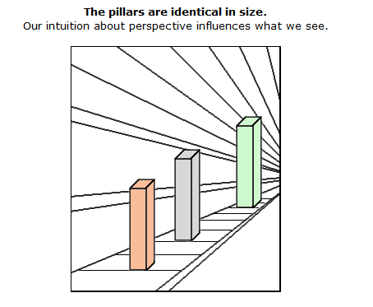
Example: linear perspective

Slide 20
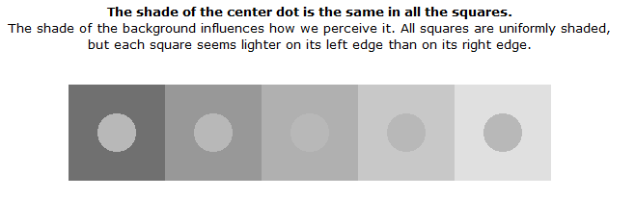
Example: lighting cues

Slide 21
Visual Depth Perception
Binocular cues include:
Convergence
Retinal Disparity
Another example of how the brain makes up for missing information (blind spot):
http://serendip.brynmawr.edu/bb/blindspot1.html

Slide 22
Visual form perception
Our brains try to perceive forms as whole shapes (even when those shapes are not actually there!)
Gestalt theory states that we perceive forms as distinct from each other and from their background by grouping elements together based on the following principles:
Proximity
Similarity
Continuation
Closure

Slide 23


Gestalt Theory
Proximity
Similarity

Slide 24
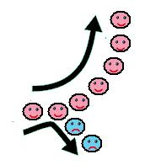


Gestalt Theory
Continuation
Closure

Slide 25
Discussion
How can the principles discussed above be applied to interface design?
Gestalt theory
Proximity
Similarity
Continuation
Closure

Slide 26
Scene perception
Studies have shown that our perceptions of a scene are not always complete
There are two problems which often occur:
Change blindness – failure to note changes
Inattentional blindness – failure to perceive part of a scene
Examples:
http://www.youtube.com/watch?v=vJG698U2Mvo
http://www.youtube.com/watch?v=IGQmdoK_ZfY
http://www.youtube.com/watch?v=1nL5ulsWMYc

Slide 27
The Geon theory of object recognition
This theory (put forward by Biederman, 1985) states that there are around 24 basic shapes that we recognise
These are called ‘geons’ (geometric icons)
We use our knowledge of these basic shapes to recognise what an object is and also make inferences about what it does or its ‘perceived affordances’

Slide 28
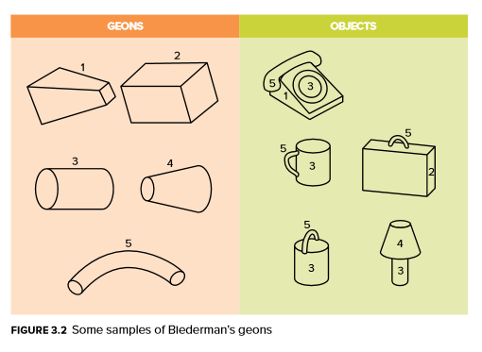
Example of geons

Slide 29
Face Recognition
Shares some features with object recognition, but also differs in many ways
Face recognition occurs in a different part of the brain to object recognition
Precise configuration of features is important – all faces include the same basic features, but yet we are able to tell them apart
Orientation affects our ability to recognise faces – see example here:
http://faculty.washington.edu/chudler/java/faces.html

Slide 30
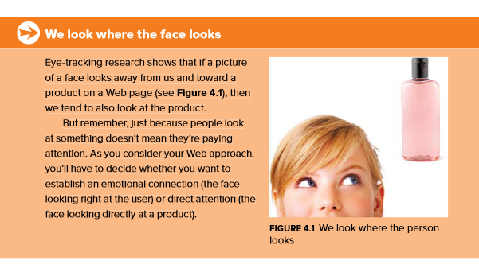
People react to faces on a webpage faster than anything else on the page

Slide 31
Cognitive Science and Design
A talk by Alex Faaborg (Designer @ Android) given at the Google I/O 2013 conference discusses how cognitive science theories are applied in the design of Google products
https://www.youtube.com/watch?v=z2exxj4COhU
First 20 minutes relates to perception

