Slide 1
Web Design guidelines
HCI & Web Design

Slide 2
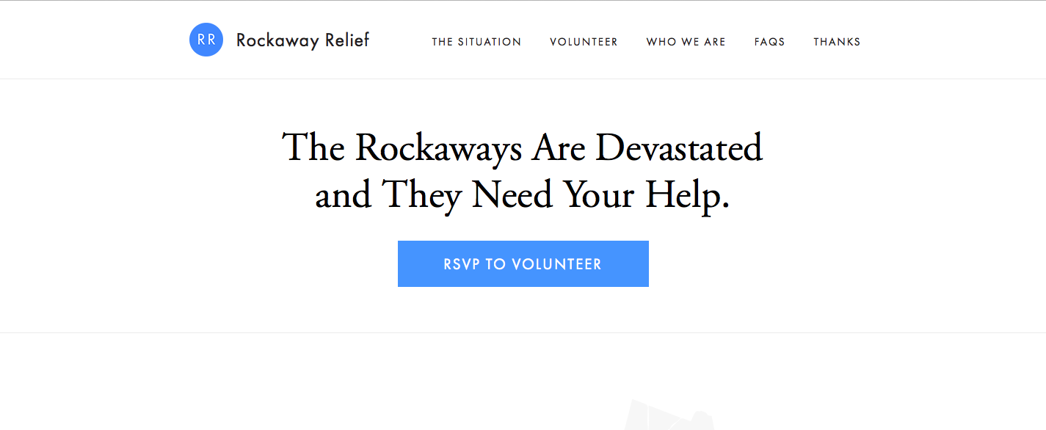
10. Simple is beautiful
Cramming too much into each page creates confusion. Visitors get frustrated when they have to scan through rows of links and images to find what they are looking for. By keeping your pages simple, your website will be easier to use.

Slide 3

9. Design is paramount
When you meet someone for the first time, you want to make a good first impression. The same should be true for your website. The overall look and feel of your site is the first thing your visitors will notice.

Slide 4
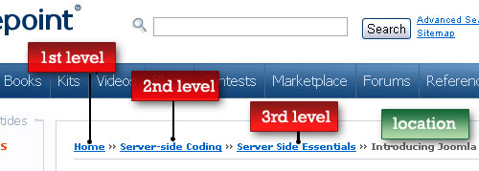
8. Navigation should be intuitive
There are few things more frustrating than not being able to find what you want on a website. Pages should be well-organized with a top-down design so that visitors can easily browse through the different sections of your site.
‘Breadcrumbs’ help the user navigate through the levels of your website

Slide 5

7. Consistency is key
Visitors shouldn't feel like they are visiting a new website each time they open a new page on your site. Consistent design across the pages within your site makes navigation a much easier task.

Slide 6
6. Colours are crucial
Color selection can make or break a website. Most of us have visited websites that are simply painful to look at. When choosing colors, use a consistent palette of colors that don't clash and make sure there is a strong contrast between the text and the background.
https://www.colorcombos.com/
http://paletton.com/

Slide 7
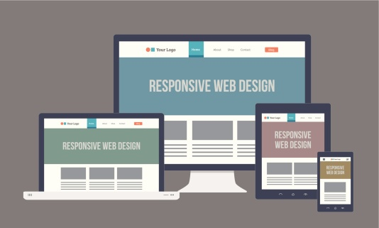
5. Make your website responsive
People will access your website using a wide variety of devices – from smartphones to desktop computers. Therefore, it is important that your website displays correctly on different screen sizes. CSS media queries are a great way to implement responsive web design

Slide 8
4. Develop for multiple browsers
Browsers are supposed to render webpages the same way, but they don't. Therefore, make sure to check your website in multiple browsers to make sure everything appears correctly. It is best to catch problems ahead of time instead of relying on complaints from your visitors.
https://html5test.com/

Slide 9
3. Check your website for errors and accessibility
As any experienced editor will tell you, a great piece of work can be tarnished by a small error. If you're a webmaster, check your websites on a regular basis for typos, broken links, and images that do not load correctly.
https://validator.w3.org/
https://jigsaw.w3.org/css-validator/
https://achecker.ca/checker/index.php

Slide 10

2. Write your own code
Whether it's HTML or PHP, nothing beats writing your code from scratch. If you build your site from templates and pre-written scripts, you will be clueless when something goes wrong. When you code your own pages, you have full control over how they look and act.

Slide 11

1. Don't forget the content
Even if your site is beautifully designed, it is only an empty shell without content. A good website has both great design and great content. Therefore, make sure your pages have unique, original content that makes them worth visiting.

Slide 12
Sources:
https://sharpened.com/web_design_rules
https://blog.hubspot.com/blog/tabid/6307/bid/30557/6-guidelines-for-exceptional-website-design-and-usability.aspx

