Slide 1
Multitask and Transfer learning for peptide properties prediction
Technical Tutorial
Rebecca Birolo
15/09/2026

Slide 2
Peptide properties prediction
Representations
F M L
N[C@@H](Cc1ccccc1)C(=O)N[C@@H](CCSC)C(=O)N[C@@H](CC(C)C)C(=O)O

Slide 3
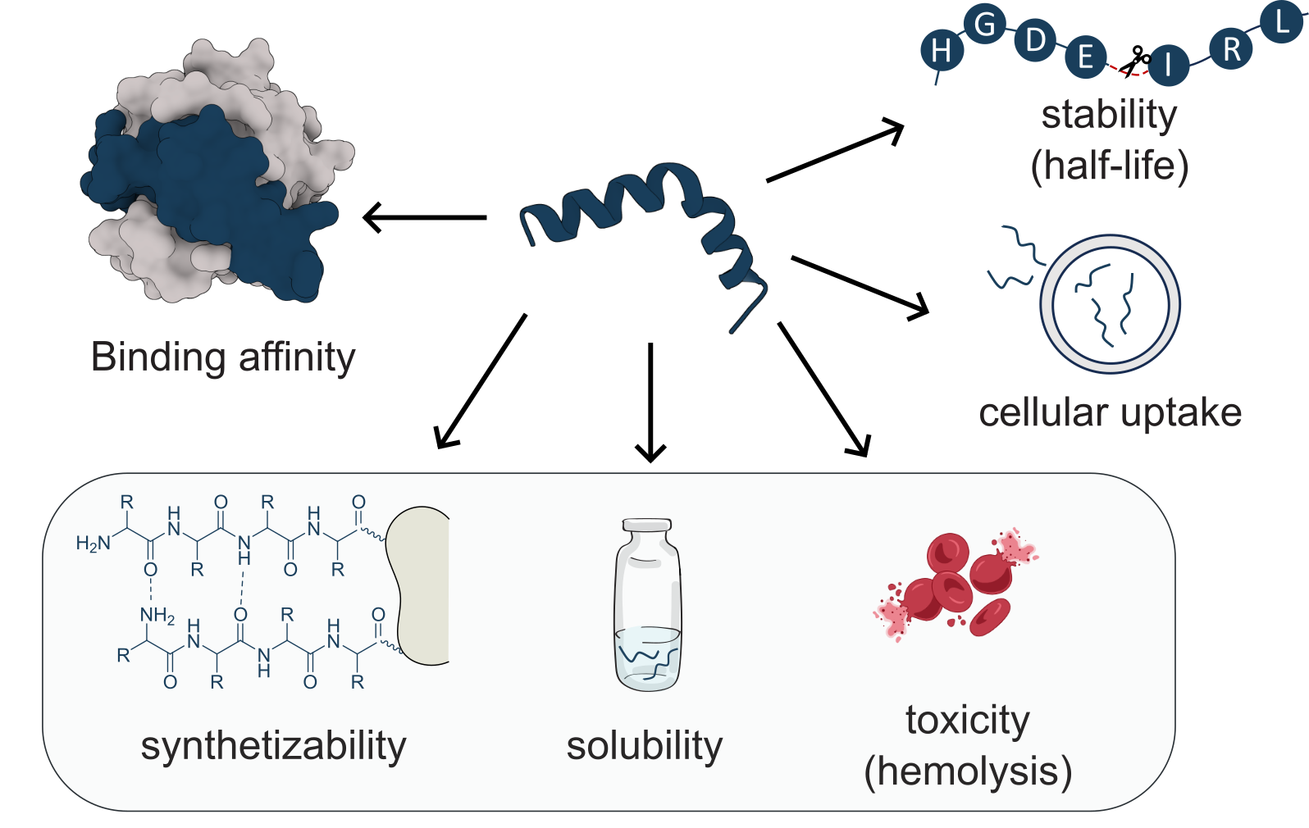
Peptide properties prediction
Representations
F M L
N[C@@H](Cc1ccccc1)C(=O)N[C@@H](CCSC)C(=O)N[C@@H](CC(C)C)C(=O)O
CCc1cc(O)cc(C[C@H](N)C(=O)N[C@@H](CCSC(C)C)C(=O)N[C@@H](CC(C)N2CC=CC2)C(=O)OC)c1
canonical
Chemical modification
for tuning
developability
properties
modified
stapled

Slide 4
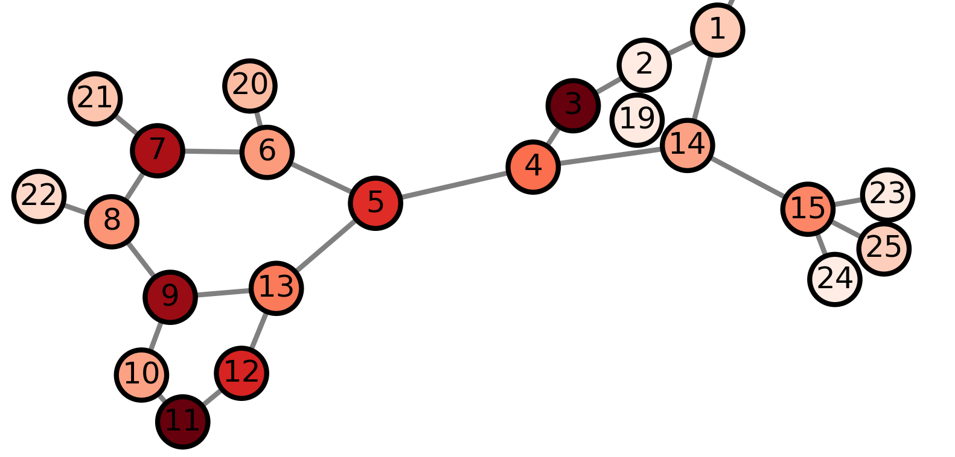

Peptide properties prediction
Representations
N[C@@H](Cc1ccccc1)C(=O)N[C@@H](CCSC)C(=O)N[C@@H](CC(C)C)C(=O)O
Morgan Fingerprints
With Classical Regression
Molecular Graphs
With ChemProp DMPNN
Chemical Language
With ChemBERTa & PepDoRA
N[C@@H](Cc1ccc
cc1)C(=O)N[C@
@H](CCSC)C
(=O)N[C@@H]
(CC(C)C)C(=O)O
-0.1246
-0.2216
Node & Edge Features
0.5246
Q
K
0.5 x
1 x
1.1276
0
1
0
1
0
0
0
0
0
1
1 x
0.5 x
V
-0.1036
$$∑$$
x_{v}
h_{v}
NN

Slide 5
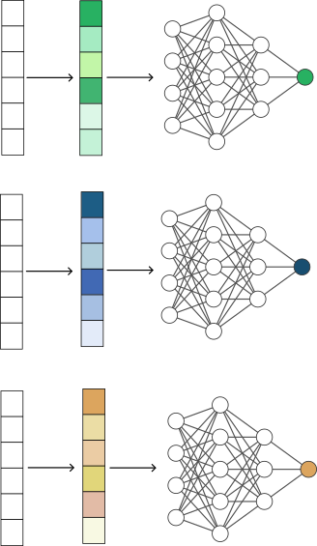
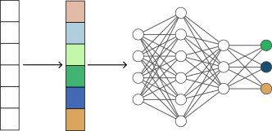
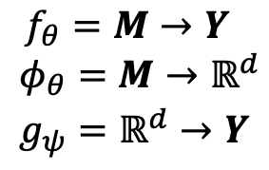
Single vs Multi-task
$$f_{θ}=M→Y$$
$$φ_{θ}=M→ℝ^{d}$$
$$g_{ψ}=ℝ^{d}→Y$$
Multi-task learning: model perform multiple tasks simultaneously.
Help where tasks are related or they can benefit from shared representations
Better generalisation across all tasks
Less memory to store model weights
Less resource during training

Slide 6
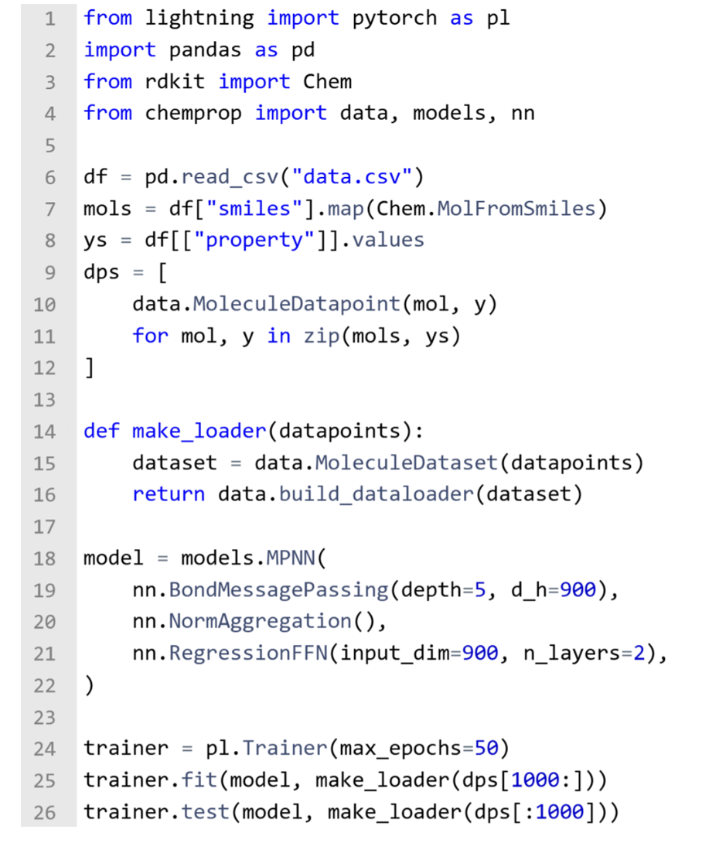
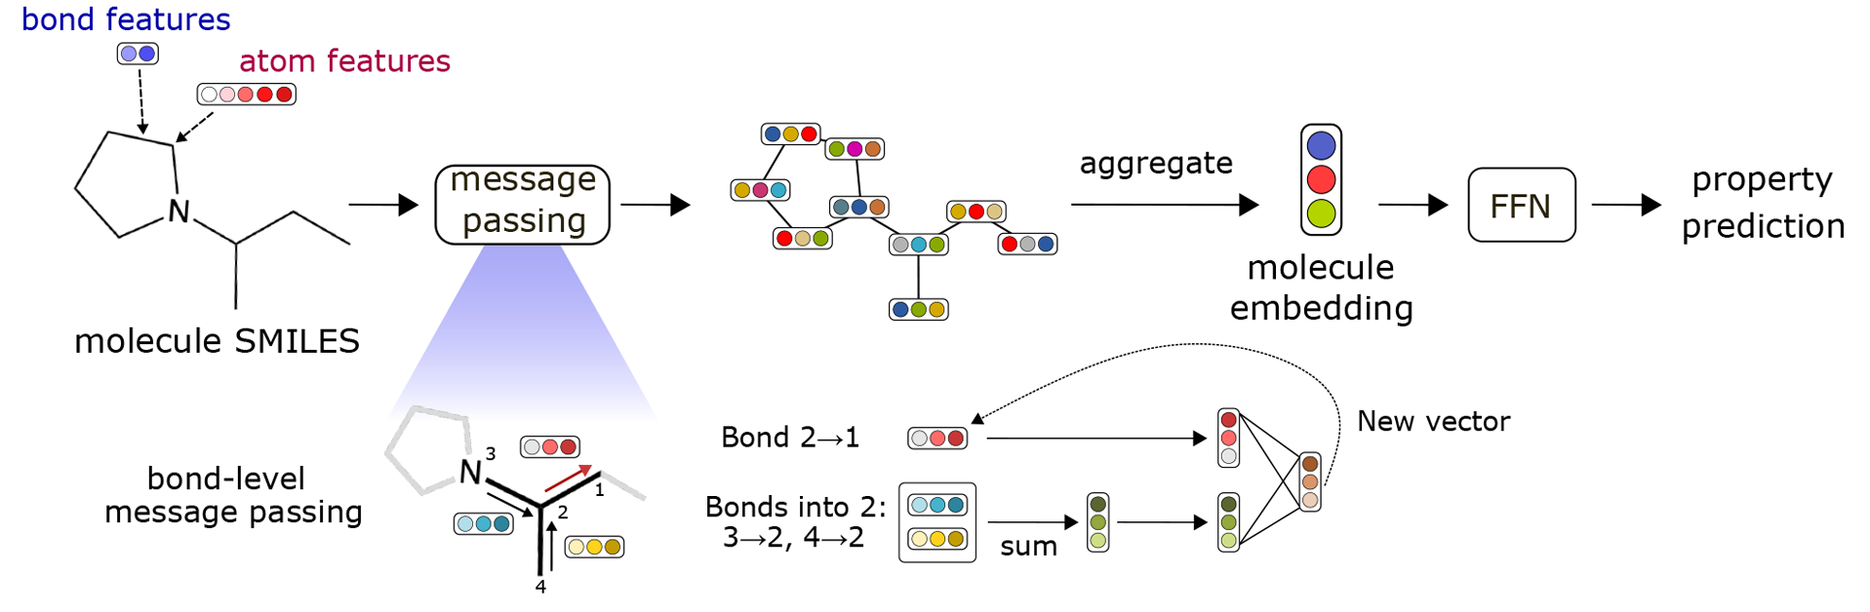
Chemprop
Model architecture

Slide 7
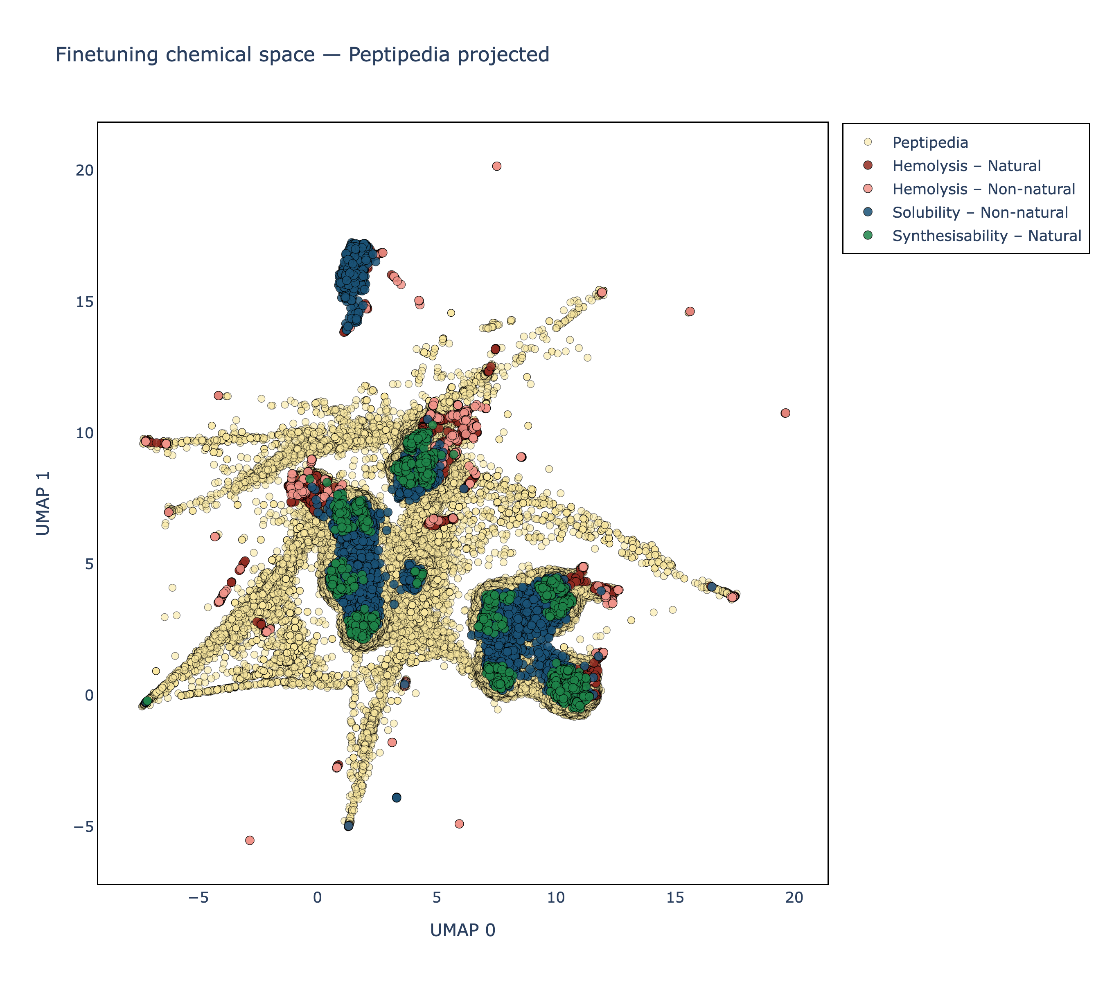
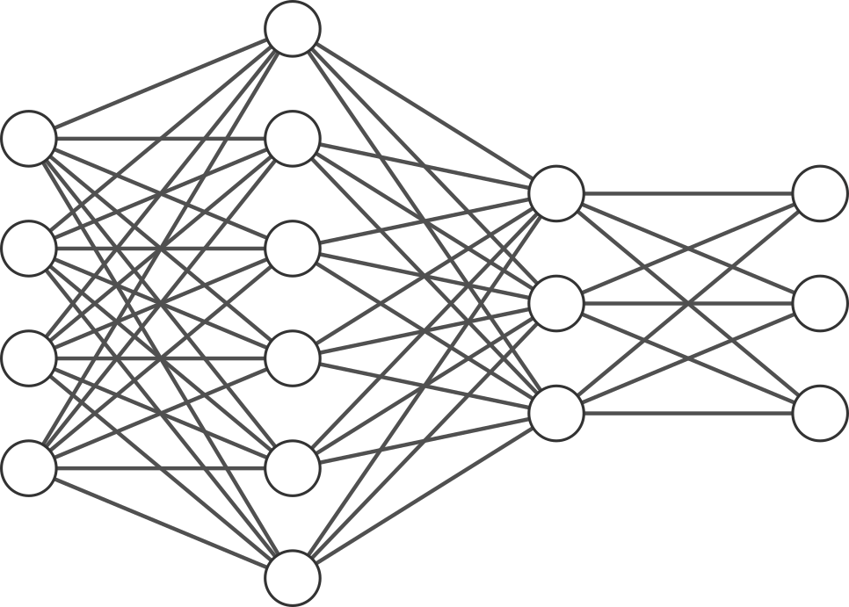
Pretraining
Peptide labels
Pretraining data
1 M canonical sequences
random generated (p2smi)
4,3 M canonical sequences
from Peptipedia
Finetuning data
Curated peptide dataset
Canonical & non-canonical sequences
Synthetisability/Purity (1,77 K)
Camsol_solubility (10 K)
Hemolysis (2 K)
ChemProp Warm Start & Frozen Encoder
D-MPNN encoder is either frozen and only FFNs is update or both are updated
Gravy Index
1) Frozen
Net charge pH=7.4
Molecular Graph
or
Instability index
2) Trainable
Aggregated Embedding
Difficulty coupling
D-MPNN
Encoder pretrained on linear peptides

Slide 8
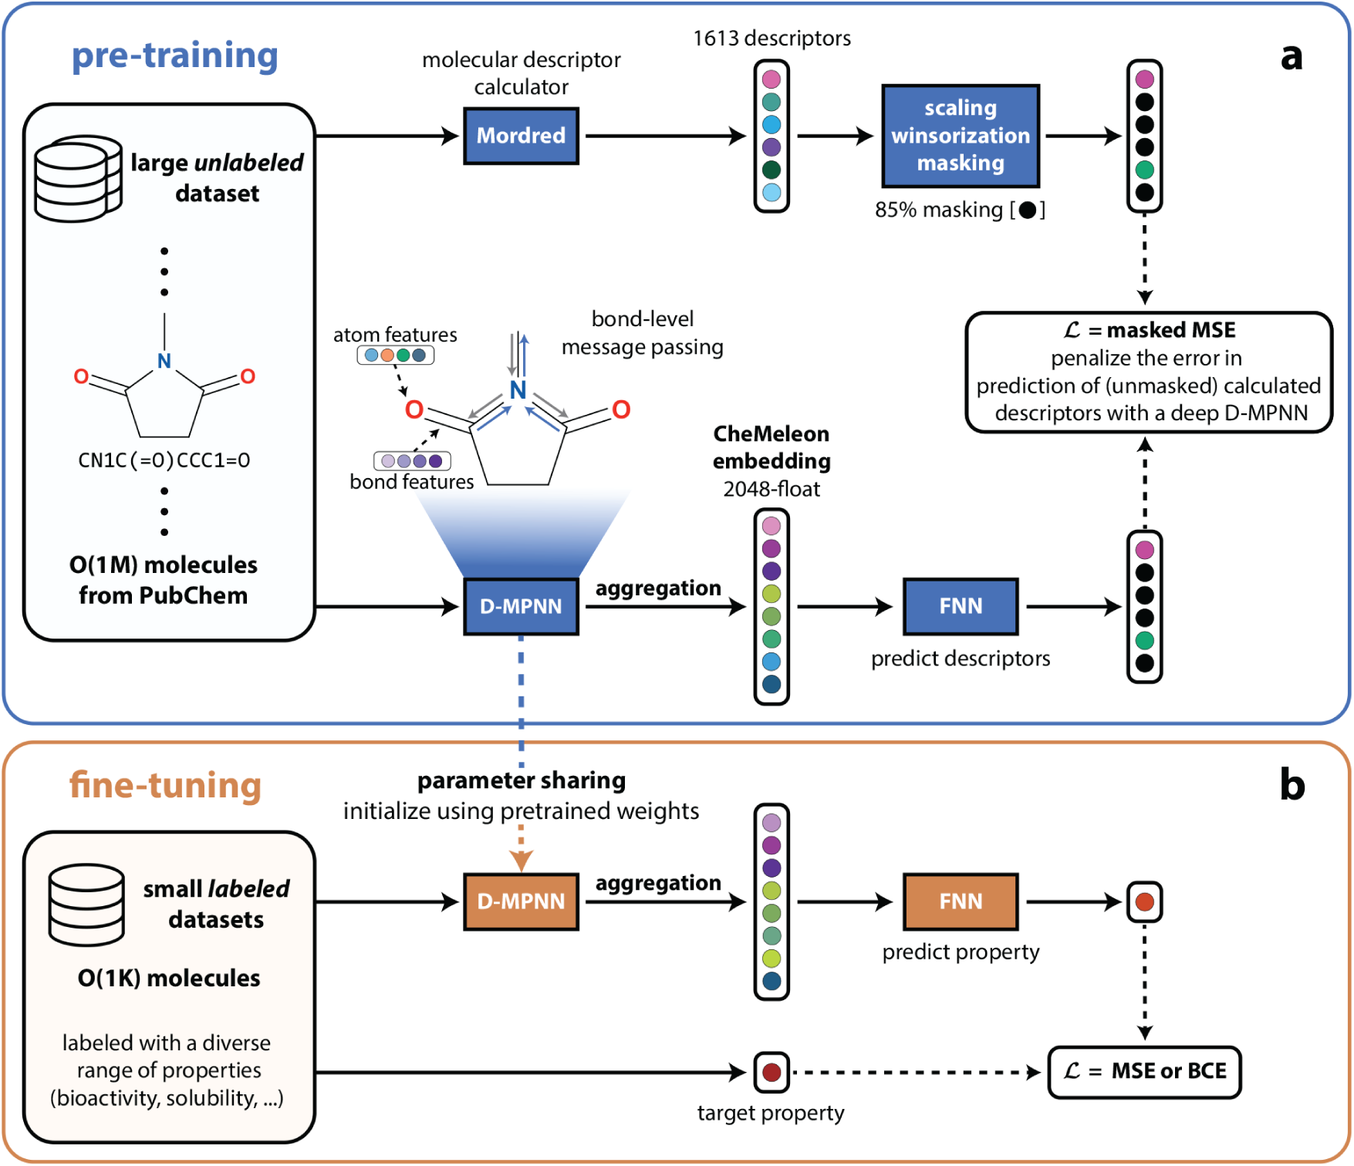
Pretraining
Chemeleon
This work
c
fine-tuning
(1)
Single-head
D-MPNN
FNN
Curated peptide
dataset
Canonical &
non-canonical
sequences
Purity (1,77 K)
camsol_solubility (10 K)
Hemolysis (2 K)
D-MPNN
FNN
D-MPNN
FNN
CheMeleon
embedding
2048-flot
Multi-head
D-MPNN
FNN
(2)
Frozen embedding

Slide 9
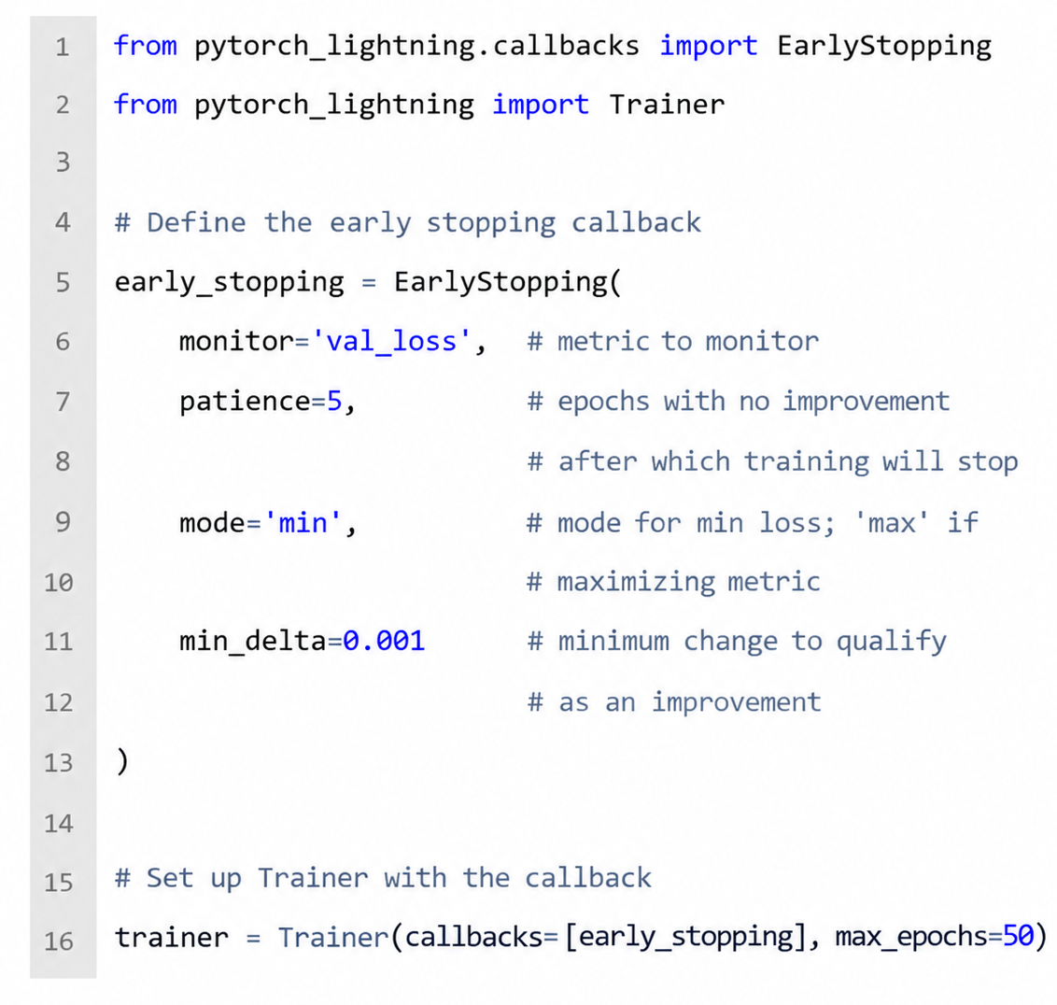
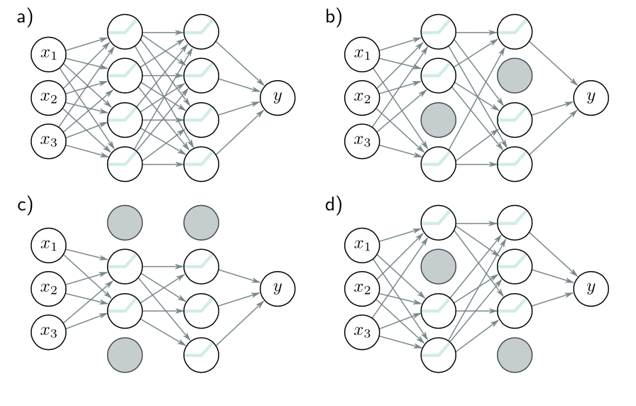
Other tricks
For low-data dataset and generalisation
Early stopping: to stop the training before it has fully converged, for reducing overfitting.
Ensembling: to build several models and average their predictions.
Dropout: to randomly clamp a subset (%) of hidden units to zero (training a slightly different network each time).
Augmentation: to transform each input data example in such way that the labels stays the same.
a)
b)
c)

Slide 10
Results
Molecular Graphs
All data – 1M pretraining, optimised hyperparameters
5-fold CV and external test set
Synthetisability
Model | Hemolysis |  |  | Solubility |  |  | Synthetisability
 | MAE | Pearson r | Spearman r | MAE | Pearson r | Spearman r | MAE | Pearson r | Spearman r
Multi-head Pretrained, Frozen Encoder | 75.0±3.2 | 0.67±0.04 | 0.63±0.02 | 0.31±0.01 | 0.95±0.01 | 0.94±0.01 | 18.5±1.15 | 0.41±0.05 | 0.29±0.04
Multi-head Pretrained, Trainable Encoder | 72.3±2.5 | 0.68±0.05 | 0.63±0.03 | 0.24±0.01 | 0.97±0.01 | 0.96±0.01 | 19.7±0.9 | 0.35±0.03 | 0.26±0.03
Multi-head | 102.5±1.9 | 0.39±0.03 | 0.34±0.03 | 0.43±0.02 | 0.89±0.01 | 0.89±0.02 | 18.8±0.9 | 0.33±0.09 | 0.26±0.06
Single-task | 106.5±1.2 | 0.17±0.21 | 0.18±0.19 | 0.48±0.01 | 0.87±0.01 | 0.87±0.03 | 19.5±1.1 | 0.24±0.05 | 0.20±0.03
Chemelon, Multi-head | 74.2±1.6 | 0.60±0.06 | 0.59±0.04 | 0.26±0.01 | 0.96±0.01 | 0.96±0.03 | 18.1±1.1 | 0.44±0.05 | 0.34±0.06
Chemelon, Single-task | 115.3±4.8 | 0.21±0.04 | 0.15±0.06 | 1.49±0.08 | 0.42±0.06 | 0.58±0.04 | 19.5±1.1 | 0.26±0.06 | 0.22±0.05
Solubility
Hemolysis
Single-Task
Multi-Task
Pretrained,
Trainable encoder
Pretrained,
Frozen encoder

Slide 11
Prospective study
Workflow
Baseline
8 peptides (from literature)
4 - low synthesisability (in-flow synthesis)
4 - high synthesisability
Synthesised and tested
Mutations (90 K each, random/sliced)
5 peptides with a purity < 70%
Sequence modifications introduced,
last 5 C-terminal residues were retained
Predictions
∆ mutated – original
Synthetised and tested
Top (2)
improvement
Bottom
Negative control

Slide 12
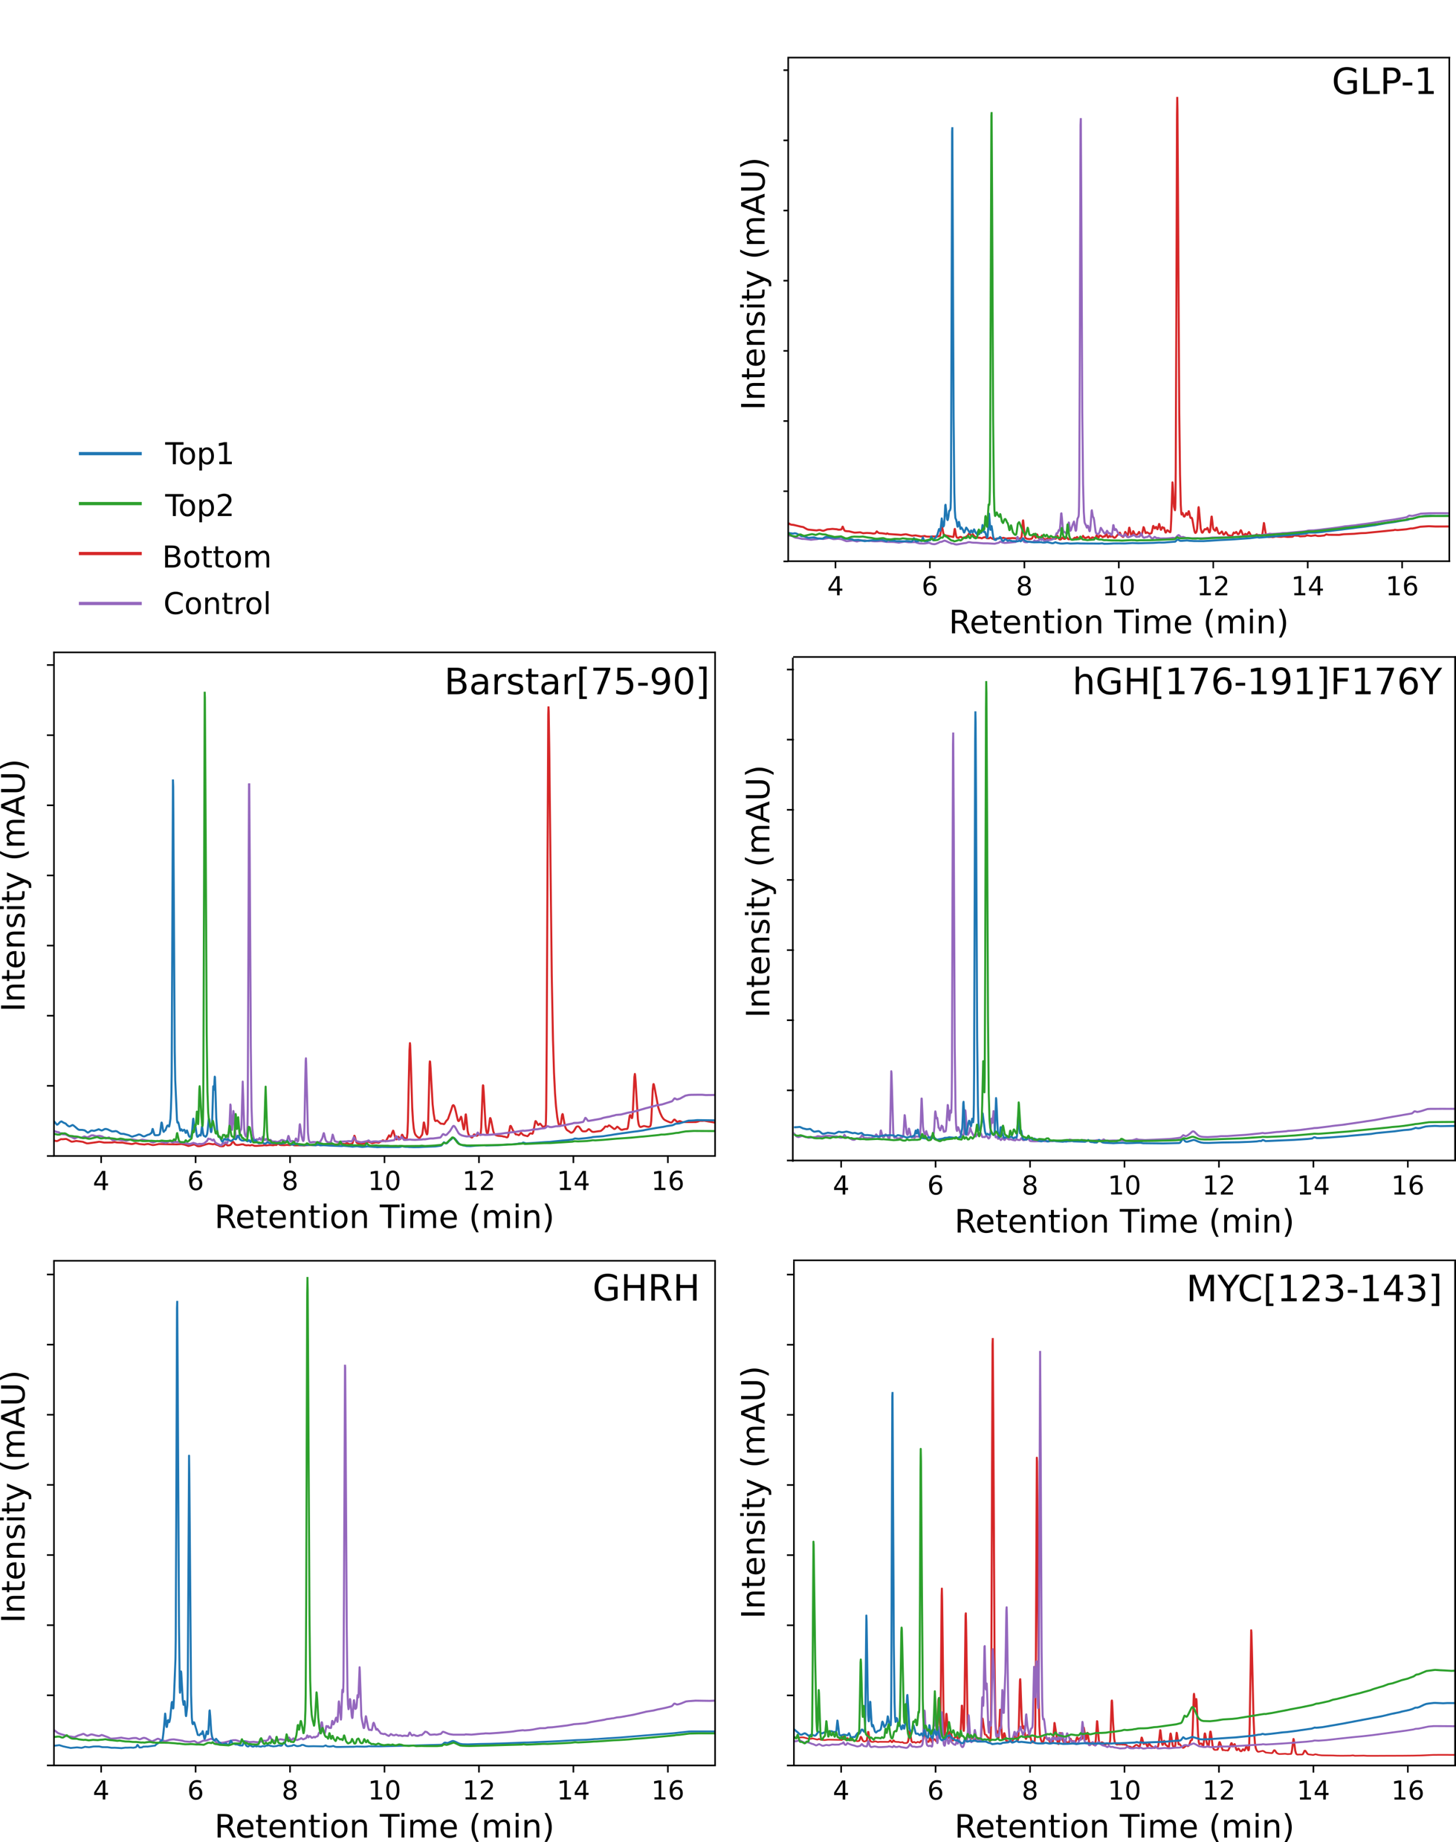
Prospective study
Results
Name​ | Sequence​ | Category​ | MultiPep (Purity %)​ | Δ | RT (min)​
Barstar[75-90]​ | FREAKAEGCDITIILS | Original​ | 58.8​ | ​ | 7.1​
 | KRRYKATGCDDTIILS | Top 1​ | 73.2​ | 14.4​ | 5.5​
 | FRESKQQRCDYTIILS | Top2​ | 71.0​ | 12.3​ | 6.1​
 | F[Aib]FSKA[Nle]GCVITIILS | Bottom​ | 52.0​ | -6.6 | -13.8
GHRH​ | YADAIFTNSYRKVLGQLSARKLLQDILSA | Original​ | 54.4​ | ​ | 9.2​
 | TADAHFTNSYRKKLGQ[Aib]SARKLHQDILSA | Top 1​ | 56.1​ | 1.7​ | 5.6​
 | YSDKIAHNSYRKVLGQLSARKLLQDILSA | Top2​ | 76.5​ | 22.1​ | 8.4​
 | YADAIFWNSYRKVLW[Nle]LSERFLLQDILSA | Bottom​ | -​ | -​ | -​
GLP1​ | HAEGTFTSDVSSYLEGQAAKEFIAWLVKGR | Original​ | 70.4​ | ​ | 9.2​
 | HAKGTFTSDVSSYYEGQDYKEKIAWLVKGR | Top1​ | 81.5​ | 11.1​ | 6.5​
 | YAEGTHTSDHSSYLEGQHYKEFIAWLVKGR | Top2​ | 72.3​ | 1.9​ | 7.3​
 | [Aib]AEGAFTSLVSSYLEG[Nle]AAKAFIAWLVKGR | Bottom​ | 69.3​ | -1.1​ | 11.3​
hGH[176-191]F176Y​ | YLRIVQCRSVEGSCGF | Original​ | 55.6​ | ​ | 6.4​
 | YLRQPQHR[Chg][Cha]EGSCG | Top1​ | 81.2​ | 25.6​ | 6.9​
 | YLR[Chg]HQP[Chg]SKEGSCGF | Top2​ | 78.5​ | 22.9​ | 7.1​
 | YLVIVQC[Nle]VV[Nle]GSCGF | Bottom​ | -​ | -​ | -​
MYC[123-143]​ | FIKNIIIQDCMWSGFSAAAK | Original​ | 26.2​ | ​ | 8.2​
 | FHKNIRYQDCMNSNFSAAAK | Top1​ | 52.3​ | 26.1​ | 5.1​
 | KIKNII[Aib]QDCMRSDQSAAAK | Top2​ | 28.9​ | 2.7​ | 5.6​
 | FI[Aib]TIIIT[Aib]CMWSGFSAAAK | Bottom​ | 21.9​ | -4.3​ | 7.1​

Slide 13

https://github.com/rbirolo/IX_technical_turorial2026

