Slide 1
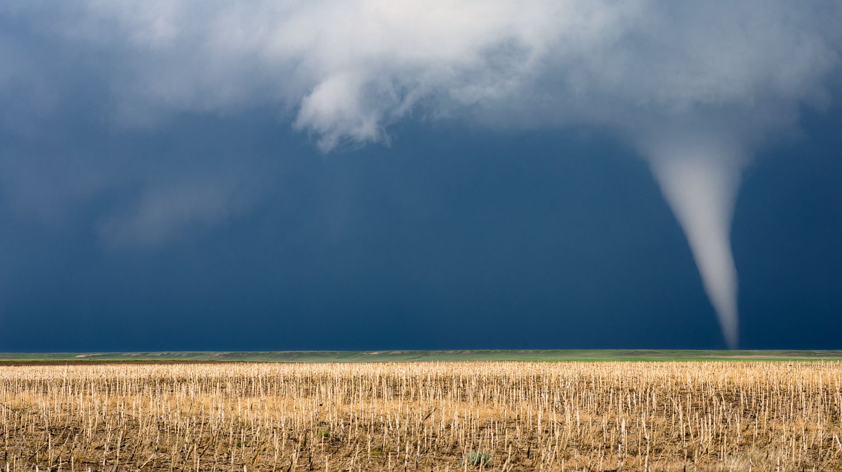
Severe Weather Conditions (Hail, Tornado, Wind)
Project 3 Group 4

Slide 2

Team Members:
Rina Neaara Bitas
Evis Saliaj
Dayana Iciano
Github Repo: https://github.com/rbitas/team4-project3/tree/main

Slide 3
Technologies and Tools
Programming Language: Python, HTML, Javascript, CSS
Libraries: sqlalchemy, pandas, flask, chart.js , D3
Database: sqlite
Dataset source: https://www.spc.noaa.gov/wcm/

Slide 4
Flask
Our Flask App connects to our sqlite databse and pulls in the data and also has our API endpoints:
"/": directs the users to index.html which holds our dashboard with the visualizations
"/api/v1.0/hailweather": pulls all the hail data from the sqlite database and returns it as a JSON.
"/api/v1.0/tornadoweather": pulls all the tornado data from the sqlite database and returns it as a JSON.
"/api/v1.0/windweather": pulls all the wind data from the sqlite database and returns it as a JSON.

Slide 5
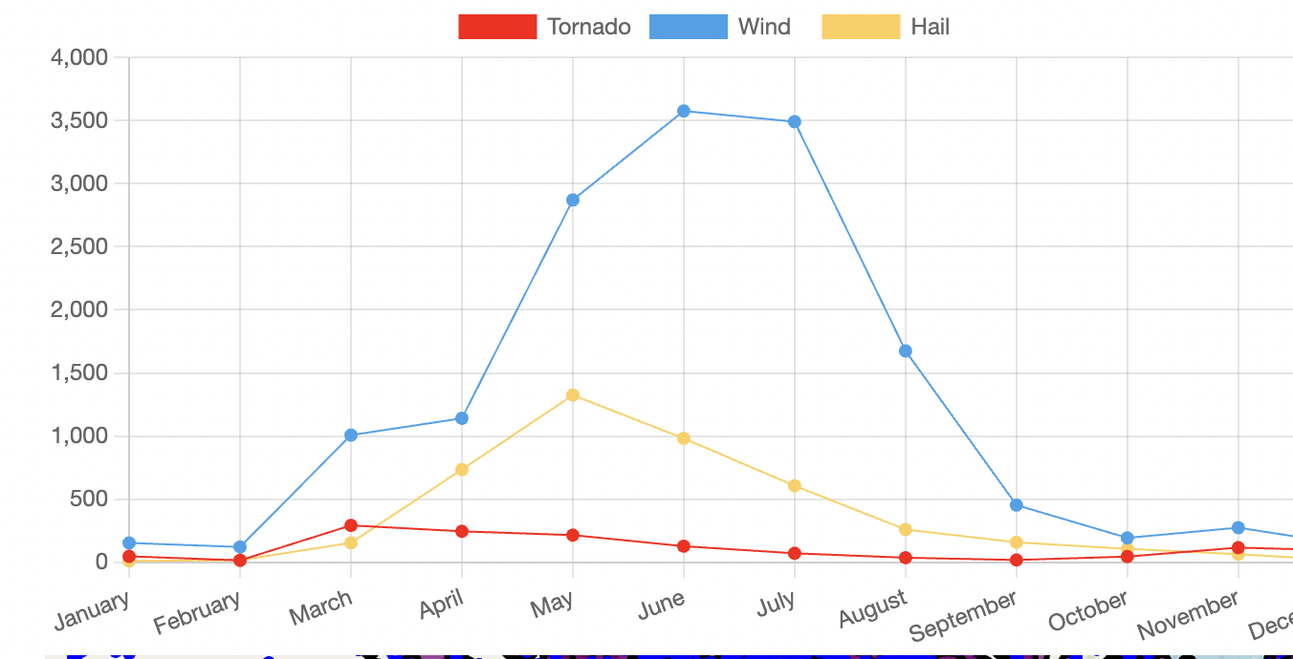
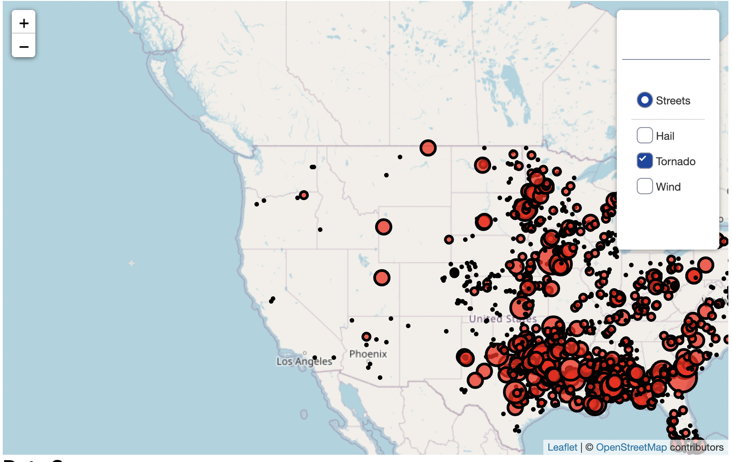
Visualization
Leaflet.js
Chart.js.

Slide 6
Thank you!

