Slide 1
C Libraries
R B jagadeesh

Slide 2
Objective:
What is Library?
Static Library
Shared Library
Building our own libraries

Slide 3
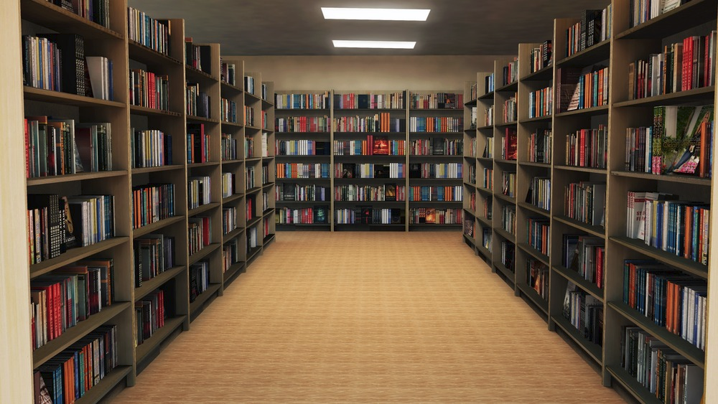
C Std Library:
Standard C Library

Slide 4
C Std Library:
libc
static
shared
libc.a
libc.so
Compiled and assembled
Compiled and linked

Slide 5
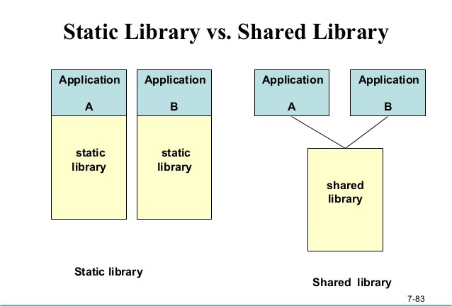
Static Linking vs. Dynamic Linking:

Slide 6
Math.c:
#include <stdio.h>
#include <math.h>
void main(void)
{
int a = 10;
int b = 5;
printf ("%d\n", (int) pow(a, b));
}
$ gcc math.c
Will it execute???

Slide 7
C Std Library:
libc
static
shared
libc.so
libc.so
libm.a
libc.a
Compiled and assembled
Compiled and linked

Slide 8
Header Files:
assert.h
ctype.h
errno.h
float.h
limits.h
locale.h
math.h
setjmp.h
signal.h
stdarg.h
stddef.h
stdio.h
stdlib.h
string.h
time.h

Slide 9
time.h:
struct tm1 {
int tm_sec; /* seconds, range 0 to 59 */
int tm_min; /* minutes, range 0 to 59 */
int tm_hour; /* hours, range 0 to 23 */
int tm_mday; /* day of the month, range 1 to 31 */
int tm_mon; /* month, range 0 to 11 */
int tm_year; /* The number of years since 1900 */
int tm_wday; /* day of the week, range 0 to 6 */
int tm_yday; /* day in the year, range 0 to 365 */
int tm_isdst; /* daylight saving time */
};
int main (void)
{
time_t tim;
time( &tim );
printf("Current local time and date: %s", asctime(localtime( &tim)));
return(0);
}

Slide 10
Advantages:
When will you use static library??
When will you use shared library??

Slide 11
Building our own libraries:
Building static library :
    compile library files
    $ ar -crU -o libmathops.a a.o b.o
    $ gcc -static -o static app.c -I./ -L./ libmathops.a
  Building shared library :
    compile library files
    $ gcc -shared a.o b.o -o libmathops.so
    $ export LD_IBRARY_PATH=$LD_LIBRARY_PATH:./
    $ gcc -o shared app.c -I./ -L./ libmathops.so

