Slide 1
Psychotherapy Feedback on the Counseling Center Assessment of Psychological Symptoms (CCAPS): Effects on Outcome and Client Moderators of Effectiveness
Rebecca Janis
Dissertation proposal
2020-01-22

Slide 2
Background
Some portion of clients get worse during treatment (5-15%)
Therapists have trouble identifying which clients will get worse or are getting worse during treatment
Routine outcome monitoring and feedback provides information to the therapist on a client’s progress, often compared to previous clients, reducing deterioration and improving outcomes
Alerts indicate when a client is not progressing as expected, prompting the therapist to check in with the client about treatment progress or try a different treatment approach

Slide 3
Counseling Center Assessment of Psychological Symptoms (CCAPS)
Subscales
Depression, Generalized Anxiety, Social Anxiety, Academic Distress, Eating, Hostility, Alcohol Use, Distress Index
Used as a repeated measure routine outcome assessment in 600+ college counseling centers

Slide 4
CCAPS deterioration
 | Depression | Anxiety | Social Anxiety | Academics | Eating | Hostility | Alcohol | DI
Deterioration | 2.83% | 3.11% | 2.30% | 5.09% | 4.92% | 2.20% | 1.83% | 2.25%
13.5% of clients deteriorate on at least one subscale

Slide 5
CCAPS feedback system
CCAPS feedback system implemented in July 2015
Graphical display of client’s scores
Graphical display of expected trajectory
Shading of cut point regions (low, moderate, high distress)
Off track alerts

Slide 6
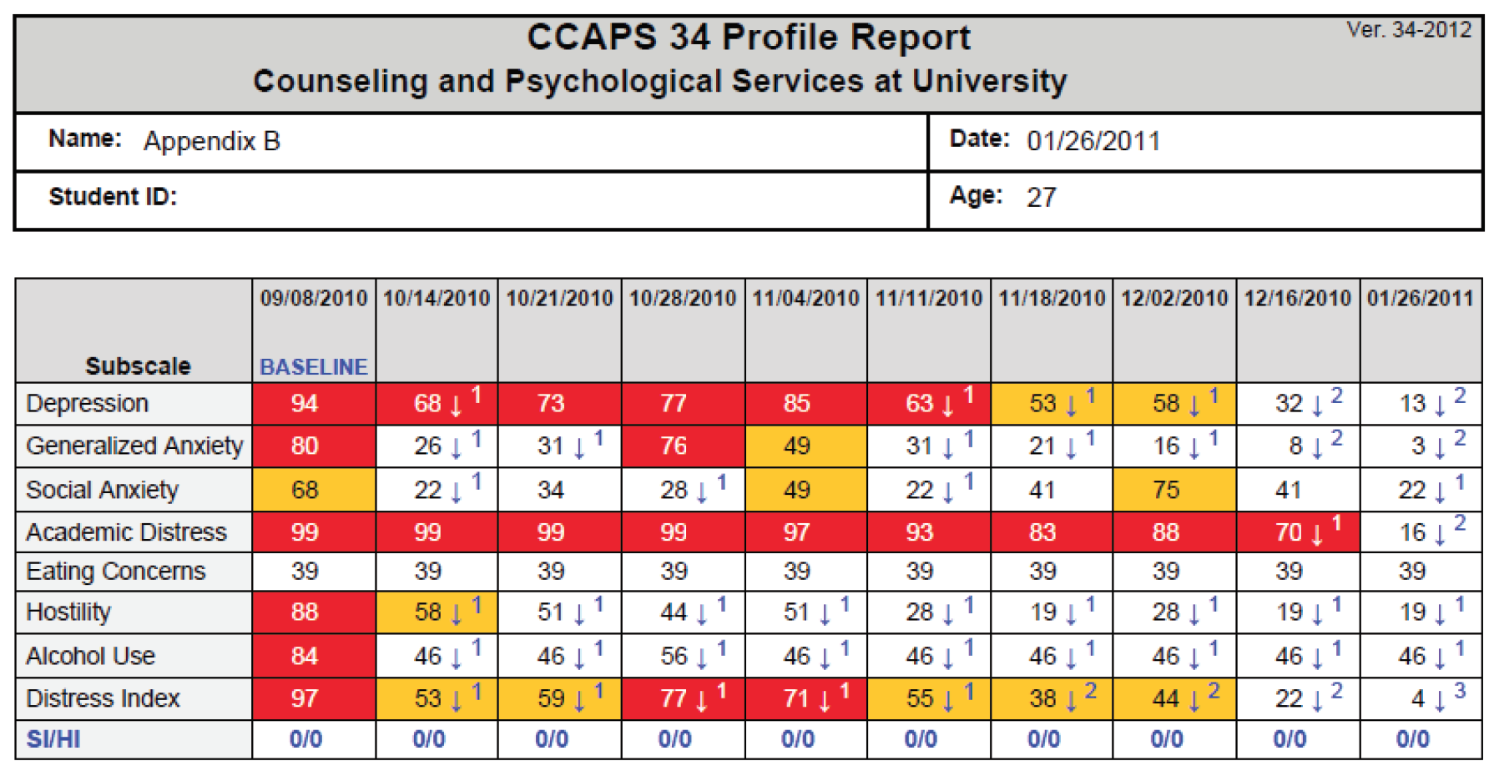
Old CCAPS report

Slide 7
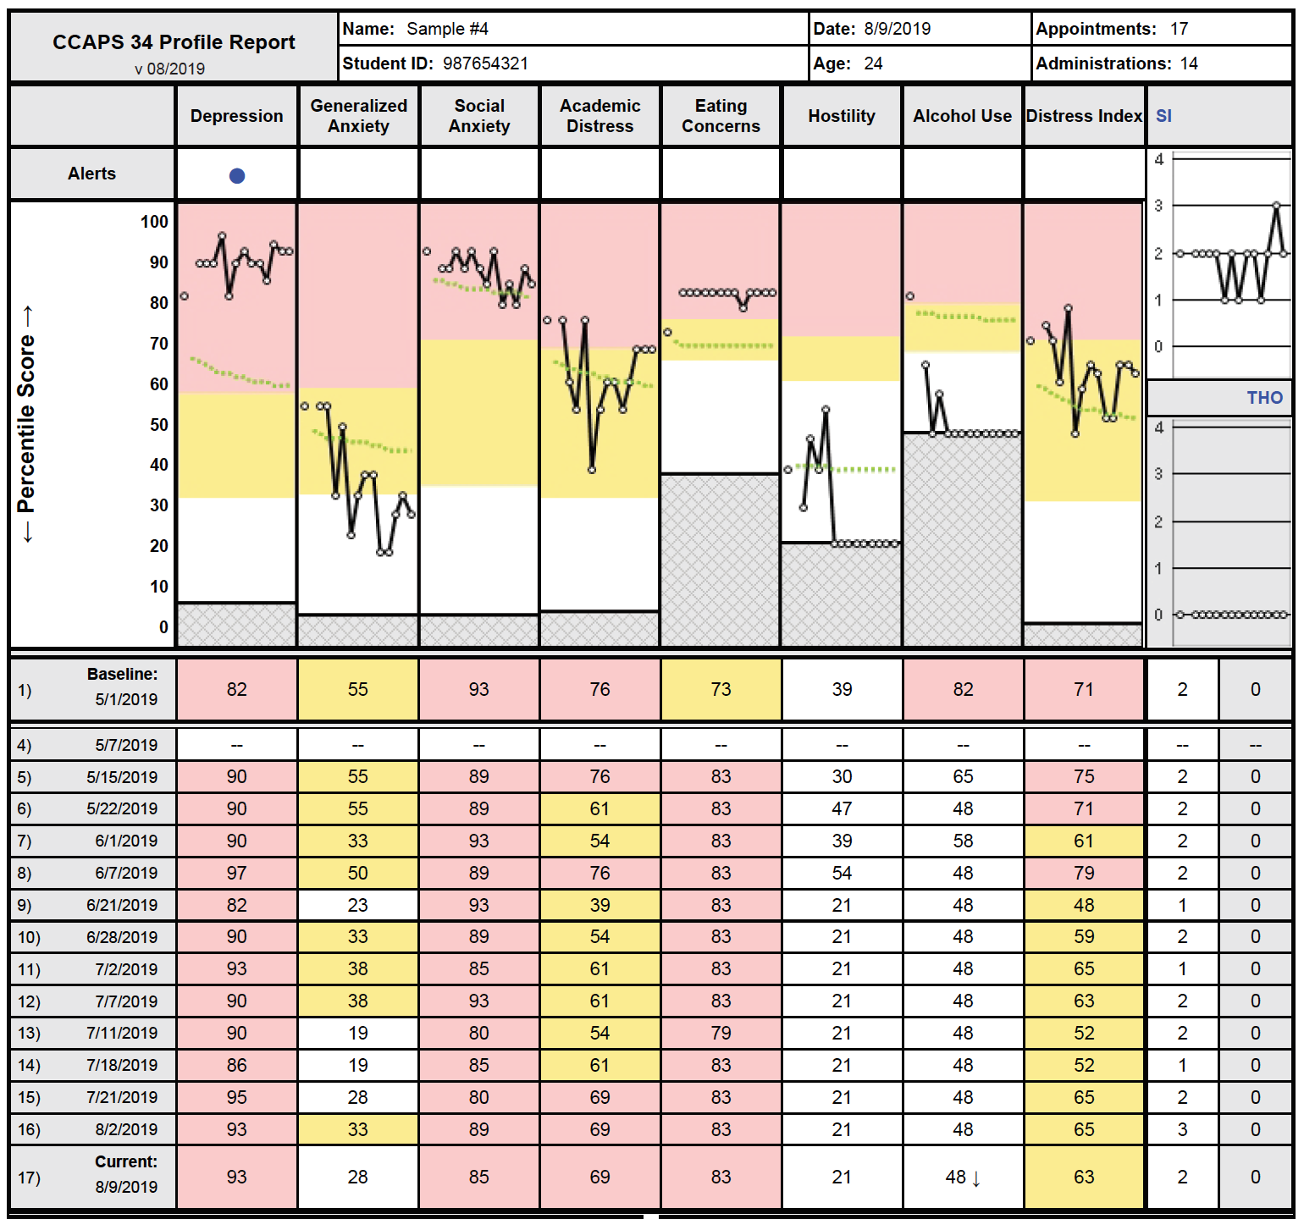
New CCAPS report

Slide 8
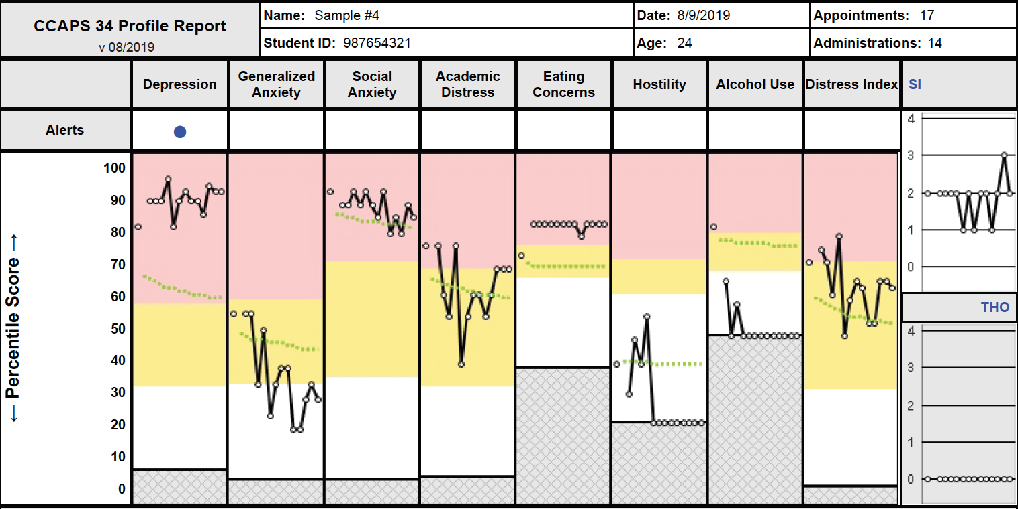
New CCAPS report

Slide 9
CCAPS feedback methods
Sample
~30,000 clients seen within CCMH from 2012-2014
Expected treatment trajectory
Each subscale modeled using linear mixed effects model
Session number log transformed
Baseline CCAPS values binned, with models fit for each bin
Off track feedback alerts
Alerts derived from upper limit of one-sided 90% tolerance interval around expected treatment trajectory treatment trajectory

Slide 10
Research questions
Did client outcomes improve after the implementation of a feedback system for the CCAPS?
Does the effect of feedback differ by CCAPS domain?
Are there client moderators of the effect of feedback?
Are there differences by center in the effect of feedback?

Slide 11
Methods
Mixed effects models for 3 client outcomes across all 8 CCAPS subscales
IV: feedback condition
No feedback: Clients seen in 2013-2015
Feedback: Clients seen in 2016-2018
Random effect of feedback for centers to test for center variance in effect of feedback
Five moderators tested with interactions with feedback condition variable

Slide 12
Outcomes
Deterioration: Rate of reliable worsening
Did feedback reduce the proportion of clients who got reliably worse in treatment?
Pre-to-post change: Absolute change in CCAPS scores from pre-to-post treatment
Did feedback result in more change on the CCAPS?
Rate of change: Slope of session by session CCAPS scores
Did feedback result in faster change in CCAPS scores?

Slide 13
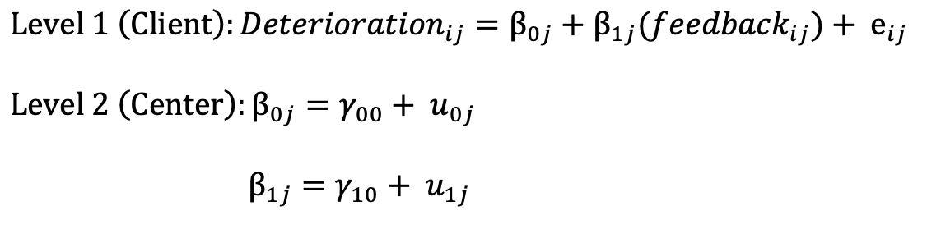
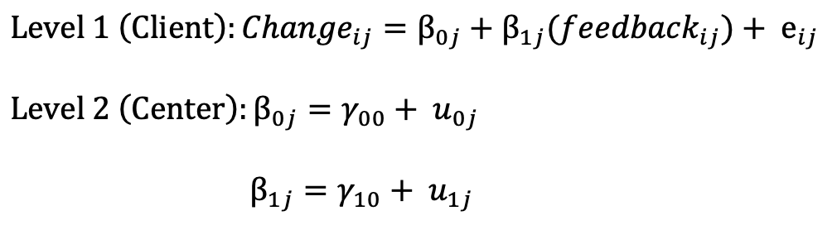
Models
Deterioration: Mixed effects logistic regression
Pre-to-post change: Mixed effects linear regression

Slide 14
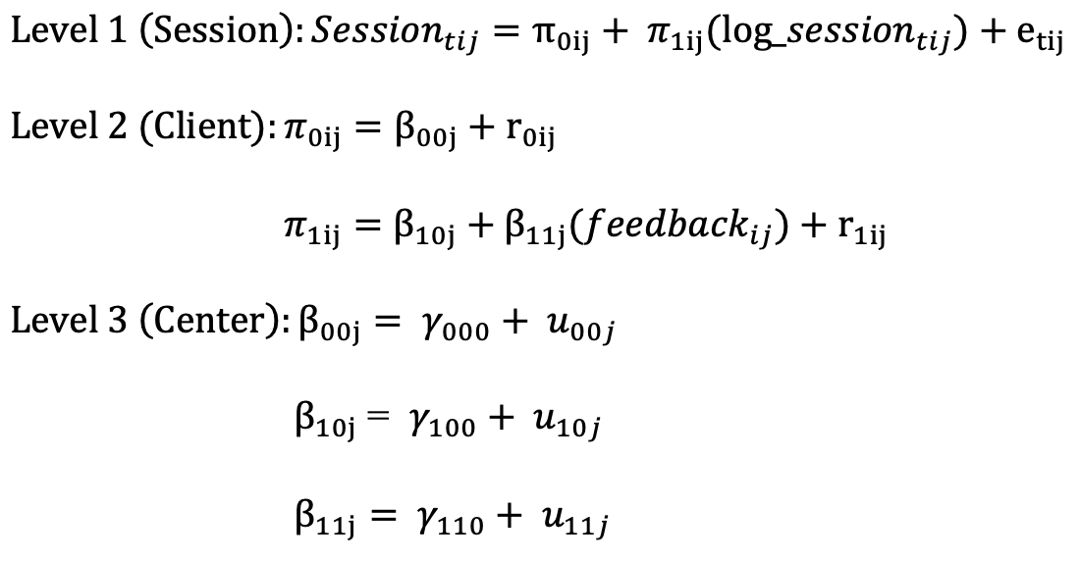
Models
Rate of change: Mixed effects linear regression

Slide 15
Moderators
Off track
Initial CCAPS score
Prior psychiatric hospitalizations
Frequency of CCAPS administrations
Total number of sessions

Slide 16
Moderators: Operationalization
Off track
Dichotomized based on whether the client alerted or would have alerted
Initial CCAPS score
Standardized and grand mean centered
Prior psychiatric hospitalizations
Dichotomized based on lifetime history of hospitalization
Frequency of CCAPS administrations
Proportion of individual sessions that had a CCAPS
Total number of attended individual sessions
Standardized and grand mean centered
Log transformed depending on skew of distribution

Slide 17
Moderators: Hypotheses
Off track
Feedback will be more effective for off track clients more than on track clients
Initial CCAPS score
Feedback will be more effective for clients with higher CCAPS scores more
Prior psychiatric hospitalizations
Feedback will be less effective for clients with hospitalizations
Frequency of CCAPS administrations
Feedback will be more effective for clients with more frequent CCAPS administrations
Total number of sessions
Feedback will be more effective for clients with more sessions

Slide 18
Data
The Center for Collegiate Mental Health (CCMH)
Large practice research network of 600+ counseling centers using common data forms, contributing data to a central repository
Eligible counseling centers:
Contributed data to CCMH all 4 years (2013-2014, 2014-2015, 2016-2017, 2017-2018)
Updated to new CCAPS version with feedback before July 1, 2016
Eligible clients:
2 individual appointments & 2+ CCAPS within 14 days of first and last appointments
Above low cut
Able to deteriorate

Slide 19
Baseline sample
88 centers
288,074 clients
115,542 in the no feedback condition
172,532 in the feedback condition

Slide 20
Methodological concerns
Ceiling effect on subscales
Some clients can’t deteriorate
Smaller percent of clients can’t alert on some subscales
Can’t control for confounding effect of time but believe effect of time on client outcomes is small to none
 | Depression | Anxiety | Social Anxiety | Academics | Eating | Hostility | Alcohol | DI
Above ceiling | 15.74% | 20.86% | 23.22% | 30.59% | 10.09% | 1.98% | 3.28% | 3.46%

Slide 21
Future directions
Therapist factors
Frequency of viewing and using CCAPS report
Frequency of discussing CCAPS feedback with clients
Contextual factors
How was the new CCAPS report introduced at each center? Did therapists feel burdened by the change? Did it feel imposed from the top down instead of something that therapists felt ownership in?

