Slide 1
Psychotherapy Feedback on the Counseling Center Assessment of Psychological Symptoms (CCAPS): Effects on Outcome and Client Moderators of Effectiveness
Rebecca Janis
Dissertation proposal
2020-01-22

Slide 2
Background
Some portion of clients get worse during treatment (5-15%)
Therapists have trouble identifying which clients will get worse or are getting worse during treatment
Routine outcome monitoring and feedback provides information to the therapist on a client’s progress, often compared to previous clients, reducing deterioration and improving outcomes
Alerts indicate when a client is not progressing as expected, prompting the therapist to check in with the client about treatment progress or try a different treatment approach

Slide 3
Counseling Center Assessment of Psychological Symptoms (CCAPS)
Subscales
Depression, Generalized Anxiety, Social Anxiety, Academic Distress, Eating, Hostility, Alcohol Use, Distress Index
Used as a repeated measure routine outcome assessment in 600+ college counseling centers

Slide 4
CCAPS deterioration
 | Depression | Anxiety | Social Anxiety | Academics | Eating | Hostility | Alcohol | DI
Deterioration | 2.83% | 3.11% | 2.30% | 5.09% | 4.92% | 2.20% | 1.83% | 2.25%
13.5% of clients deteriorate on at least one subscale

Slide 5
CCAPS feedback system
CCAPS feedback system implemented in July 2015
Clients seen before July 2015 coded as “no feedback” condition
Clients seen after July 2016 coded as “feedback” condition
This leaves a 1 year gap for centers to adopt new CCAPS system and acclimate to it
Graphical display of client’s scores
Graphical display of expected trajectory
Shading of cut point regions (low, moderate, high distress)
Off track alerts

Slide 6
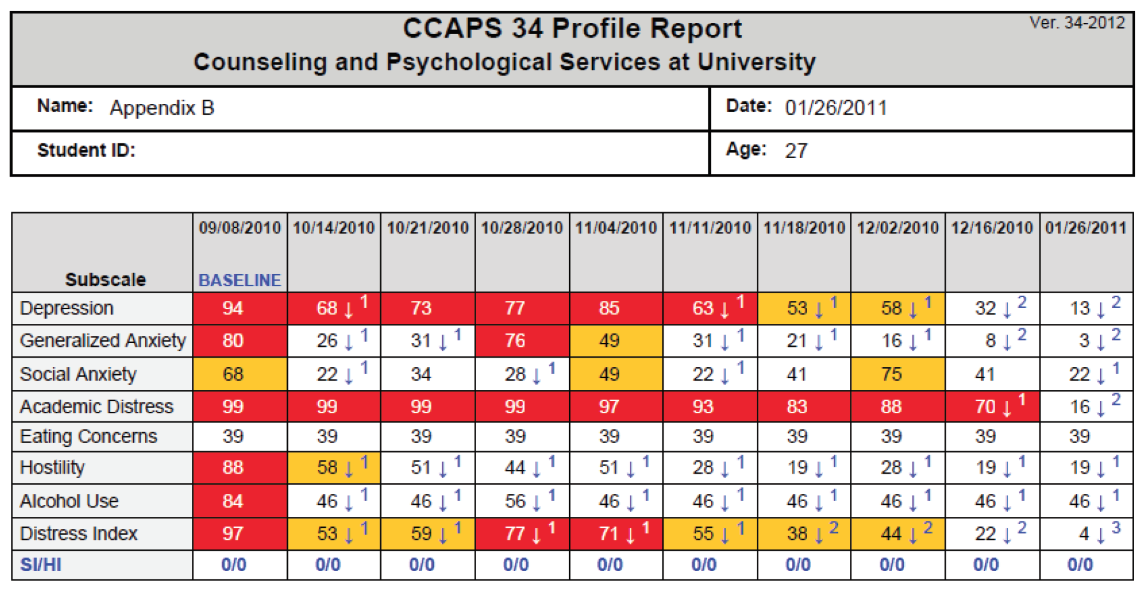
Old CCAPS report

Slide 7
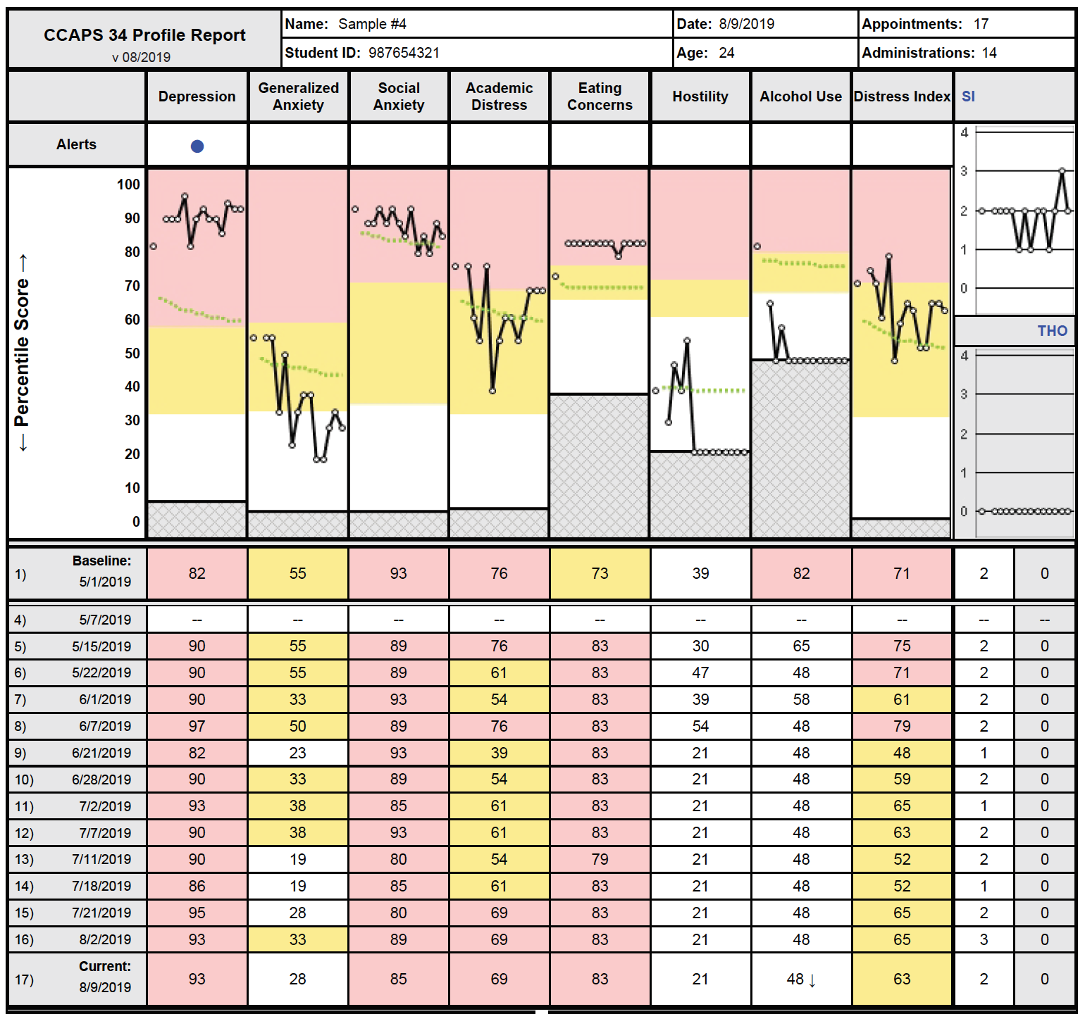
New CCAPS report

Slide 8
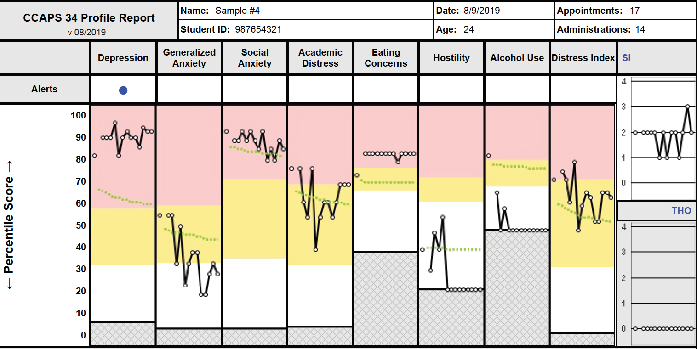
New CCAPS report

Slide 9
CCAPS feedback methods
Sample
~30,000 clients seen within CCMH from 2012-2014
Expected treatment trajectory
Each subscale modeled using linear mixed effects model
Session number log transformed
Baseline CCAPS values binned, with models fit for each bin
Off track feedback alerts
Alerts derived from upper limit of one-sided 90% tolerance interval around expected treatment trajectory treatment trajectory

Slide 10
Hypotheses & Research Questions
Client outcomes will improve after the implementation of a feedback system for the CCAPS.
Does the effect of feedback differ by CCAPS domain?
Are there differences by center in the effect of feedback?
Are there client moderators of the effect of feedback?

Slide 11
Methods
Mixed effects models for 3 client outcomes across all 8 CCAPS subscales
IV: feedback condition
No feedback: Clients seen in 2013-2015
Feedback: Clients seen in 2016-2018
Random effect of feedback for centers to test for center variance in effect of feedback
Five moderators tested with interactions with feedback condition variable

Slide 12
Outcomes
Deterioration: Rate of reliable worsening
Did feedback reduce the proportion of clients who got reliably worse in treatment?
Pre-to-post change: Absolute change in CCAPS scores from pre-to-post treatment, where positive change indicates improvement
Did feedback result in more change on the CCAPS?
Rate of change: Slope of session by session CCAPS scores
Did feedback result in faster change in CCAPS scores?
Client trajectories anchored through their baseline

Slide 13
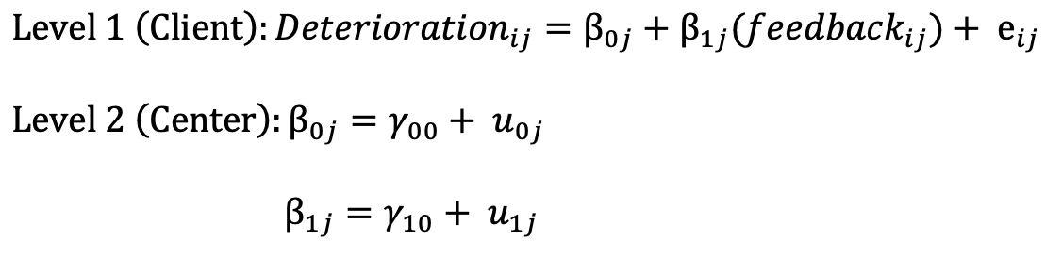
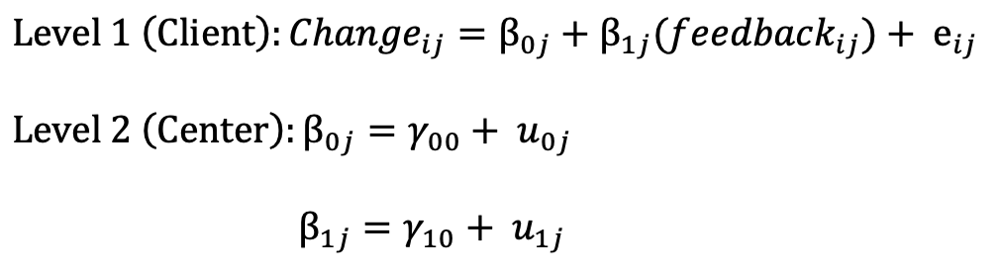
Models
Deterioration: 2-level mixed effects logistic regression
Pre-to-post change: 2-level mixed effects linear regression

Slide 14
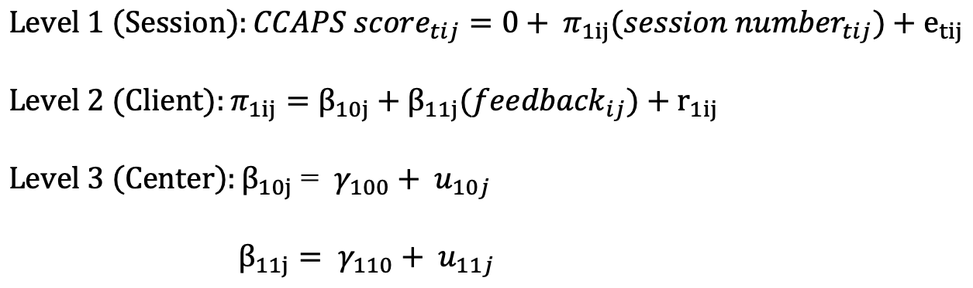
Models
Rate of change: 3-level mixed effects linear regression
Client scores anchored through their own baseline score and no fixed or random intercept estimated

Slide 15
Moderators
Off track
Initial CCAPS score
Prior psychiatric hospitalizations
Frequency of CCAPS administrations
Total number of sessions

Slide 16
Moderators: Operationalization
Off track
Dichotomized based on whether the client alerted or would have alerted
Initial CCAPS score
Standardized and grand mean centered
Prior psychiatric hospitalizations
Dichotomized based on lifetime history of hospitalization
Frequency of CCAPS administrations
Proportion of individual sessions that had a CCAPS
Total number of attended individual sessions
Standardized and grand mean centered
Log transformed depending on skew of distribution

Slide 17
Moderators: Hypotheses
Off track
Feedback will be more effective for off track clients more than on track clients
AKA Clients who go off track in the feedback condition will improve more than clients who go off track in the no feedback condition
Initial CCAPS score
Feedback will be more effective for clients with higher CCAPS scores
Prior psychiatric hospitalizations
Feedback will be less effective for clients with hospitalizations
Frequency of CCAPS administrations
Feedback will be more effective for clients with more frequent CCAPS administrations
Total number of sessions
Feedback will be more effective for clients with more sessions

Slide 18
Data
The Center for Collegiate Mental Health (CCMH)
Large practice research network of 600+ counseling centers using common data forms, contributing data to a central repository
Eligible counseling centers:
Contributed data to CCMH all 4 years (2013-2014, 2014-2015, 2016-2017, 2017-2018)
Updated to new CCAPS version with feedback before July 1, 2016
Eligible clients:
3 individual appointments & 3+ CCAPS within 14 days of first and last appointments
Able to deteriorate
Able to alert

Slide 19
Sample
71 centers
39,358 clients
13,765 in the no feedback condition
25,593 in the feedback condition

Slide 20
Hypotheses & Research Questions
Client outcomes will improve after the implementation of a feedback system for the CCAPS.
Does the effect of feedback differ by CCAPS domain?
Are there differences by center in the effect of feedback?
Are there client moderators of the effect of feedback?

Slide 21
Results

Slide 22
Pre-post change
2 level mixed effects model predicting total change from pre to post treatment

Slide 23
Pre-post change: Feedback effects
 | Depression34 | Anxiety34 | Social_Anxiety34 | Academics34 | Eating34 | Hostility34 | Alcohol34 | DI
Intercept | 0.63** (0.02) | 0.48** (0.02) | 0.31** (0.01) | 0.28** (0.02) | 0.14** (0.01) | 0.35** (0.01) | 0.18** (0.01) | 0.52** (0.02)
Feedback | 0.01 (0.02) | 0.02 (0.02) | 0.02 (0.01) | 0.01 (0.01) | 0.02 (0.01) | 0.00 (0.01) | 0.01 (0.01) | 0.01 (0.01)
Intercept | 0.14 | 0.11 | 0.08 | 0.12 | 0.06 | 0.09 | 0.08 | 0.12
Correlation | -0.22 | -0.1 | -0.15 | -0.03 | 0.12 | -0.18 | -0.52 | -0.18
Feedback | 0.08 | 0.07 | 0.05 | 0.01 | 0.04 | 0.04 | 0.05 | 0.07
Residual | 0.9 | 0.83 | 0.69 | 0.95 | 0.79 | 0.68 | 0.65 | 0.68
No significant effects, but coefficients in the direction of more change (positive)
Effect sizes all 0

Slide 24
Pre-post change: Domain differences
 | Depression34 | Anxiety34 | Social_Anxiety34 | Academics34 | Eating34 | Hostility34 | Alcohol34 | DI
Intercept | 0.63** (0.02) | 0.48** (0.02) | 0.31** (0.01) | 0.28** (0.02) | 0.14** (0.01) | 0.35** (0.01) | 0.18** (0.01) | 0.52** (0.02)
Feedback | 0.01 (0.02) | 0.02 (0.02) | 0.02 (0.01) | 0.01 (0.01) | 0.02 (0.01) | 0.00 (0.01) | 0.01 (0.01) | 0.01 (0.01)
Intercept | 0.14 | 0.11 | 0.08 | 0.12 | 0.06 | 0.09 | 0.08 | 0.12
Correlation | -0.22 | -0.1 | -0.15 | -0.03 | 0.12 | -0.18 | -0.52 | -0.18
Feedback | 0.08 | 0.07 | 0.05 | 0.01 | 0.04 | 0.04 | 0.05 | 0.07
Residual | 0.9 | 0.83 | 0.69 | 0.95 | 0.79 | 0.68 | 0.65 | 0.68
No evidence of meaningful differences by domain

Slide 25
Pre-post change: Center differences
 | Depression34 | Anxiety34 | Social_Anxiety34 | Academics34 | Eating34 | Hostility34 | Alcohol34 | DI
Intercept | 0.63** (0.02) | 0.48** (0.02) | 0.31** (0.01) | 0.28** (0.02) | 0.14** (0.01) | 0.35** (0.01) | 0.18** (0.01) | 0.52** (0.02)
Feedback | 0.01 (0.02) | 0.02 (0.02) | 0.02 (0.01) | 0.01 (0.01) | 0.02 (0.01) | 0.00 (0.01) | 0.01 (0.01) | 0.01 (0.01)
Intercept | 0.14 | 0.11 | 0.08 | 0.12 | 0.06 | 0.09 | 0.08 | 0.12
Correlation | -0.22 | -0.1 | -0.15 | -0.03 | 0.12 | -0.18 | -0.52 | -0.18
Feedback | 0.08 | 0.07 | 0.05 | 0.01 | 0.04 | 0.04 | 0.05 | 0.07
Residual | 0.9 | 0.83 | 0.69 | 0.95 | 0.79 | 0.68 | 0.65 | 0.68
Some evidence for center differences, although small, indicating that the effect of feedback was stronger in some centers
Center effect significantly improved models for Depression, Anxiety, Social Anxiety, Alcohol, and DI

Slide 26
Pre-post change: Moderators
 | Depression34 | Anxiety34 | Social_Anxiety34 | Academics34 | Eating34 | Hostility34 | Alcohol34 | DI
Intercept | 0.87** (0.02) | 0.72** (0.01) | 0.49** (0.01) | 0.59** (0.02) | 0.36** (0.01) | 0.49** (0.01) | 0.3** (0.01) | 0.69** (0.02)
Feedback | -0.02 (0.01) | -0.02 (0.01) | 0.00 (0.01) | -0.02 (0.01) | 0.01 (0.01) | 0.01 (0.01) | 0.02 (0.01) | -0.02 (0.01)
Off track | -0.77** (0.01) | -0.81** (0.01) | -0.72** (0.01) | -0.96** (0.02) | -0.85** (0.01) | -0.55** (0.01) | -0.55** (0.01) | -0.66** (0.01)
Client baseline | 0.47** (0.01) | 0.36** (0.01) | 0.25** (0.01) | 0.42** (0.01) | 0.35** (0.01) | 0.42** (0) | 0.42** (0) | 0.3** (0)
Center baseline | 0.33* (0.1) | 0.33* (0.12) | 0.1 (0.1) | 0.26* (0.09) | 0.28 (0.11) | 0.49** (0.06) | 0.26** (0.06) | 0.26* (0.09)
CCAPS frequency | 0.12** (0.01) | 0.12** (0.01) | 0.1** (0.01) | 0.12** (0.01) | 0.08** (0.01) | 0.11** (0.01) | 0.07** (0.01) | 0.1** (0.01)
Appointment N | 0.1** (0.01) | 0.08** (0.01) | 0.06** (0.01) | 0.1** (0.01) | 0.06** (0.01) | 0.07** (0) | 0.05** (0) | 0.07** (0.01)
Hospitalization | -0.09** (0.02) | -0.09** (0.02) | -0.06** (0.02) | -0.07* (0.02) | -0.03 (0.02) | -0.07** (0.01) | -0.03 (0.01) | -0.09** (0.02)
Feedback * Off track | -0.01 (0.02) | -0.01 (0.02) | 0.00 (0.02) | 0.04 (0.02) | 0.01 (0.02) | 0.01 (0.01) | -0.02 (0.01) | 0.00 (0.02)
Feedback * Client baseline | -0.02 (0.01) | -0.02* (0.01) | 0.00 (0.01) | -0.01 (0.01) | 0.01 (0.01) | 0.01* (0) | 0.02** (0) | -0.02* (0.01)
Feedback * Center baseline | 0.07 (0.07) | 0.00 (0.1) | 0.16 (0.09) | 0.1 (0.07) | 0.1 (0.11) | -0.05 (0.05) | 0.1 (0.06) | 0.06 (0.07)
Feedback * CCAPS frequency | 0.03* (0.01) | 0.02 (0.01) | 0.02 (0.01) | -0.01 (0.01) | 0.01 (0.01) | -0.01 (0.01) | -0.01 (0.01) | 0.02 (0.01)
Feedback * Appointment N | 0.01 (0.01) | 0.02 (0.01) | 0.02* (0.01) | 0.00 (0.01) | 0.00 (0.01) | 0.01 (0.01) | 0.01 (0.01) | 0.01 (0.01)
Feedback * Hospitalization | -0.01 (0.03) | 0.01 (0.03) | 0.02 (0.02) | -0.01 (0.03) | 0.00 (0.02) | 0.03 (0.02) | 0.02 (0.02) | 0.01 (0.02)
Intercept | 0.01 | 0.01 | 0 | 0.01 | 0 | 0 | 0 | 0.01
Feedback | 0 | 0 |  |  |  |  | 0 | 0
Residual | 0.48 | 0.44 | 0.32 | 0.55 | 0.36 | 0.21 | 0.19 | 0.31
Some significant moderators, but no consistent direction, and effect sizes are 0
Notes:
Anxiety: As baseline increases, feedback becomes less effective
Hostility: As baseline increases, feedback becomes more effective
Alcohol: As baseline increases, feedback becomes more effective
DI: As baseline increases, feedback becomes less effective
Depression: As CCAPS frequency increases, the effect of feedback on outcome becomes more positive
Social Anxiety: As appointment frequency increases, the effect of feedback on outcome becomes more positive

Slide 27
Rate of change
3-level mixed effects model
Effect of interest is the slope for session number, which represents how fast clients’ CCAPS scores changed
Client scores anchored through their baseline, so no intercept was estimated
Different shapes of change were tested to model decelerating curve typical of psychotherapy change
Typically our lab has used a logarithmic transformation
I found that log transformation fit best for some subscales, while inverse fit best for others
Each subscale uses the transformation that fits best

Slide 28
Rate of change: Feedback effects
 | Depression34 | Anxiety34 | Social_Anxiety34 | Academics34 | Eating34 | Hostility34 | Alcohol34 | DI
Transformation | loglinear | loglinear | loglinear | inverse | inverse | inverse | inverse | loglinear
Slope | -0.29** (0.01) | -0.21** (0.01) | -0.13** (0.01) | -0.24** (0.02) | -0.13** (0.01) | -0.35** (0.02) | -0.19** (0.02) | -0.23** (0.01)
Slope * Feedback | -0.03* (0.01) | -0.02* (0.01) | -0.02* (0.01) | -0.01 (0.01) | -0.03* (0.01) | -0.01 (0.01) | -0.02 (0.01) | -0.02* (0.01)
Center Slope | 0.01 | 0 | 0 | 0.24 | 0.16 | 0.09 | 0.08 | 0
Center Slope * Feedback | 0 | 0 | 0 | 0.01 | 0.01 | 0.01 | 0.01 | 0
Client Slope | 0.21 | 0.17 | 0.12 | 0 | 0 | 0 | 0 | 0.12
Residual | 0.19 | 0.17 | 0.12 | 0.86 | 0.66 | 0.5 | 0.47 | 0.1
Negative slope indicates faster rate of change
Interaction between slope and Feedback indicates whether rate of change differs between feedback conditions
All coefficients in the direction of faster change in the feedback condition, and several significant
Need effect sizes to determine if this is a meaningful effect, but requires too much compute power to run on my laptop

Slide 29
Rate of change: Domain differences
 | Depression34 | Anxiety34 | Social_Anxiety34 | Academics34 | Eating34 | Hostility34 | Alcohol34 | DI
Transformation | loglinear | loglinear | loglinear | inverse | inverse | inverse | inverse | loglinear
Slope | -0.29** (0.01) | -0.21** (0.01) | -0.13** (0.01) | -0.24** (0.02) | -0.13** (0.01) | -0.35** (0.02) | -0.19** (0.02) | -0.23** (0.01)
Slope * Feedback | -0.03* (0.01) | -0.02* (0.01) | -0.02* (0.01) | -0.01 (0.01) | -0.03* (0.01) | -0.01 (0.01) | -0.02 (0.01) | -0.02* (0.01)
Center Slope | 0.01 | 0 | 0 | 0.24 | 0.16 | 0.09 | 0.08 | 0
Center Slope * Feedback | 0 | 0 | 0 | 0.01 | 0.01 | 0.01 | 0.01 | 0
Client Slope | 0.21 | 0.17 | 0.12 | 0 | 0 | 0 | 0 | 0.12
Residual | 0.19 | 0.17 | 0.12 | 0.86 | 0.66 | 0.5 | 0.47 | 0.1
Maybe?

Slide 30
Rate of change: Center differences
 | Depression34 | Anxiety34 | Social_Anxiety34 | Academics34 | Eating34 | Hostility34 | Alcohol34 | DI
Transformation | loglinear | loglinear | loglinear | inverse | inverse | inverse | inverse | loglinear
Slope | -0.29** (0.01) | -0.21** (0.01) | -0.13** (0.01) | -0.24** (0.02) | -0.13** (0.01) | -0.35** (0.02) | -0.19** (0.02) | -0.23** (0.01)
Slope * Feedback | -0.03* (0.01) | -0.02* (0.01) | -0.02* (0.01) | -0.01 (0.01) | -0.03* (0.01) | -0.01 (0.01) | -0.02 (0.01) | -0.02* (0.01)
Center Slope | 0.01 | 0 | 0 | 0.01 | 0.01 | 0.01 | 0.01 | 0
Center Slope * Feedback | 0 | 0 | 0 | 0 | 0 | 0 | 0 | 0
Client Slope | 0.21 | 0.17 | 0.12 | 0.86 | 0.66 | 0.5 | 0.47 | 0.12
Residual | 0.19 | 0.17 | 0.12 | 0.24 | 0.16 | 0.09 | 0.08 | 0.1
Seems like no

Slide 31
Rate of change: Moderators
 | Depression34 | Anxiety34 | Social_Anxiety34 | Academics34 | Eating34 | Hostility34 | Alcohol34 | DI
Transformation | loglinear | loglinear | loglinear | inverse | inverse | inverse | inverse | loglinear
Slope | -0.46** (0.01) | -0.38** (0.01) | -0.26** (0.01) | -0.64** (0.01) | -0.42** (0.01) | -0.55** (0.01) | -0.35** (0.01) | -0.36** (0.01)
Slope * Feedback | 0.00 (0) | 0.00 (0) | -0.01 (0) | 0.02 (0.01) | -0.02 (0.01) | -0.01 (0.01) | -0.02* (0.01) | 0.00 (0)
Slope * Client baseline | -0.24** (0) | -0.19** (0) | -0.13** (0) | -0.46** (0.01) | -0.39** (0.01) | -0.45** (0) | -0.47** (0) | -0.16** (0)
Slope * Center baseline | -0.2** (0.04) | -0.17** (0.05) | -0.06 (0.05) | -0.33** (0.08) | -0.29* (0.11) | -0.5** (0.06) | -0.33** (0.05) | -0.13** (0.04)
Slope * Off track | 0.5** (0.01) | 0.51** (0.01) | 0.46** (0.01) | 1.24** (0.01) | 1.12** (0.01) | 0.76** (0.01) | 0.75** (0.01) | 0.41** (0.01)
Slope * CCAPS Frequency | -0.05** (0) | -0.06** (0) | -0.05** (0) | -0.11** (0.01) | -0.1** (0.01) | -0.12** (0.01) | -0.09** (0.01) | -0.04** (0)
Slope * Appointment N | 0.03** (0) | 0.01* (0) | 0.00 (0) | -0.06** (0.01) | -0.06** (0.01) | -0.05** (0) | -0.05** (0) | 0.03** (0)
Slope * Hospitalization | 0.03* (0.01) | 0.03* (0.01) | 0.02 (0.01) | 0.07* (0.02) | 0.02 (0.02) | 0.05** (0.01) | 0.01 (0.01) | 0.03** (0.01)
Slope * Feedback * Client baseline | 0.00 (0) | 0.00 (0) | 0.00 (0) | 0.00 (0.01) | -0.02* (0.01) | -0.03** (0) | -0.04** (0) | 0.00 (0)
Slope * Feedback * Center baseline | -0.03 (0.03) | 0.00 (0.04) | -0.07 (0.04) | -0.05 (0.06) | -0.15 (0.11) | 0.05 (0.05) | -0.07 (0.04) | -0.02 (0.03)
Slope * Feedback * Off track | 0.02 (0.01) | 0.02 (0.01) | 0.01 (0.01) | -0.03 (0.02) | -0.01 (0.02) | -0.01 (0.01) | 0.00 (0.01) | 0.01 (0.01)
Slope * Feedback * CCAPS Frequency | -0.02** (0) | -0.01 (0) | -0.01 (0) | 0.00 (0.01) | -0.01 (0.01) | 0.01 (0.01) | 0.01 (0.01) | -0.01* (0)
Slope * Feedback * Appointment N | 0.00 (0) | 0.00 (0) | 0.00 (0) | -0.01 (0.01) | 0.00 (0.01) | 0.00 (0.01) | 0.00 (0.01) | 0.00 (0)
Slope * Feedback * Hospitalization | 0.01 (0.01) | 0.01 (0.01) | 0.00 (0.01) | 0.00 (0.03) | 0.00 (0.02) | -0.03 (0.02) | -0.01 (0.02) | 0.00 (0.01)
Some small effects in expected directions, but TBD on size of effect
Notes:
As client baseline increases, effect of feedback on positive outcome increases. Feedback more effective for more distressed clients.
As CCAPS frequency increases, feedback becomes more effective

Slide 32
Methodological concerns
Ceiling effect on subscales
Some clients can’t deteriorate
Smaller percent of clients can’t alert on some subscales
Can’t control for confounding effect of time but believe effect of time on client outcomes is small to none
 | Depression | Anxiety | Social Anxiety | Academics | Eating | Hostility | Alcohol | DI
Above ceiling | 15.74% | 20.86% | 23.22% | 30.59% | 10.09% | 1.98% | 3.28% | 3.46%

Slide 33
Future directions
Therapist factors
Frequency of viewing and using CCAPS report
Frequency of discussing CCAPS feedback with clients
Contextual factors
How was the new CCAPS report introduced at each center? Did therapists feel burdened by the change? Did it feel imposed from the top down instead of something that therapists felt ownership in?

