Slide 1


Events Analysis Report
for UMD Alumni Association
Team : 0507_07
Present Date: December 9
Member: Bharath Kumar Routhu, Hsin-Yu Tsai, Yingnan Mu, Ying-Ting Lin

Slide 2
Introduction
Method
Identify the Correlated Variables
(Time, Location, Group Code)
Recommendations
Future Work

Slide 3
INTRODUCTION
Mission Statements & Objectives
GOAL :
Increasing Event Attendance of
First Time Attendees & Major Prospect Attendees
Mission Statements:
To identify the correlated variables (Time, Location, Group Code)
To understand what type of events attract the objective the most
To figure out how to optimize the current and future event

Slide 4
Introduction
Method
Identify the Correlated Variables
(Time, Location, Group Code)
Recommendations
Future Work

Slide 5
METHODS
Preliminary Analysis & Further Analysis
Preliminary Analysis :
focusing on the participation rate, the number of events held in each location,
and the number of events held for each group.
Pie Chart: to see percentage of events held in each location and group
Heat Map: to see the correlation between all the variables
Bar Chart: to see number of participants over different days of week
Histogram/Line Chart: to see number of events and participants over time
Charts :
Understanding how each variable related to first time attendees, as well as how each variable related to the major prospects.
Scatter Plot: age of participants
Histogram: for the location of events and event's intended purposes and
audiences (i.e., Group)
Tree Map: combine location of events and event’s intended purposes and audiences

Slide 6
Introduction
Method
Identify the Correlated Variables
(Time, Location, Group Code)
Recommendations
Future Work

Slide 7
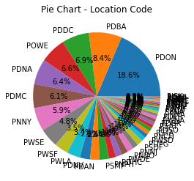
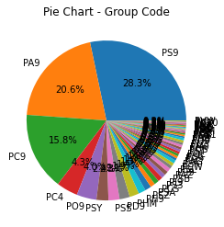
Preliminary Analysis (Location & Group Code)
Percentage of events held in each location
Percentage of events held for each group
PDON:
The number of events held on campus (DMV area), with 18.6% of the total events, are among the most
PS9:
The number of events held for Social-General types, with 28.3% of the total events, are among the most

Slide 8
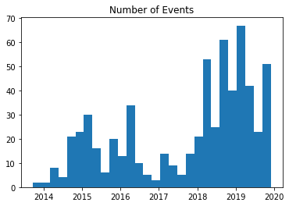
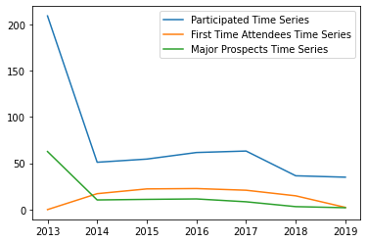
Preliminary Analysis (Time)
Number of events and participants over time
The average number of participants decrease by time, however, the number of events increase.
Namely, holding more events seems not to attract more participants. Consequently, holding more events does not really increase the first time attendees and major prospects.

Slide 9
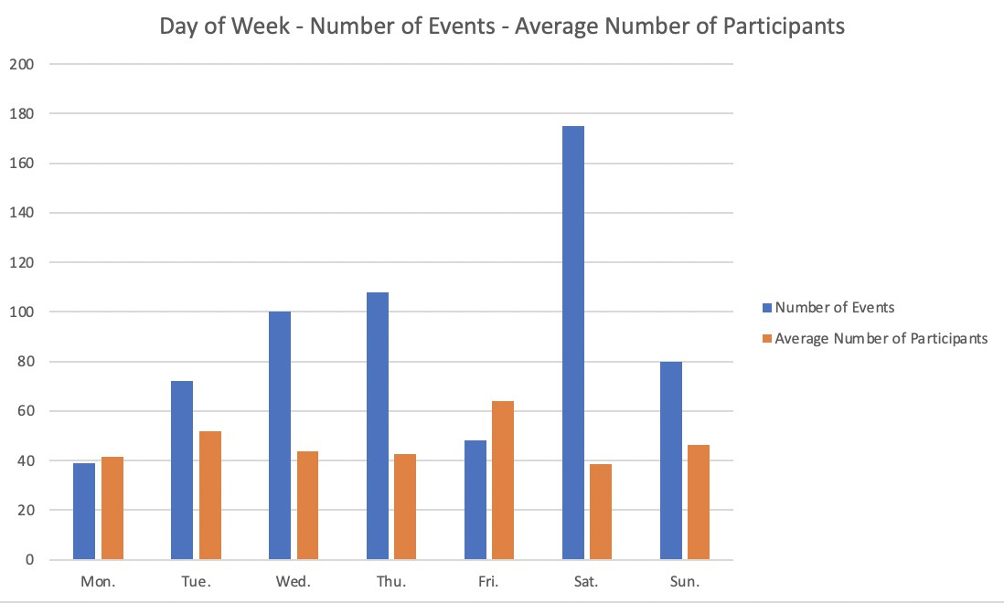
Preliminary Analysis (Time)
Number of participants over weekdays and weekends
Holding events during weekends does not intuitively attract more participants.
Holding events on Friday seems to attract more participants, whereas on Saturday might have lower participation rate.

Slide 10
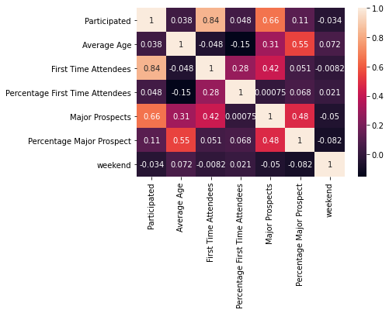
Preliminary Analysis
Heat Map: correlation of other variables to objectives
Strong Correlation:
Participated First Time Attendees
Participated Major Prospects
Holding events during weekend cannot effectively attract more first time attendees and major prospects.
The increase of age of participants seems to increase only the percentage of prospects.
Notes:
A more scientific way of interpreting the correlation analysis
High degree: If the coefficient value lies between ± 0.50 and ± 1, then it is said to be a strong correlation.
Moderate degree: If the value lies between ± 0.30 and ± 0.49, then it is said to be a medium correlation.
Low degree: When the value lies below + .29, then it is said to be a small correlation.
我覺得只需要考慮 Major prospects, percentage major prospects, first time attendees, percentage first time attendees 跟其他變數的correlation coefficient
例如: Participated - First time Attendees (0.84 - strong correlation) & Participated - Major Prospects (0.66 - strong correlation)
-> 如果想要吸引更多的first time attendees和major prospects, 可以傾向舉辦活動人數多的活動
For attracting more first time attendees and major prospects, one can hold the event that can accommodate more participants.
在Weekend舉辦活動無法有效的增加first time attendees和major prospects (Holding events during weekend cannot effectively attract more first time attendees and major prospects)
Age只有對Percentage Major Prospects有正向的影響 (The increase of age of participants seems to increase only the percentage of prospects) -> such insights are shown by more readable charts in the following slides

Slide 11
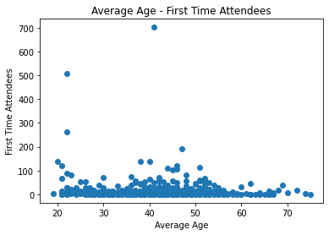
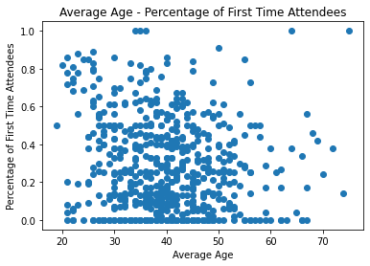
Analysis of Age on the First Time Attendees
The age of participants seems to not have conspicuous impacts on the number and percentage of first time attendees.

Slide 12
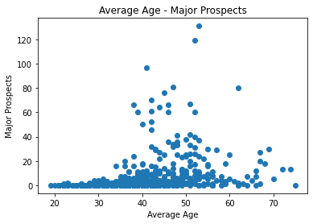
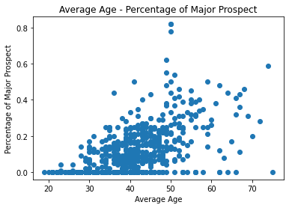
Analysis of Age on the Major Prospects
The age of participants seems to not have conspicuous impacts on the number of major prospects, yet there seems to have positive relationship between average age and percentage of major prospects (i.e., correlation coefficient = 0.55)

Slide 13
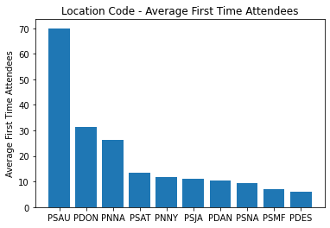
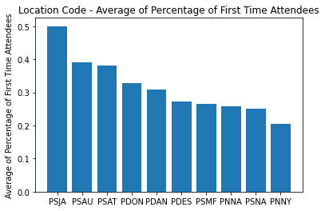
Analysis of Location on the First Time Attendees
PSAU (Southeast- Austin) contributes to the most number of the first time attendees than other locations.
PSJA(Southeast-Jacksonville) has the highest average of percentage of the first time attendee than other locations.
Conclusion:
Regardless the cost of holding an event, holding events at PSAU is possible to attract the most number of first time attendees. However, if to consider the cost, holding events at PSJA might have the highest ROI.

Slide 14
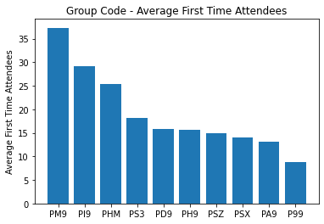
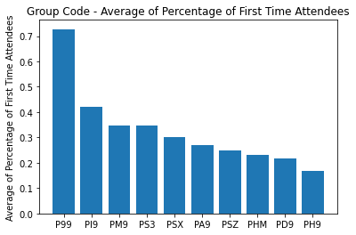
Analysis of Group Code on First Time Attendee
PSAU (Southeast- Austin) contributes to the most number of the first time attendees than other locations.
PSJA(Southeast-Jacksonville) has the highest average of percentage of the first time attendee than other locations.
Conclusion:
Regardless the cost of holding an event, holding events for Group PM9 is possible to attract the most number of first time attendees. However, if to consider the cost, holding events for Group P99 might have the highest ROI

Slide 15
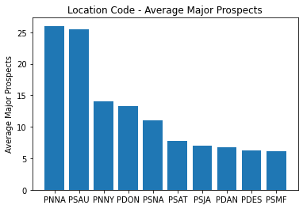
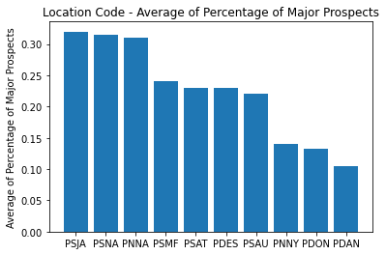
Analysis of Location on the Major Prospects
PNNA(Northeast-General) and PSAU(Southeast- Austin), contribute to the most number of the major prospects.
PSJA(Southeast-Jacksonville), PSNA(Southeast-General), and PNNA(Northeast-General) , have the highest average of percentage of major prospects.
Conclusion:
Regardless the cost of holding an event, holding events at Location PNNA is possible to attract the most number of major prospects. However, if to consider the cost, holding events at Location PSJA might have the highest ROI.

Slide 16
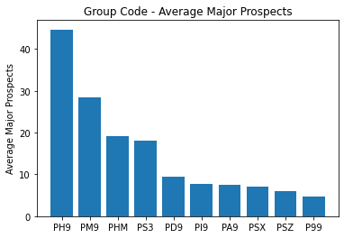
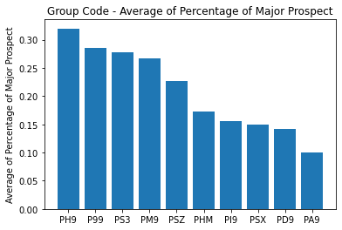
Analysis of Group Code on Major Prospects
PH9(CP Stewardship-General) contributes to the most number of the average major prospects.
PH9(CP Stewardship-General) has the highest average of percentage of major prospects.
Conclusion:
With and without considering the cost of holding an event, holding events for Group PH9 might have the highest ROI and is possibly to attract the most number of major prospects and.

Slide 17
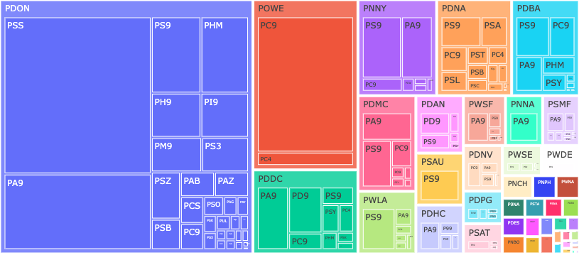
Integration of Locations and Groups -
First Time Attendees
Considering both locations and groups, the events held at Location PDON for Group PSS is possible to attract the most number of first time attendees

Slide 18
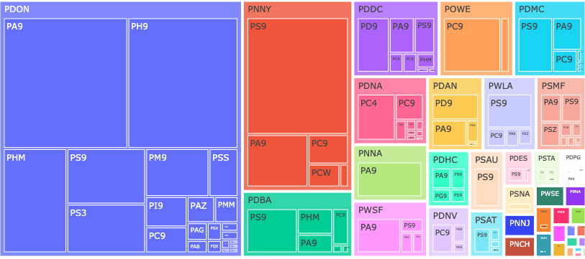
Integration of Locations and Groups -
Major Prospects
Considering both locations and groups, the events held at Location PDON for Group PA9 and Group PH9 is possible to attract the most number of major prospects.

Slide 19
Introduction
Method
Identify the Correlated Variables
(Time, Location, Group Code)
Recommendations
Future Work

Slide 20
Recommendations
what type of events attract the objective the most ?
Considering both locations and groups:
the social events held on campus (DMV area) for students are possible to attract the most
number of first time attendees.
Considering both locations and groups:
general events held on campus (DMV area) for Group athletics and stewardship are possible to attract the most number of major prospects

Slide 21
Recommendations
How can we improve current and future events?
Holding more events does not really increase the first time attendees and major prospects, thus UMD alumni association should focus more on targeting the type of events.
For attracting more first time attendees and major prospects, UMD alumni association can hold the event that can accommodate more participants.
Day of week of events does not really affect the number of first time attendees and the major prospects, thus UMD alumni association might not need to particularly hold events during weekends.
If to have higher percentage of major prospect, a possible strategy of UMD alumni association is to target on the participants with higher age.

Slide 22
Introduction
Method
Identify the Correlated Variables
(Time, Location, Group Code)
Recommendations
Future Work

Slide 23
Future Work
Clustering
Linear Regression

Slide 24

Thank you!

