Slide 1
Vectors and DataFrames

Slide 2



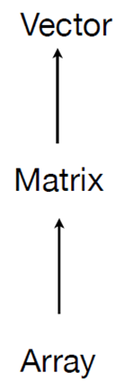



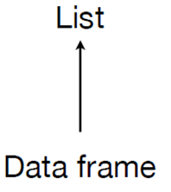
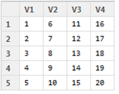
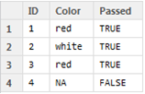

Data Structures
numeric vector
character vector
Dataframe:
d <- c(1,2,3,4)
e <- c("red", "white", "red", NA)
f <- c(TRUE,TRUE,TRUE,FALSE)
mydata <- data.frame(d,e,f)
names(mydata) <- c("ID","Color","Passed")
List:
w <- list(name="Fred", age=5.3)
Numeric Vector: a <- c(1,2,5.3,6,-2,4)
Character Vector: b <- c("one","two","three")
Matrix: y<-matrix(1:20, nrow=5,ncol=4)
Framework Source: Hadley Wickham

Slide 3
Variable Types
Numeric: e.g. heights
String: e.g. names
Dates: “12-03-2013
Factor: e.g. gender
Boolean: TRUE, FALSE

Slide 4
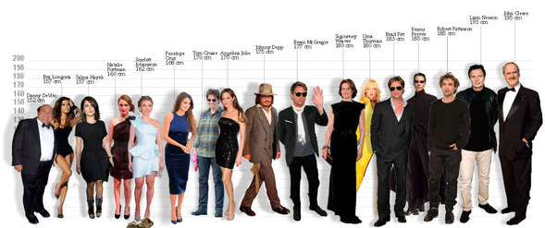
Actor Heights
Create Vectors of Actor Attributes
Names, Heights, Date of Birth, Gender
2) Combine the 4 Vectors into a DataFrame

Slide 5
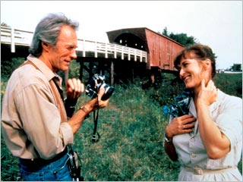
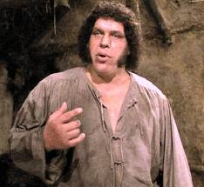

Creating a Character / String Vector
Create a variable (aka object) called ActorNames:
  Actors <- c("John", "Meryl", "Andre")

Slide 6
Class, Length, Index
class(Actors)
length(Actors)
Actors[2]

Slide 7
Creating a Numeric Vector / Variable
Create a variable called h (inches):
  h <- c(77, 66, 90)
Using just one letter for the name to make this quicker to enter.

Slide 8
Creating a Date Variable
Create a Character Vector
  DOB <- c("1930-10-27", "1949-06-22", "1946-05-19" )
Use the as.Date() function:
  DOB <-as.Date(DOB)
Each date has been entered as a text string (in quotations) in the appropriate format (yyyy-mm-dd).
By enclosing these data in the as.Date() function, these strings are converted to date objects.

Slide 9
Creating a Categorical / Factor Variable
Create a character vector:
  g <- c("m", "f", "m")
  class(g)
Use the factor() function to convert to a categorical:
  g <- factor(g)
Notes:
https://www.stat.berkeley.edu/classes/s133/factors.html

Slide 10
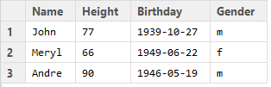
Create a DataFrame from Vectors
Actors.DF <- data.frame(Name=Actor, Height=h, Birthday = DOB, Gender=g)
dim(Actors.DF)
Actors.DF$Name

Slide 11

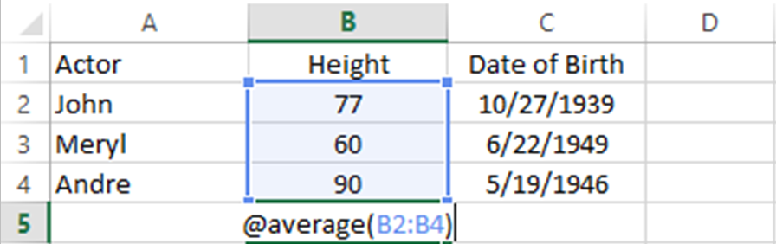
Rows and Columns

Slide 12

Array of Rows and Columns
1
2
3
4
Actors.DF[1,]
Actors.DF[,2]
Actors.DF[3,3]
Actors.DF[2:3,]
row 1
column 2
row 3,
column 3
rows 2,3,
all columns
mean(Actors.DF[,2])

Slide 13
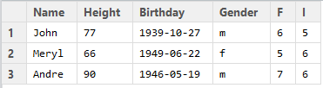
Add New Variable: Height -> Feet, Inches
Actors.DF$F <- floor(Actor.DF$Height/12)
Actors.DF$I <- Actor.DF$Height - (Actor.DF$ *12)

Slide 14
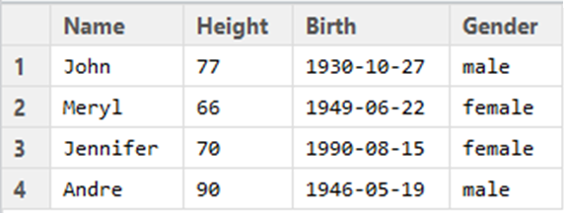
Sort
Actors.DF[with(Actors.DF, order(-Height)), ]

Slide 15
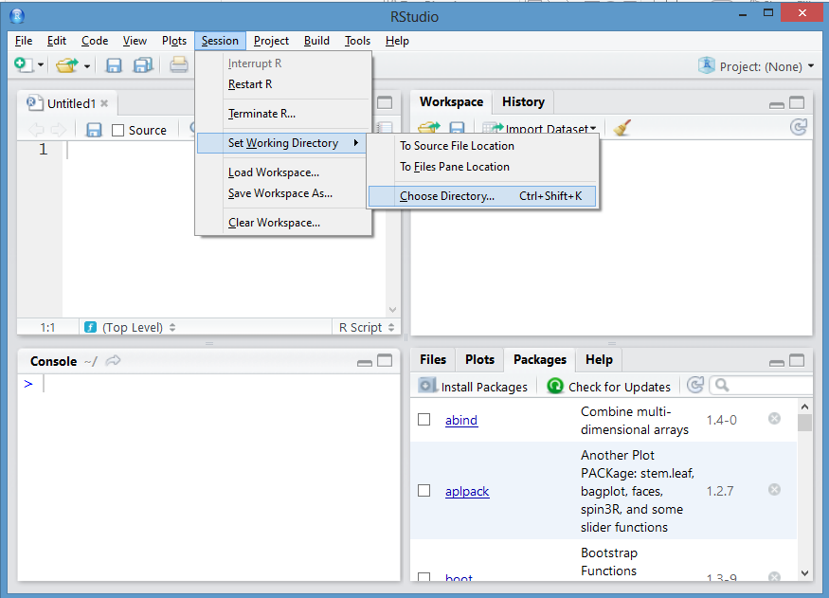
getwd() setwd()
> getwd()
[1] "C:/Users/johnp_000/Documents"
> setwd()

Slide 16
Write / Create a File
write.table(Actors.DF, "ActorData.txt", sep="\t", row.names = TRUE)
write.csv(Actors.DF, "ActorData.csv")

