Slide 1
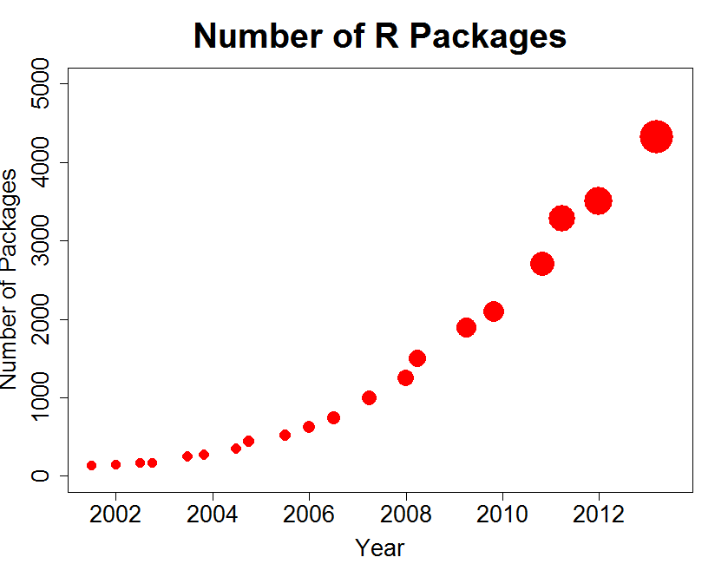

Currently, how many R Packages?
At the command line enter:
dim(available.packages())
available.packages()
Notes:
5495 on 6/4/2014

Slide 2
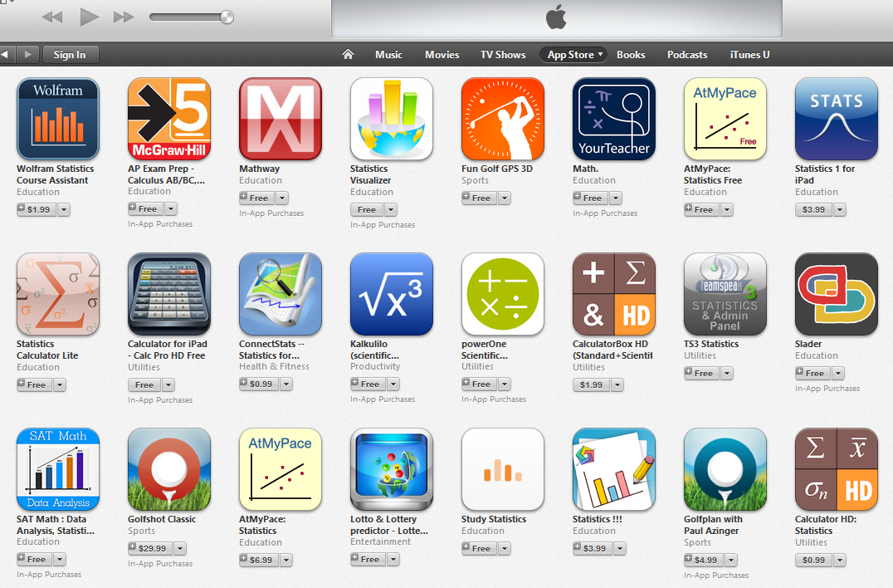
Is there an R App Store?

Slide 3
Library Categories
Data Input / Output
Data Management (plyr, reshape)
Mathematics and Statistics
Graphics (ggplot2)
Subject Matter Specific

Slide 4















Packages for reading, writing for various file formats
XLConnect
Comma Separated Variables
sas7bdat
Hmisc
foreign
RMySQL
XML
RODBC / ROracle
RJSONIO
RWeka
rhbase
Rcpp

Slide 5
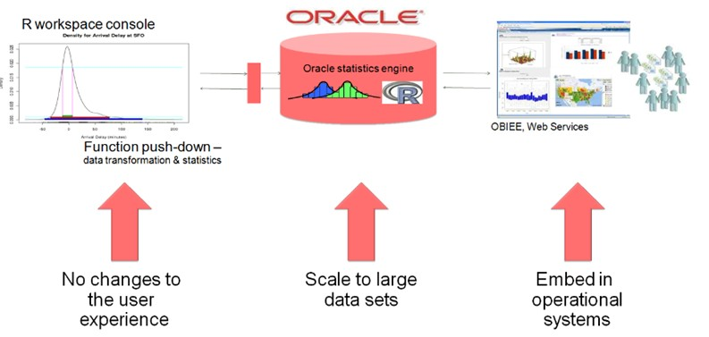



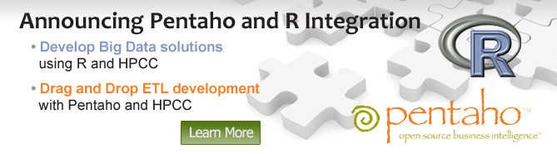
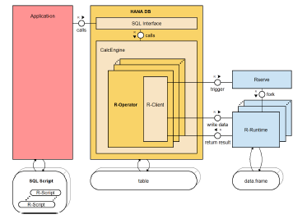

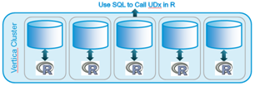



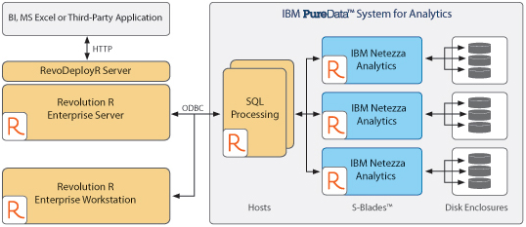
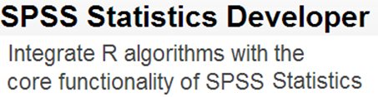
R Being Integrated Into Other Data-Related Products
“Both R and SAS are here to stay, and finding ways to make them work better with each other is in the best interests of our customers.”`
Oracle R Enterprise (ORE)
http://support.sas.com/rnd/app/studio/Rinterface2.html
https://blogs.oracle.com/R/
http://help.sap.com/hana/hana_dev_r_emb_en.pdf
http://www-142.ibm.com/software/products/us/en/spss-stats-developer/

Slide 6

Industries / Organizations Using and Creating R
Industry | Pct.
Research | 24%
Higher Education | 7%
Information Technology | 9%
Computer Software | 7%
Financial Services | 6%
Banking | 2%
Pharmaceuticals | 4%
Biotechnology | 4%
Market Research | 3%
Management Consulting | 3%
Total | 69%

Slide 7
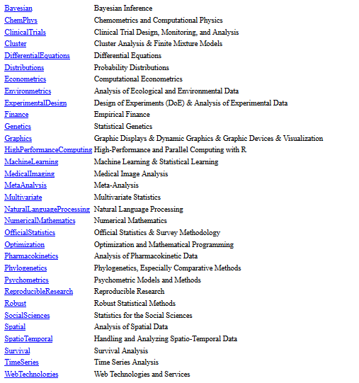
Task Views
Task Views

Slide 8
R “Machine Learning” Libraries
Analytic Technique | R Package/Library | Author | Organization
Support Vector Mach. | libsvm (ksvm) | Chih-Chung Chang Chih-Jen Lin | National Taiwan Univ. + EBay Research Labs
Neural Networks | neuralnet | Frauke Gunther Stefan Fritsch | Epidemiology and Prevention Research
 | nnet | Brian Ripley | University of Oxford
 | monmlp | Alex J. Cannon | Atmospheric Science
Randomized Forests | randomForest | Fortran original by Leo Breiman & Adele Cutler, R port by Andy Liaw and Matthew Wiener. | Merck
Decision Trees | rpart | Terry M Therneau and Beth Atkinson. R port by Brian Ripley. | Mayo Clinic University of Oxford
Boosting Model | Ada | Mark Culp | West Virginia University
Maximum Entropy | maxent | Yoshimasha Tsuruoka Timothy Jurka | University of Tokyo UC-Davis
Bagging, bootstrap | adabag | Esteban Alfaro-Cortes | La Universidad de Castilla-La Mancha
Latent Diralect | slda | Jonathan Chang | Facebook
Naïve Bayes | e1071 | David Meyer Evgenia Dimitriadout | Vienna University
Bayesian Network | bnlearn | Marco Scutari. | UCL Genetics Institute
Hidden Markov | hiddenmarkov | David Harte | Statistics Research

Slide 9
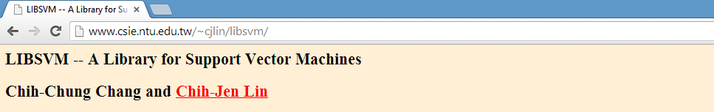
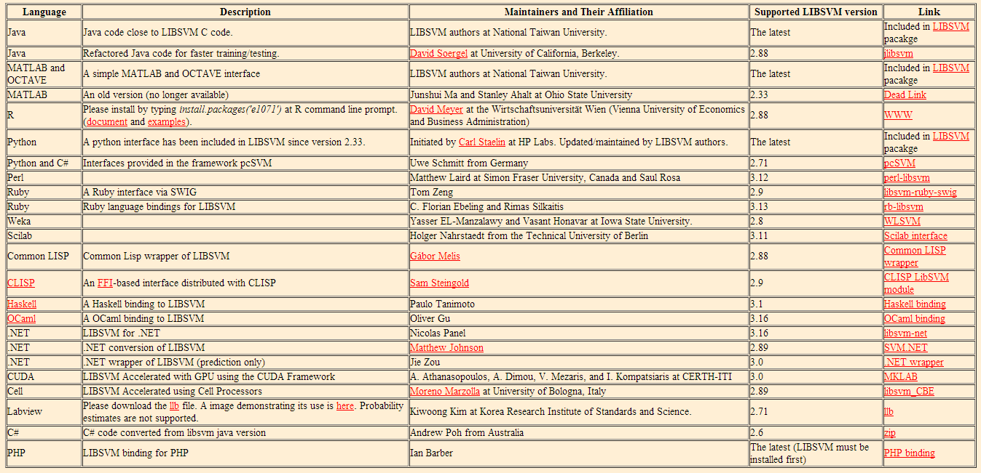
Notes:
http://www.csie.ntu.edu.tw/~cjlin/libsvm/

Slide 10
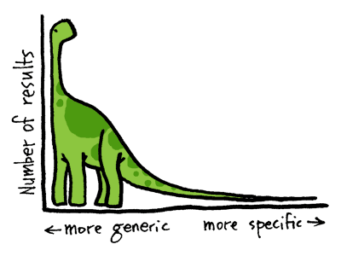
Beginner
Built-In
Some Coverage
Packages
Specialized
“Domain”
stats
graphics
Graphics
ggplot2
car
Bayesian
DifferentialEquations
Econometrics
Environmetrics
ExperimentalDesign
Finance
Genetics
HighPerformanceComputing
MachineLearning
MedicalImaging
NaturalLanguageProcessing
Pharmacokinetics
Phylogenetics
Psychometrics
SocialSciences
Spatial
TimeSeries

