Slide 1
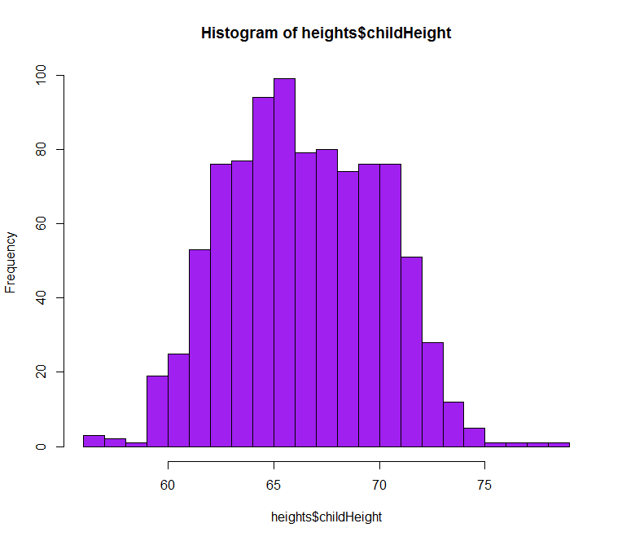

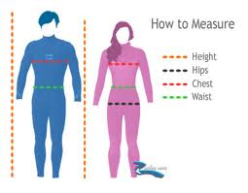
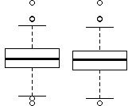
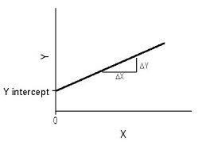

Variable
Type
Steps
Y
Child’s Height
Continuous
Histogram
X1, X2
Dad’s Height
Scatter
Continuous
Mom’s Height
X3
Gender
Categorical
Boxplot
Linear
Regression

Slide 2
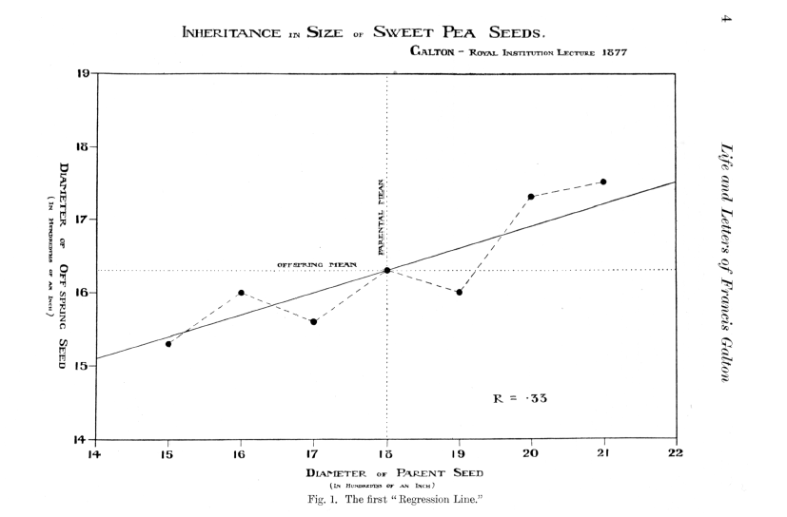

Analytics & History: 1st Regression Line
The first “Regression Line”
Notes:
http://galton.org/cgi-bin/searchImages/search/pearson/vol3a/pages/vol3a_0019.htm

Slide 3
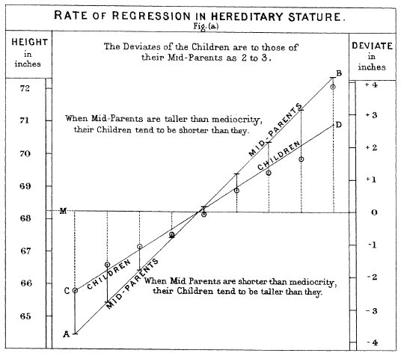

Slide 4
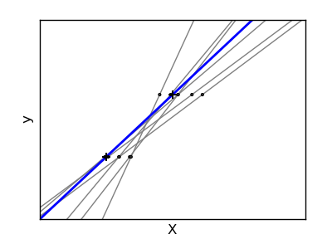
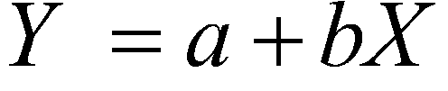
Which line fits the best?

Slide 5
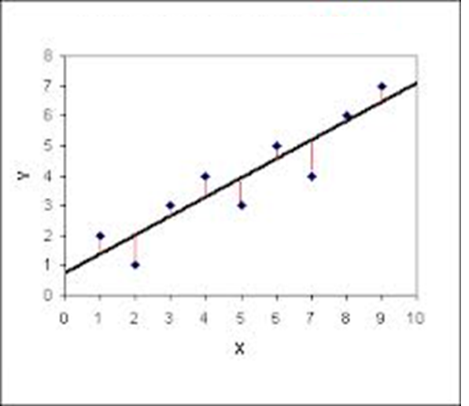
Least Squares Regression
Sum of Squares

Slide 6
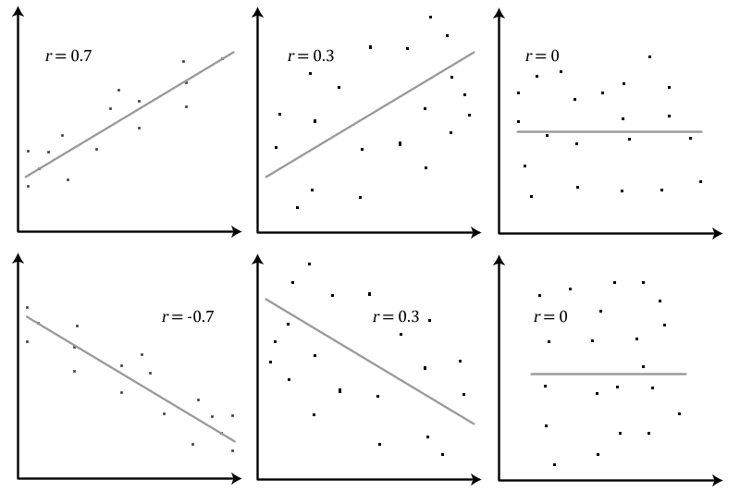

Slide 7
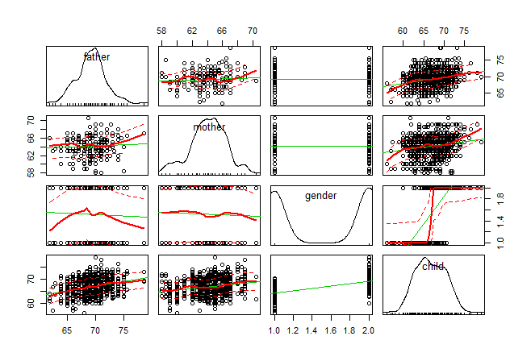
Correlations Matrix
library(car) scatterplotMatrix(heights)
0.267
0.201
0.716

Slide 8
Linear Modeling: Regression
lm() function – lm stands for ‘linear model’.
Model <-lm(outcome ~ predictor(s), data = dataFrame, na.action = an action))

Slide 9
Compare Models
 | 1 | 2 | 3 | 4 | 5
Father | X |  | X |  | X
Mom |  | X | X |  | X
Gender |  |  |  | X | X
R-square
r | 0.27 | 0.2 |  | 0.716
R^2 | 0.0707 | 0.0405 |  | 0.514
model.1 <- lm(childHeight~father, data = h)
model.2 <- lm(childHeight~mother, data = h)
model.3 <- lm(childHeight~father + mother, data = data =h)
model.4 <- lm(childHeight~gender, data = h)
model.5 <- lm(childHeight~father + mother + gender, data = h)

Slide 10
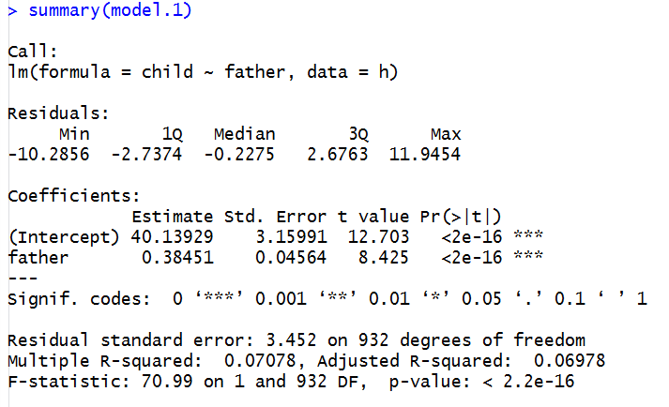
Model 1

Slide 11
Compare Models
 | 1 | 2 | 3 | 4 | 5
Father | X |  | X |  | X
Mom |  | X | X |  | X
Gender |  |  |  | X | X
R-square
r | 0.27 | 0.2 |  | 0.716
R^2 | 0.0707 | 0.0405 | 0.105 | 0.514 | 0.6354
summary(model.1)
summary(model.2)
summary(model.3)
summary(model.4)
summary(model.5)

Slide 12
Model Specification
Height = 16.5 + 0.39*father + 0.21mother + 5.21Gender + error
Gender:
Male: 1
Female: 0

