Slide 1

BEADS
Give your AI agent a memory
Notes:
[0:00 to 0:30] Hi everyone. Today I want to show you Beads. It's a small open source tool that fixes a big problem with AI coding agents: they forget things. I'll show you the problem, how Beads works, how Claude Code uses it, other tools like it, and the good and the bad parts. (~30s)

Slide 2





AI agents forget things
The plan is gone
Notes get messy
Bugs get lost
They need a place to write things down.
Notes:
[0:30 to 1:35] The agent works well for a while. Then the chat gets too long, or you start a new one, and the plan is gone. Every morning, you explain everything again.
The usual fix is a markdown file with the plan. That works for a day or two. After a week, you have PLAN.md, TODO.md, PROGRESS.md, and nobody knows which one is right.
And the worst part: the agent finds a bug while fixing something else. It says it once, and then it's lost.
So the problem is not that the agent is not smart. The problem is that it has no good place to write things down. (~65s)

Slide 3





What is Beads?
A to-do list for AI agents, inside your repo.
By Steve Yegge, 2025
Free, open source
Command line
Lives in your repo
Made for agents
28k+ GitHub stars
Notes:
[1:35 to 2:45] So, what is Beads? It's a to-do list made for AI agents, not for people. It's a command line tool called bd. It saves your tasks, and also what each task is waiting for. And it all lives inside your project, next to your code.
Three things make it different. It's a command line tool that can answer in JSON, so it's easy for an agent to use. It lives in your repo, so it's saved with your code. And it was made for agents from day one.
Quick facts: Steve Yegge created it in October 2025. It's free and open source, with more than twenty-eight thousand stars on GitHub. The latest version is 1.3.2, from this month. (~70s)

Slide 4





Tasks connected like beads
Short ID
shop-s05
OAuth login
Big task, small tasks
shop-s05.1
Token endpoint
shop-s05.2
Login UI
shop-s05.3
E2E tests
Priority P0 to P4
done
shop-xbg
Bug found
Links between tasks
in progress
waiting
Notes:
[2:45 to 3:55] Each task is called a bead. And like beads on a string, they are connected.
Every task gets a short ID, like shop-s05. It starts with your project name, and the rest is random.
Each task has a priority, from P0, urgent, to P4, someday. And a status: open, in progress, blocked or done.
Look at the picture. The token endpoint is done. The login UI is in progress. The tests are waiting for the UI. Because Beads knows what waits for what, it can tell the agent what it can do right now.
And the red one: while working, the agent found a bug. It saved it as a new task, linked to where it was found. No more lost bugs. (~70s)

Slide 5








How the agent works
1. Catch up
2. Pick
3. Claim
4. Write down
5. Finish
bd prime
bd ready
bd update --claim
bd create
bd close
The agent updates the list. Not you.
Notes:
[3:55 to 5:05] How does the agent use it? The same five steps, every time.
One, catch up. A new chat starts and the agent runs bd prime. This prints the rules and saved notes.
Two, pick. The agent runs bd ready. It shows only tasks that are not waiting for anything. The agent just asks: "what can I do now?"
Three, claim. bd update --claim says "this one is mine".
Four, write down. If it finds something new, it creates a new task.
Five, finish. It closes the task, and the tasks that were waiting are free to start.
The big idea: you don't update the list. The agent does. Tomorrow, in a new chat, it asks "what's next?" and keeps going. (~70s)

Slide 6








Agents build it, Beads keeps track
SPEC.md
Coordinator plans in Beads
Agents build
Reviewer checks
Closed, bugs saved
Claude Code
Coordinator: owns the list
Agents: only write code
Notes:
[5:05 to 5:50] Now let's go one step further: agents. The main Claude session is the coordinator. It reads the spec, plans the small tasks in Beads, and gives each ready task to an implementer agent. A reviewer agent checks the work. The task is closed only when the reviewer approves. Small problems the reviewer finds become new bugs in Beads. And on a dashboard, you see everything as it happens. Let me show you, live. (~45s)

Slide 7



Live demo
> /coordinate Build everything in SPEC.md.
Claude plans
Agents build
Watch the dashboard
Notes:
[5:50 to 9:50] [Start] Here is the spec: a small Java shop with three features. A catalog, discount codes, and a cart. On the right, the dashboard. It's called Bead Me Up, Scotty, a free community tool. It's empty. In Claude Code, I type one line: coordinate, build everything in the spec.
[While it plans] Claude reads the spec and plans. Look at the board: three tasks. The cart is blocked, because it needs the catalog and the discounts.
[While the agents build] Now two implementer agents work at the same time: one on the catalog, one on the discounts. Their cards are In Progress. Each agent writes the code and the tests. I'm not typing anything.
Now the reviewer checks each task. It runs the tests and compares the code with the spec. Only when it says "approved", the coordinator closes the task. Look, the cards move to Done. And now the cart is ready, so a new agent starts on it.
[While you wait] If the reviewer finds a small problem outside the task, the coordinator saves it as a bug. Watch: new cards appear in Ready.
[At the end] Now the Activity view: everything the agents did, newest first. Created, closed, new bugs. And the Graph shows how the tasks and the bugs are connected. All tests passed, and nothing was committed. I still review the code. (~240s)

Slide 8

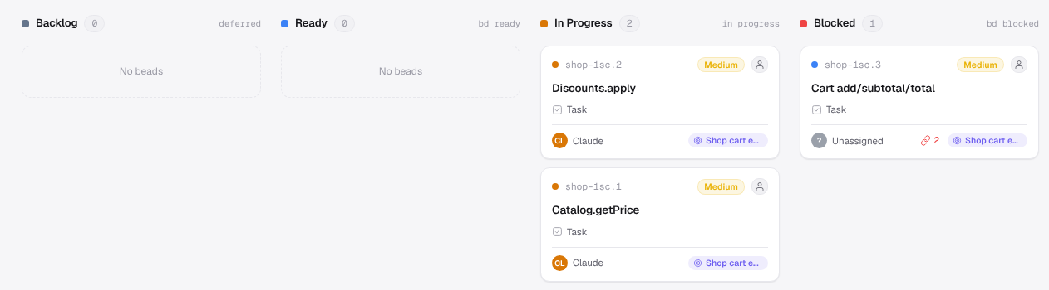
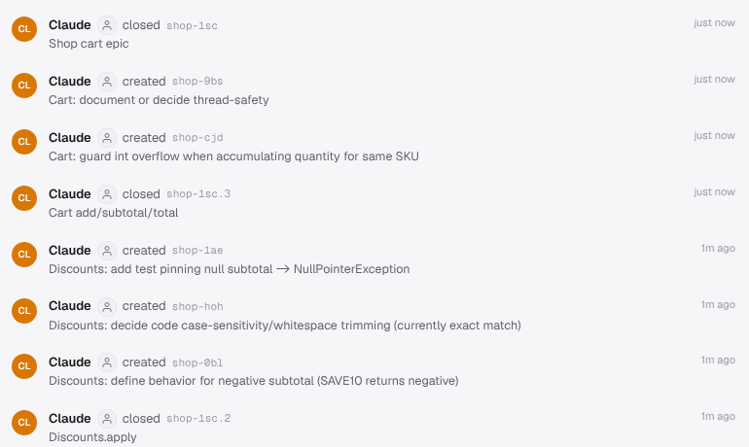



The dashboard: what the agents did
Board: agents working, the cart is blocked
Updates live
Activity feed
Community tool
Activity: who did what, and when
Bead Me Up, Scotty
Notes:
[9:50 to 10:15] So that's the dashboard. The board shows where each task is. The activity feed shows who did what, and when. It updates live, while the agents work. It's a community tool, not part of Beads, but it reads the same data. (~25s)

Slide 9




Under the hood
your-repo/
├── .beads/
│ ├── embeddeddolt/ the database
│ ├── config.yaml settings
│ ├── metadata.json which backend
│ └── hooks/ git hooks
├── CLAUDE.md rules for
├── AGENTS.md the agents
└── src/ ...
Dolt database
SQL tables with Git-style history: issues, links, comments, every change.
Not in your commits
embeddeddolt/ is git-ignored. bd dolt push sends it to your Git remote (refs/dolt/data).
JSONL export
bd export: one issue per line, as JSON. Easy to read or move.
Notes:
[10:15 to 11:30] Now, under the hood. Beads keeps everything in the .beads folder. The database is Dolt. Dolt is a SQL database that works like Git: every change is a commit, so you have the full history of every task. It stores the issues, the links between them, the comments, and every change.
One important detail: the database itself is not in your Git commits. The embeddeddolt folder is git-ignored. To share it, you run bd dolt push, and it goes to your normal Git remote, in a special branch called refs/dolt/data. And if you want plain files, bd export gives you JSONL: one issue per line, as JSON.
Next to it, bd init adds a few files for the agents: CLAUDE.md, AGENTS.md, and some hooks. That's how Claude knows how to use it. (~75s)

Slide 10



Setting it up
$ npm i -g @beads/bd
$ bd init # also sets up Claude Code, Codex, Cursor
$ scotty # dashboard: Bead Me Up, Scotty (community tool)
With your team
Someone else's repo
Just for you
Notes:
[11:30 to 12:05] Setting it up is quick. Install bd with npm or brew, and run bd init. It also sets up Claude Code, Codex and Cursor. For the dashboard, install Bead Me Up, Scotty, and run it in your project. You can use Beads with your team, on someone else's project, or just for you. (~35s)

Slide 11
Other tools like Beads
 | Beads | Claude Code Tasks | Backlog.md | Taskmaster
Lives in | Your repo | ~/.claude | Your repo | Your repo
Works with | Any agent | Claude Code | Any agent | Any agent
Best for | Long work, many agents | Quick work in Claude | Plain files + board | Spec to tasks
Notes:
[12:05 to 12:55] Beads is not the only tool like this. Claude Code Tasks is built into Claude Code. It came after Beads, with a similar idea. Nothing to install, but it lives outside your repo and only works with Claude Code. Backlog.md saves each task as a markdown file and has a board built in. Taskmaster is great for turning a spec into tasks.
Simple rule: only Claude Code? Tasks. Plain files and a board? Backlog.md. Long work, many agents? That's where Beads is strongest. (~50s)

Slide 12


Pros & cons
Pros
Cons
Remembers between chats
One more tool to learn
Always knows what's next
Changes a lot
Bugs don't get lost
Agent must use it
Works with any agent
Not for managers
Notes:
[12:55 to 14:10] Let's be fair and look at both sides.
The good parts. It remembers between chats. The agent always knows what's next. Nothing gets forgotten: new bugs become tasks. And it works with any agent, from your repo.
The bad parts. It's one more tool: you need to learn a bit of Dolt, especially sync and upgrades. It changes a lot: new versions every few weeks, and this year two versions were released by mistake. So pick a version. And the agent has to actually use it. And it's not for managers: no reports or roadmaps. It works next to Jira, not instead of it.
My opinion: for long work, over many days and many chats, it's really worth it. For small, quick tasks, it's too much. (~75s)

Slide 13


What to remember
Agents need memory outside the chat
Beads: tasks + links, in your repo
Try it: bd init, then "what's ready?"
Questions?
github.com/gastownhall/beads
Notes:
[14:10 to 14:35] Three things to remember. One: AI agents need a memory outside the chat. Two: Beads is a to-do list with links, inside your repo. Three: it's easy to try. Run bd init, and ask your agent: "what's ready?"
Thank you! Any questions? (~25s)

Slide 14

BACKUP
Let's see it
$ bd create "OAuth login" -t epic
$ bd create "Token endpoint" --parent shop-s05
$ bd create "Login UI" --parent shop-s05 --deps shop-s05.1
$ bd ready
shop-s05.1 Token endpoint
$ bd close shop-s05.1
$ bd ready
shop-s05.2 Login UI ← ready now
Notes:
[BACKUP if the demo fails] Here are the commands. I create a big task and two small tasks inside it. The login UI uses --deps, so it waits for the endpoint.
bd ready shows only the endpoint. The agent claims it, finishes it, and closes it. Now the login UI is ready.
But the good news: you don't need to learn any of this.

Slide 15


BACKUP
You don't need the commands
"Split OAuth login into tasks."
3 tasks, in the right order
"Endpoint done. Found a bug, fix later."
Task closed, bug saved
New chat: "What's next?"
"Build the login UI."
Claude runs bd for you. You just talk.
Notes:
[BACKUP if the demo fails] I tested this with Claude Code. I never typed a bd command. I just talked to it in plain English.
First prompt: "Add OAuth login. Split it into tasks. The UI needs the endpoint, and the tests need the UI." Claude created three tasks, with the right links between them.
Second prompt: "I finished the endpoint. I found a race condition, we fix it later." Claude closed the task, created a bug, and linked it to where it was found.
Third prompt, in a brand new chat, like the next morning: "What's the state of the OAuth work? What's next?" Claude asked Beads and said: build the login UI next, and don't forget the race condition.
How does it know? When you run bd init, it adds a few lines to CLAUDE.md and a Beads skill. So Claude already knows how to use it. You just talk.

Slide 16

BACKUP
What bd init adds to your repo
.beads/
config.yaml, metadata.json, README.md, .gitignore, hooks/ (5 git hooks)
.beads/embeddeddolt/
the Dolt database (git-ignored, synced with bd dolt push)
CLAUDE.md, AGENTS.md
rules for the agents: use bd, run bd prime
.claude/settings.json
Claude Code hook: runs bd prime when a session starts
.agents/skills/beads/
a Beads skill the agent can load
.codex/, .cursor/
the same setup for Codex and Cursor
Notes:
[BACKUP for questions] If someone asks what bd init changes in the repo: it adds the .beads folder with the settings, the git hooks and the database. The database is git-ignored. It adds CLAUDE.md and AGENTS.md with the rules for the agents, a Claude Code hook that runs bd prime when a session starts, a Beads skill, and the same setup for Codex and Cursor. Nothing else in your code changes.

