Slide 1


Apache Pekko
Actor Architecture

Slide 2
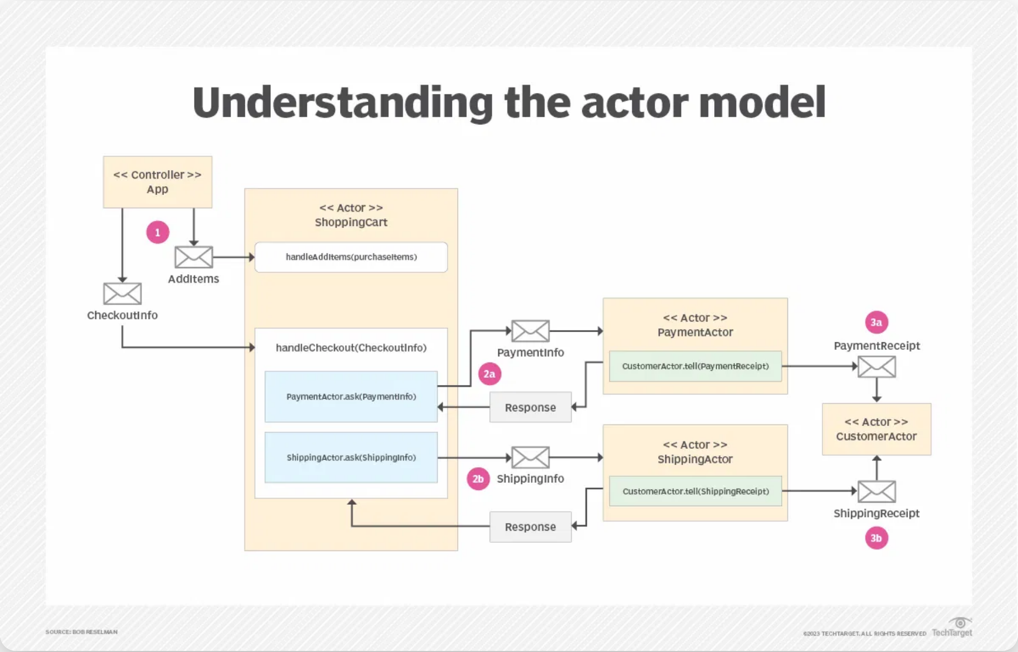

The Actor Model
A mathematical model of concurrent computation that treats actors as the universal primitives of computation.
Created by Carl Hewitt, Peter Bishop, and Richard Steiger in 1973
Actors communicate exclusively through asynchronous message passing
Each actor maintains its own private state, isolated from other actors

Slide 3




Apache Pekko Overview
An open-source framework for building concurrent, distributed, and resilient message-driven applications.
Fork of Akka 2.6.2, released in September 2022
Member project of the Apache Software Foundation
Licensed under Apache v2 license

Slide 4







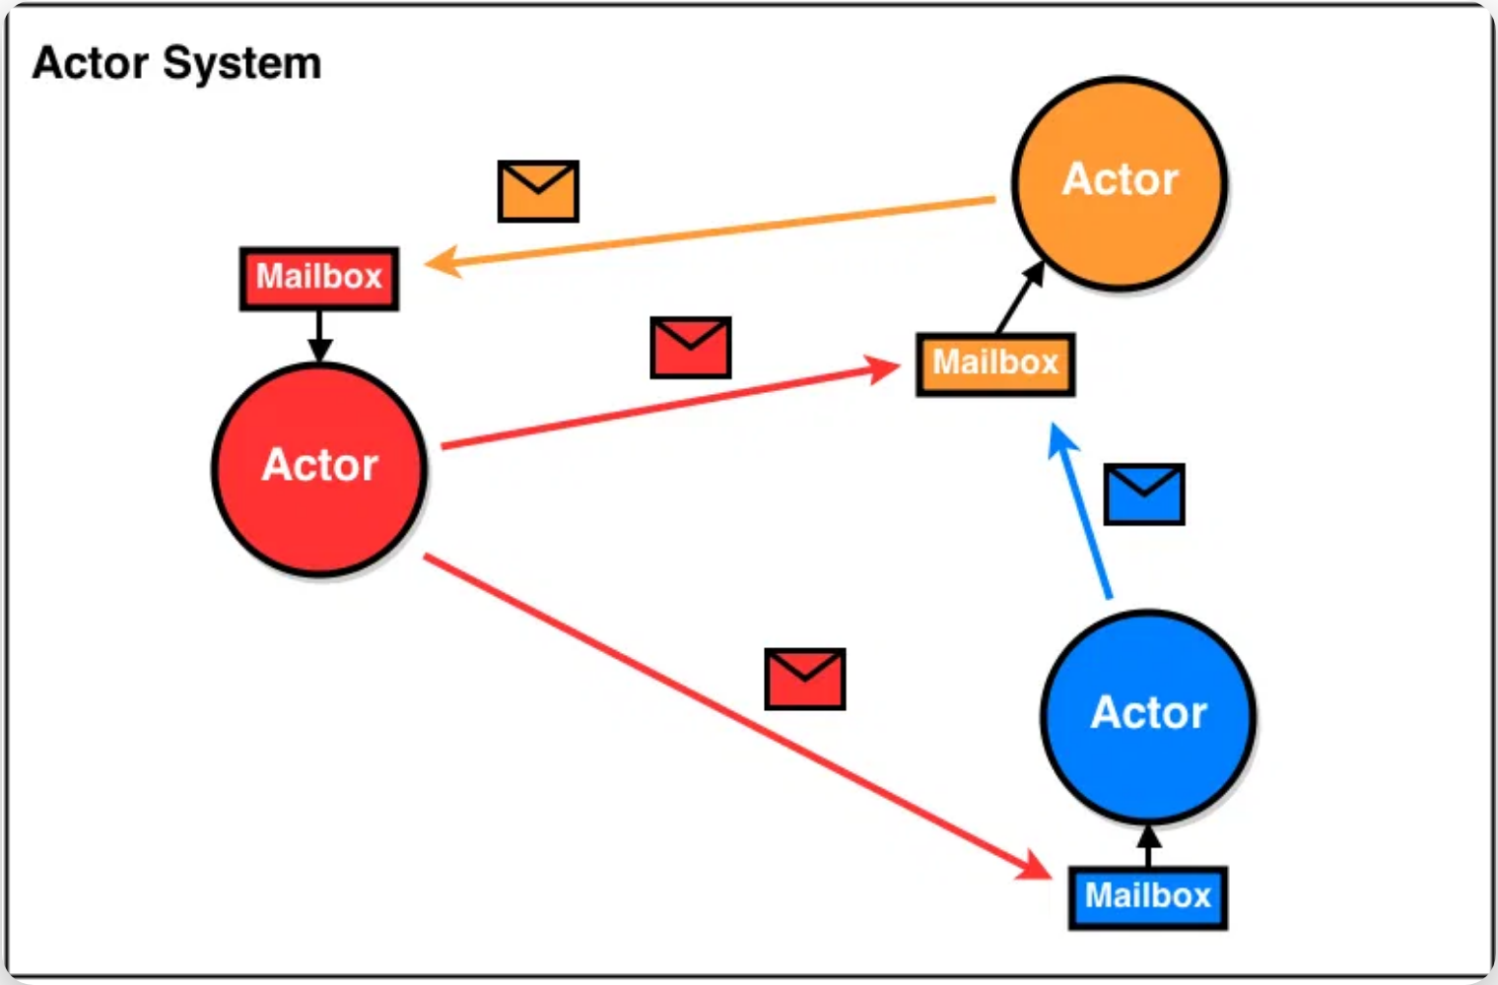

Pekko Actor Architecture & Features
Core Architecture
Advanced Features
Actors are the fundamental building blocks of Pekko's concurrency model.
Pekko provides powerful features for building distributed systems.
ActorSystem:
Hosts multiple actors and manages their
Clustering:
Allows actors to communicate transparently across
lifecycle
multiple nodes
ActorRef:
Reference to an actor, used for sending messages
Supervision:
Hierarchical structure that isolates and recovers
from failures
Mailbox:
Each actor has a mailbox that queues incoming
messages
Event Sourcing:
Support for event-based persistence and CQRS
patterns
Message Patterns:
Support for request-response, pub-sub,
and other patterns

Slide 5




Pekko vs Erlang OTP: Code Comparison
Apache Pekko
Erlang OTP
object HelloWorld {
final case class Greet(whom: String,
replyTo: ActorRef[Greeted])
final case class Greeted(whom: String,
from: ActorRef[Greet])
def apply(): Behavior[Greet] =
Behaviors.receive { (context, message) =>
context.log.info("Hello {}!", message.whom)
message.replyTo ! Greeted(message.whom, context.self)
Behaviors.same
}
}
-module(ch3).
-behaviour(gen_server).
-export([start_link/0, alloc/0, free/1]).
-export([init/1, handle_call/3, handle_cast/2]).
start_link() ->
gen_server:start_link({local, ch3}, ch3, [], []).
alloc() ->
gen_server:call(ch3, alloc).
free(Ch) ->
gen_server:cast(ch3, {free, Ch}).
Key Differences
Type System:
Pekko has strong
Syntax:
Pekko uses ! operator, Erlang
Runtime:
Pekko runs on JVM, Erlang
typing, Erlang is dynamically typed
uses call/cast functions
on BEAM virtual machine

Slide 6


Key Takeaways
Apache Pekko provides a robust implementation of the Actor Model for building concurrent, distributed systems
Pekko's Actor architecture offers state isolation, asynchronous communication, and supervision hierarchy
Pekko offers strong type safety and JVM integration, facilitating the development of resilient systems
Apache Pekko: Building resilient, message-driven applications

