Slide 1
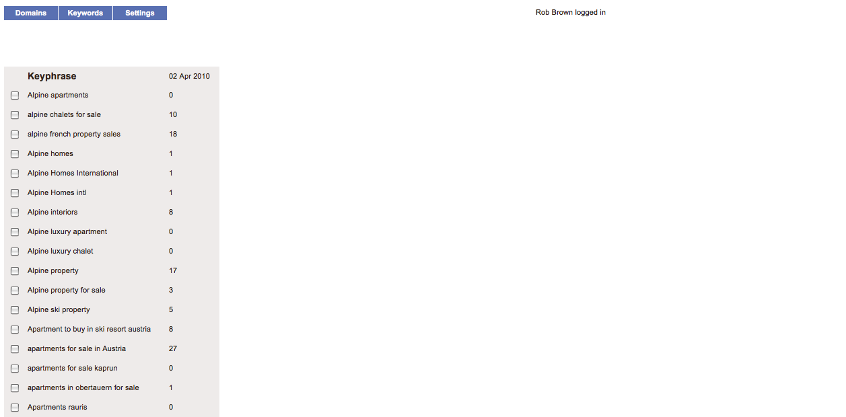
Rankings for ‘Alpine apartments’ on 02 Apr 2010
Ranking | URL
1 | http://www.holidaylettings.co.uk/zell-am-see/
2 | http://www.ownersdirect.co.uk/zell-am-see.htm
3
4
5
6
7

Slide 2
35%
Pause /
Restart
Stop

