Slide 1
AI Copilot for Smarter Insurance Support
Created by FNU Raja Bhaiya
Access URL : https://huggingface.co/spaces/niranjan9795/PolicyChatBot

Slide 2
AI Copilot for Smarter Insurance Support
Policy & Claims Copilot
Grounded AI assistant for policy understanding and claim readiness.
Use Case
Customer support automation and claim pre‑check guidance.

Slide 3
Policy Understanding Challenges Delay Claims
Coverage Confusion
Customers struggle to interpret what is covered or excluded.
Waiting Period Complexity
Policy limits and timelines are difficult to understand.
Document Preparation Gaps
Incorrect documentation leads to submission delays.
Lack of Instant Guidance
Customers depend heavily on call centers for clarity.

Slide 4
AI Copilot Converts Policy PDFs into Actionable Insights
LLM + RAG Architecture
Combines reasoning with real policy clause retrieval.
Policy Knowledge Extraction
Reads and understands policy PDFs automatically.
Grounded Answers
Ensures responses are factual and clause‑backed.
Claim Pre‑check
Evaluates eligibility before claim submission.

Slide 5
RAG Enables Trustworthy Insurance Intelligence
Hallucination Reduction
Prevents incorrect policy interpretation by standalone LLM.
Clause Retrieval
Fetches real policy content during query processing.
Consistency
Ensures factual and repeatable answers.
Transparency
Provides page‑level source citations.

Slide 6
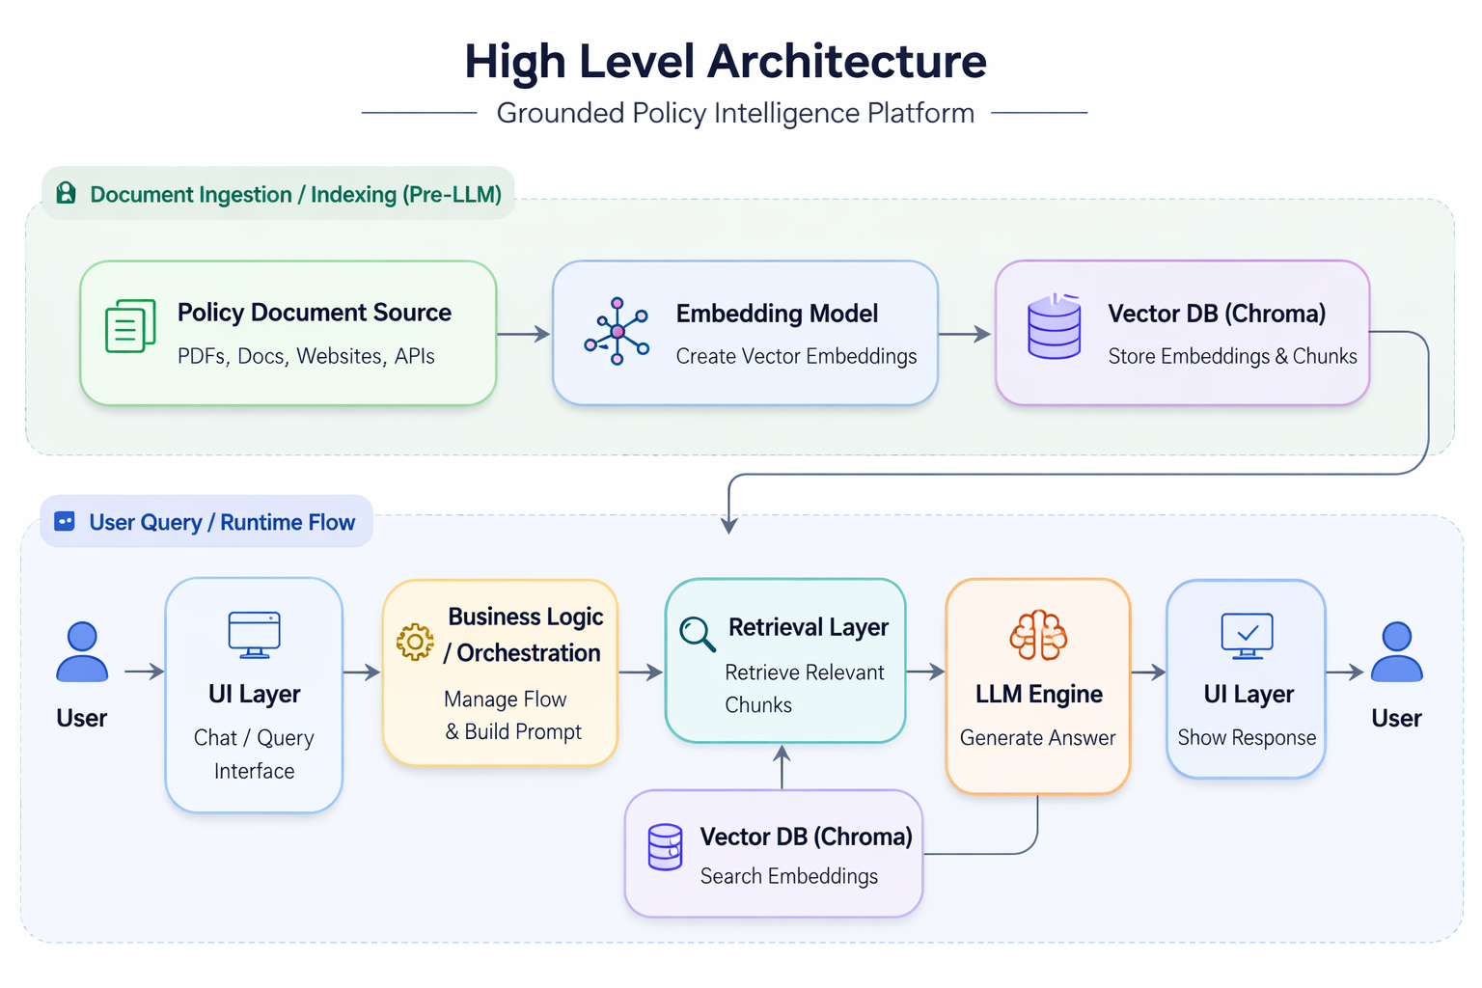

Slide 7
Technology Stack Enabling the Copilot
Orchestration
LangChain manages retrieval and prompt workflows.
LLM
DeepSeek‑R1 Distilled model powers reasoning.
Embeddings
Sentence Transformers enable semantic search.
Vector Store
Chroma stores policy embeddings.
UI Layer
Gradio provides simple conversational interface.
Environment
Google Colab used for experimentation.

Slide 8
Core Features Delivered
Policy Q&A Mode
Users can ask coverage or clause related questions.
Claim Pre‑check Mode
System evaluates claim likelihood.
Source Citation
Displays policy page references.
Grounded Reasoning
Answers built using retrieved policy context.
Simple Chat UI
Intuitive conversational interaction.

Slide 9
Claim Pre‑check Decision Intelligence
Coverage Status
Indicates Likely Covered / Not Covered / Unclear.
Policy Reasoning
Explains decision using clause references.
Limits & Waiting Periods
Highlights constraints impacting eligibility.
Document Guidance
Suggests required documents.
Disclaimer
Clarifies advisory nature of AI output.

Slide 10
Demo Flow — From Query to Grounded Decision
User Query
Customer asks a policy or claim question.
Clause Retrieval
System finds relevant policy sections.
LLM Response
AI generates contextual grounded answer.
Citation Display
Shows policy page reference.
Claim Scenario
Demonstrates pre‑check automation.

Slide 11
Business Impact and Value
Reduced Support Load
Minimizes repetitive policy queries.
Faster Claim Submission
Improves readiness before filing.
Higher First‑Time‑Right Claims
Reduces rework and delays.
Better Customer Experience
Provides instant clarity.

Slide 12
Future Enhancements and Scalability
Multi‑Policy Intelligence
Support multiple policy documents.
Structured Clause Extraction
Improve reasoning accuracy.
Confidence Scoring
Indicate reliability of AI responses.
Section‑Aware Retrieval
Better semantic ranking.
Voice Interface
Enable conversational voice interaction.

Slide 13
Conclusion — AI Grounding is the Future of Insurance Support
Transformational Potential
LLM + RAG can modernize support workflows.
Accurate Assistance
Grounded responses improve trust.
Operational Efficiency
Automation reduces cost and delays.

