Slide 1



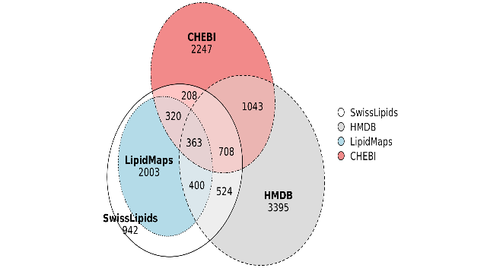
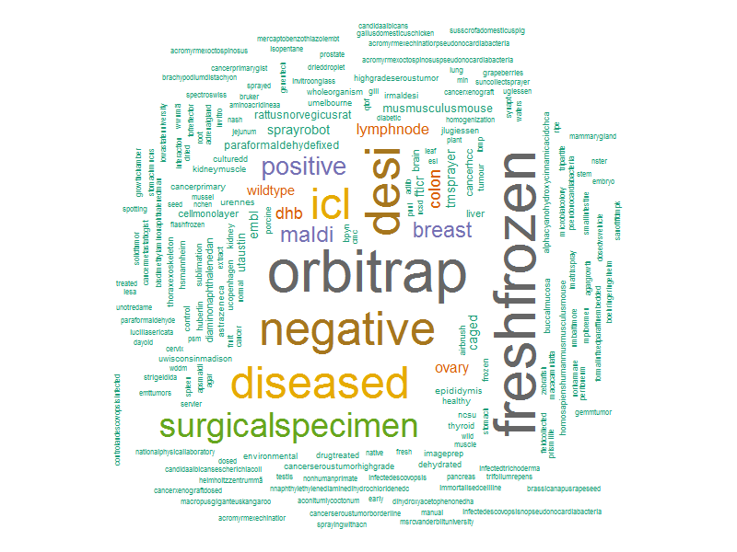

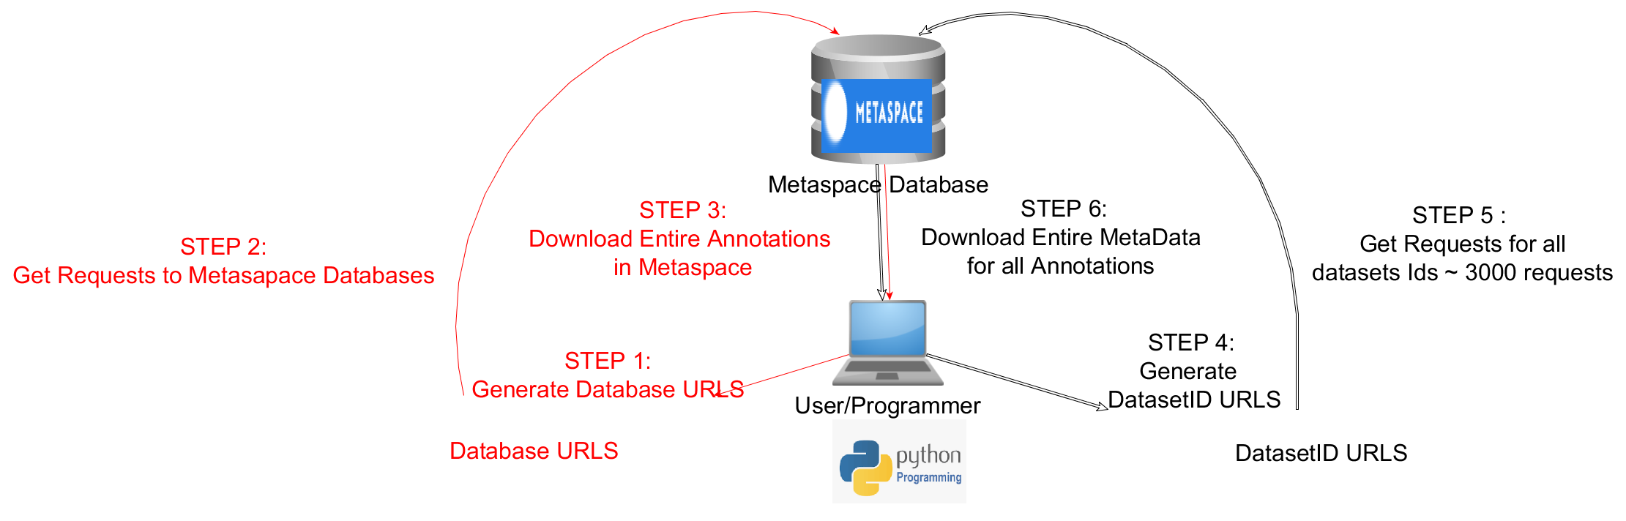

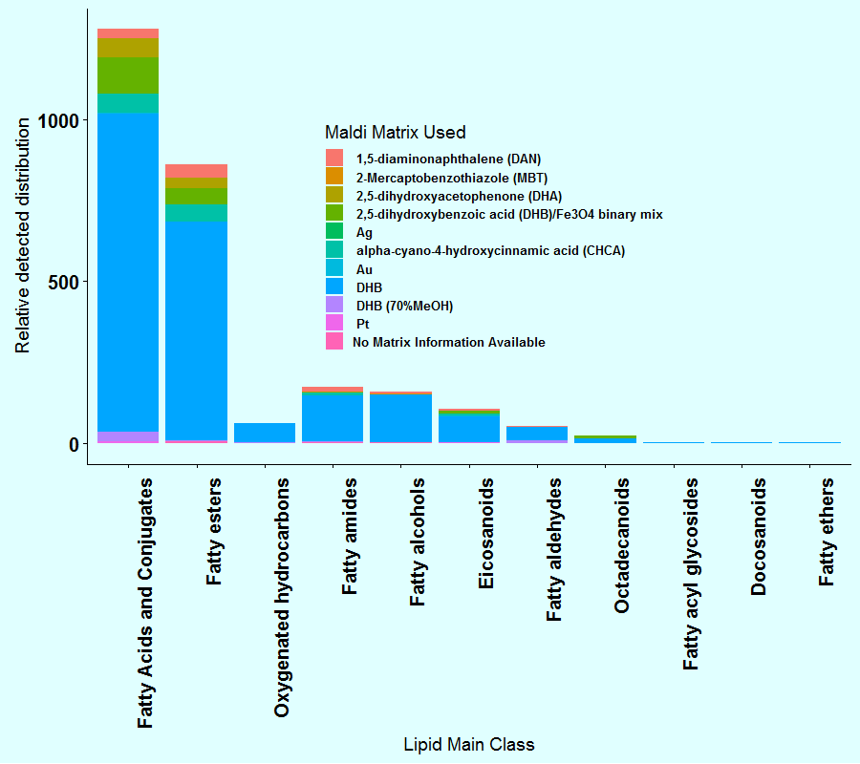
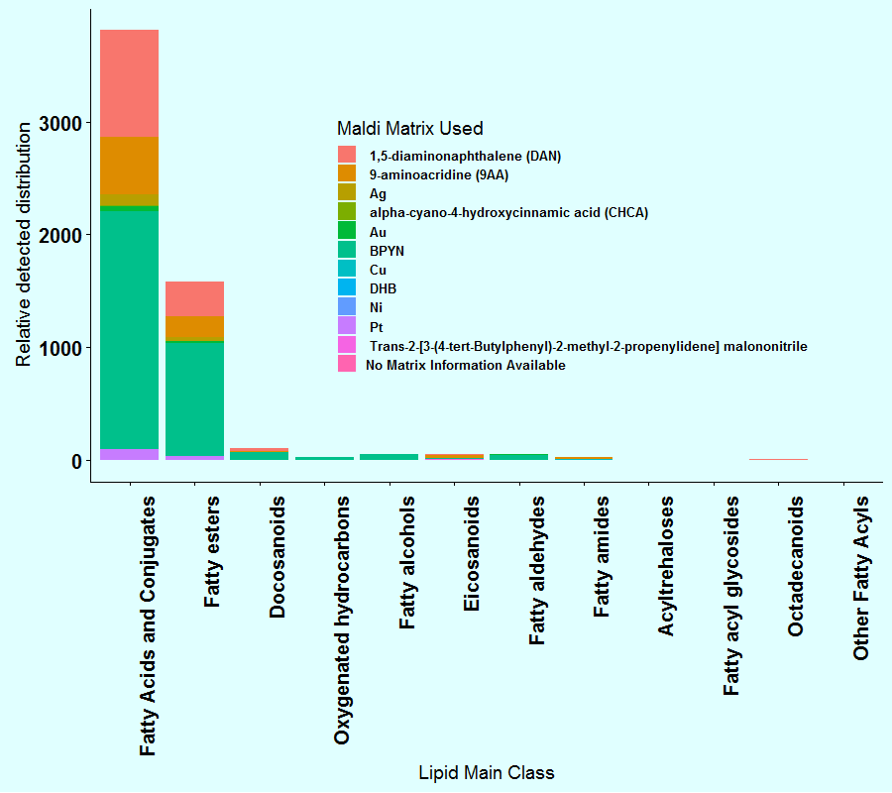
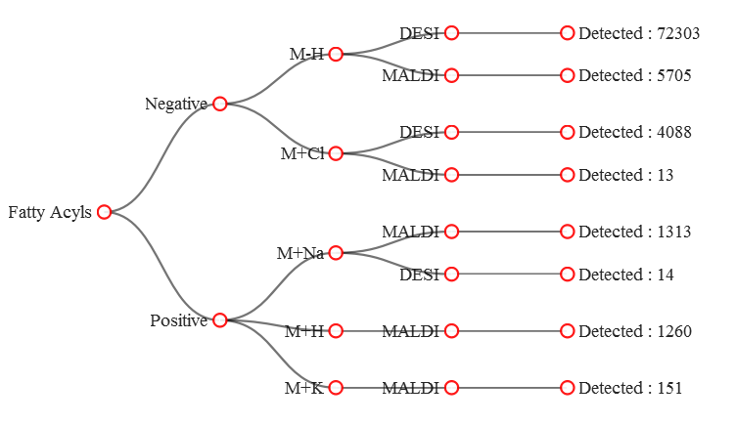
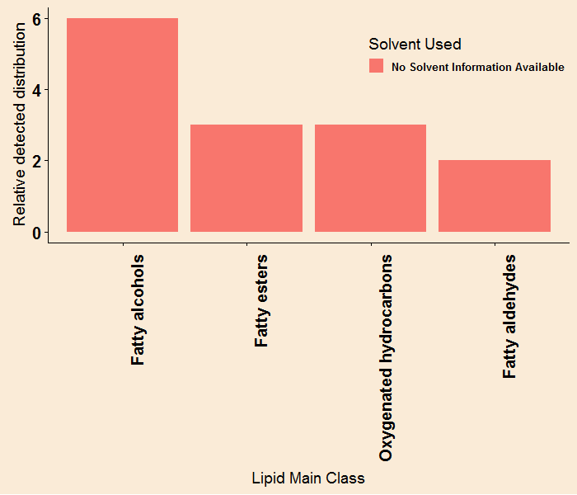
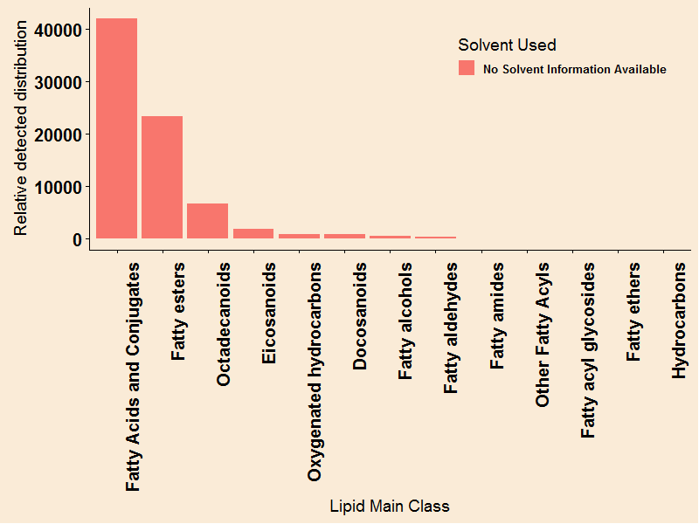
A Meta-review of Metaspace to guide and improve metabolite detection
Robin Philip^{1,2}, Alex Dexter¹, Spencer A. Thomas¹, Adam J. Taylor ¹, Ala Al-Afeef¹, Tingting Fu¹, Efstathios A. Elia¹ Rory T. Steven¹ ,Teresa Murta¹ ,Bin Yan¹ ,Kenneth Robinson¹ ,Chelsea J. Nikula¹ , Josephine Bunch^{1, 2}
¹ National Physical Laboratory, Teddington, Middlesex TW11 0LW, United Kingdom;
² Imperial College London, Kensington, London, SW7 2AZ, United Kingdom
Introduction
Below : A Pyramid scheme showing the aims of the study
Text
Metaspace is an online platform engine developed at the European Molecular Biology Laboratory (EMBL), which annotates metabolites from high resolution mass spectrometry imaging (MSI) data
As a Annotation based Web platform Metaspace captures User , Sample and Experimental Related data (metadata) for each dataset uploaded.
The aim of this study is mining these meta- data, which comprises of approximately half a million annotations to report and understand the experimental parameters used by the community ,thereby improving detection rates of metabolites.
Report on different Experimental Parameters used within the community
Apply Statistical Models to study correlations between datasets
Improved detection rates of metabolites
Reporting tool
Reporting tool
Machine Learning Models
Machine Learning Models
Understand detection rates for classes of Molecules
Understand detection rates for classes of Molecules
Below: Euler Plot of Unique molecules detected across databases in Metaspace
Below : Metaspace Metadata in the form of word cloud
Methods
Fully Automated python scripts used with a web automation tool “SELENIUM” to access Metadata with Metaspace
Combined HMDB and LipidMaps databases with Metaspace data to obtain Taxonomy of Classes
Built a Shiny Dashboard using networkD3 to explore experimental parameters used within the community for Classes of Molecules
Metaspace as a Reporting Tool
Above : Workflow of downloading Meta-data contained in Metaspace
Positive : 2738
Negative : 4413
MALDI : 7151
DESI : 76405
Positive : 14
Negative : 76391
Above : Diagonal network representation of Molecules Distribution in various Instrument Modes
Above : Quadrant representation of Molecules Distribution in various Instrument Modes
Metaspace Metadata has a wide variety of experimental and sample conditions recorded .Here , the distribution of molecules (Lipid sub classes of Fatty Accyls) detected using Instruments MALDI and DESI in different modes (Polarity :+ve /-ve) with the experimental conditions used by the community is shown
An Alternative representation , visualised as a diagonal network (Reingold-Tilford –Tree) prototype implemented in a Shiny Dashboard using “networkD3” and “data. Tree” package in R.
Allows quick visualisation of detection rates and corresponding experimental parameters used in the detection of various Super classes/classes/subclasses using HMDB taxonomy.
Future work
Use Extracted Metadata to address the goals of CRUK Grand Challenge
References
Acknowledgements
Palmer et al., 2016, Nature Methods
This work was supported by Cancer Research UK [C58393/A24034]

