Slide 1

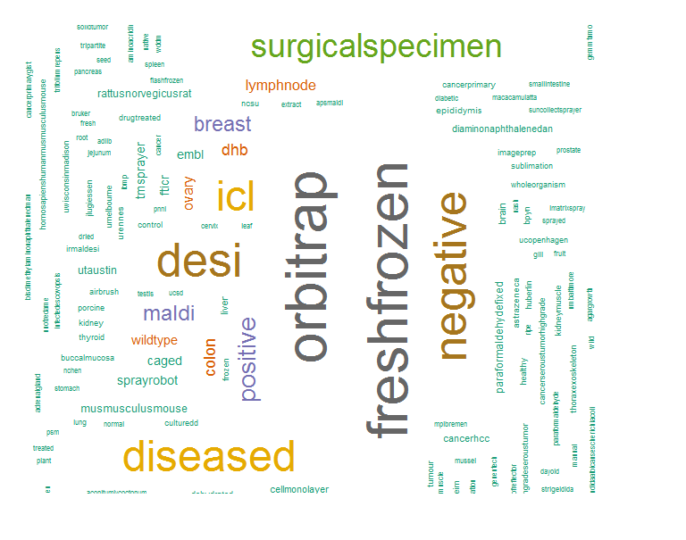
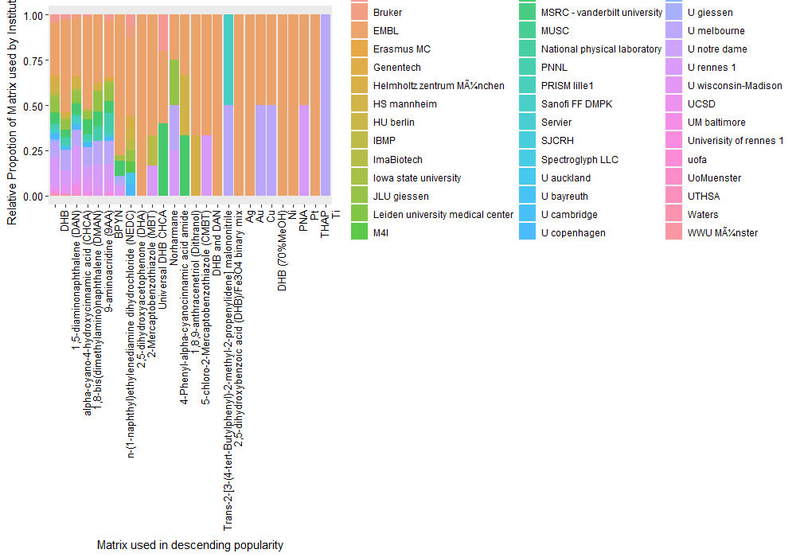
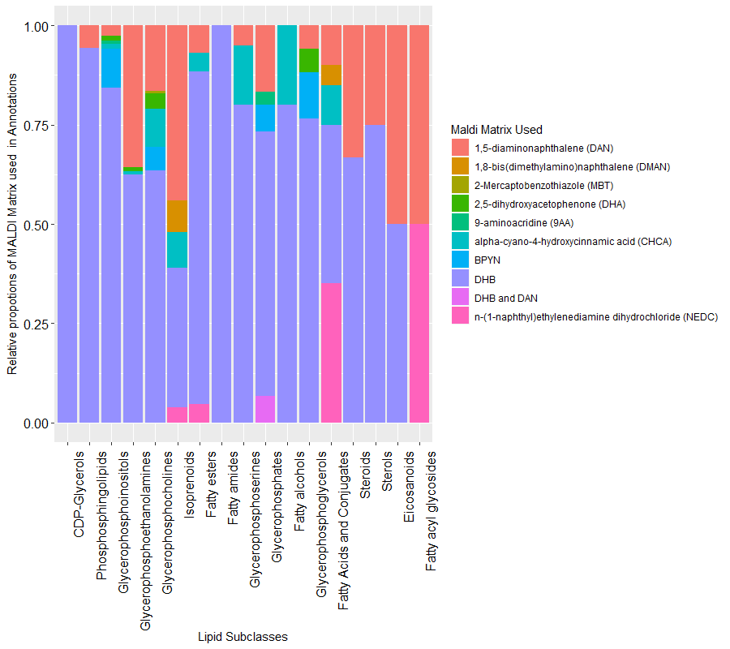
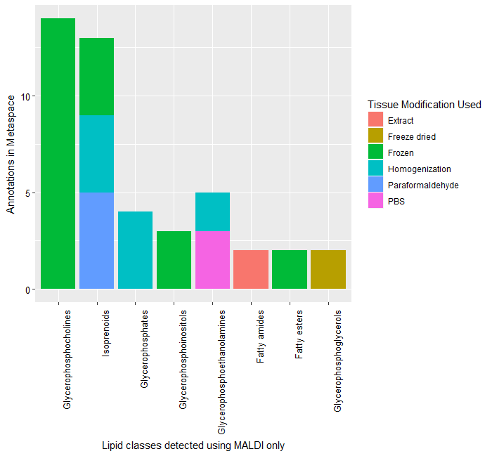
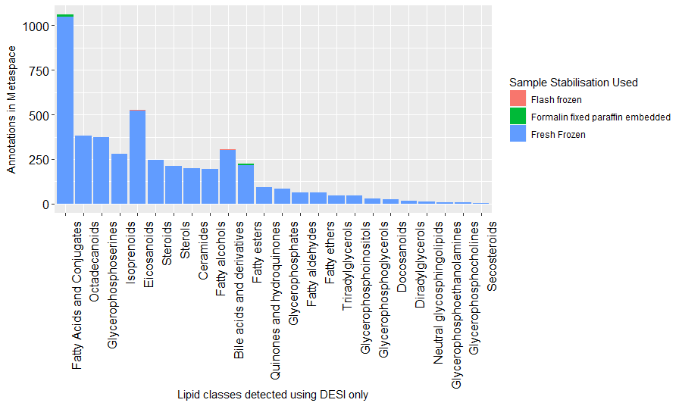
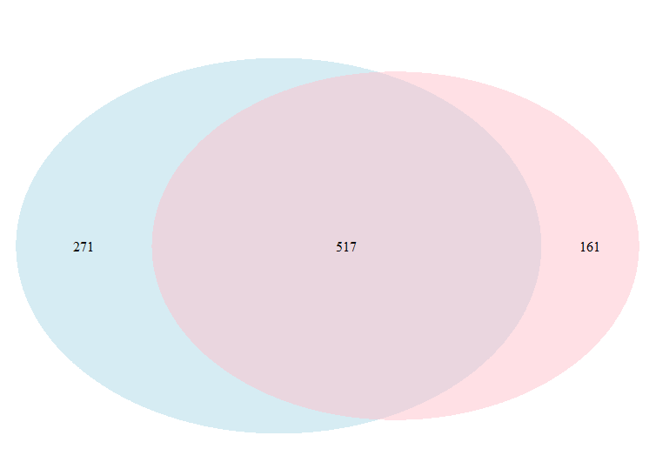
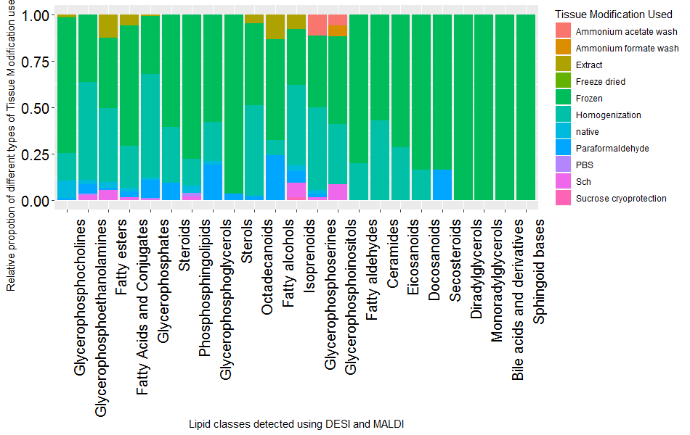
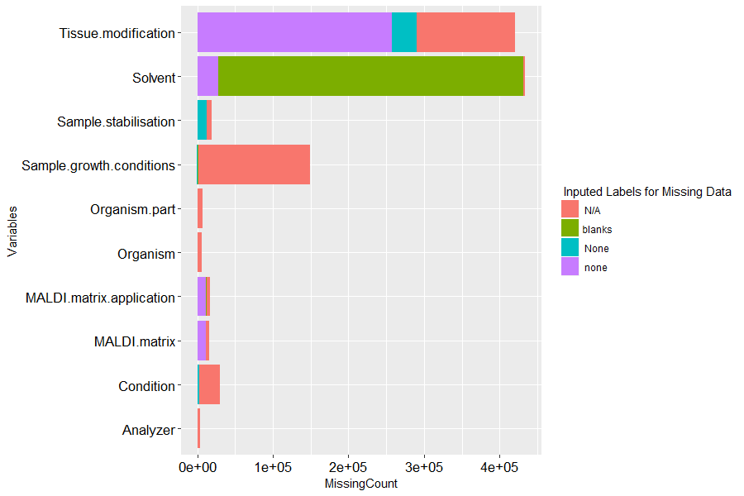



A Meta-review of Metaspace to guide and improve metabolite detection
Robin Philip¹, Alex Dexter¹, Spencer A. Thomas¹, Adam J. Taylor ¹, Ala Al-Afeef¹, Tingting Fu¹, Efstathios A. Elia^{1,} Rory T. Steven¹ ,Teresa Murta¹ ,Bin Yan¹ ,Chelsea J. Nikula¹ , Josephine Bunch^{1, 2}
¹ National Physical Laboratory, Teddington, Middlesex TW11 0LW, United Kingdom;
² Imperial College London, Kensington, London, SW7 2AZ, United Kingdom
Introduction
(A)
(B)
Metaspace is an online platform engine developed at the European Molecular Biology Laboratory (EMBL), which annotates metabolites from high resolution mass spectrometry imaging (MSI) data
The goal of this study is mining these data, which comprises of approximately half a million annotations to provide insight from community data
Figure 1: A) Word Cloud of metaspace metadata B) Matrix used across institutions with descending popularity
Methods
Automated python scripts to extract data from metaspace
Annotate metaspace lipids data with lipid maps Classification
Exploratory analysis of lipodmics metadata and experimental parameters used
Model fitting and likelihood estimates of lipid classes using a simple Naïve Bayes model for MALDI and DESI data
Lipid Sub Classes and MALDI matrix used in MALDI sources
Lipid Sub Classes and Tissue Modification used in MALDI
Lipid Sub Classes and Sample Stabilisation used in DESI
DESI
MALDI
Common Lipid Classes Detected
Lipid Sub Classes and Tissue Modification used in DESI and MALDI sources
Glycerophosphoglycerols: annotated using MALDI only with entirely Freeze dried method
Glycerophosphocholines , Glycerophosphoinostols and Fatty esters entirely Frozen samples
Fresh Frozen: most common sample stabilisation used for Lipid analysis in DESI instruments
Glycerophosphocholines : most widely annotated across MALDI and DESI instruments, with samples prepared in frozen or homogenised preparations
Figure2): Break down of Lipids by Ionisation method and corresponding sample preparation used in MALDI and DESI sources
Importance of capturing complete metadata
Extent of Metadata captured in MALDI metadata produces high accuracy classifiers for Lipid Classes compared to DESI meta data
MALDI metadata captures larger number of important variables (e.g. MALDI Matrix , MALDI Matrix Application) where as some are missing in DESI (e.g. ambient lab conditions)
Ambiguity of NA’s, None, none and Blanks, can be interpreted as either “Not Applicable” or “Missing”
Lipid Classification using MALDI meta data
Lipid Classification using DESI meta data
A simple Naïve Bayes Model trained on metaspace metadata containing Sample Preparation and Sample Information
Model predictions on lipid classes based on lipid maps classification for MALDI and DESI metadata
Conclusions and Future work
Figure 3) Break down of columns with missing data based on labels
Metadata within metaspace and combined domain knowledge provides a valuable insight in guiding future experimental procedures in high mass spectrometry Imaging Fig 2
Multivariate Analysis can be used as a future exploratory tool to detect and represent the underlying categorical structure of the dataset
References
Acknowledgements
Palmer et al., 2016, Nature Methods
This work was funded by the Cancer Research UK Grand Challenge

