Slide 1
12 – Play + Media
Slides ©2023 Rose bohrer, used for cs 4536/536 at wpi. Educational Reuse permitted with credit

Slide 2
Outline
Motivation
Play with Twine (Ch. 16) reinforces theory (and more)
Play with Processing (Ch. 15) reinforces design

Slide 3
Motivation: Reinforce Ideas Before Exam
Theorist: Work through defining an operational semantics and stating theorems about a language
Implementer: Operational semantics informs implementation
Practitioner: Write small Processing programs
Social Scientist: Explore use of Twine in social science research
Humanist: Untangle the cultural + design values embedded in each programming language
Takeaway message: These people can be friends. Even Twine, centered on very casual developers, has rich connections with theory

Slide 4
Motivation: It’s Almost Finals Week
Play is fun, by definition
Let’s end the course with a fun lecture
While still learning some things
HW5 Note: HW5 coding is intended to be easier than the others, leave time for studying

Slide 5
Section: Twine

Slide 6
Activity: Play Some Twine Games
For 15 minutes: Pick 1 or more games and play them:
Search engines:
https://itch.io/games/tag-twine
https://ifdb.org/search?searchfor=system:Twine
Professor’s suggestions:
https://chubbbbbs.itch.io/at-the-edge-of-the-world-there-is-a-gas-station
https://tommchenry.itch.io/horse-master (long)
https://pieartsy.itch.io/erstwhile (From Prof. Schneider)
Feel free to play/chat together with each other

Slide 7
Activity: Play Some Twine Games
For 15 minutes: Pick 1 or more games and play them
As you play, keep these questions in mind:
If Twine is a programming language, what are the main concepts in that language? What ideas might we use while developing the theory of Twine?
What are the limitations of Twine? e.g. what programs can it write?
Twine’s main programmer audience is very casual game developers. How might Twine’s design serve this audience? Where might they struggle?

Slide 8
Discuss Twine (~5 minutes)
In Social Science, getting people to share their experiences is an important research technique
1. Share your experiences playing Twine games. Funny? Weird?
2. Has anyone in this room made a Twine game before? If so, share your programmer experience making that game
3. We’re going to develop the theory of Twine as a way of reviewing our core theory skills. Brainstorm how we might represent the (abstract) syntax, semantics, or even type system of Twine

Slide 9
Demo of Twine Editor
https://twinery.org/2/#/

Slide 10


Outline of Twine Theory
What we will / won’t explore
Concrete syntax?
Abstract syntax?
Operational semantics?
Type system?
State some theorems?
Special: Twine theory was developed for this course. Point: Analyze existing PL in new ways
https://pixabay.com/vectors/cross-delete-remove-cancel-abort-296507/
https://pixabay.com/vectors/check-mark-tick-mark-check-correct-1292787/

Slide 11
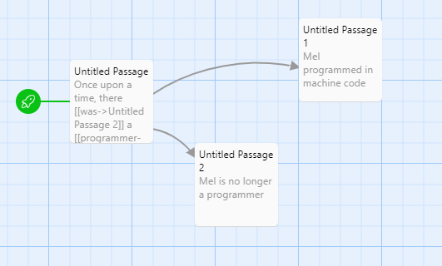
Concrete Syntax? No
The concrete syntax of a programming language means the exact way a program is written down in source code
In most programming languages, source code = text file
Twine’s story is more complicated:
It lets you code in full PLs
Or use graphical editor
Both would be complicated to define concrete syntax

Slide 12
Abstract Syntax
Abstract syntax is a simplified, yet accurate, representation of a program, used as a core data structure in PL implementation. Most often, we use a tree (AST), but Twine uses a graph
Idea:
Passage = Vertex
Link = Edge
Attach data to vertex and edge:
Name and content of passage
Text displayed for link
Later: Make it extensible

Slide 13
Abstract Syntax Review
In abstract syntax, we often want to represent both the code of the program and its runtime state. Important for the semantics
(Non-essential) vocab: A machine m is the abstract syntax of a program at runtime, i.e., program combined with state.
Toi: A machine is a pair of an environment E and an expression e, written (E, e)

Slide 14
Twine Abstract Syntax, Formally
We define Twine machines by m ≡ (G,s). G = graph, s = state name
G ≡ (V, E) where V is the set of vertices v and E is set of edges e
v ≡ (n, p) where n is the passage name and p is the passage text
e ≡ (u,v, ℓ) where u is the name of the passage we start from, v is the name of the passage it links to, and ℓ is the name on the label

Slide 15
Twine Abstract Syntax, Details
Let Q be the set of passage names n Let Σ be the set of link names
Recall G ≡ (V, E) where v ≡ (n, p) and e ≡ (u,v, ℓ)
Require
n, u, v ∈ Q
p ∈ string
ℓ ∈ Σ
Every n is unique within V
Every (u,v) is unique within E

Slide 16
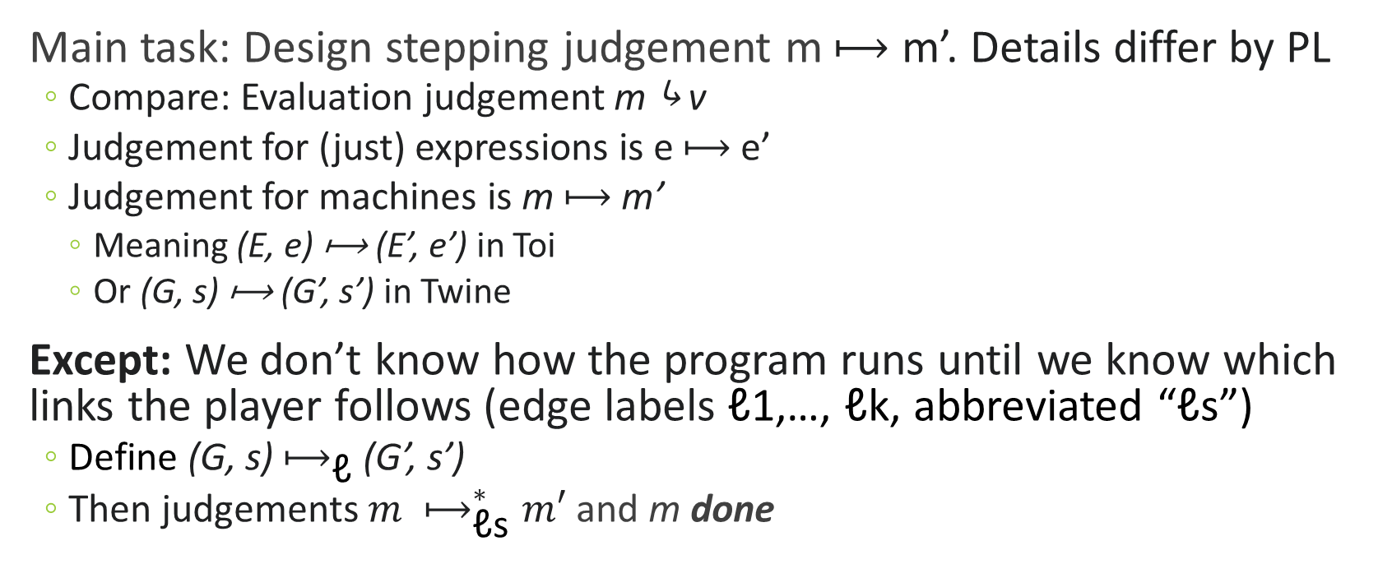
(Small-Step Operational) Semantics
Main task: Design stepping judgement m ⟼ m’. Details differ by PL
Compare: Evaluation judgement m ⤷ v
Judgement for (just) expressions is e ⟼ e’
Judgement for machines is m ⟼ m’
Meaning (E, e) ⟼ (E’, e’) in Toi
Or (G, s) ⟼ (G’, s’) in Twine
Except: We don’t know how the program runs until we know which links the player follows (edge labels ℓ1,…, ℓk, abbreviated “ℓs”)
Define (G, s) $⟼_{\text{ℓ}}$ (G’, s’)
Then judgements ${m ⟼}_{\text{ℓ}\text{s}}^{∗}m′$ and m done

Slide 17
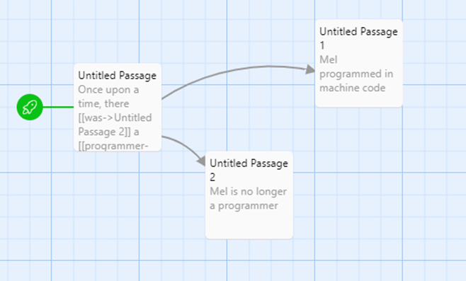

Main Stepping Rule
s’
Rule StepOne
G = (V, E) (s, s’, ℓ) ∈ E
(G, s) $⟼_{\text{ℓ}}$ (G, s’)
s
(s, s’, ℓ)
ℓ=“was”

Slide 18
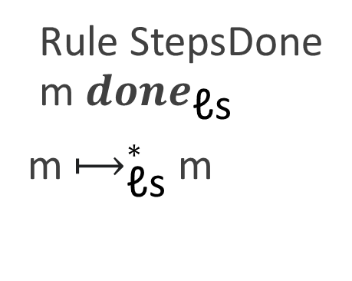
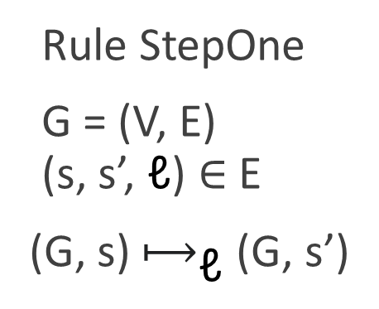
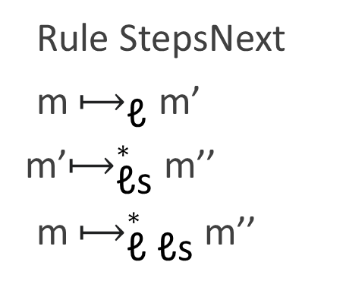
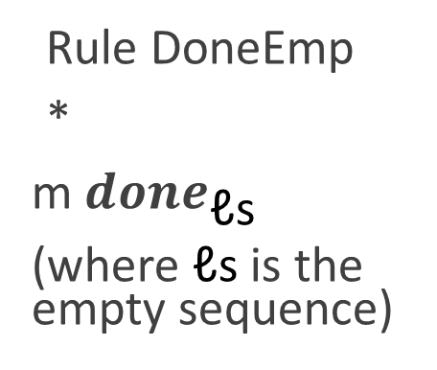
All Stepping Rules
Rule StepOne
G = (V, E) (s, s’, ℓ) ∈ E
(G, s) $⟼_{\text{ℓ}}$ (G, s’)
Rule StepsDone m ${done}_{\text{ℓ}\text{s}}$
m $⟼_{\text{ℓ}\text{s}}^{∗}$m
Rule DoneEmp
*
m ${done}_{\text{ℓ}\text{s}}$
(where $\text{ℓ}\text{s}$ is the empty sequence)
Rule StepsNext
m $⟼_{\text{ℓ}}$ m’
m’$⟼_{\text{ℓ}\text{s}}^{∗}$ m’’
m $⟼_{\text{ℓ} \text{ℓ}\text{s}}^{∗}$m’’

Slide 19
Type System? No thanks
(Static) type systems are used to look at a program before running it and predict what will happen when it runs
Examples: Predict type of return value, Ensure absence of memory-related errors
These kinds of guarantees don’t apply to Twine
Coming with alternative guarantees is hard. “I win the game”? (Could maybe do this? But is it types? …)

Slide 20
Theory Can Require Creativity
We want to prove something about Twine, but not using types ☹
Let’s brainstorm: does Twine look similar to any existing theories, that we could use for inspiration?
Ideas:
Twine looks a lot like directed graphs (true, but this didn’t go anywhere)
Twine looks a lot like deterministic finite state machines Note: This is covered in detail in CS 3133/503, but let’s just give some high-level ideas here.

Slide 21
Twine and Deterministic Finite Automata
A deterministic finite automaton (DFA), often used to match a regular expression over some characters, is formally a 5-tuple (Q, Σ, δ, q0, F), with the following meanings:
Q = list of states DFA can be in
Σ = list of characters in strings
δ = function δ(state,char)=newstate
q0 = initial state
F = set of desired end states
A DFA defines a language of strings that it accepts

Slide 22
Deterministic Finite Automata: Example
DFA = (Q, Σ, δ, q0, F)
Q = list of states DFA can be in
Σ = list of characters in strings
δ = function δ(state,char)=newstate
q0 = initial state
F = set of desired end states
Q = {1,2,3}, Σ = {a,b}, q0 = 1, F = {3}, δ = arrows, Language: accepts only “ab”
1
“a”
2
“b”
2
3
q0
(accept state)

Slide 23
Twine and Deterministic Finite Automata
A deterministic finite automaton (DFA), often used to match a regular expression over some characters, is formally a 5-tuple (Q, Σ, δ, q0, F), with the following meanings:
Q = list of states DFA can be in
Σ = list of characters in strings
δ = function δ(state,char)=newstate
q0 = initial state
F = set of desired end states
In Twine
Names of passages
Names of links
function δ(passage,link)=newpassage
Initial passage
Set of “winning” final passages

Slide 24
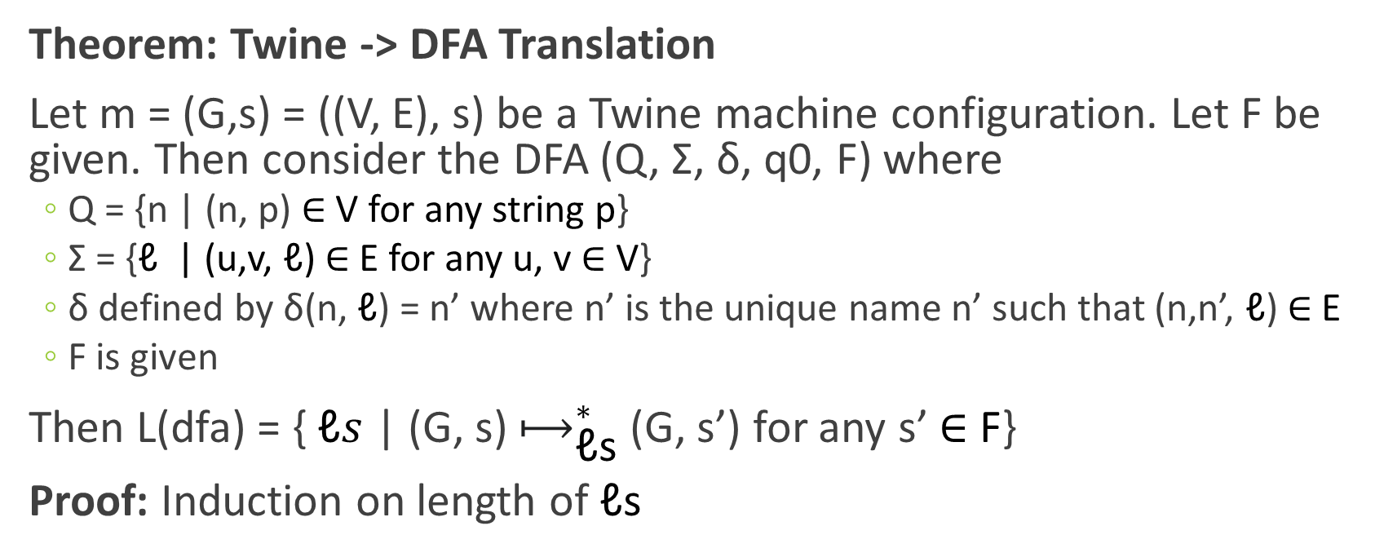
First Theorem
Theorem: Twine -> DFA Translation
Let m = (G,s) = ((V, E), s) be a Twine machine configuration. Let F be given. Then consider the DFA (Q, Σ, δ, q0, F) where
Q = {n | (n, p) ∈ V for any string p}
Σ = {$\text{ℓ}$ | (u,v, $\text{ℓ}$) ∈ E for any u, v ∈ V}
δ defined by δ(n, $\text{ℓ}$) = n’ where n’ is the unique name n’ such that (n,n’, $\text{ℓ}$) ∈ E
F is given
Then L(dfa) = { $\text{ℓ}s$ | (G, s) $⟼_{\text{ℓ}\text{s}}^{∗}$(G, s’) for any s’ ∈ F}
Proof: Induction on length of $\text{ℓ}\text{s}$

Slide 25
Recall: Pumping Lemma for RE
Formally: The pumping lemma shows that every RE behaves like a loop when the string is long enough*:
Let r be an RE. Then r has a pumping length n such that for all strings s of length at least n:
n can be split into some s1s2s3 where
s1(s2^k)s3 in L(r) iff s1s2s3 in L(r) for all natural numbers k
E.g. s1s3 in L(r) and s1s2s3 in L(r)
Understanding check: If r = a(bc)*d and s = abcbcd then s1s2s3 = ???

Slide 26
Next: Pumping Lemma for DFA
Formally: The pumping lemma shows that every DFA behaves like a loop when the string is long enough*:
Let dfa = (Q, Σ, δ, q0, F) be a DFA. Then the pumping length is n=|Q|, the number of states. For all strings s of length at least n:
n can be split into some s1s2s3 where
s1(s2^k)s3 in L(dfa) iff s1s2s3 in L(dfa) for all natural numbers k
E.g. s1s3 in L(dfa) and s1s2s3 in L(dfa)
What does this mean for Twine???

Slide 27
Twine Theorems
Theorem [Bounding Shortest Winning Play] Let m be a (winnable) Twine game containing k prompts. Then the game can be won in at most k steps of play.
Proof: Given a play longer than k, a cycle exists by the pumping lemma. That cycle can be removed without affecting result.
Theorem [Unbounding Longest Winning Play] Let m be a (winnable) Twine game containing k prompts. If any winning play contains a cycle (e.g. if it is length k), then there exist arbitrarily long winning plays.
Proof: By the pumping lemma, the cycle can be repeated

Slide 28
Section: Processing

Slide 29

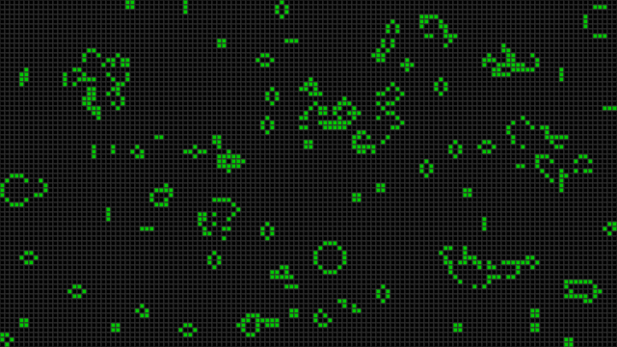
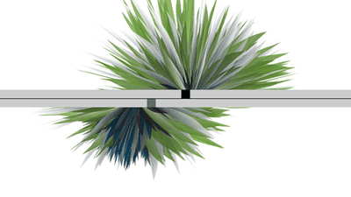

Processing = Programming for Media Arts
PL Design Goal: Help media artists (visual, audio, animation) use programming in their artistic work
Learning goal: Reflect on design values that support this design goal
Examples are taken from https://processing.org/examples/

Slide 30
Guided Exploration: Saturation Example
Let’s walk through the example “Saturation” which can be viewed and run at https://processing.org/examples/saturation.html
I use this editor: https://hello.processing.org/editor/#editor
Then discuss: what (design or implementation) decisions did the Processing developers make to support media artists?
Notes:
This program is an exploration of color. In an HSB (aka HSV) color space, each color is represented by its hue, saturation, and brightness (aka value). Saturation is a number that is 0 when the color is completely gray and is at its maximum value when the color is as not-gray as possible. The program displays a rainbow pattern and interactively updates the saturation of each column whenever you move the mouse.
Processing uses a C-like syntax. Variables can be defined outside of functions, and must be given types. This program defines integer variables barWidth and lastBar, respectively for the width of bars to draw and the x-position of the most recent bar drawn.
The most important functions in a Processing program are named setup() and draw(); the have no arguments or return values. The setup() function is called once at the beginning of the program to set up the drawing area, etc. The draw() function is run repeatedly to draw the screen, and is the main part of the program.
Here, the setup() function sets the canvas size, sets an HSB color space scaled to a maximum value of 100 and noStroke() indicates not to draw the outlines of shapes.
The main draw() function checks whether the mouse has moved. If so, it sets the fill color based on the Y coordinate of the mouse, draws a rectangle in that color, and remembers the mouse position.

Slide 31
Free Exploration: 5-10 minutes
Pick an example from https://processing.org/examples and play
Interact with it
Play with changes to the code in https://hello.processing.org/editor/#editor
Do your answers to the last discussion change?
“What (design or implementation) decisions did the Processing developers make to support media artists?”

Slide 32
List of Design Values
Humanist Reflection: How do we go about forming an opinion when science can’t help us do that?
I’ve prepared material about four specific design values, based on:
Statements from the designers in their published articles
Conversations with instructors who use Processing in their courses
Reflection on my experience programming in Processing
Reflection on core design themes in the course
The values: Visuality, Immediacy, Continuity And one more concept: Contingency

Slide 33
Visuality
What is Visuality? Visuality is the idea that the act of programming should engage the programmer’s visual senses as much as possible
In Processing, visuality is achieved through visual outputs, while the source code of a program remains purely textual. There are other PLs which explore visual syntax as well.
How does Visuality affect the design? This value directly impacts the formal structure of a program. A program’s main function is named draw because creating visuals is their main task
Pros: Accessibility. Cons: Accessibility.

Slide 34
Immediacy
What is Immediacy? Immediacy is not part of the PL design itself but rather a part of Programmer Experience (PX). Immediacy is the idea that when a programmer makes changes to a program, they should be able to observe the impact of those changes right away
How does Immediacy affect the design? The choice to provide an interactive web-based interface is based on immediacy. This value goes deeper, however: Processing has no static type system, so that programmers can run buggy code. Also, web editing demands a language that can be compiled or interpreted quickly.
Pros: Motivating, productive Cons: Can promote incorrectness

Slide 35
(Familiarity +) Continuity
Familiarity is the idea that because each PL has its own audience of programmers, each audience will be familiar with different features
What is Continuity? Continuity is that idea that when a PL breaks away from the familiar, it must be done with intention and motivation. For features where a new approach can not be motivated, rely on the familiar.
Pros: Reduce learning curve Cons: Continue past mistakes?
Question: How does Continuity affect the design? What are some examples?

Slide 36
Examples of Continuity
Many features in Processing look like features from C.
Comments
Function def.
Variable def.
If-then-else
Assignment
/** Saturation … */ void draw () { … } int barWidth = 20; if (whichBar != lastBar) { … } lastBar = whichBar;

Slide 37
Contingency
Contingency is not a design value, but a concept: The current state of world is rooted in history, and history could have been different. Different PL designers will respond to this observation with different design values
Continuity is a design value, it expresses a preference: new PLs keep contingent design features from old PLs until change is needed
Radicalism would be the opposite design value: some designers may prefer to reverse many contingent choices, not for usability, but for the sake of challenging current ideas in design

Slide 38
Summary
Through Twine, we reviewed:
The concepts of abstract syntax and semantics
Core notation for operational semantics
The use of theory to predict program behavior
Through Processing, we reviewed:
How a Humanist analyzes a programming language
How values like continuity inform a design
The relationship between PL design and Programmer Experience
Not on exam: deterministic finite automata

Slide 39
Preparing for the Exam
Exam philosophy: Balance rigor with stress reduction
Approach: I release a set of practice problems on Canvas. The exam problems are a subset of the practice problems
How to Prepare: You are allowed to directly ask course staff for help with specific problems and to look over your answers. You are also allowed to work on them with other students
What Material?: Material covered in programming HW, written HW, and lectures. (The book contains a bit of other material, not covered)
What Kind of Questions?: See posted questions. Questions range from vocabulary to multiple-choice to code. I try to assign the most points to things you have spent the most time on.

Slide 40
Exam Logistics
Last week of course:
1. Review session during class time in classroom, second-to-last day
2. Final exam during class time in classroom, last day
For CS4536: Prof. Bohrer is absent the last week of A term due to a research conference. The review session and exam will be run by our teaching assistant
Bring a computer: The exam is online, but proctored in-person.
Extra-time accommodations are in-person

