Slide 1
09+ Human-Computer Interaction Part 3
Slides ©2024 Rose bohrer, used for cs 4536/536 at wpi. Educational Reuse permitted with credit

Slide 2
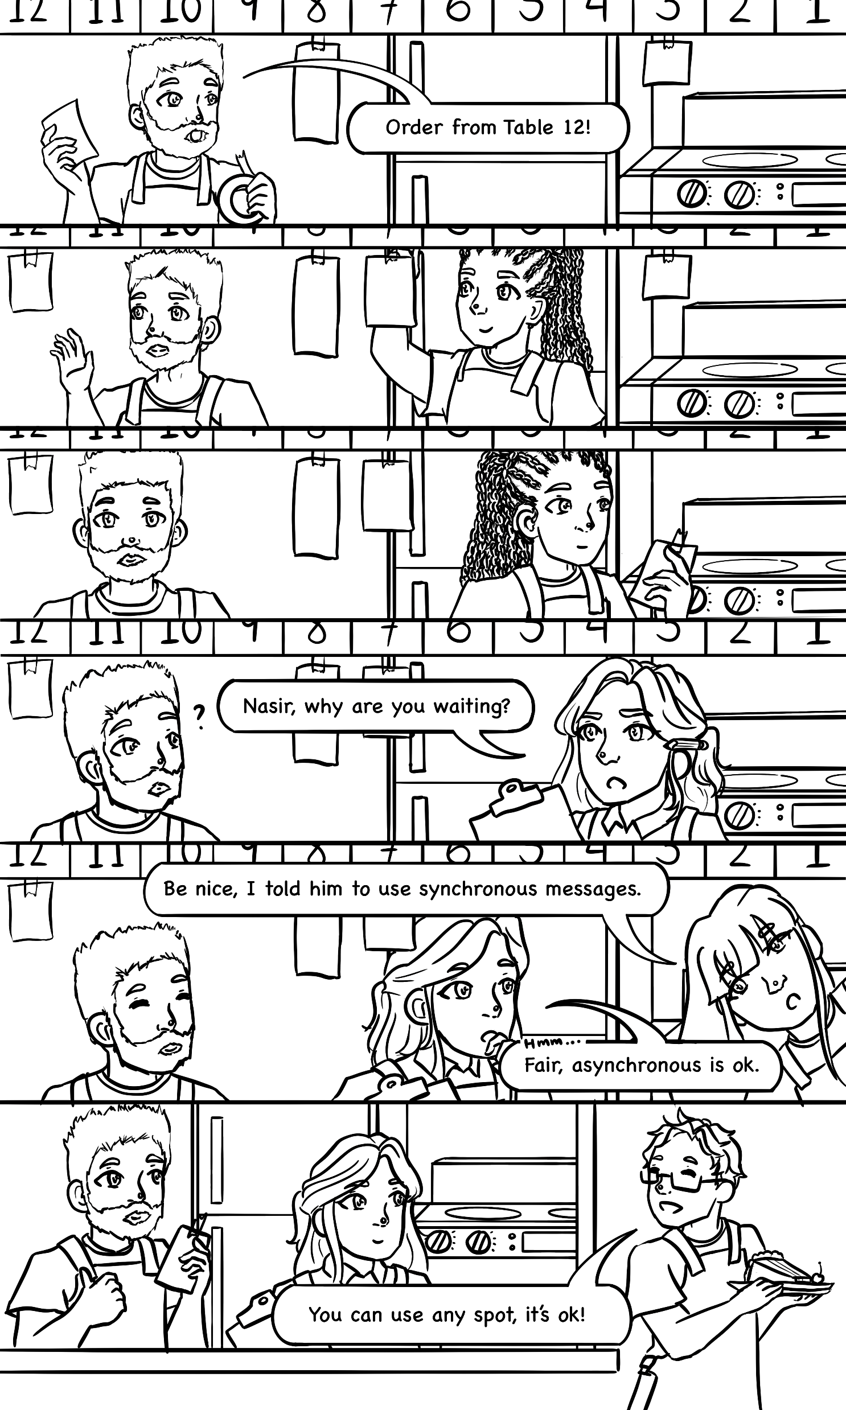
Catching Up on Comics

Slide 3
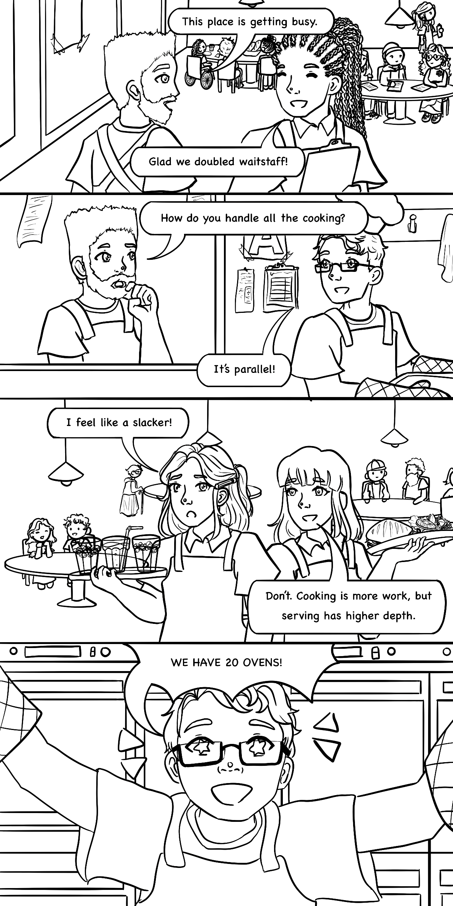

Catching Up on Comics

Slide 4
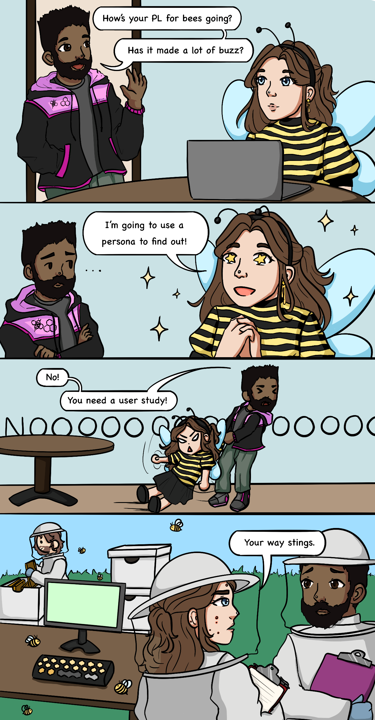
Catching Up on Comics

Slide 5
Outline: Qualitative Methods
Interviews: Collecting Data
Thematic Analysis: Interpreting Qualitative Data
Appendix: Observational Studies

Slide 6
Section: Interviews

Slide 7
Interviews
Common tool for collecting qualitative data from subjects
Pro: Provides greater flexibility than a survey. You can ask follow-up questions, clarify, etc.
Con: Takes more time to perform and to analyze that survey
Preparing for an Interview:
Write a script
Understand how you will use the script
Consider a semi-structured interview, where some deviation from the script is allowed

Slide 8
Writing an Interview Script
1. First question: Do they consent to recording the interview?
Recording is a helpful standard practice, so you need not rely on written notes
2. Write your core questions
What are the core research questions you want to answer? How?
3. Write follow-ups, including probes
“How do you mean that?”
“Tell me more about that”
“Anything else?”
Probe sometimes gets more answers than original Use neutral tone, no leading questions

Slide 9
Example Interview Script: Motivation
How do you (want to) use programming as a tool in your life?
What do you most want to learn about your tools?
How would learning that help you?
In addition to the scripted questions, you will ask probe questions (e.g., “tell me more,” “what do you mean by that?”) and other follow-up questions when appropriate.

Slide 10
Section: Thematic Analysis

Slide 11
Interpreting Qualitative Data
Challenge: Interpreting qualitative data is always subjective. How do we deal with this challenge in an intellectually serious way?
Two answers:
“little-q qualitative”: Ensure that the analysis is reproducible
“Big-Q Qualitative”: Embrace subjectivity, communicate it well
Two main methods, grounded theory and thematic analysis, share:
Annotate insightful data in a process called coding
Iteratively collect codes together to form your conclusions

Slide 12
Thematic Analysis Steps
Familiarize yourself with the data
Code the data
Search for themes in the code
Revise the themes
Define the themes
Write a report

Slide 13
Worked Example: Familiarize
Data (Example responses to example interview): “In my life, I want to use programming for something productive, to help people make things. Maybe engineering software or productivity software. I want to know how a programmer should think about performance day-to-day. I know about common optimizations, but I also know they aren’t always needed in real life. If I knew this, I would be able to ensure that productivity software scale to the large projects that happen when engineers are trying to develop new things in the real world, whether it’s roads or movies.”

Slide 14
Worked Example: Familiarize
Data (Example responses to example interview): “In my life, I want to use programming for something productive, to help people make things. Maybe engineering software or productivity software. I want to know how a programmer should think about performance day-to-day. I know about common optimizations, but I also know they aren’t always needed in real life. If I knew this, I would be able to ensure that productivity software scale to the large projects that happen when engineers are trying to develop new things in the real world, whether it’s roads or movies.”
Familiarize means read the data more than once.
Ask questions about the data.
Form initial observations.
Get in the subject’s head.
Where are they coming from?
How are they feeling?

Slide 15
Worked Example: Coding
Data (Example responses to example interview): “In my life, I want to use programming for something productive, to help people make things. Maybe engineering software or productivity software. I want to know how a programmer should think about performance day-to-day. I know about common optimizations, but I also know they aren’t always needed in real life. If I knew this, I would be able to ensure that productivity software scale to the large projects that happen when engineers are trying to develop new things in the real world, whether it’s roads or movies.”
Coding means assigning descriptive labels to interesting parts of data. If the same thing happens repeatedly, reuse the code.
When you assign codes, you may or may not have a specific goal in mind. Depending on this, the same person could assign wildly different codes.
You do not need to code every line of the data.

Slide 16
Worked Example: Coding
Data (Example responses to example interview): “In my life, I want to use programming for something productive, to help people make things. Maybe engineering software or productivity software. I want to know how a programmer should think about performance day-to-day. I know about common optimizations, but I also know they aren’t always needed in real life. If I knew this, I would be able to ensure that productivity software scale to the large projects that happen when engineers are trying to develop new things in the real world, whether it’s roads or movies.”
CODES
“Desire to Help”
“Productivity-minded”
“Practical-minded”
“Practical-minded”
“Productivity-minded”
“Applications matter”

Slide 17
Worked Example: Coding (with goal)
Data (Example responses to example interview): “In my life, I want to use programming for something productive, to help people make things. Maybe engineering software or productivity software. I want to know how a programmer should think about performance day-to-day. I know about common optimizations, but I also know they aren’t always needed in real life. If I knew this, I would be able to ensure that productivity software scale to the large projects that happen when engineers are trying to develop new things in the real world, whether it’s roads or movies.”
CODES
“Implementation-focused”
“Large codebases”
“Performance-minded”
“Scalability-minded”
Goal: Assess which classroom topics the subject cares about

Slide 18
Worked Example: Coding (Are You Done?)
Data (Example responses to example interview): “In my life, I want to use programming for something productive, to help people make things. Maybe engineering software or productivity software. I want to know how a programmer should think about performance day-to-day. I know about common optimizations, but I also know they aren’t always needed in real life. If I knew this, I would be able to ensure that productivity software scale to the large projects that happen when engineers are trying to develop new things in the real world, whether it’s roads or movies.”
CODES
“Implementation-focused”
“Large codebases”
“Performance-minded”
“Scalability-minded”
“Take-away-the-data” test: If I delete data, can I finish analysis?

Slide 19
Worked Example: Searching
CODES
“Implementation-focused”
“Large codebases”
“Performance-minded”
“Scalability-minded”
Goal: Assess which classroom topics the subject cares about
Based on codes + goal, identify initial list of themes

Slide 20
Worked Example: Searching
The subject’s highest priority is to learn implementation skills as opposed to theory
This includes programming in the large
It should be efficient
It should scale to large datasets
Correctness is not essential
CODES
“Implementation-focused”
“Large codebases”
“Performance-minded”
“Scalability-minded”
Goal: Assess which classroom topics the subject cares about
Based on codes + goal, identify initial list of themes

Slide 21
Worked Example: Revising
The subject’s highest priority is to learn implementation skills as opposed to theory
Within implementation skills, scalability is a priority, broadly defined.
Performance is a priority
Note: Ideally, themes unite multiple data points. In very small data sets (i.e., exercises), sometimes a single data point becomes a theme
CODES
“Implementation-focused”
“Large codebases”
“Performance-minded”
“Scalability-minded”
Goal: Assess which classroom topics the subject cares about
Check: Supported by data? Redundant? Clear description + relations?

Slide 22
Worked Example: Defining
“Implementation”: The subject’s highest priority is to learn implementation skills as opposed to theory.
“Scalability”: Within implementation skills, scalability is a priority. Here, scalability ranges from supporting large codebases to supporting large inputs.
“Performance”: Performance is a priority, specifically observed performance in a practical use context, as opposed to best-case theoretical performance.
CODES
“Implementation-focused”
“Large codebases”
“Performance-minded”
“Scalability-minded”
Goal: Assess which classroom topics the subject cares about
Check: Supported by codes? Descriptive and insightful?

Slide 23
Worked Example: Writing
Self-explanatory: Write a report

Slide 24
Activity (5-10 minutes)
Perform a thematic analysis on the interview data you collected in the previous exercise. Ask questions as needed. Recall the steps.
Familiarize yourself with the data
Code the data
Search for themes in the code
Revise the themes
Define the themes
Write a report (not for in-class exercise)

Slide 25
Appendix: Observational Studies

Slide 26
Observational Studies
Often not an “experiment”: Usually, the setting is not completely controlled and you are not looking for a single exact outcome
Usually: Give the participant a task, watch them do it, analyze that
Open-ended with potentially unpredictable results

Slide 27
Picking Tasks
Let your research questions guide you. Let yourself iterate. Try tasks for yourself and revise. Examples:
“Write a program that satisfies this specification”
“Fill in the missing code to satisfy the specification”
“Read this code. Are there bugs? If so, which?”
“Here is a debugger. Debug this code”
“This code does not compile. Modify it so that it compiles”
Parsons problems: Given these code snippets, put them in right order.

Slide 28
Participant Preparation
Do they need training? What kind?
What tools (physical + software) are needed? Simulate code on paper?
Know how much information and help you’re willing to provide, in very clear terms, before you start.
Rehearse interviewing best-practices such as using probe questions, asking one question at a time, speaking in clear, simple terms, and providing adequate time to answer.
Bring a notetaking device in addition to any recordings, so that you can go through the recordings “as-needed” rather than in their entirety.
Keep a timer/clock in view so that you can record timestamps in your notes

Slide 29
Revising Tasks
Identify the most important point of your language design, design task for that
Task should be easy enough to be possible, hard enough to be meaningful
Don’t give too many tasks
Minimize distractions, e.g., you don’t want a subject to spend 30 minutes exploring whitespace questions if the language is whitespace-insensitive.
Narrow task scope to only things you care about
For big monolithic tasks, consider breaking them down into small tasks (unless your point is to assess integration of the smaller parts, big-picture thinking, etc.)

Slide 30
Collecting Data
Audio + Video + Screen recordings
Eye tracking (expensive!!)
Post-study Surveys (see Survey lecture)
Think-aloud: have them think through thoughts out loud either after or during study. Prompt them to keep talking.
Take lots of notes

