Slide 1
04,05 - Parsing
Slides ©2024 Rose bohrer, used for cs 4536/536 at wpi. Educational Reuse permitted with credit

Slide 2
Outline
Intro
Why Care About Syntax
A Toy Programming Language: Toi
Part 1: Regular Expressions
Part 2: Context-Free Grammars

Slide 3
Introduction

Slide 4
Basic Stages of a PL Implementation*
Source
Code
Evaluator (if implemented as interpreter)
Parser
Type Checker (if Statically Typed PL)
Lexer
Translator (if implemented as compiler)
Direct Execution on CPU
*As always, the real world is more diverse than this

Slide 5
Basic Stages of a PL Implementation*
CS 4536 Only Does Interpreter
Source
Code
Evaluator (if implemented as interpreter)
Parser
Type Checker (if Statically Typed PL)
Lexer
Translator (if implemented as compiler)
Direct Execution on CPU
Today’s Lecture
*As always, the real world is more diverse than this

Slide 6
Why Care About Syntax
Most programs are still written in text. If we want to do anything with a program, we need to understand its text representation
Natural language is a fundamental part of being human, and syntax is an opportunity to reflect on the relationship between natural language and programming languages
Let’s briefly reflect on natural language to get some insights about PLs

Slide 7
Natural Language Examples
Core PL Vocab: A string is syntactically valid if it follows the grammar of the language
Core PL Vocab: A syntactically valid string has a semantics if it can be assigned a meaning. It has an ambiguous semantics if >1.
Which are syntactically valid? Have semantics? Ambiguous?
“Buffalo buffalo Buffalo buffalo buffalo buffalo Buffalo buffalo”
“Fruit flies like a banana”
“Colorless green ideas sleep furiously”
“He made her duck”
“Give orange me give eat orange me eat orange give me eat orange give me you”

Slide 8
Picking an Example Language
Throughout HW 2-4 of CS 536 we will implement parsing, type-checking, and evaluation for a small example language. We should pick a language
Discuss: If you only had a few weeks to implement a programming language, what features would you want the language to have? What PL features are most important to you?

Slide 9
Picking an Example Language
Throughout HW 2-4 of CS 536 we will implement parsing, type-checking, and evaluation for a small example language. We should pick a language
Discuss: If you only had a few weeks to implement a programming language, what features would you want the language to have? What PL features are most important to you?
Note: I’m sure some of your answers are not included in CS 536. You are encouraged to explore such features in the open-ended design exercise part of your homework assignments

Slide 10
CS 536 Example Language: Toi*
How do we even define a language?
Today: We’ll learn how to define the syntax rigorously
Later lectures: Learn to define evaluation and type-checking
Until then: Let’s give some examples
*Pronounced either like English “toy” or Vietnamese “tôi”

Slide 11
CS 536 Example Language: Toi*
let fact(n) = if n = 0 { 1 } else { n * fact(n – 1) } in fact(100)
let y = 0 in let sum(n) = if n = 0 { y } else { y := y + n; sum(n - 1) } in sum(100)
Discuss: What might these programs do? Why might you be able to guess what they do without being told?
*Pronounced either like English “toy” or Vietnamese “tôi”

Slide 12
Regular Expressions

Slide 13
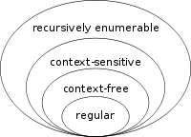
Chomsky hierarchy
Put formal languages into classes of “parsing complexity”
Simpler classes are subsets of more complex classes
Recognizable by a Turing machine Example: Perl programming language
“Rules depend on context” Example: C parser tracks type defs.
“Parse using the same
rules in every context”
Example: Most PLs, Almost
Definable with regular expression Example: numbers
https://en.wikipedia.org/wiki/Chomsky_hierarchy

Slide 14
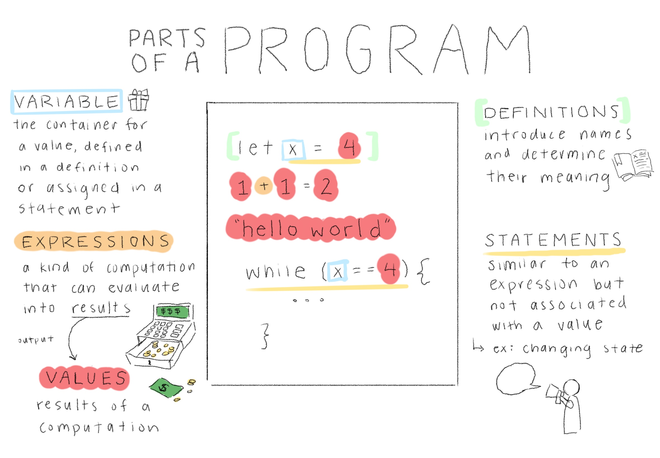
Review: Parts of a Program
Figure by Ellen Kim, PL Comics Project

Slide 15
Why Have Regular Expressions? What Do They Parse Anyway?
Motivation: When you read this sentence, you are probably reading words and not individual letters
Use regular expressions to recognize the building blocks (“words”) of a program, before using context-free grammars to build “sentences”
Regular expressions are very weak, but that’s okay
We’re just trying to “split it into words”
Very weak -> Very fast parsing, in this case
This process is called “lexing” or “tokenization”

Slide 16
Lexing Diagram
What are the tokens of this Toi program?
if n = 0 { 1 } else { n * fact(n – 1) }

Slide 17
Lexing Diagram
What are the tokens of this Toi program?
if n = 0 { 1 } else { n * fact(n – 1) }
This single line has 18 tokens – parsing speed matters
Each kind of token has a regular expression (RE). Standard lexing repeatedly finds the longest possible match of any RE
Regular Expressions need to express ideas like:
A specific string like “=“, “{“, “}”, “(“, “)”, “-”, “*”, “if”, “else”
“Any variable or function name”
“Any integer”

Slide 18
Regular Expressions are Little Language
The semantics (meaning) of a regular expression (RE) is “what set of strings does the RE describe?” e.g. “a specific string?” “all numbers?”
A regular expression(RE) r is a program written using these features:
Character: A single character c means match the string “c”. e.g. ‘{‘ matches “{“
Sequence: r1r2 matches RE r1, then r2. e.g. ‘if’ matches “if”
Choice: r1|r2 matches a string if it matches either r1 or r2. e.g. ‘+|*|-|/’ matches all 4 basic arithmetic symbols
Repetition: r* matches any number of copies of r, including 0 e.g. ‘(0|1)*’ matches “”, “0”, “101101”, “0000”, and so on

Slide 19
Semantics: The Language of an RE
The language L(r) of r is the set of strings it matches:
L(c) = { “c” }
L(r1r2) = { s1s2 such that s1 in L(r1) and s2 in L(r2) }
L(r1|r2) = { s such that s in L(r1) or s in L(r2) }
L(r*) = { s such that s in L(r^k) for some integer k >= 0}, where
L(r^0) = { “” }
L(r^(k+1)) = { s1s2 such that s1 in L(r) and s2 in L(r^k) }

Slide 20


Example: Natural Numbers
Goal: All digits. Non-empty. First digit can only be 0 if number is 0. Examples: “0” “” “1240” “01” “-1.2”
Activity: Let’s derive the solution

Slide 21
Example: Natural Numbers
Goal: All digits. Non-empty. First digit can only be 0 if number is 0. Examples: “0” “” “1240” “01” “-1.2”
Activity: Let’s derive the solution Solution: (0|(1|2|3|4|5|6|7|8|9)(0|1|2|3|4|5|6|7|8|9)*)
This does not spark joy
Idea: Add “extended REs”. These could be implemented using standard REs, but make the syntax much nicer.

Slide 22
Extended RE: Character Sets
Observation: We often want to match “any character in a set”
Character set notation, enclosed in square brackets, does this:
[abc] is the same as a|b|c (only small benefit)
[0-9] is the same as 0|1|2|3|4|5|6|7|8|9 (big benefit)
[a-zA-Z0-9] is all alphanumeric characters (~10x more concise)
[^a] is any character except a

Slide 23
Extended RE: Wildcard and r+
‘.’ (named the wildcard) matches any one character
\d matches any one digit
r{k} matches exactly k copies of r
r+ matches 1 or more copies of r
Check understanding: How can you define r+ using the other RE’s?
Activity: Define dates in YYYY-MM-DD format using these features:

Slide 24
Extended RE: Wildcard and r+
‘.’ (named the wildcard) matches any one character
\d matches any one digit
r{k} matches exactly k copies of r
r+ matches 1 or more copies of r
Check understanding: How can you define r+ using the other RE’s?
Activity: Define dates in YYYY-MM-DD format using these features:
Solution: \d{4}-\d{2}-\d{2}

Slide 25
Extended Matching
The same RE could be matched in several ways:
Theoretical matching (s in L(r)) must match entire string
Maximal munch is standard in lexers: try many REs at one, pick the longest prefix that matches
Extended matching: The RE says what to do
New REs:
^r match r starting from first character of input
r$ match r, ending at final character of input
Otherwise: allow matching any substring (common in search applications)
Understanding check: How to match entire string in extended RE?

Slide 26
Example Revisited
Ranges make natural numbers (and many others) more concise:
Recall verbose solution: (0|(1|2|3|4|5|6|7|8|9)(0|1|2|3|4|5|6|7|8|9)*)
Activity: What’s a more concise solution?
Solution: ‘0|([1-9][0-9]*)’ or others
On HW2: You will implement REs which are a bit more complex than this, but you will implement them using a different representation called Parsing Expression Grammars

Slide 27
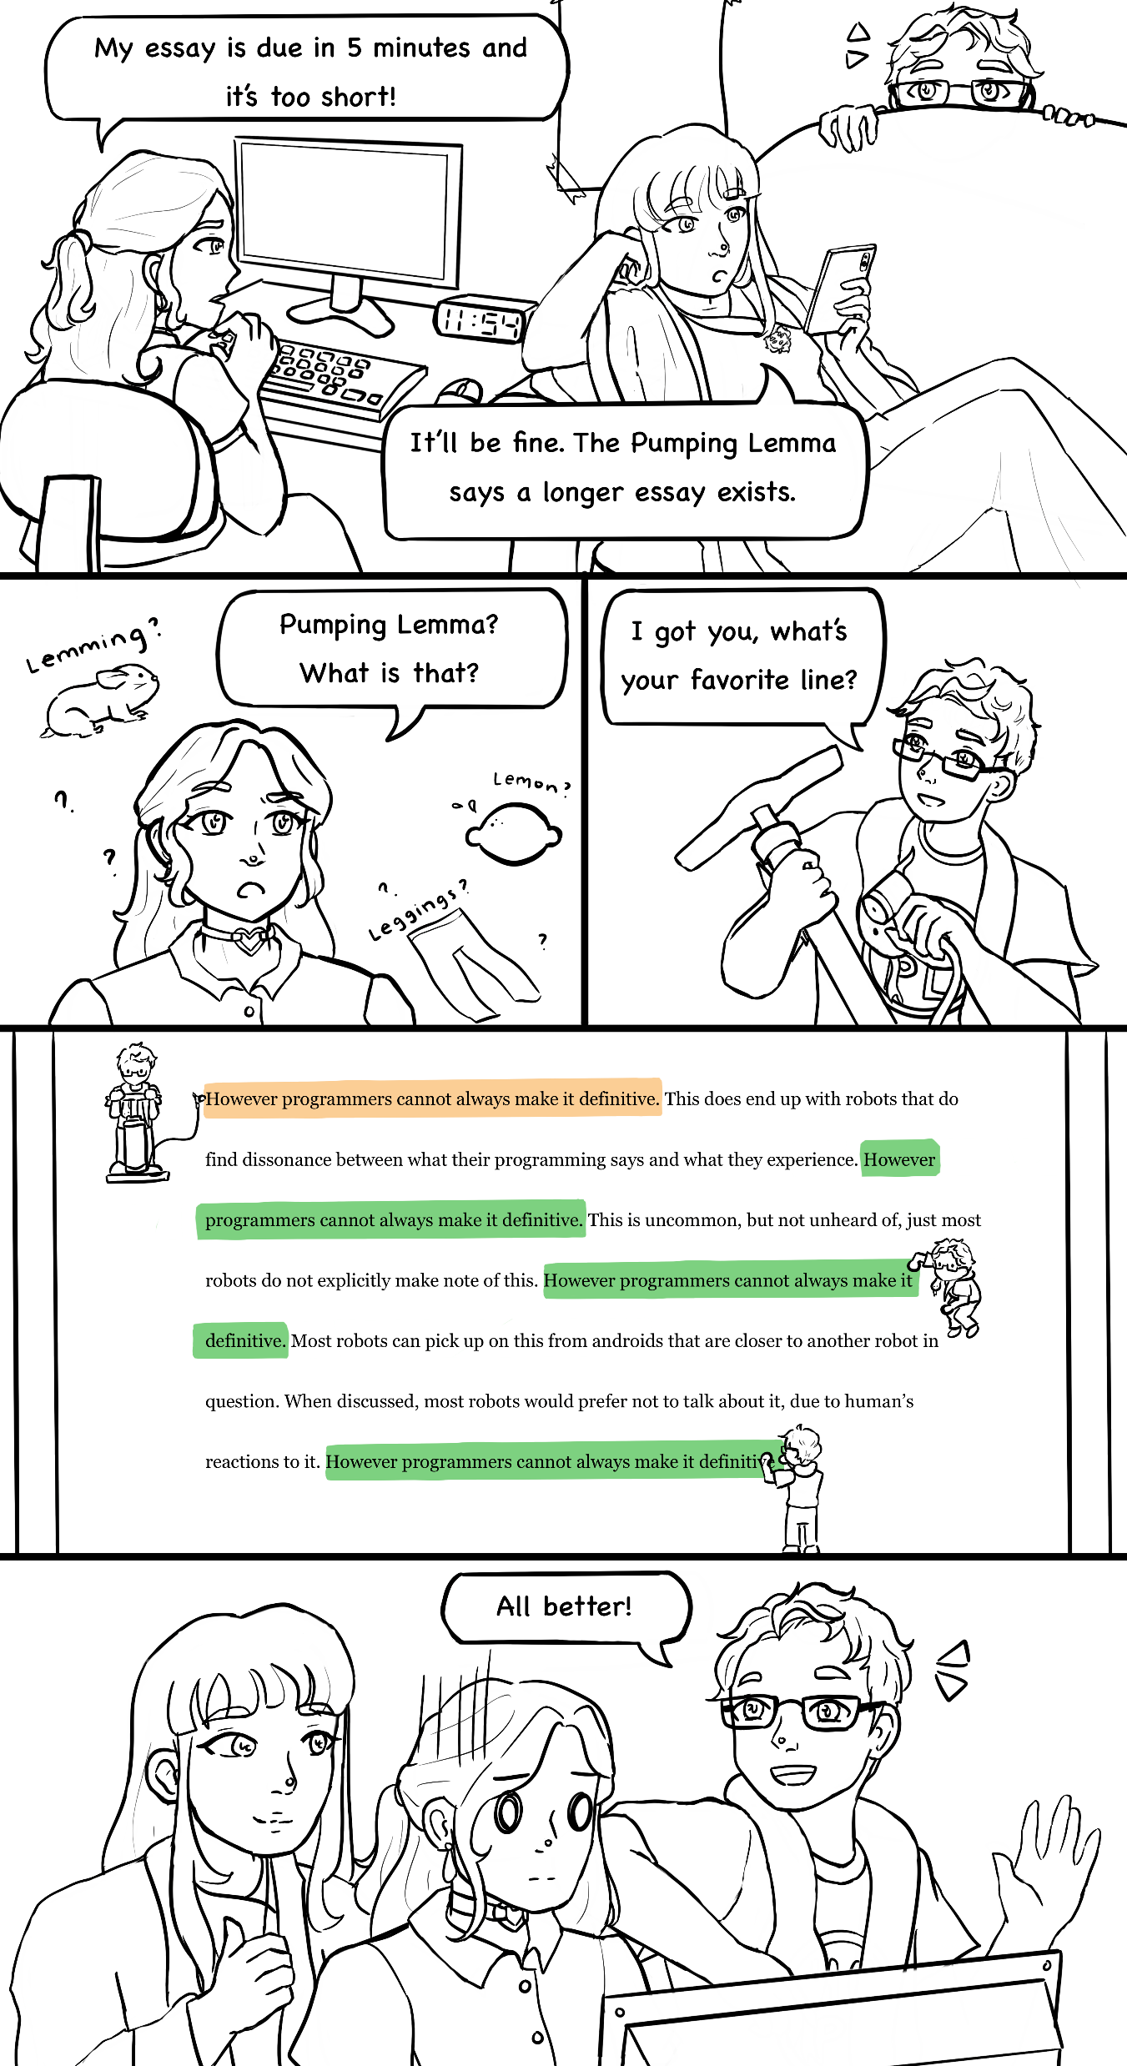
Limits of RE: Pumping Lemma
Credit: Ellen Kim, HCPL Comics Project
This comic has been modified from its original version. It has been reformatted to fit your PowerPoint slide

Slide 28
Limits of RE: Pumping Lemma
The Pumping Lemma says that long strings in a regular language always contain a “cycle”, a piece of text that can be added or removed as much as you want to get another string in the language.
This helps us understand when something stronger is needed: whenever we need “More than loops”
Credit: Ellen Kim, HCPL Comics Project

Slide 29
Section: Context-Free Grammars (CFG)

Slide 30
Chomsky hierarchy
Put formal languages into classes of “parsing complexity”
Simpler classes are subsets of more complex classes
Recognizable by a Turing machine Example: Perl programming language
“Rules depend on context” Example: C parser tracks type defs.
“Parse using the same
rules in every context”
Example: Most PLs, Almost
Definable with regular expression Example: numbers
https://en.wikipedia.org/wiki/Chomsky_hierarchy

Slide 31
Goal of Context-Free Grammars (CFG)
Goal: Discover the tree-like (recursive) structure of a program
English Example:
Token:
adj adj noun verb adv Colorless green ideas sleep furiously
https://en.wikipedia.org/wiki/Chomsky_hierarchy

Slide 32
Goal of Context-Free Grammars (CFG)
Goal: Discover the tree-like (recursive) structure of a program
English Example:
Sentence
NounPhrase
VerbPhrase
NounPhrase
Token:
adj adj noun verb adv Colorless green ideas sleep furiously
https://en.wikipedia.org/wiki/Chomsky_hierarchy

Slide 33
Goal of Context-Free Grammars (CFG)
Goal: Discover the tree-like (recursive) structure of a program
Toi Code Example: x := 1; f(x*2)
var := num ; var ( var * num ) x := 1 ; f ( x * 2 )
Token:
https://en.wikipedia.org/wiki/Chomsky_hierarchy

Slide 34
Goal of Context-Free Grammars (CFG)
Goal: Discover the tree-like (recursive) structure of a program
Toi Code Example: x := 1; f(x*2)
Stmt
Stmt
Expr
Stmt
Expr
Expr
Expr
Expr
var := num ; var ( var * num ) x := 1 ; f ( x * 2 )
Token:
https://en.wikipedia.org/wiki/Chomsky_hierarchy

Slide 35
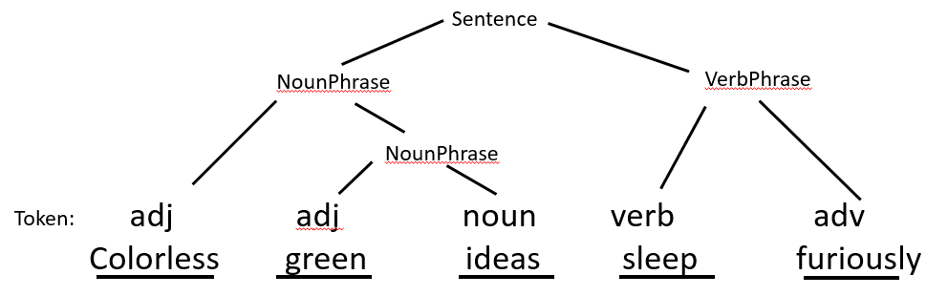
Rough Idea
Here “symbol” is a string like “adj”, “noun”, or “verb”
A Context-Free Grammar (CFG) must specify:
A set of variable symbols which are all the symbol names except tokens
A set of terminal symbols which are names of tokens
Rules V → S … S turning V into S … S
The start symbol: what are we trying to make? What’s at top of the tree?
Exercise: Fill in all 4 parts for this tree

Slide 36
Rough Idea
Here “symbol” is a string like “adj”, “noun”, or “verb”
A Context-Free Grammar (CFG) for the example specifies
Variable symbols: {Sentence, NounPhrase, VerbPhrase}
Terminal symbols: {adj, noun, verb, adv}
Rules: Sentence → NounPhrase VerbPhrase, NounPhrase → adj NounPhrase, NounPhrase → adj noun, VerbPhrase → verb adv
Start Symbol: Sentence
Exercise: Fill in all 4 parts for this tree

Slide 37
Formal Definition
Terminal
Production Rules
Variable
Start
A CFG is a four-element tuple (V,Σ,P,S) such that:
V ∪ Σ ⊆ string (all symbols are strings)
V ∩ Σ = {} (variable and terminal symbols are different
S ∈ V (the start symbol is a variable symbol)
P ⊆ V × (V ∪ Σ)* (every production produces one variable symbol from a sequence of symbols, each variable or terminal)
In practice, terminal symbols are often defined using REs, but this is not part of CFG definition

Slide 38
Example Formal CFG: Paren Matching
Let “(“ and “)” be terminal symbols standing for left and right parentheses and S be the start symbol, then the following tuple (V,Σ,P,S) recognizes well-matched strings of parentheses
V = {S}
Σ = {“(“, “)”}
(officially, rule A → B is tuple (A,B)) P = {(S, “”), (S, SS), (S, (S)))
S = S
Matches “”, “()()()”, “()(()())” but not “(()))”, “)()(“ or “(()”
This works, but the notation is too complicated

Slide 39
Simplifying Notation
Let’s simplify
1.
V = {S}
Σ = {“(“, “)”}
(officially, rule A → B is tuple (A,B)) P = {(S, “”), (S, SS), (S, (S)))
S = S

Slide 40
Simplifying Notation
Let’s simplify
1. Use → and , for rules
V = {S}
Σ = {“(“, “)”}
P = S → “”, S → SS, S → (S)
S = S

Slide 41
Simplifying Notation
Let’s simplify
1. Use → and , for rules
2. Convention: Uppercase means variable. Don’t need V or S now
3. S is start symbol. We only need to write down the rules
S → “”, S → SS, S → (S)

Slide 42
Simplifying Notation
Let’s simplify
1. Use → for rules
2. Convention: Uppercase means variable. Don’t need V or S now
3. S is start symbol. We only need to write down the rules
4. Use | to group rules for the same variable symbol
S → “” | SS | (S)
So much simpler!!!

Slide 43
Simplifying Notation
Let’s simplify
1. Use → for rules
2. Convention: Uppercase means variable. Don’t need V or S now
3. S is start symbol. We only need to write down the rules
4. Use | to group rules for the same variable symbol
S → “” | SS | (S)
Alternative notation note: sometimes you see ::= instead of →, especially for an “informal” grammar

Slide 44
Derivations
To parse a string str (of tokens), we derive it from the CFG
Start with the start symbol S
Repeatedly, replace any symbol A with right-hand-side B of some rule A → B
When you have the string str, you’re finished parsing it
The derivation can be used to read off a tree showing the program structure

Slide 45
Derivation Example
Consider this CFG for polynomials, where op is + or *:
S → num | var | (S) | S op S
Example: Derive the polynomial “1 + 1 * x” (bold: replacement)
S → S op S S op S → S op S op S S op S op S → num op S op S num op S op S → num op num op S num op num op S → num op num op var num op num op var matches “1 + 1 * x” by regular expression matching

Slide 46
Language of CFG
The meaning of a CFG is defined by “what strings does it match?”, called its language L(CFG). The language is defined by: L(CFG) = { str | str there exists a derivation S → str according to CFG }
Examples:
{well-matched parentheses} = L(S → “” | (S) | SS)
{polynomials} = L(S → num | var | (S) | S op S)

Slide 47
Ambiguity
To build a tree from a derivation, add children to node whenever a replacement occurs. Example:
S
S →

Slide 48
Ambiguity
To build a tree from a derivation, add children to node whenever a replacement occurs. Example:
S
S
op
S
S → S op S

Slide 49
Ambiguity
To build a tree from a derivation, add children to node whenever a replacement occurs. Example:
S
S
op
S
S → S op S S op S → S op S op S
S
op
S

Slide 50
Ambiguity
To build a tree from a derivation, add children to node whenever a replacement occurs. Example:
S
S
op
S
S → S op S S op S → S op S op S S op S op S → num op S op S
S
op
S
num

Slide 51
Ambiguity
To build a tree from a derivation, add children to node whenever a replacement occurs. Example:
S
S
op
S
S → S op S S op S → S op S op S S op S op S → num op S op S num op S op S → num op num op S
S
op
S
num
num

Slide 52
Ambiguity
To build a tree from a derivation, add children to node whenever a replacement occurs. Example:
S
S
op
S
S → S op S S op S → S op S op S S op S op S → num op S op S num op S op S → num op num op S num op num op S → num op num op var
S
op
S
I
num
num

Slide 53
Ambiguity
To build a tree from a derivation, add children to node whenever a replacement occurs. Example:
S
S
op
S
S → S op S S op S → S op S op S S op S op S → num op S op S num op S op S → num op num op S num op num op S → num op num op var
S
op
S
var
num
num
1 + 1 * x

Slide 54
Ambiguity
PROBLEM: String has 2 different derivations, 2 trees, 2 diff. meanings! -> Ambiguous grammar
Is it (1 + 1) * x or 1 + (1 * x)?
S
S → S op S S op S → S op S op S S op S op S → num op S op S num op S op S → num op num op S num op num op S → num op num op var
S
op
S
S
op
S
num
num
var
1 + 1 * x
S
S → S op S S op S → S op S op S S op S op S → num op S op S num op S op S → num op num op S num op num op S → num op num op var
op
S
S
S
op
S
num
num
var
1 + 1 * x

Slide 55
Precedence Ambiguity
Precedence ambiguity is when there are two different operators (like + and *) and you don’t know which one comes first
Example: “1 + 1 * x” could be either
(1 + 1) * x = 2*x + 0
1 + (1 * x) = 1*x + 1 Different polynomials, different meanings (semantics)

Slide 56
Fixing Precedence Ambiguity
Idea: Insert new variable symbol. Force * to be tighter than +
S → S + S | E1 E1 → E1 * E1 | num | var | (S)
This rules out (1 + 1)*x. Why? (1+1)*x needs * to appear first in deriv S → E1 E1 → E1 * E1 E1 * E1 → E1 * var E1 * var → ??? (can’t change E1 into + without explicit parens) Parens reset symbol to S so all ops can be used

Slide 57
Associativity Ambiguity
Associativity ambiguity is when the same operator appears twice and we don’t know the order, but it matters. Such as subtraction Consider polynomials with subtraction: S → S+S | S-S | E1 E1 → E1*E1 | num | var | (S)
Example: 8-4-2 is ambiguous
Could be (8-4)-2 = 4-2 = 2, or
Could be 8-(4-2) = 8-2 = 6.
Unfortunately, 2 is not 6 ☹

Slide 58
Fixing Associativity Ambiguity
Use the same trick again. Subtraction is left-associative, so you can only use it again on the left side. The right side goes to new symbol
Instead of S → S+S | S-S | E1 E1 → E1*E1 | num | var | (S) Have S → S+E1 | S-E1 | E1 E1 → E1 * E2 | E2 E2 → num | var | (S) Check understanding: How does this prevent 8-(4-2)?

Slide 59
Idea: Precedence Climbing
Precedence + associativity are the most common ambiguities. Both fixes reflect a shared idea called precedence climbing:
Operators are divided into precedence levels. High precedence = tighter e.g. a*b + c*d is (a*b) + (c*d) and * is higher precedence than +
The precedence level starts at the lowest level
Precedence increases at the right of a left-associative operators, vice-versa
Once precedence increases, you can never again parse a low-precedence operator unless you reset the level with parens ()
Precedence starts low and climbs because CFG is top-down
Check understanding: What is the precedence of each operator on last slide?

Slide 60
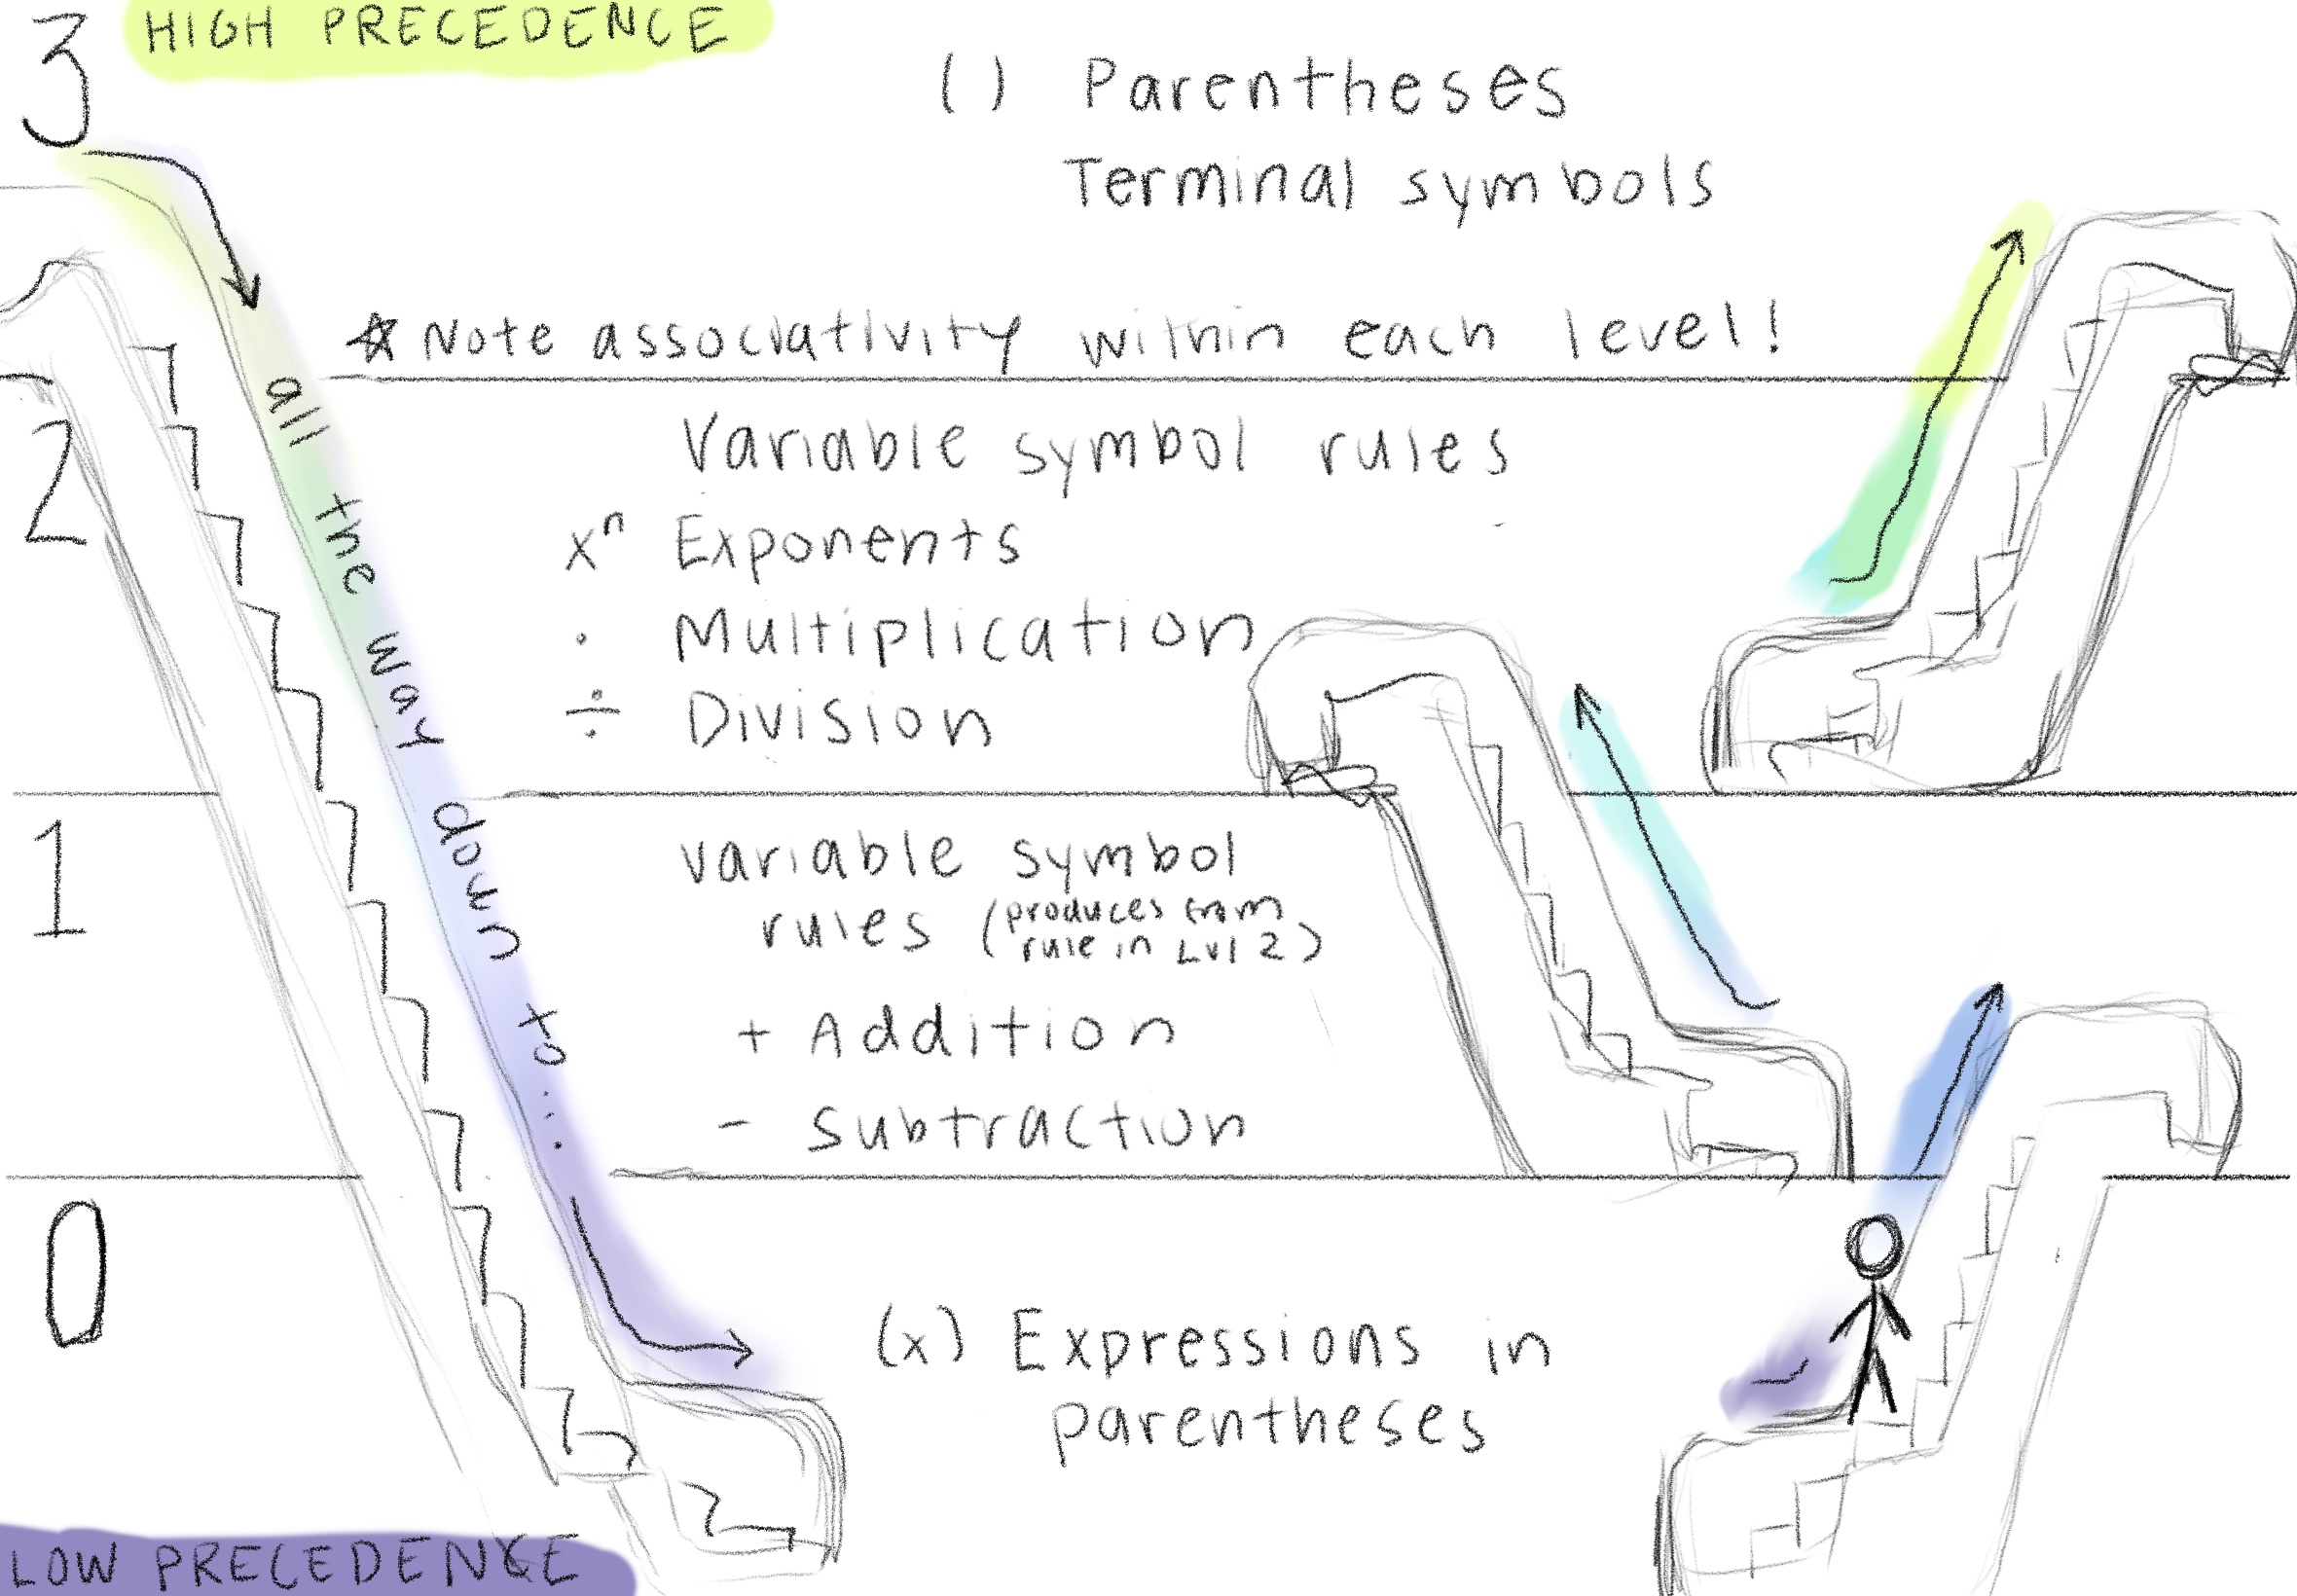
Metaphor: Escalator
Figure by Ellen Kim, PL Comics Project

Slide 61
Toward a Grammar of Toi
The language Toi will continue to evolve, but let’s attempt a CFG
Brainstorm main concepts -> Variable symbols
S → D S | D // list of definitions D → definitions V → values E → expressions

Slide 62
Toward a Grammar of Toi
The language Toi will continue to evolve, but let’s attempt a CFG
Brainstorm main concepts -> Variable symbols
Fill in what you know
S → D S | D // list of definitions D → definitions V → num E → expressions

Slide 63
Toward a Grammar of Toi
The language Toi will continue to evolve, but let’s attempt a CFG
Brainstorm main concepts -> Variable symbols
Fill in what you know
Add new concepts when needed (P = param list)
S → D S | D // list of definitions D → var “=“ E | var “(“ P “)” “=“ E P → param list, left as exercise V → num E → expressions

Slide 64
Toward a Grammar of Toi
The language Toi will continue to evolve, but let’s attempt a CFG
Brainstorm main concepts -> Variable symbols
Fill in what you know
Add new concepts when needed (P = param list)
Build precedence table
Precedence # | Operator
0 | let, if
1 | +, -
2 | *
3 | f(x), f(), V, var, ()
S → D S | D // list of definitions D → var “=“ E | var “(“ P “)” “=“ E P → param list, left as exercise V → num E → expressions

Slide 65
Toward a Grammar of Toi
The language Toi will continue to evolve, but let’s attempt a CFG
Brainstorm main concepts -> Variable symbols
Fill in what you know
Add new concepts when needed (P = param list)
Build precedence table
Implement precedence table
Precedence # | Operator
0 | let, if
1 | +, -
2 | *
3 | f(x), f(), V, var, ()
S → D S | D // list of definitions D → var “=“ E | var “(“ P “)” “=“ E P → param list, left as exercise (likewise A for args) V → num E → “let” D “in” E | “if” E “{“ E “}” “else” “{“ E “}” | “E1
E1 → E1 “+” E2 | E1 “-” E2 | E2 E2 → E2 “*” E3 | E3 E3 → var “(“ A “)” | var “()” | V | var | “(“ E “)”

Slide 66
Summary
Traditional Parsing = RE + CFG
RE “lexing” identifies basic building blocks like “x” or “=“ or “124.4”
CFG parsing organizing basic building blocks into full tree
Ambiguous CFG often bad, often fixable (precedence climbing)
Not obvious how to implement CFG parsing Next time: Parsing Expression Grammars make implementation clearer than CFGs

Slide 67
Appendix B: Extra Material

Slide 68
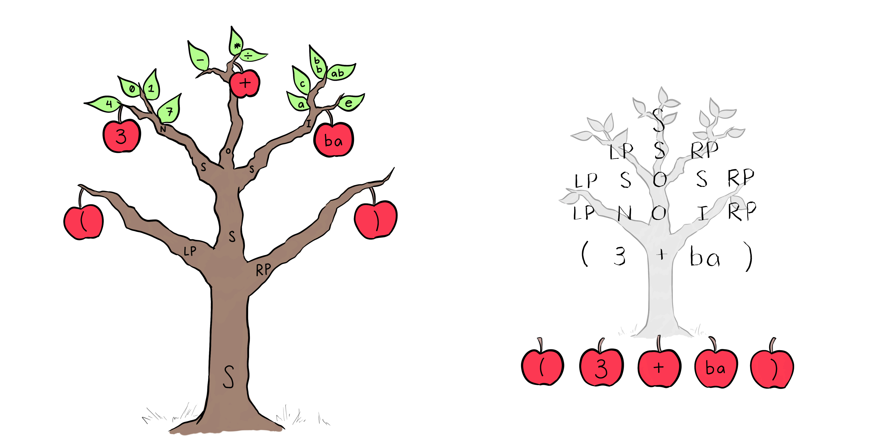
Metaphor: Apples on the Parse Tree
The leaves (apples) of the tree fall into a neat row
The green leaves represent other strings that match the same symbol as the apple
Figure by Ellen Kim, PL Comics Project

Slide 69
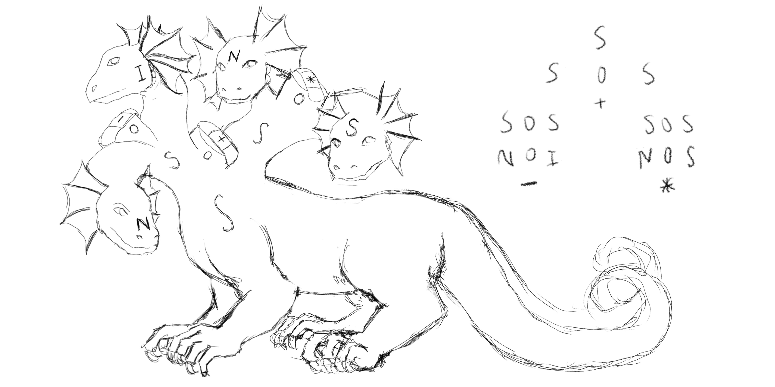
Metaphor: Parsing as a Hydra
Variable symbol: Remove one head, multiple grow back
Terminal symbol: Bandage the head, it’s “done”
Figure by Ellen Kim, PL Comics Project

Slide 70

Bonus: Context-Free Art
Context Free is a program (and PL) for generating visual art using CFGs
We do not use it in this course
It can be used to explore the power and limitations of CFGs (what can’t it draw?)
If you’re curious about it, you could consider exploring it in your design homework
https://www.contextfreeart.org/

Slide 71
Section: RE Implementation

Slide 72
Section: RE Implementation
This is not the library used on HW2
RE is implemented with the regex crate
use regex::Regex;
Example: dates in YYYY-MM-DD format
let re = Regex::new(r"d{4}-d{2}-d{2}").unwrap();

Slide 73
Section: RE Implementation
Full example:
let re = Regex::new( r"(d{4})-(d{2})-d({2})").unwrap(); let text = "2012-03-14, 2013-01-01 and 2014-07-05"; for cap in re.captures_iter(text) { println!("Month: {} Day: {} Year: {}", &cap[2], &cap[3], &cap[1]); }

Slide 74
More to Come
We learned lexing using RE because this is by far the most common way it is handled – out in the world, you will want to know it
Soon we will learn Parsing Expression Grammars, a more recent way of defining grammars that includes all REs
In HW2 you will use Parsing Expression Grammars to implement your code, but your knowledge of RE will certainly help you understand it

Slide 75
Limitations of RE
Informally: RE can handle flat and iterated patterns
A date contains a fixed number of digits and hyphens in fixed order
Variable names contain letters, repeatedly
Numbers contain digits, repeatedly
But cannot handle any kind of recursive or tree-like structure
Fundamental limitation for PL: Cannot match parentheses/braces (only say “this character is a parenthesis”)

Slide 76
Limitations of RE
Formally: The pumping lemma shows that every RE behaves like a loop when the string is long enough*:
Let r be an RE. Then r has a pumping length n such that for all strings s of length at least n:
n can be split into some s1s2s3 where
s1(s2^k)s3 in L(r) iff s1s2s3 in L(r) for all natural numbers k
E.g. s1s3 in L(r) and s1s2s3 in L(r)
Understanding check: If r = a(bc)*d and s = abcbcd then s1s2s3 = ???
*The same lemma is often described using state machines. Both versions are equivalent.

