Slide 1

Centering Humans in the Programming Languages Classroom:
Building a Text for the Next Generation
Rose Bohrer (she/her/她) Assistant Prof. Computer Science Worcester Polytechnic Institute, MA, USA
SPLASH-E 2023 (Cascais / Virtual)

Slide 2
Outline
Introduction
The Book
Turning it Into a Course (Stories from the Classroom)
Data Analysis
Conclusion

Slide 3


Introduction: What
This work presents the research and design processes behind the development of “Human-Centered Programming Languages”:
A new open-access textbook and accompanying course for upper-level undergraduate programming languages courses directed at Computer Science majors
Contribution: This book is the first truly interdisciplinary book (+course) of its kind, placing shared emphasis on programming language theory and human-centered computing
Scale: 20 chapters, roughly 100k words, prints as ~600 pages
Read: https://bookish.press/hcpl Open course materials!: https://github.com/rbohrer/pl-course

Slide 4
Motivation
Who takes a Programming Languages course?
“PL courses are taken by students who want to learn many different languages”?
“PL courses are taken by students who want to prepare for research in programming language theory.”?
“PL courses are taken by students who want to become programmers who understand their tools. “?

Slide 5
Motivation
Who takes a Programming Languages course?
“PL courses are taken by students who want to learn many different languages”?
“PL courses are taken by students who want to prepare for research in programming language theory.”?
“PL courses are taken by students who want to become programmers who understand their tools. “?
Our radical answer: PL courses are taken by students who will work in interdisciplinary teams, and who must work across disciplinary boundaries. PL as a breadth course
Backed by data: My recent graduate PL course was 25% “traditional audience”

Slide 6
Defining Audience
Who do we design an interdisciplinary book for? The HCPL book is scoped based on 2 groups:
Students for my undergraduate course: Usually CS majors in years 3-4 with prior experience in interdisciplinary group projects. Most are comfortable programming in several languages but not comfortable with proofs
Students for my graduate course: Majors range from CS to robotics, data science, and computational media. Range from 2nd-year undergrad to doctoral level. Very wide experience range. Rarely comfortable with proofs

Slide 7
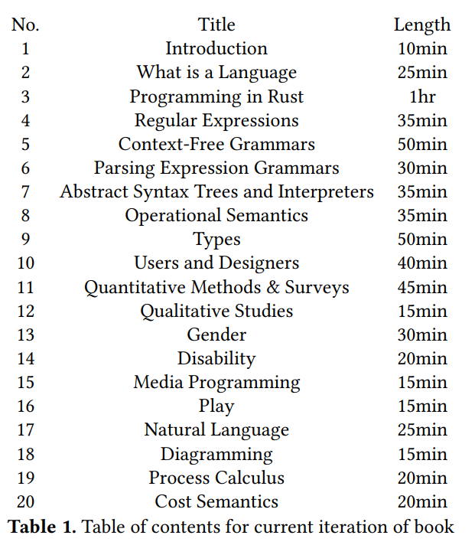
Outline
Chapters selected based on learning objectives, archetypes, students, interest
CS Core: Implementation + Theory
HCI Core: Social Science + Critical Studies
Media Module: Case Studies
Advanced Theory Module

Slide 8
Interdisciplinary Strategies
Interdisciplinary work is hard; interdisciplinary curriculum is no different
Core Pedagogical Strategy: Develop characters (“Archetypes”) standing in for different academic disciplines, emphasize student ability to communicate across each; literacy. Use design as a uniting topic across disciplines

Slide 9
Archetypes: PL as Breadth Topic Through Characters
The Practitioner is a typical career programmer
The Implementer implements, e.g., interpreters or compilers
The Theorist sees PLs are formal languages. “Good PL” = “Analyze it in powerful ways”
The Social Scientist studies humans, often empirically, for humans’ sake or for design
The Humanist studies humans too, but often emphasizes structural critique over empiricism

Slide 10
Exercises
Book contains exercises for every archetype
Practitioner: Implement function X in favorite PL; make a picture in Processing
Implementer: Implement type-checker in favorite PL
Theorist: Construct derivations for context-free grammars; language of a regex
Social Scientist: Qualitative corpus analysis; autoethnography for code
Humanist: Critical essays in cultural, gender, and disability studies
And multiple complexity levels:
Exam questions: reason about examples of regex, CFG, semantics, types
Homework + Projects: Implement PL feature X. Design + run user study
Research-Level: Design a type system that does X; do proofs, user studies, etc…

Slide 11
Assignments
Core Assessment Strategy (for CS course): Two spokes
Coding Assignments Auto-graded
Toy programs in Rust
PEG parser
Evaluator
Type-checker
Quantitative data analysis
Written Assignments Participation-graded + intrinsic motivation
Goal-setting
User study brainstorm
Autoethnography
User study; detailed plan
User study results

Slide 12
Assignments
Core Assessment Strategy (for CS course): Two spokes
Coding Assignments Auto-graded
Toy programs in Rust
PEG parser
Evaluator
Type-checker
Quantitative data analysis
Written Assignments Participation-graded + intrinsic motivation
Goal-setting
User study brainstorm
Autoethnography
User study; detailed plan
User study results
BUILT TO SCALE! Automatic except instructor feedback (peer feedback helps with scale)

Slide 13
Language Choice
Book moves language-specific content to the margins; course cannot
Choice informed by learning goals, stated student opinions, student background
Learning Goals: Implement evaluator + type-checker by recursion over AST; implement parser for toy language; assess benefits and barriers of static typing Implied needs: Static types, ADTs, recursion
Stated Student Opinions: Career-oriented. Needs industry growth (potential)
Student Background: Exposure to systems and object-oriented programming. Limited exposure to functional programming or Hindley-Milner-style type systems

Slide 14
Language Choice
Book moves language-specific content to the margins; course cannot
Choice informed by learning goals, stated student opinions, student background
Learning Goals: Implement evaluator + type-checker by recursion over AST; implement parser for toy language; assess benefits and barriers of static typing Implied needs: Static types, ADTs, recursion
Stated Student Opinions: Career-oriented. Needs industry growth (potential)
Student Background: Exposure to systems and object-oriented programming. Limited exposure to functional programming or Hindley-Milner-style type systems
Based this combination of needs, we chose Rust

Slide 15
Story 1: Student Letter
Let’s share stories from the classroom (with student permission). Thank-you letter from a Spring 2023 student in graduate course (then project-based):
“Coming into this class I didn’t have any prior interest or experience in theory behind languages but this definitely stoked my desire to work with it.”
“I really enjoyed the freedom to design whatever we wanted. … it has been amazing overall and taught me so much, especially because it was a tough term personally. What a great experience that I wanted to spend all of my time on”

Slide 16
Story 2: Posture Study
This story shows user study assignment served as a creative, exploratory opportunity while still supporting key learning objectives
One student wanted to know whether posture affects programming productivity. To test this, they had half their classmates code sitting on the floor, half slouched at a table. It was hard to avoid laughter or curious table neighbors, but this was good for the class. This day was a much-needed opportunity to see each other’s interests and laugh together.

Slide 17
Story 3: Twine + Rust
In Fall A-Term 2023, the final homework includes an extra credit question: make an artwork in any media technology discussed in the book (Processing, Context Free Art, Twine).
19 students did this optional problem of 47 submissions
Student submissions included fractals, a cartoon guy, and text adventures, but one stands out:
Without prompting, one student wrote a Twine-style text adventure game entirely in Rust, perfecting reinforcing the desired takeaway message:

Slide 18
Story 3: Twine + Rust
In Fall A-Term 2023, the final homework includes an extra credit question: make an artwork in any media technology discussed in the book (Processing, Context Free Art, Twine).
19 students did this optional problem of 47 submissions
Student submissions included fractals, a cartoon guy, and text adventures, but one stands out:
Without prompting, one student wrote a Twine-style text adventure game entirely in Rust, perfecting reinforcing the desired takeaway message: PL Nerds and Art Nerds Can Be Friends!! <3

Slide 19
Data Analysis
Paper includes thematic analysis of course evaluations to inform course design. Summary:
3 courses: old PL, beta test of new PL, intro FP
Ungrading sentiment: liked intrinsic motivation, stress reduction. Some rigor concerns
Language choice: Racket was unpopular in intro course. Motivated PL choice exploration
Social issue integration: remains controversial in some CS classrooms, esp. for women profs.

Slide 20
Future Plans
The book is now “released.” But I will now look for an open-access academic publisher
Collaboration opportunities:
Let me support you in using the book in your classroom!
For future editions, I wish to include interviews with interesting researchers
For future editions, I wish to include comics as a stretch goal
If you are proficient in Classical Chinese (古文/文言文), you help would be invaluable in writing about multi-cultural language design

Slide 21
Thank You to Many People!
Writing a book is a significant time and emotional investment. I’m deeply grateful to the many people who kept me motivated and supported throughout the writing process
Gillian Smith and Chris Martens for reminding me this book needs to exist
Matthew Ahrens for feedback on paper draft
Molly Feldman for encouraging this paper submission
Leif Andersen for lived experience on PL research and disability
Felienne J.J. Hermans for encouragement, feedback, and cross-cultural PL expertise
Ichiro Hasuo for encouraging me to keep my PL brain and human-centered brain on at the same time
And many students, friends, and colleagues who told me something in the work resonated with them

Slide 22
BONUS SLIDES

Slide 23
Collaboration Opportunities
Though this work is sole-authored, it is rooted in community, and I am excited to look for collaboration opportunities going forward
Certain additions are likely to need collaborators, e.g., PLs for different native/natural languages
If you are proficient in Classical Chinese (古文/文言文）I will be your friend
I’m looking to interview PL researchers with human-centered interests, for “published” ed.
My stretch goal is to include comics about the archetypes as well. I will not say no to interested artists, including enthusiasts
Open to other ideas!

Slide 24
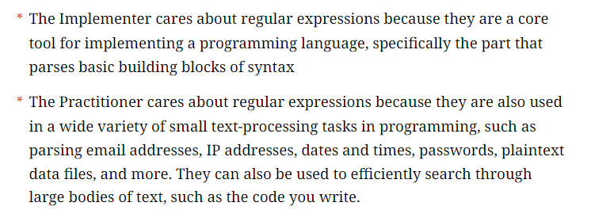
Platform + Format
Prepared using Bookish, ebook platform by Amy J. Ko
Typical chapter structure: Introduction
Introduction contextualizes content for each archetype

Slide 25
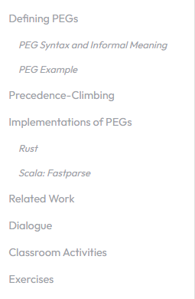
Platform + Format
Prepared using Bookish, ebook platform by Amy J. Ko
Typical chapter structure: Introduction
Introduction contextualizes content for each archetype
Core Content
Implementation
Citations
Dialogues
Classroom Ideas
Exercises

Slide 26
Corpus
Course A: Programming Language Design (CS 4536), A-term 2021: 14 respondents of 31 students (45%).
Course B: Introduction to Program Design (CS 1101), A-term 2022: 46 respondents of 70 students (66%) (Intro programming, not PL elective)
Course C: Programming Language Design (CS 536), Spring semester 2023: 14 respondents of 16 students (88%). (Uses notes that informed the book)
Not analyzed: CS 4536 and CS 536 from this semester (uses the full book)

Slide 27
Methodology
Thematic analysis of course evaluations for Course A and Course C (i.e., qualitative coding of written responses; identify themes among codes)
Limited qualitative coding for Course B
Research questions:
What sentiments do students hold toward ungrading in an HCPL-based course?
What course delivery recommendations did students make for future iterations of course?
What sentiments do students hold toward centering social issues in PL curricula?
What sentiments do students hold toward language choice in PL and PL-adjacent courses?

Slide 28
Results
Ungrading (C):
Self-direction improved motivation, learning (x4)
Reduced stress (x2)
Rigor concerns (x1)
Delivery (A+C): Needed proper slides (x5)
Social Issues (C): Appreciated (x1); Perceived as divisive (x3)
Language Choice (B): 11/26 mentioned language choice, all 11 opposed Racket

Slide 29
Revisions
Based on student recommendations, comprehensive set of slides were developed
Based on student recommendations, revised grading scheme to blend autograding and ungraded activities
All slides, assignments, autograders are available for reuse on GitHub: https://github.com/rbohrer/pl-course
Open education: Creating course materials takes time; let’s save each other work

Slide 30
Gender Bias
Comparing Course A and Course C feedback on social issues in classroom provides a rare opportunity to explore role of student bias in course evaluations
… because my gender transition occurred after Course A and before Course C
I cannot help but notice that in Course A, supportive students were vocal and unsupportive students took on a restrained tone. In Course C, the numbers and tones flipped, with unsupportive students being the vocal ones
This is why “big-Q” qualitative analysis matters. This was a “natural experiment” which cannot be reproduced, yet instructor lived experience during transition deserves to be a part of academic discourse, even without reproducibility

Slide 31
Archetypes – Example Dialogue
Question: Do context-free grammars model human language?
Social Scientist: Of course they do. I invented context-free grammars and I invented them to model natural human language. That’s what’s so amazing about them, they can model every natural language that has ever existed.
Theorist: Woah! Did I just hear you make a universal claim, SS? I never thought I’d see this day. Can I prove this by induction?
Humanist: I never thought you would have me agreeing with T, but desperate times call for desperate measures. You and I both know not all human language is context-free. What about Swiss German? [40]

