Slide 1
Programming Language Case Studies Can Be Deep
Rose Bohrer (she/her) Asst. Prof. CS, Worcester Polytechnic Institute
Trends in Functional Programming in Education (TFPiE) 2024 South Orange, NJ, USA Jan 9th 2024

Slide 2
Section 1: introduction

Slide 3
Thesis
“Programming Language Case Studies Can be Deep”
Meaning: Key ideas in PL’s, especially PL design, can be taught through case studies
Some of those key ideas could not be effectively taught using other common approaches
Underlying question: Which topics even are key topics? This changes if we emphasize design, not just theory

Slide 4
Context
This paper is a part of the Human-Centered Programming Languages (HCPL) project
Textbook: Available open-access at bookish.press/hcpl. Currently self-published
Materials: GitHub repository has slides, assignments (Rust + written), autograders
Papers: In addition to this paper, SPLASHE’23 documents the textbook design
Classroom-tested:
Graduate class: Spring ’23, ~18 students (prelim.), Fall’23, ~28 students (full)
Undergraduate class: Fall’23, 55 students (full)

Slide 5
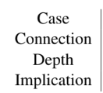
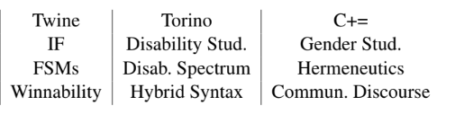
Outline / Structure
The thesis fundamentally must be argued from examples
The paper has more case studies, the book has even more than that
For each case study I will present its depth: what foundational idea it teaches, how that idea fits into the course, and what beyond the case study is done in the lesson
Breadth of subject matter makes interdisciplinary teaching hard. We’ll close the presentation with recommendations

Slide 6
Section 2: Torino A PL for visually disabled children

Slide 7
How does torino work? Tactile syntax
Challenge: Existing PL syntaxes are not good for groups of visually-disabled children
Text-based: Challenging for all young chlidren (limited literacy)
Block-based: Good for most children, but not visually accessible
Sound-based: May make partially-sighted children feel “held back”. Over-reliant on memory
Bead-based tactile syntax:
Distinct shapes allow telling constructs apart by touch
Physical wires can be used to trace the flow of a program
Colors of beads accommodate those who have some vision
Output is sound, to avoid reliance on vision

Slide 8
Depth 1: Syntax
Traditional PL courses have struggle to provide students a clear intellectual foundation for questions of syntax design
The “Theory” approach -> “Syntax doesn’t matter”
The “Racket” approach -> (Make (it all) parentheses)
Try the “Randomo” approach? -> Randomized controlled trials (too narrow)
Torino suggests a foundational two-prong approach:
Use critical theory from the humanities to identify design values
Use qualitative methods from human-computer interaction to assess, iterate
Importance: Syntax is one of the most common stated interests among students

Slide 9
Depth 2: Disability Continuum
In this case study, we do not draw directly on any methodology from the humanities, rather we draw on a key concept from (critical) disability studies, for goal-setting
The disability continuum is a key concept in the nature of disability itself
Continuum means that disability status is not a binary “abled” vs. “disabled”
Continuum means that disability is multi-dimensional (e.g., developmental, visual, motor, …)
Continuum means that disability is dynamic: not only can a person’s status change throughout the years, but presentation can change throughout the day and between environments
Because this concept has direct design implications, it is an effective tool for getting CS-minded students to engage with disability studies.

Slide 10
Influence on language design
The syntax choice is informed by the co-existence of multiple programmer subpopulations with various levels of vision
Design goal: A single syntax which supports multiple interaction modes, one of which is convenient for each sub-population
High-vision children: Color-coding on beads promotes visual interaction
Low+no-vision children: Distinctive shapes promote tactile interaction
The notion of disability as a spectrum is fundamental to motivating this hybrid style of interaction with language syntax (tactile + visual)

Slide 11
Section 3: C+=
Content warning: misogyny and transphobia

Slide 12
Goals
Anti-goal: Provide immediate design recommendations
If we restrict ourselves only to immediately actionable studies, we deprive ourselves of the opportunity to build a robust theory
Goal: Directly demonstrate the usefulness of a methodology from the humanities (close reading) to a PL designer
Bonus goal: Preserve significant events from PL history. Though not the original goal, this became pressing when primary sources became inaccessible during paper revisions!

Slide 13
description
C+= (“C Plus Equality”) is not a programming language in a meaningful sense
No serious implementation, theory, application, or user base
Has: A design document. Thus C+= is most meaningful when viewed as media and we will analyze it as such
C+= exists primarily in the form of a Git repository hosted on GitHub*, containing a design document, example programs, and minimal prototype implementation** of a self-proclaimed “feminist” programming language Unpacking historical context is essential to interpreting this design document
* Repository disabled for its terms-of-service violations
** Implementation consists of a trivial set of C preprocessors macros

Slide 14
context
In 2013, humanist scholar Ari Schlesinger started a conversation on the HASTAC blog about what it might mean for a code or even a PL to be feminist
Codework, i.e., code as poetry (e.g. Mez Breeze, micha cardenas)
Browser extensions for manipulating gendered language (Jailbreak the Patriarchy)
As the article circulated through online tech news, reactionary viewers responded with a satirical design document, typically attributed to anonymous 4chan trolls
Approach: Our close reading of the design document must be informed by an understanding of 4chan troll culture and the memes and tropes employed by this community
Contemporary impact: As of this writing, if my students search for feminism and PL design, Schlesinger’s legitimate article is drowned out of search results by C+=

Slide 15
Depth 1: close reading
By close-reading a document that uses coded language to address PLs, we demonstrate to computer science students the irreplaceability of humanistic methods for a task relevant to their work as PL designers
Close reading here means interpreting a text by zooming in to the details such as individual words and phrases, then zooming out to interrogate their textual arrangement (e.g. order) and finally comprehend their rhetorical functions,
Hermeneutic inquiry is a stance: we view close reading as means of “divination”. Though the author has an intended “true meaning,” the act of reading is simultaneously a creative, generative one, and any effort to erase the subjectivity of the reader is futile

Slide 16

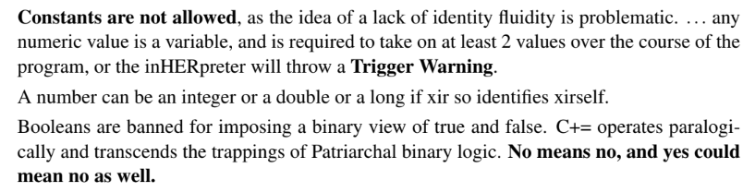
The reading

Slide 17
Insight: misogyny and transphobia
Misogynistic and transphobic elements collocated, suggesting relation
Misogynistic elements: Use of keywords that reinforce the “hysterical feminist” trope
Transphobic elements: Illegitimizing neopronouns and the notion of gender mutability by attributing these traits to inanimate programs
By observing these elements collocated, we gain insight into how interpersonal bias may operate in PL discourse circles: bias against women-as-a-whole and trans-people-as-a-whole and intrinsically linked
Design implications: Codes of conduct must protect us all or they protect none

Slide 18
Section 4: Twine

Slide 19
Goals: “Found” theory
The HCPL curriculum is interdisciplinary, but CS theory is still one of those disciplines!
Retaining strong CS foundations is essential to legitimizing interdisciplinary methods
Engage CS students by connecting theory with application
Protect instructors from reactionary backlash
Accommodate realities of curriculum constraints
Goal for case study: Prove that “found theory” exists, i.e., that novel theoretical results can be identified within pre-existing languages

Slide 20
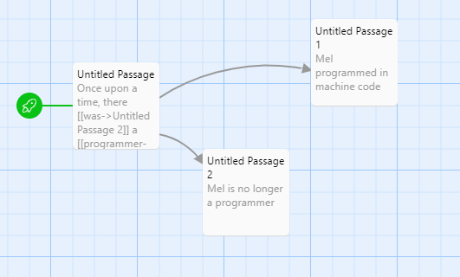
Description
Twine is a graphical tool for creating interactive fiction (“text adventures”), emphasizing ease-of-use over expressive power
Is Twine a programming language? We dodge this question. Though Twine does not describe itself as a programming language, it teaches us something about PL design, thus it falls within our scope regardless
Twine allows the use of multiple PLs such as JavaScript whose formalisms are complex, so we use a novel idealized calculus for simplicity

Slide 21
Graph Model
To a first approximation, a Twine game is a directed, labeled graph
G = (V, E) where V is the vertex set and E is the edge set
V = {(n, p)} i.e., passages with titles n and text p
E = {(u,v,l)}, i.e., links from source passage u to destination passage v with text l
Let Sigma = {l}, Q = {n}, and delta(u,l) = the unique v such that (u,v,l) is in E
Insight: Then (Sigma, Q, delta, s, F) is a DFA for every passage s, set of passages F

Slide 22
Pumping Lemma for DFA
Formally: The pumping lemma shows that every DFA behaves like a loop when the string is long enough*:
Let dfa = (Q, Σ, δ, q0, F) be a DFA. Then the pumping length is n=|Q|, the number of states. For all strings s of length at least n:
n can be split into some s1s2s3 where
s1(s2^k)s3 in L(dfa) iff s1s2s3 in L(dfa) for all natural numbers k
E.g. s1s3 in L(dfa) and s1s2s3 in L(dfa)
What does this mean for Twine???

Slide 23
Twine Theorems
Theorem [Regularity] Let m be a Twine game. The set of winning plays of m is a regular language. Proof: By definition of regularity and translation of Twine <-> DFA correspondence.
Theorem [Bounding Shortest Winning Play] Let m be a (winnable) Twine game containing k prompts. Then the game can be won in at most k steps of play.
Proof: Given a play longer than k, a cycle exists by the pumping lemma. That cycle can be removed without affecting result.
Theorem [Unbounding Longest Winning Play] Let m be a (winnable) Twine game containing k prompts. If any winning play contains a cycle (e.g. if it is length k), then there exist arbitrarily long winning plays.
Proof: By the pumping lemma, the cycle can be repeated

Slide 24
Section 5: Conclusion

Slide 25
Conclusion
Case studies serve an irreplaceable pedagogical role when used for foundations of design
This work is in large part an invitation to give design a critical role in PL curriculum
This interdisciplinary pedagogy is ambitious and thus needs several forms of support
Using fictional characters (archetypes) to contextualize competing disciplinary views
Grading schemes blending autograded coding and participation-graded user study design
Future work:
Finding a publisher
Supporting you in using this material

Slide 26
EXTRAS

Slide 27
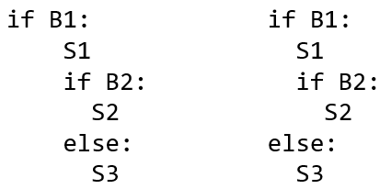
Rest of lesson
To complete the exploration of visibility, we do a hands-on exploration of the idea that the same syntax might be perceived differently by two different groups, and that requiring a separate accessible syntax would violate autonomy of visibility
Motivations matter:
Motivations based on empathy-building tend to backfire, heavily criticized
Emphasize factual knowledge and design implications (e.g. should recruit disabled test users!)

Slide 28
Influence on user study design
The design and execution of PL usability studies are major connecting themes in HCPL
A PL design will only be as good as its usability study
Disability studies theory sets the foundation for a good usability study
Through theory, identify social integration and collaboration across the spectrum as key aspects of usability within this specific use context
Quantitative methods are likely to struggle with measuring nuance of children’s social behavior
Qualitative analysis of behavior in collaborative study was selected as method
Takeaway: If you want to build a good PL, read relevant social theories!

Slide 29
Who is Torino for?
“Early” programming language for children ages 7-11
Research prototype out of Microsoft Research, not commercially released
Special focus: Visually-disabled children
The details matter:
All students in this learning environment are visually-disabled, but the extent of disability varies greatly between them
Social well-being is a focus for this population

Slide 30
Assimilation and integration
Through the goal of collaborative programming, I engage students with major concepts in contemporary disability discourse: Separatism, assimilationism, and integrationism
Separatism: Advocates for disabled people to maintain separate (sub)-communities and proudly maintain distinctive way of doing things. Often with goal of radical liberation
Assimilationism: Advocates for blending in with the majority. Goals often include safety, access to equal opportunity, and ease of life
The two above ideas are diametrically opposed, yet assimilation can be distinguished from integrationism, which allows elements of separatism to coexist:
Integrationism: Advocates for a single community. Does not require everyone within the community to behave in a similar way. This is what Torino does.

Slide 31
Limits of competing approaches
The closest predecessor of Torino are the block-based languages (e.g. Scratch)
Block-based programming is often advocated as being accessible in the sense that it is easily picked up by newcomers
Yet the word “accessibility” has multiple meanings, and block-based languages are not especially accessible in terms of (visual) disability
They are not completely unusable (as research on hybrid syntax disproves)
Yet the provide disequal experiences, often requiring disabled people to effectively disclose their disability status
When this occurs, the core principle of autonomy over one’s visibility is violated

Slide 32
Why kids?
The notion of usability depends on the tasks and goals of a specific user group
Let’s explore the goals and non-goals for children who code
Anti-goal: Producing useful production code
Potential Goals:
Teach computational thinking
Promote sense of belonging in support of diversifying talent pipeline
Context: Disabled people often have fewer economic opportunities, and programming careers are potentially a rare accessible well-paying career

Slide 33
Depth: Static Analysis vs. types
The Twine case study enriches and complicates students understanding of the central role of static type systems in PL theory
In the Type Systems lecture: “Good PL = Strong Safety Theorem = Strong Guarantees“
Twine exemplifies the idea that type safety is not a meaningful guarantee in every PL, and that other forms of static analysis (here, a graph-based analysis) are more fruitful in certain PLs

Slide 34
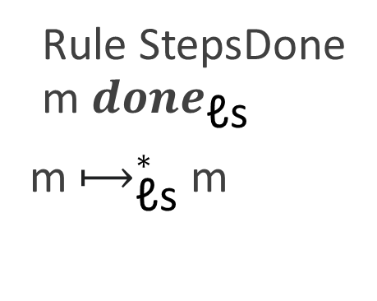
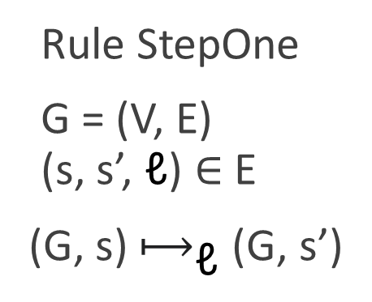
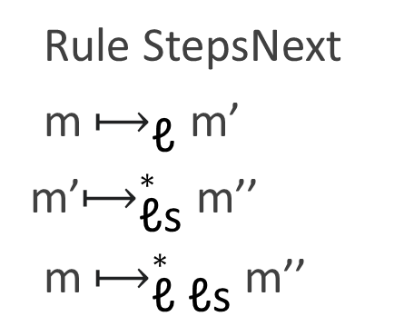
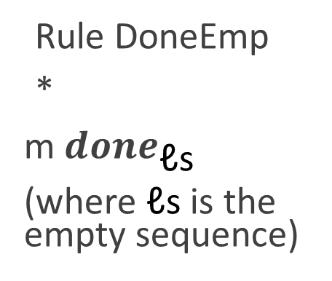
All Stepping Rules
Rule StepOne
G = (V, E) (s, s’, ℓ) ∈ E
(G, s) $⟼_{\text{ℓ}}$ (G, s’)
Rule StepsDone m ${done}_{\text{ℓ}\text{s}}$
m $⟼_{\text{ℓ}\text{s}}^{∗}$m
Rule DoneEmp
*
m ${done}_{\text{ℓ}\text{s}}$
(where $\text{ℓ}\text{s}$ is the empty sequence)
Rule StepsNext
m $⟼_{\text{ℓ}}$ m’
m’$⟼_{\text{ℓ}\text{s}}^{∗}$ m’’
m $⟼_{\text{ℓ} \text{ℓ}\text{s}}^{∗}$m’’

Slide 35
Role of Disabled Researchers
Common disability rights slogan: “Nothing about us without us”
This does not mean that abled people are unqualified to teach this lesson, but rather that decisions which affect disabled people ought to be made by disabled people
The HCPL lesson closes by highlighting the impacts of disabled PL researchers
Leif Andersen’s work on hybrid visual-textual syntax dovetails with many of the same themes explored in the Torino case study
I highlight researchers who have adopted audio input mechanisms to cope with temporary musculoskeletal disability*
I highlight disabled researchers who do not work on disability-related topics, because we need not be pigeon-holed* * These researchers are not mentioned by name here out of respect for privacy

Slide 36
Depth 2: scope of pl design
This case study encourages us to question and expand our notion of PL as a field “What do we study when we study PLs?”
Implication 1: When we decide what our curriculum is for, this can have subtle implications on whom it is for, i.e., which students feel included or not
Implication 2: When we view PL design as including the design of a PL’s user community and their discourse, we confront the idea that community discourse can be designed:
From a Foucauldian perspective, written policy creates institutional restrictions on permitted discourse, which underly the social construction of a community
In plain English: Community codes of conducts and governance procedures matter

Slide 37
Implications on language choice
As PL educators, we ought to entertain the idea that PL community discourses are a design choice not just in the creation of a new PL but in curriculum design
When your students search for help online, who are they talking to, and how are they being spoken to? What self-images might these interactions promote?
If a given PL community exhibits toxic interaction, educators should be wary of potential impacts on all students, but especially students from marginalized groups
We also have the choice of rewarding language communities that have dedicated special attention to the experience of newcomers (Rust and Racket are both contenders)

Slide 38
Beyond case study: GenderMag
The C+= case study does not seek immediate design implications
Yet PL design is a unifying theme of the course. We should try. But how?
Lacking a Gender-PL-Design methodology, appeal to GenderMag, from gender HCI
Identify aspects of problem-solving style whose statistical averages vary by gender according to large-scale empirical studies
Develop user personas which reflect diverse values of those problem-solving styles
Walk through (simulated) steps of user interaction using those personas
Use these interactions to drive iterative design process
Figure: The facets and potential ideas for gender-inclusive PL design

Slide 39
Future work
Publication: HCPL is currently self-published, publisher search is in-progress
Content: HCPL contains 20 chapters already, but at least one more is planned, e.g., on multi-cultural considerations in PL design
Creative instructional materials: Such as instructive comics with each chapter
Broader Classroom Use: If you are interested in using my materials in your classrooms, I am happy to provide support

Slide 40
Thank You to Many People!
Writing a book is a significant time and emotional investment. I’m deeply grateful to the many people who kept me motivated and supported throughout the writing process
Gillian Smith and Chris Martens for reminding me the book needs to exist
Matthew Ahrens for feedback on paper draft
Molly Feldman for encouraging this paper submission
Leif Andersen for lived experience on PL research and disability
Felienne J.J. Hermans for encouragement, feedback, and cross-cultural PL expertise
Ichiro Hasuo for encouraging me to keep my PL brain and human-centered brain on at the same time
And many students, friends, and colleagues who told me something in the work resonated with them

