Slide 1
12 – Play + Media
Slides ©2023 Rose bohrer, used for cs 4536/536 at wpi. Educational Reuse permitted with credit

Slide 2
Outline
Motivation
Play with Twine (Ch. 16)
Play with Processing (Ch. 15)
Time-depending
Interactive fiction with Inform
Diagrams with Penrose

Slide 3
Motivation: Reinforce Ideas Before Exam
Theorist: Work through defining an operational semantics and stating theorems about a language
Implementer: Operational semantics informs implementation
Practitioner: Write small Processing programs
Social Scientist: Explore use of Twine in social science research
Humanist: Untangle the cultural + design values embedded in each programming language
Takeaway message: These people can be friends. Even Twine, centered on very casual developers, has rich connections with theory

Slide 4
Motivation: It’s Almost Finals Week
Play is fun, by definition
Let’s end the course with a fun lecture
While still learning some things

Slide 5
Section: Twine

Slide 6
Activity: Play Some Twine Games
For 15 minutes: Pick 1 or more games and play them on https://itch.io/games/tag-twine
It’s more fun to pick your own, but I have a few suggestions:
https://chubbbbbs.itch.io/at-the-edge-of-the-world-there-is-a-gas-station (light)
https://tommchenry.itch.io/horse-master (heavy)
Feel free to play/chat with others

Slide 7
Discuss Twine (~5 minutes)
In Social Science, getting people to share their experiences is an important research technique
1. Share your experiences playing Twine games. Funny? Weird?
2. Has anyone in this room made a Twine game before? If so, share your programmer experience making that game
3. We’re going to develop the theory of Twine as a way of reviewing our core theory skills. Brainstorm how we might represent the (abstract) syntax, semantics, or even type system of Twine

Slide 8


Outline of Twine Theory
What we will / won’t explore
Concrete syntax?
Abstract syntax?
Operational semantics?
Type system?
State some theorems?
Something special: The Twine developers never developed its theory. The theory of Twine was developed specially for this course. It is evidence that we can languages which already exist and analyze them in new ways
https://pixabay.com/vectors/cross-delete-remove-cancel-abort-296507/
https://pixabay.com/vectors/check-mark-tick-mark-check-correct-1292787/

Slide 9
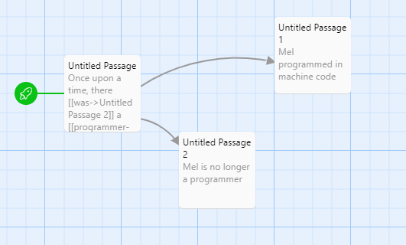
Concrete Syntax? No
The concrete syntax of a programming language means the exact way a program is written down in source code
In most programming languages, source code = text file
Twine’s story is more complicated:
It lets you code in full PLs
Or use graphical editor
Both would be complicated to define concrete syntax

Slide 10
Abstract Syntax
Abstract syntax is a simplified, yet accurate, representation of a program, used as a core data structure in PL implementation. Most often, we use a tree (AST), but Twine uses a graph
Idea:
Passage = Vertex
Link = Edge
Attach data to vertex and edge:
Name and content of passage
Text displayed for link
Later: Make it extensible

Slide 11
Twine Abstract Syntax, Formally
Core PL Vocab: A (machine) configuration m is the abstract syntax of a program at runtime, i.e., program combined with state.
We define Twine machines by m ≡ (G,s). G = graph, s = state name
G ≡ (V, E) where V is the set of vertices v and E is set of edges e
v ≡ (n, p) where n is the passage name and p is the passage text
e ≡ (u,v, ℓ) where u is the name of the passage we start from, v is the name of the passage it links to, and ℓ is the name on the label

Slide 12
Twine Abstract Syntax, Details
Let Q be the set of passage names n Let Σ be the set of link names
Recall G ≡ (V, E) where v ≡ (n, p) and e ≡ (u,v, ℓ)
Require
n, u, v ∈ Q
p ∈ string
ℓ ∈ Σ
Every n is unique within V
Every (u,v) is unique within E

Slide 13
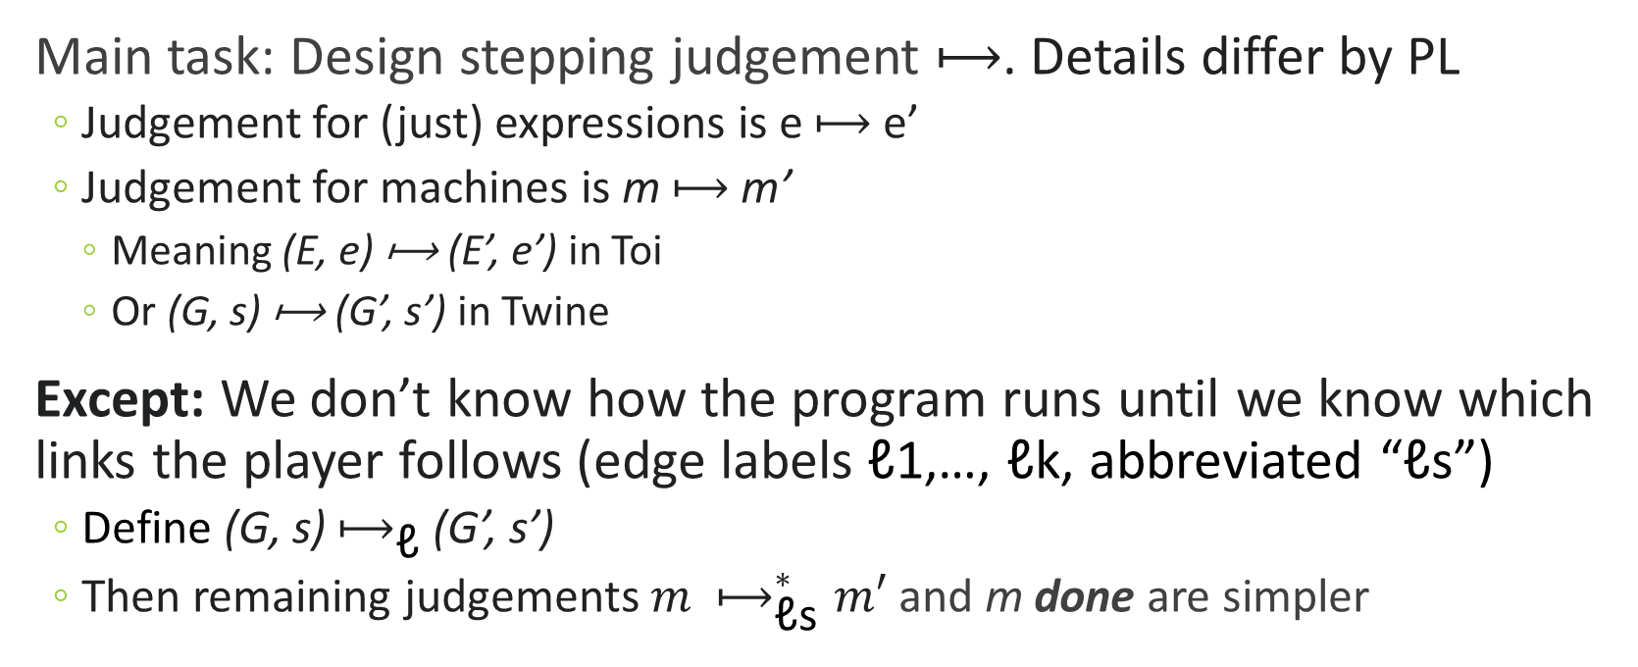
(Small-Step Operational) Semantics
Main task: Design stepping judgement ⟼. Details differ by PL
Judgement for (just) expressions is e ⟼ e’
Judgement for machines is m ⟼ m’
Meaning (E, e) ⟼ (E’, e’) in Toi
Or (G, s) ⟼ (G’, s’) in Twine
Except: We don’t know how the program runs until we know which links the player follows (edge labels ℓ1,…, ℓk, abbreviated “ℓs”)
Define (G, s) $⟼_{\text{ℓ}}$ (G’, s’)
Then remaining judgements ${m ⟼}_{\text{ℓ}\text{s}}^{∗}m′$ and m done are simpler

Slide 14

Main Stepping Rule
Rule StepOne
G = (V, E) (s, s’, ℓ) ∈ E
(G, s) $⟼_{\text{ℓ}}$ (G, s’)

Slide 15
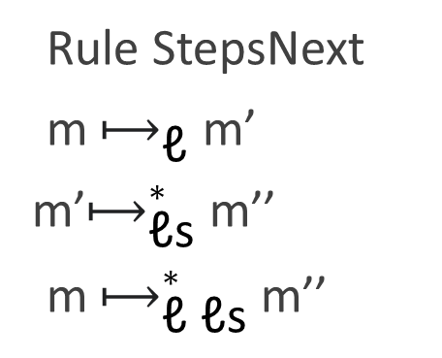
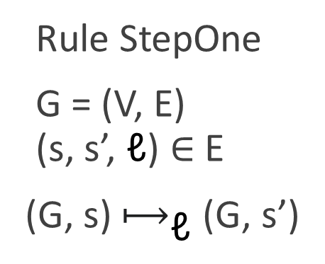
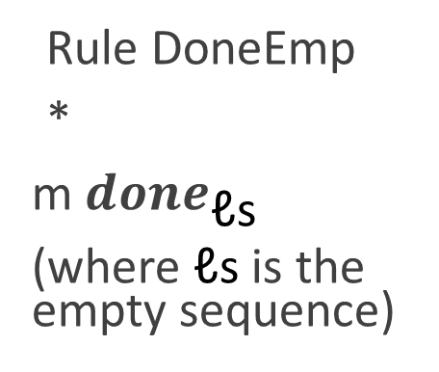
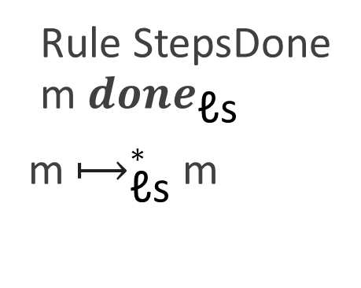
All Stepping Rules
Rule StepOne
G = (V, E) (s, s’, ℓ) ∈ E
(G, s) $⟼_{\text{ℓ}}$ (G, s’)
Rule StepsNext
m $⟼_{\text{ℓ}}$ m’
m’$⟼_{\text{ℓ}\text{s}}^{∗}$ m’’
m $⟼_{\text{ℓ} \text{ℓ}\text{s}}^{∗}$m’’
Rule DoneEmp
*
m ${done}_{\text{ℓ}\text{s}}$
(where $\text{ℓ}\text{s}$ is the empty sequence)
Rule StepsDone m ${done}_{\text{ℓ}\text{s}}$
m $⟼_{\text{ℓ}\text{s}}^{∗}$m

Slide 16
Type System? No thanks
(Static) type systems are used to look at a program before running it and predict what will happen when it runs
Examples: Predict type of return value, Ensure absence of memory-related errors
These kinds of guarantees don’t apply to Twine
Coming with alternative guarantees is hard. “I win the game”? (Could maybe do this? But is it types? …)

Slide 17
Theory Can Require Creativity
We want to prove something about Twine, but not using types ☹
Let’s brainstorm: does Twine look similar to any existing theories, that we could use for inspiration?
Ideas:
Twine looks a lot like directed graphs (true, but this didn’t go anywhere)
Twine looks a lot like deterministic finite state machines Note: This is covered in detail in CS 3133/503, but let’s just give some high-level ideas here.

Slide 18
Twine and Deterministic Finite Automata
A deterministic finite automaton (DFA), often used to match a regular expression over some characters, is formally a 5-tuple (Q, Σ, δ, q0, F), with the following meanings:
Q = list of states DFA can be in
Σ = list of characters in strings
δ = function δ(state,char)=newstate
q0 = initial state
F = set of desired end state

Slide 19
Twine and Deterministic Finite Automata
A deterministic finite automaton (DFA), often used to match a regular expression over some characters, is formally a 5-tuple (Q, Σ, δ, q0, F), with the following meanings:
Q = list of states DFA can be in
Σ = list of characters in strings
δ = function δ(state,char)=newstate
q0 = initial state
F = set of desired end states
In Twine
Names of passages
Names of links
function δ(passage,link)=newpassage
Initial passage
Set of “winning” final passages

Slide 20
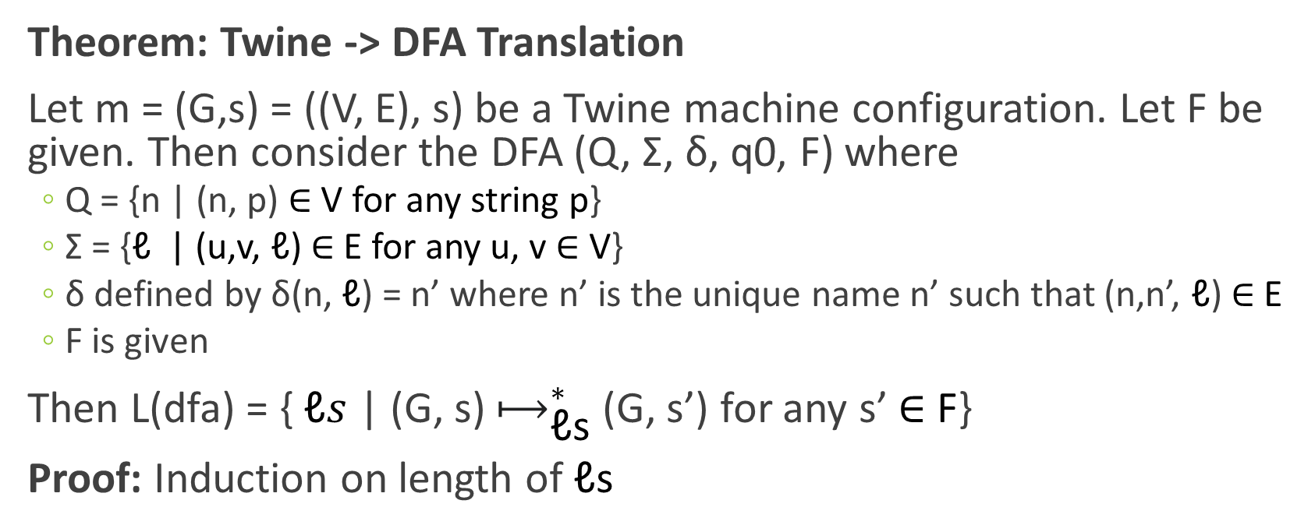
First Theorem
Theorem: Twine -> DFA Translation
Let m = (G,s) = ((V, E), s) be a Twine machine configuration. Let F be given. Then consider the DFA (Q, Σ, δ, q0, F) where
Q = {n | (n, p) ∈ V for any string p}
Σ = {$\text{ℓ}$ | (u,v, $\text{ℓ}$) ∈ E for any u, v ∈ V}
δ defined by δ(n, $\text{ℓ}$) = n’ where n’ is the unique name n’ such that (n,n’, $\text{ℓ}$) ∈ E
F is given
Then L(dfa) = { $\text{ℓ}s$ | (G, s) $⟼_{\text{ℓ}\text{s}}^{∗}$(G, s’) for any s’ ∈ F}
Proof: Induction on length of $\text{ℓ}\text{s}$

Slide 21
Recall: Pumping Lemma
Let’s see what we can do with some old theory
(For RE)
(For DFA)

Slide 22
Twine Theorems

Slide 23
Section: Processing

