Slide 1
02 - Introduction
Slides ©2024 Rose bohrer, used for cs 4536/536 at wpi. Educational Reuse permitted with credit

Slide 2
Outline
Introductions
Expectations
Whether to take the course
How to take the course
What is a Programming Language?
Things you Have to Do

Slide 3
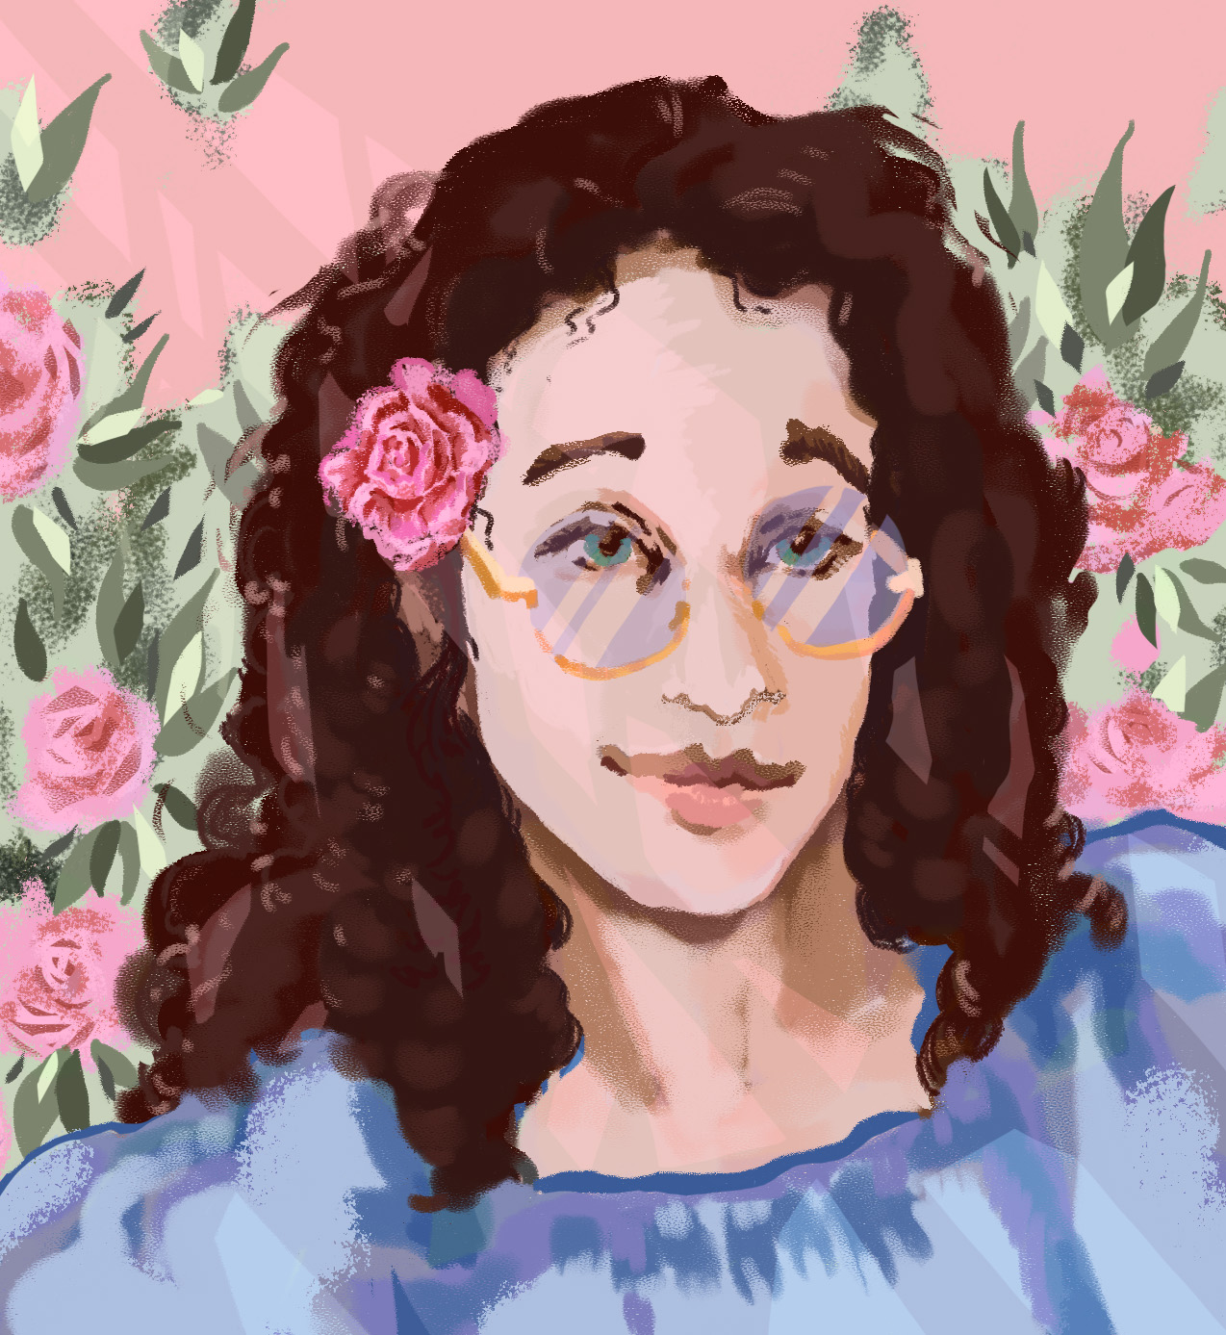
Meet the Instructor
Name: Rose Bohrer (she/her/她)
Assistant Professor of Computer Science (Tenure-Track)
This is my 3rd year as a professor at WPI
My research area is closely related to programming language design:
“How do we prove that a program works?”
“How do we get computers to help us with this?”
“How do we design languages to support this work?”
How are these topics related? We will learn!

Slide 4
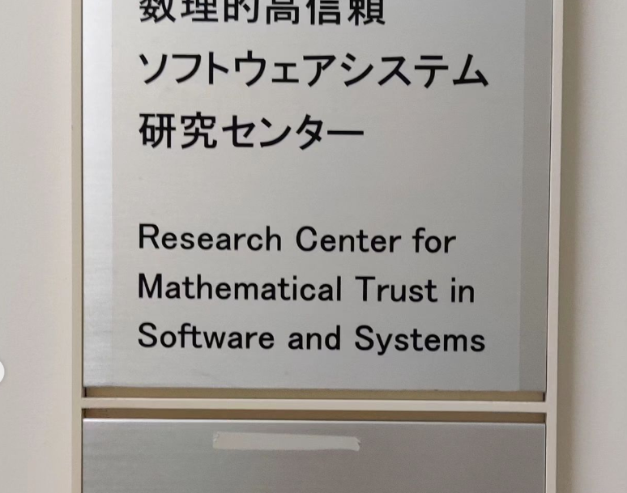
More About My Work
PhD thesis: Proving safety of physical systems (e.g. cars)
Ranked #2 dissertation in my year at Carnegie Mellon CS
A lot of math: formal logic, mathematical games, real analysis, ordinal arithmetic, and so on…
I still have strong collaborations on this topic with the National Institute of Informatics in Tokyo
Nowadays: Also very interested in human-computer interaction (HCI)

Slide 5
More About My Work
PhD thesis: Proving safety of physical systems (e.g. cars)
Ranked #2 dissertation in my year at Carnegie Mellon CS
A lot of math: formal logic, mathematical games, real analysis, ordinal arithmetic, and so on…
I still have strong collaborations on this topic with the National Institute of Informatics in Tokyo
Nowadays: Also very interested in human-computer interaction (HCI)
This course combines both of my interests: Programming Languages + Design = Math + People!

Slide 6
Meet the Students – x2
Note: The undergraduate course (CS 4536) and graduate course (CS 536) are running at the same time this year
See syllabus on Canvas for links to Slack for each course
There is a good amount of material overlap – but the graduate course covers more
The Canvas sites, lectures, etc., for both courses are completely separate

Slide 7
Meet the Students – CS 4536
50 students – Many have multiple majors
47 Computer Science
5 Interactive Media and Game Design
2 Math
2 Data Science
2 Robotics
1 Aerospace
1 Interdisciplinary
Years?:
43 Seniors
6 Juniors
1 Sophomore

Slide 8
Meet the Students – CS 536
30 students
30 Computer Science
3 Robotics
2 Electrical and Computer Engineering
1 Math
Years?
3 PhD
12 MS in CS
9 Senior
3 Junior
3 Sophomore

Slide 9
Meet the Students – CS 536
30 students
30 Computer Science
3 Robotics
2 Electrical and Computer Engineering
1 Math
Years?
3 PhD
12 MS in CS
9 Senior
3 Junior
3 Sophomore
I am comfortable with this broad range of experience! But it can take getting used to for students

Slide 10
Classroom Expectations: Inclusivity
Expectation: It’s a team effort to create a welcoming classroom environment
You are expected not to make classmates feel bad if they don’t know something
Asking questions is encouraged – helping answer classmates’ questions is encouraged too
Expectation: When social issues come up in lecture, respect others’ experiences
Students are not expected to speak up about any topic that they don’t want to
Students are not all expected to share common opinions
But if a student shares an experience of marginalization to help educate the whole class, classmates are expected to respect their experience as legitimate
Expectation: Profs. need to be safe people to talk to
My average student does not feel the need to talk with me about more than class material. That’s ok
But when students experience marginalization, I want them to know I’m safe to talk to. Been there.

Slide 11
Classroom Expectations: Mental Health
Expectation: Do not support stress culture in this space. I aim for a 40 hour work week for myself and strongly encourage it for all of my students.
Expectation: Mental health needs should be baked into the course design
I aim to set a workload which falls within 13 total hours per week
It is not a personal failing if it takes you longer than I intended
If students need an adjusted schedule for mental health reasons, the course is designed to make this relatively easy
Expectation: See last slide re: “safe person to talk to”. Been there.
More info in syllabus

Slide 12
Classroom Expectations: Disability
For standard accommodations: Go through OAS/Clockwork as usual
If you would benefit from non-standard accommodations: I’m happy to chat
This is personal to me
I have a lecture dedicated to disability issues in programming language design (Depending on the year, we may or may not cover every lecture)

Slide 13
Deciding Whether to Take Course
You should take this course if you’re interested in Programming Languages:
How can I better understand the tools I use every day?
How can I deeply understand whether a program is correct?
How can I implement a small language?
How can I can understand the meaning and execution of a program in perfect detail?
or Design:
How do I rigorously learn the needs of a specific group of programmers?
How do I assess whether a proposed language meets the group’s needs?
How do I design programming languages with marginalized users in mind?
How do I theorize about the impacts of design choices in society?
How do all these considerations play out in real case studies?

Slide 14
Expected Background
My Actual Requirements
You should be ready to do programming assignments in an unfamiliar programming language
The programming assignments will use Rust, which is probably new to most of you
You need to be okay with going outside your comfort zone
We will do usability studies and design exercises
These will be new to the large majority of you
You need to be comfortable with the idea that I include social issues in my courses
If not, drop the course now. I realize this sounds harsh, but:
I want students to have fun in their classes. I am helping you decide whether you’ll like it
Every year I receive course evaluations asserting that discussion of society does not belong in computer science classrooms. Students should be aware that such statements are ignored

Slide 15
Expected Background
What the Syllabus Says
CS 2303 Systems Programming Concepts: The main reason we list this course as a prerequisite is that it’s best if you have seen several different programming languages before taking CS 4536. I will casually mention different programming languages as examples in lecture. Although this is not a very “systemsy” course, understanding systems helps understand how to program Rust.
CS 3133 Foundations of Computer Science: The main reason we list this course as a prerequisite is that we will use regular expressions and context-free grammars in CS 4536. We will teach these concepts as if they are new to you, but it can’t hurt if you have seen them
CS 4536/CS 536 does not require doing proofs

Slide 16
Importance of Growth Mindset
This course is designed so that few people will be experts on every single lecture
If you expect perfection of yourself in every lecture, you will likely get stressed out
If you want to have a good time in this class, you need to let yourself try when you might fail
This course is designed so that it is easy to try again if you need to

Slide 17
When to Stop
That being said, there are some times when dropping a course is a reasonable decision
If your weekly working hours are excessive after getting help and you are burning out
If your health suffers
If you have explored the topic and learned your interests lie elsewhere

Slide 18
Course Content – Schedule (CS 4536)
Approximate class schedule, subject to change
Topic | Date | Read Ch. | Deadline
Course Intro | 25-Aug | 1,2
Rust | 29-Aug | 3
RE+CFG | 1-Sep | 4,5 | A1
AST+PEG | 5-Sep | 6,7
Evaluators | 8-Sep | 7 | A2
OpSem | 12-Sep | 8
Types | 15-Sep | 9 | A3
User1 | 19-Sep | 10
User2 | 26-Sep | 12,13
Natural Language | 29-Sep | 17 | A4
Gender+Disability | 3-Oct | 13,14
Media+Play | 6-Oct | 15,16
Review | 10-Oct |  | A5
Final | 13-Oct

Slide 19
Course Content – Schedule (CS 536)
Approximate class schedule, subject to change
# | Topic | Date | Due | Read Ch.
1 | Intro | 28-Aug |  | 1,2
2 | Rust 1 | 30-Aug |  | 3
3 | Rust 2 | 6-Sep |  | 3
4 | Regular Expressions | 7-Sep | A1 | 4
5 | Context Free Grammars | 11-Sep |  | 5
6 | PEGs | 13-Sep |  | 6
7 | ADTs+ASTs | 18-Sep |  | 7
8 | Evaluators | 20-Sep | A2 | 7
9 | OpSem1 | 25-Sep |  | 8
10 | OpSem2 | 27-Sep |  | 8
11 | Types1 | 2-Oct | A3 | 9
12 | Types2 | 4-Oct |  | 9
13 | Review | 9-Oct
14 | Exam | 11-Oct
15 | Design 1 | 23-Oct |  | 10
16 | Design 2 | 25-Oct |  | 11
17 | Design 3 | 30-Oct |  | 12
18 | Natural Language | 1-Nov | A4 | 17
19 | Do Study | 8-Nov
20 | Gender | 13-Nov |  | 13
21 | Disability | 15-Nov |  | 14
22 | Parallel + Cost Sem | 20-Nov |  | 20
23 | Proc Calc | 27-Nov | A5 | 19
24 | Diagrams | 29-Nov |  | 18
25 | Media | 4-Dec |  | 15
26 | Play | 6-Dec |  | 16
27 | Review | 11-Dec
28 | Exam | 13-Dec

Slide 20
Course Content - Schedule
Logistics Note: I’m at a research conference the last week of A-term. The course staff will lead a review session and exam in my absence
I’m not a huge fan of final exams, but this was the best fit for the schedule

Slide 21
Course Content - Activities
Five Homeworks, each has Programming + Written:
Programming: Rust fundamentals (Installation, Short functions, Common types) Written: Goal-setting and reflecting on background
Programming: Parsing (regular expressions + parsing expression grammars) Written: User Study Design (initial proposal)
Programming: Interpreting/Running Programs (recursion on syntax trees) Written: Reflect on Rust
Programming: Type-checking (recursion on syntax trees, typing contexts) Written: User Study Design (final plan)
Programming: Analyzing survey data (scoring scales, averages, medians) Written: Interpret Experiment Results

Slide 22
Thinking About Difficulty
Warning: The difficulty of my courses can vary greatly from year to year, as I explore different course designs
Students often want to know how difficult a course will be, but there is no universal answer. Instead, here are some things I can answer.
How much time should it take?: If it takes more than 15 hrs/week, reach out for help
What do I do if I don’t like my homework grade?: Resubmit
What if I find it too easy?: The textbook is full of challenge problems
How much control do I have over my grade?: I try to provide a lot of control

Slide 23
Thinking About Grades
I have tried a lot of different things with grades over time
Let’s talk about grades, their limitations, and what to do about that
I do scientific research on this topic – I discussed the results in a recent research publication which looked at student comments over three courses over two years:
https://users.wpi.edu/~rbohrer/pub/splashe23.pdf

Slide 24
CS 4536 in 2021: Traditional Grading
What’s not to like about grading?:
It’s bad for the teacher-student dynamic, makes it our job to evaluate you, not just teach you
It gives professors too much power over students
It reduces flexibility in course content: What if each student has different interests? Different majors?
It reduces flexibility in life: What if you get sick? What if you need mental health days?
The best available science shows that grades are not as meaningful as we would like
The science shows that because grades focus our motivation on something outside ourselves, they can decrease creativity and engagement compared to approaches based on intrinsic motivation

Slide 25
CS 536 in Spring 2023: Full Ungrading
Students identified their learning goals at the beginning of the semester
In teams, students designed and implemented a programming language of their own choice
Regularly-scheduled checkpoints were submitted, but only for written feedback
At end of semester, students presented work and self-graded based on their own reflections
Pros (according to students):
Greatly increased ability to pursue own goals and interests
Accommodates many different majors
Significant reduction in academic stress
For some students, increased motivation by letting them make course relevant
Cons (according to students):
When all other courses are graded, students often did not dedicate much time to course
The lack of externally-imposed metrics was a cause of anxiety for some
Some expressed concerns about rigor

Slide 26
This time: Anti-Grading Grading Club
This year’s course is graded, but tries to keep as many benefits from ungrading as possible:
Time Flexibility All homework follows an honest-effort policy: if you submit an honest attempt by the deadline (or get an extension) you can resubmit as much as you want without penalty
Content Flexibility In the written homeworks, you explore a topic of your choice
Creativity The goal of the written homeworks is to write something your classmates would find interesting, not to match a pre-written rubric. This encourages creativity
I am Mostly Not in Charge of Your Grade The programming homework is autograded on publicly-visible test cases. Written homework is graded by completion. Only the exams use traditional, subjective human grading. This lets us focus on teaching and learning.
While keeping these benefits, the new approach addresses student concerns over rigor and provides a consistent external source of motivation

Slide 27
Coding Homeworks: Autograded
On each of the 5 assignments, the programming work is about 75% of the score
Your homework solution is graded by running it against a set of test cases on Gradescope
Your grade is the sum of the point values for each test case that succeeds
Gradescope will print some basic error messages in the case of failing test cases. If these messages do not help, you are encouraged to run the test case in a debugger on your own machine – I make all the test cases public
(Zero points will be assigned if course staff discovers that a homework submission takes advantage of the auto-grader to avoid solving the assigned problems, e.g. by hard-coding responses to each test case)
If you make an honest effort, you gain the right to resubmit as much as you like without penalty

Slide 28
What is an Honest Effort?
If you do any of the following things, it’s an honest effort (you don’t have to do every one):
You submitted a program which compiles, runs, and includes more than simple boilerplate, placeholder, or nonsense code, across every assigned task
Your program does not do all of the above, but you included comments where you clearly explained three or more different things which you tried to resolve your code’s problems
You reached out for help before the deadline, for example by attending office hours, sending an email to the course staff, or asking questions on Slack. This rule is meant to encourage you to seek help when you would benefit from it

Slide 29
Written Homeworks: Completion-Graded
For each homework, about 20-25% of the points are assigned to written problems. The problems are a mix of self-directed programming language design exercises and self-reflection
Your grade is proportional to the number of assigned tasks that you complete. The notion of completion is based on honest effort. Spam submissions do not receive credit. Full credit is given for these problems if the submission reflects an honest attempt without mastery of material
Most weeks, one of the assigned tasks is to provide peer evaluation of classmates’ design ideas. You do not give each other grades. You give each other ideas which you are free to use or not. Writing peer reviews is considered a participation-graded task, i.e., you get points for doing it
To receive credit, your evaluations must follow provided rules for writing in a respectful tone. If you are not sure whether you followed the rules, course staff can advise you. The rules are to ensure a constructive classroom climate. They are based on National Science Foundation rules

Slide 30
Exam: Traditionally-Graded*
An exam will be given at the end of A-term. For CS 4536 this is a final; for CS 536 a midterm
The exam will be delivered in-person during class time, and in the exam proctoring center for those who have extra time accommodations.
The exam will be traditionally graded by course staff using a rubric. However, we hope to give you substantial control over your grade within this approach:
As the exam approaches, I will publish a list of “study exercises” from the textbook.
The exam questions will be a subset of this list
You are allowed to ask course staff whether your answers to study questions are correct and for help in answering them correctly. You are allowed to go over them in detail at the review session

Slide 31
Thinking About Participation
I do not provide participation grades, out of equality concerns
I do want you to participate in lecture – it’s more fun
In many lectures, when time allows, we will do active learning activities where you work together with classmates
For this reason, it’s expected that attendance is the norm, and that you only skip class when you have an “excused absence” such as a medical appointment
Out of respect for student privacy, I will not police your attendance
If you are looking to get the most out of the class, consider reading external material that is linked in the textbook, or exploring a few of the textbook exercises that were not assigned as homework. This is participation too.

Slide 32
Office Hours / Student Hours
Student hours (or Office Hours) are times that the course staff set aside every week in order to help the students in whatever way we can
Usually, this resource is under-used. Rule: If you think we might be able to help, you might as well come. You do not need to have a hyper-specific or well-formed question
In addition to helping directly with the course, office hours can be a great opportunity to discuss things that don’t fit neatly into a lecture, whether getting career advice or learning about PL
Prof. OH for CS 536: Tuesdays, 10am-11am, in-person in FL 139
Prof. OH for CS 4536: Thursdays, 11am-12pm, in-person in FL 139
For Prof. OH Only: You are welcome to come to both courses’ hours. The course number only determines which students get priority during that time. TA OH for CS 536 only: TBA

Slide 33
Collaboration
For the exact collaboration policy, see the syllabus.
Short version: Do: Ask each other questions about lecture and homework. Study for the exam together
Don’t: Post your code publicly on Slack or online. Submit someone else’s work. Type on someone else’s keyboard with the intent that they submit the results.
Rule of thumb: If I could ask you questions about the details of your code and you could answer them, it is probably your code and you are following the policy as intended. If you could not answer questions about the code, it might not be yours.

Slide 34
Part 2: What is a Programming Language?
Outline:
Reiterate why it’s worth studying PLs
Discuss what about PLs should be taught in a course
Discuss the idea of a PL Zoo
We structure the course around people instead – “archetypes”
Learn who the 5 archetypes are
Outline the stages of a PL implementation

Slide 35
PLs Are All Around You
Domain-specific languages are common & growing!
Graphic shaders, macro languages, permission policies
Many things are secretly languages!
Spreadsheets, email filters, config files, video+sound editor effects
You will probably build or use one of these
Most of us will not write C or Java compilers for a living
Many of us will write big programs
Little languages are a good program design approach!
Programming language theory: Every valid program “works”
Little languages: Every input from the user “works”

Slide 36
Discussion: What’s Important About PLs?
As a group, let’s come up with (one) list of programming language concepts, topics, and paradigms
With that in mind… How to design a course?

Slide 37
Approach 1: Tour of Languages
Three “Traditional” Paradigms:
Imperative: commands change state. (Ex: C, Java)
Functional: use functions, evaluate to values. (Ex: Lisp, Haskell)
Logic: running code = searching for proofs (Ex: Prolog)
”Pseudo-paradigms”:
Object-oriented
Scripting languages (we don’t talk about these)
Limitation: these labels have been criticized as unhelpful
Diversity within paradigm (C, Java both imperative) and language (Lisp “has objects”)
More helpful to consider language principles. 1 language can have many principles.

Slide 38
Approach 2: Tour of Principles
Principles of syntax (Is this a program? Which one?)
Principles of execution (How do I run it? What happens then?)
Principles of program state (“Imperative” vs. “Functional”)
Manual memory management (malloc) vs. automatic (garbage collection)
Principles of types (What can I learn without running the code?)
Different type systems give different guarantees + abstractions
Principles of verification (Why is my code correct?)
Limitation: This leaves out everything about design! The course has design in the title! We cannot provide a comprehensive discussion of PLs without talking about people.

Slide 39
Approach 3: Focus on Tour Guides
Professors love to say things like “college teaches you how to think”
At least: the most practical thing we can do is prepare you for career-long self-driven learning. For a course do this seriously, we must explicitly highlight different schools of thought/study
This helps students be aware that many different intellectual tools are available for their work
This approach emphasizes the value of communication: in your professional life, you must learn how to communicate thoughts to someone who thinks about the topic through a different lens
We consider five ways of thinking represented by five different archetypes (fictional characters): Theorist, Practitioner, Implementer, Social Scientist, and Humanist. Let’s look at each archetype

Slide 40
The Practitioner
Goal
Write a program that accomplishes a task
Approach
Learn from the experience of writing programs
Goal-directed thinking: evaluate programming languages based on how you want to use them in a programming task
Interface first: what happens when I interact with a language (by programming in it?)
Reading List
The Practice of Programming
The Pragmatic Programmer
The C++ Programming Language
The Rust Programming Language

Slide 41
The Implementer
Goal
Implement a given programming language, e.g., as a compiler or an interpreter
Approach
Implement syntax with regular expressions and formal grammars
Represent programs with abstract syntax trees
Implement programs by recursion over syntax
Reading List
Introduction to Compilers and Language Design
Compiler Construction
Crafting Interpreters

Slide 42
The Social Scientist
Goal
Measure the impacts of programming languages on communities of people
Approach
Qualitative studies: interview programmers, observe them as they program
Quantitative studies: measure productivity, error rates, etc.
Reading List
Thematic Analysis
Ways of Knowing in HCI
The Programmer’s Brain

Slide 43
The Humanist
Goal
Understand interactions between systems in society and programming languages
Approach
Analyze a program as text which can be interpreted as any other, with a rhetorical structure, an aesthetics, an author and audience
Draw on critical social theories to extrapolate their implications for language design
Reading List
Rhetorical Code Studies
Persuasive Games

Slide 44
The Theorist
Goal
Rigorously prove mathematical guarantees that apply to every program in a language
“If the compiler says yes, the program is a success”
Approach
Inductively define the meaning of programs
Develop static type systems which rule out undesirable programs
Inductively prove that all well-type programs have the desired property
Reading List
Types and Programming Languages
Concrete Semantics
Practical Foundations for Programming Languages

Slide 45
Yet Let’s Revisit the Tour of Principles
The “tour of principles” is not how we organize the course as a whole
Yet it helps explain the different kinds of work you will perform

Slide 46
Course is Organized Around Principles
Principles of syntax (Is this a program? Which one?)
Principles of execution (How do I run it? What happens then?)
Principles of program state (“Imperative” vs. “Functional”)
Principles of types (What can I learn without running the code?)
Different type systems give different guarantees + abstractions
Principles of verification (Why is my code correct?)
How to use the principles in real life?
A hierarchy: Well-formed programs Executable programs Well-typed programs Correct programs Happy programs

Slide 47
Syntax: The Hardest Solved Problem in PL
We revisit core tools from CS 3133, this time with an emphasis on the Implementer:
Regular expressions: Parse basic building blocks
Context-free grammars: Parse complex structures, declaratively
Parsing expression grammars: Parse complex structures, directly
The above tools allow us to specify and implement a syntax precisely
How do we identify a syntax that makes programmers happy or minimizes their error rate? We explore this question through the lens of the Social Scientist

Slide 48
Execution+Semantics: What Did You Do?
To design correct programs and languages, we must know what a program means. Semantics is the study of what programs mean.
Different theories of semantics give different perspectives:
Operational Semantics: How does it run?
Intepreter (the homeworks): A program that implements operational semantics
Equational semantics: When are two programs “the same”?
You will implement an interpreter using an operational semantics

Slide 49
Static Types: Predictions About Programs
Types let us know something about a program without running it
Example Theorem: If the program e has type the int (written e : int) and e terminates, the result is an integer
Types catch lots of common programming mistakes (e.g., I wanted a number but got a string).
What about dynamic types?
They are not static predictions about programs
We talk about them less, because theory has less to say about them
This does not make them evil
You will implement a type-checker for a static type system

Slide 50
Verification: Getting it Right
Types can prevent some bugs. Are all bugs preventable?

Slide 51
Verification: Getting it Right
Types can prevent some bugs. Are all bugs preventable?
Several research approaches:
Fancy type systems
Theorem-proving: state and prove theorems about programs
Model-checking: explore program automatically
This is out-of-scope for CS 4536 and CS 536. If you are interested in this topic, see the many external references listed in the book or chat with the instructor

Slide 52
Happy Programs (This is Not a Real Thing)
Science can tell us a lot about programs, but it cannot do everything.
In addition to correctness, we might ask ourselves:
Does this code feel natural to me?
Is it pretty?
Do I want to maintain this code for 10 years?
Can I explain it to a coworker?
The Social Scientist helps identify the best way to ask these questions, then how to answer them

Slide 53
Action Items
Things you should do:
Access the textbook online and do the readings for each lecture
Ensure you are on the Canvas site for the course; get familiar with it
Ensure you are on the Slack for the course; check it regularly for announcements
Get started on HW1
As part of HW1, you will install the Rust programming language

Slide 54
Textbook
I wrote a textbook specifically for this course: “Human-Centered Programming Languages”
It is the first truly interdisciplinary PL textbook, with significant focus on how to perform user studies, design for the full diversity of programmer populations, and theorize social impacts. It is an academically-rigorous book with extensive references to the latest research literature
It is open-access, available free-of-charge at https://bookish.press/hcpl
I used a precursor of this book to teach CS 536 in Spring 2023. The book has doubled in length since that time. Though some planned changes remain, it is quite extensive and ready for use

Slide 55
Canvas
Slides will be posted on Canvas
Homework handouts are distributed on Canvas
Homework solutions are submitted on Canvas and graded through Gradescope

Slide 56
Slack
Join the Slack server for the course as soon as possible, if you have not already
Important course announcements will primarily be sent through Slack, such as any corrections to assigned problems, notifications about the exam, or any changes to deadlines or lectures

Slide 57
HW1
Homework 1 is released
Install the Rust programming language and Visual Studio Code editor/plugin
Coding: Write 9 short Rust functions to learn the fundamentals of the language Next lecture is all about Rust – you may want to wait, or read ahead
Written: Identify your learning goals and reflect on your past programming experience

Slide 58
Rust: What and Why?
What: Introduced in 2015, Rust is a strongly-typed programming language which is meant to be suitable for systems programming. Its defining feature is the idea of ownership in the type system, which supports efficient-yet-safe compilers, especially efficient memory management
Why:
Rust is growing in popularity. There is a decent chance that it will be useful in your career
Rust is a major success story about transferring academic ideas about PL into practice
Static typing and recursive data types, though not unique to Rust, are essential for the programming tasks we wish to perform
Recommended environment: Visual Studio Code and its Rust plugin. See HW1 handout for instructions on setting the environment up

