Slide 1

Centering Humans in the Programming Languages Classroom:
Building a Text for the Next Generation
Rose Bohrer (she/her/她) Assistant Prof. Computer Science Worcester Polytechnic Institute, MA, USA
SPLASH-E 2023 (Cascais / Virtual)

Slide 2
Outline
Introduction
The Book
Turning it Into a Course (Stories from the Classroom)
Data Analysis
Conclusion

Slide 3
Section: Introduction

Slide 4
Introduction: What
This work presents the research and design processes behind the development of “Human-Centered Programming Languages”:
A new open-access textbook and accompanying course for upper-level undergraduate programming languages courses directed at Computer Science majors
Contribution: This book is the first truly interdisciplinary book (+course) of its kind, placing shared emphasis on programming language theory and human-centered computing
Scale: 20 chapters, roughly 100k words, prints as ~600 pages
Read now: https://bookish.press/hcpl

Slide 5
Introduction: Why
Who takes a Programming Languages course?
“PL courses are taken by students who want to learn many different languages”?
“PL courses are taken by students who want to prepare for research in programming language theory.”?
“PL courses are taken by students who want to become programmers who understand their tools. “?

Slide 6
Introduction: Why
Who takes a Programming Languages course?
“PL courses are taken by students who want to learn many different languages”?
“PL courses are taken by students who want to prepare for research in programming language theory.”?
“PL courses are taken by students who want to become programmers who understand their tools. “?
Our radical answer: PL courses are taken by students who will work in interdisciplinary teams, and who must work across disciplinary boundaries
Backed by data: My recent graduate PL course was 25% “traditional audience”

Slide 7
Introduction: How
Interdisciplinary work is hard; interdisciplinary curriculum is no different
Core Pedagogical Strategy: Develop characters (“Archetypes”) standing in for different academic disciplines, emphasize student ability to communicate across each; literacy. Use design as a uniting topic across disciplines
Core Assessment Strategy: Two-spoke approach This approach assumes CS majors
Auto-graded programming assignments
Participation-graded design assignments (payoff = show fun output to classmates)

Slide 8
Introduction: Who
Who do we design an interdisciplinary book for? The HCPL book is scoped based on 2 groups:
Students for my undergraduate course: Usually CS majors in years 3-4 with prior experience in interdisciplinary group projects. Most are comfortable programming in several languages but not comfortable with proofs
Students for my graduate course: Majors range from CS to robotics, data science, and computational media. Range from 2nd-year undergrad to doctoral level. Very wide experience range. Rarely comfortable with proofs

Slide 9
Section: The Book

Slide 10
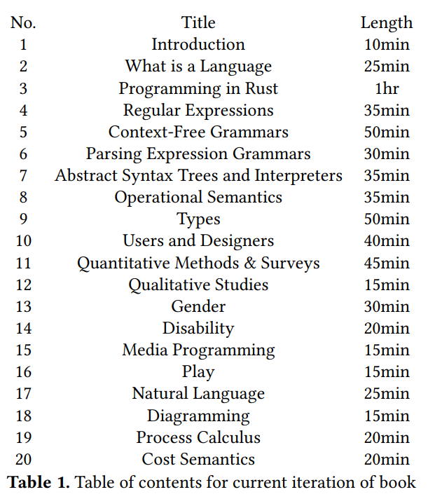
Outline
Chapters selected based on learning objectives, archetypes, student population, and interest
Chapters form several clusters, which can be integrated in various courses
CS Core: Implementation + Theory
HCI Core: Social Science + Critical Studies
Media Module: Case Studies
Advanced Theory Module

Slide 11
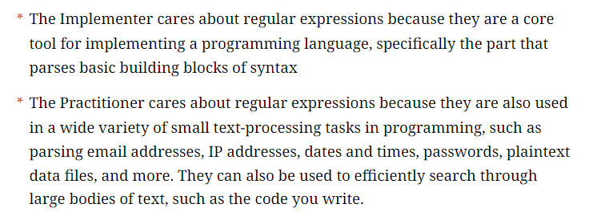
Platform + Format
Prepared using Bookish, ebook platform by Amy J. Ko
Typical chapter structure: Introduction
Introduction contextualizes content for each archetype

Slide 12
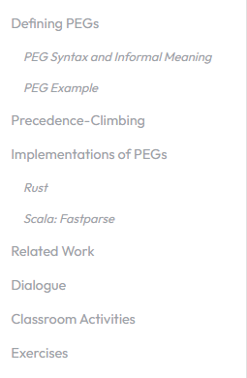
Platform + Format
Prepared using Bookish, ebook platform by Amy J. Ko
Typical chapter structure: Introduction
Introduction contextualizes content for each archetype
Core Content
Implementation
Citations
Dialogues
Classroom Ideas
Exercises

Slide 13
Archetypes
The Practitioner is someone who interacts with code as a programmer, but does not implement, design, nor theorize about programming languages.
The Implementer is anyone who implements a programming language, typically as a compiler or interpreter. By definition, they are simultaneously a Practitioner, but they have an additional set of needs and concerns.
The Theorist says that PLs are formal languages that can be defined and analyzed mathematically. A “good PL” is a language that we can analyze in powerful ways.
The Social Scientist’s emphasis is on the rigorous academic study of humans. The Social Scientist may study humans for humans’ sakes or for the sake of informing technical solutions to the users’ problems.
The Humanist also studies society. The most important differences are methodology and motivation - the Humanist relies primarily on critique

Slide 14
Archetypes – Example Dialogue
Question: Do context-free grammars model human language?
Social Scientist: Of course they do. I invented context-free grammars and I invented them to model natural human language. That’s what’s so amazing about them, they can model every natural language that has ever existed.
Theorist: Woah! Did I just hear you make a universal claim, SS? I never thought I’d see this day. Can I prove this by induction?
Humanist: I never thought you would have me agreeing with T, but desperate times call for desperate measures. You and I both know not all human language is context-free. What about Swiss German? [40]

Slide 15
Example Chapter
[Give demo of Regular Expressions chapter]

Slide 16
Section: Turning it Into a Course

Slide 17
Language Choice
Book moves language-specific content to the margins; course cannot
Choice informed by learning goals, stated student opinions, student background
Learning Goals: Implement evaluator + type-checker by recursion over AST; implement parser for toy language; assess benefits and barriers of static typing Implied needs: Static types, ADTs, recursion
Stated Student Opinions: Career-oriented. Needs industry growth (potential)
Student Background: Exposure to systems and object-oriented programming. Limited exposure to functional programming or Hindley-Milner-style type systems

Slide 18
Language Choice
Book moves language-specific content to the margins; course cannot
Choice informed by learning goals, stated student opinions, student background
Learning Goals: Implement evaluator + type-checker by recursion over AST; implement parser for toy language; assess benefits and barriers of static typing Implied needs: Static types, ADTs, recursion
Stated Student Opinions: Career-oriented. Needs industry growth (potential)
Student Background: Exposure to systems and object-oriented programming. Limited exposure to functional programming or Hindley-Milner-style type systems
Based this combination of needs, we chose Rust

Slide 19
Exercises
Book contains exercises for every archetype
Practitioner: Implement function X in Rust; make a picture in Processing
Implementer: Implement type-checker in Rust
Theorist: Construct derivations for context-free grammars; language of a regex
Social Scientist: Qualitative corpus analysis; autoethnography for code
Humanist: Critical essays in cultural, gender, and disability studies
And multiple complexity levels:
Exam questions: reason about examples of regex, CFG, semantics, types
Homework + Projects: Implement PL feature X. Design + run user study
Research-Level: Design a type system that does X; do proofs, user studies, etc…

Slide 20
Assignments
Coursework has 2 core thrusts: “Implement core of a PL” + “Self-Directed User Study”
Coding Assignments
Toy programs in Rust
PEG parser
Evaluator
Type-checker
Quantitative data analysis
Written Assignments
Goal-setting
User study brainstorm
Autoethnography
User study; detailed plan
User study results

Slide 21
Grading Approach
BUILT TO SCALE! e.g. 85 students, 2 sections, <=1 TA Philosophy: “Ungrading” philosophy, but not quite ungraded
Coding Assignments
Toy programs in Rust
PEG parser
Evaluator
Type-checker
Quantitative data analysis
Written Assignments
Goal-setting
User study brainstorm
Autoethnography
User study; detailed plan
User study results
Autograding with public test cases
“Make an attempt” -> Full Points Receive peer + instructor feedback

Slide 22
Story 1: Student Letter
Let’s share stories from the classroom (with student permission). Thank-you letter from a Spring 2023 student in graduate course (then project-based):
“Coming into this class I didn’t have any prior interest or experience in theory behind languages but this definitely stoked my desire to work with it.”
“I really enjoyed the freedom to design whatever we wanted. … it has been amazing overall and taught me so much, especially because it was a tough term personally. What a great experience that I wanted to spend all of my time on”

Slide 23
Story 2: Twine + Rust
In Fall A-Term 2023, the final homework includes an extra credit question: make an artwork in any media technology discussed in the book (Processing, Context Free Art, Twine).
19 students did this optional problem of 47 submissions
Student submissions included fractals, a cartoon guy, and text adventures, but one stands out:
Without prompting, one student wrote a Twine-style text adventure game entirely in Rust, perfecting reinforcing the desired takeaway message:

Slide 24
Story 2: Twine + Rust
In Fall A-Term 2023, the final homework includes an extra credit question: make an artwork in any media technology discussed in the book (Processing, Context Free Art, Twine).
19 students did this optional problem of 47 submissions
Student submissions included fractals, a cartoon guy, and text adventures, but one stands out:
Without prompting, one student wrote a Twine-style text adventure game entirely in Rust, perfecting reinforcing the desired takeaway message: PL Nerds and Art Nerds Can Be Friends!! <3

Slide 25
Story 3: Posture Study
Every student poses a question about PL’s, designs and executes small user study in class For most students, participation grade + peer expectations ensured genuine effort
For single-discipline majors, interdisciplinary work can serve as a creative, exploratory, space. Still “real work,” but “fun work”. The following study stands out for creativity:
One student wanted to know whether posture affects programming productivity. To test this, they had half their classmates code sitting on the floor, half slouched at a table. It was hard to avoid laughter or curious table neighbors, but this was good for the class. This day was a much-needed opportunity to see each other’s interests and laugh together.

Slide 26
Section: Data Analysis
How did my prior teaching experience inform book design?

Slide 27
Corpus
Course A: Programming Language Design (CS 4536), A-term 2021: 14 respondents of 31 students (45%).
Course B: Introduction to Program Design (CS 1101), A-term 2022: 46 respondents of 70 students (66%) (Intro programming, not PL elective)
Course C: Programming Language Design (CS 536), Spring semester 2023: 14 respondents of 16 students (88%). (Uses notes that informed the book)
Not analyzed: CS 4536 and CS 536 from this semester (uses the full book)

Slide 28
Methodology
Thematic analysis of course evaluations for Course A and Course C (i.e., qualitative coding of written responses; identify themes among codes)
Limited qualitative coding for Course B
Research questions:
What sentiments do students hold toward ungrading in an HCPL-based course?
What course delivery recommendations did students make for future iterations of course?
What sentiments do students hold toward centering social issues in PL curricula?
What sentiments do students hold toward language choice in PL and PL-adjacent courses?

Slide 29
Results
Ungrading (C):
Self-direction improved motivation, learning (x4)
Reduced stress (x2)
Rigor concerns (x1)
Delivery (A+C): Needed proper slides (x5)
Social Issues (C): Appreciated (x1); Perceived as divisive (x3)
Language Choice (B): 11/26 mentioned language choice, all 11 opposed Racket

Slide 30
Revisions
Based on student recommendations, comprehensive set of slides were developed
Based on student recommendations, revised grading scheme to blend autograding and ungraded activities
All slides, assignments, autograders are available for reuse on GitHub: https://github.com/rbohrer/pl-course
Open education: Creating course materials takes time; let’s save each other work

Slide 31
Gender Bias
Comparing Course A and Course C feedback on social issues in classroom provides a rare opportunity to explore role of student bias in course evaluations
… because my gender transition occurred after Course A and before Course C
I cannot help but notice that in Course A, supportive students were vocal and unsupportive students took on a restrained tone. In Course C, the numbers and tones flipped, with unsupportive students being the vocal ones
This is why “big-Q” qualitative analysis matters. This was a “natural experiment” which cannot be reproduced, yet instructor lived experience during transition deserves to be a part of academic discourse, even without reproducibility

Slide 32
Section: Conclusion

Slide 33
Future Plans
I consider the book to be “released” and “in production” as of today, but also…
An open-access peer-reviewed publisher will be sought after the current course ends
For a “published” edition, deeper dives into the real people behind PL
Additional chapters are expected to be added over the years
Next step: World domination supporting instructors using book outside WPI!

Slide 34
Collaboration Opportunities
Though this work is sole-authored, it is rooted in community, and I am excited to look for collaboration opportunities going forward
Certain additions are likely to need collaborators, e.g., PLs for different native/natural languages
If you are proficient in Classical Chinese (古文/文言文）I will be your friend
I’m looking to interview PL researchers with human-centered interests, for “published” ed.
My stretch goal is to include comics about the archetypes as well. I will not say no to interested artists, including enthusiasts
Open to other ideas!

Slide 35
Thank You to Many People!
Writing a book is a significant time and emotional investment. I’m deeply grateful to the many people who kept me motivated and supported throughout the writing process
Gillian Smith and Chris Martens for reminding me this book needs to exist
Matthew Ahrens for feedback on paper draft
Molly Feldman for encouraging this paper submission
Leif Andersen for lived experience on PL research and disability
F.J.J Hermans for encouragement, feedback, and cross-cultural PL expertise
Ichiro Hasuo for encouraging me to keep my PL brain and human-centered brain on at the same time
And many students, friends, and colleagues who told me something in the work resonated with them

