Slide 1
24 – Content and Style
Slides ©2023 Rose bohrer, used for cs 4536/536 at wpi. Educational Reuse permitted with credit

Slide 2
Outline
Introduction
Visual Design
Content-Style Separation
Automation
Case studies
HTML + CSS
Penrose
Constraint Satisfaction Programming

Slide 3
Core Topic: Visual Design
We often write programs which create visual content. There are surprisingly many different approaches to do the design of such programs and the PLs that support them.
Today, we focus on PLs that incorporate aspects of visual design specifically, i.e., addressing aspects like the layout, sizing, and color of elements in a 2-dimensional visual design.
This contrasts both with 3D-graphics PLs such as shader languages and certain media-focused languages such as Processing where these visual design tasks are not an inherent focus.

Slide 4
Guiding Question: Automation
Theorist: “A good PL is one that gives us things for free”
Humanist: “What do we want to get for free? Do we lose something when we gain ‘free things’?”
When PLs automate common and time-consuming tasks, they open the potential of increased programmer productivity. Yet, it is not always clear which tasks the Practitioner prefers to automate or not. This is particularly true is the visual domain: for example, graphic designers vs. artists might prefer different kinds of control over generated images.

Slide 5
Design Idea: Content-Style Separation
Recall that the design of abstractions is a key task in PL (and program) design.
For languages dealing with visual design, a key observation is that visual design requires a large number of stylistic decisions of a separate nature to those of those that occur when designing content, let alone designing code.
Content-Style Separation is the PL design principle of representing style designs, content decisions, (and code decisions) with separate program elements, typically using different language constructs or even two separate languages working together.

Slide 6
Section: Case Studies
- HTML-and-CSS
- Penrose
- Constraint Satisfaction Programming

Slide 7
HTML+CSS: Basic Concepts
Web browsers are built around three primary languages:
Content: HTML (HyperText Markup Language)
Style: CSS (Cascading Style Sheets)
Code: Javascript
Notable design concepts:
CSS is distinguished by its selector feature, which allows applying stylistic choices in bulk. It is named after the cascade rule of its semantics, used to resolve conflicting style rules
HTML is recognizable for the design of its syntax, with nested tags.
Semantic Web: HTML is also notable for this paradigm, wherein HTML writers seek to write HTML that focuses entirely on semantic content, with no style information

Slide 8
HTML+CSS Snippets (from author’s site)
HTML
<!DOCTYPE html> <html lang="en"> <head> <title>Rose Bohrer - Assistant Professor of Computer Science</title> <link href=“assets/css/bootstrap.css” rel=“stylesheet”/> </head> <body> <div class="navbar navbar-inverse navbar-static-top"> <div class="container"> <div class="navbar-header"> <button type="button" class="navbar-toggle" data-toggle="collapse" data-target=".navbar-collapse"> <span class="icon-bar"> </span></button></div></div></div> </body> </html>

Slide 9
HTML+CSS Snippets (from author’s site)
HTML
CSS
/* Derived from STANLEY theme by Carlos Alvarez
* URLs: http://alvarez.is http://blacktie.co*/
h1 {
font-size: 35px;
margin-top: 30px;
margin-bottom: 30px; } .navbar{ text-transform: uppercase; margin-bottom: 0px; } #footer p { color: white; }
<!DOCTYPE html> <html lang="en"> <head> <title>Rose Bohrer - Assistant Professor of Computer Science</title> <link href=“assets/css/bootstrap.css” rel=“stylesheet”/> </head> <body> <div class="navbar navbar-inverse navbar-static-top"> <div class="container"> <div class="navbar-header"> <button type="button" class="navbar-toggle" data-toggle="collapse" data-target=".navbar-collapse"> <span class="icon-bar"> </span></button></div></div></div> </body> </html>

Slide 10
Are HTML + CSS PLs?
How does each archetype answer this question?
Practitioner: It’s very domain-specific, but sure it’s a PL. Definitely code.
Theorist: Hobbyists wrote HTML+CSS which, combined with human input, can simulate Turing-complete code. It can compute!
Implementer: The implementation is nothing like a standard PL.
Social Scientist: The mental process of producing HTML+CSS likely differs from languages like JavaScript. Not PLs in that sense.
Humanist: Language choice plays a key role in identity formation. When we debate this question, we are debating who “counts” as being a programmer

Slide 11
Are HTML + CSS PLs?
Rephrase: Is the design of HTML and CSS part of PL design?
Yes!
They have unique audiences, which make them great case studies for the role of audience choice in language design (a focus today)
They have a syntax and semantics, for which traditional theoretical techniques can be applied. (We won’t go into details)
They are just a poor match for operational semantics, HTML+CSS are not naturally described in terms of traditional computation

Slide 12
Defining Audience with an Example Persona
Ellie (25 y/o) works full-time as a web designer in partnership with a web developer. She has an associate’s degree in graphic design, which included one course in programming, with multiple courses in visual design. Her daily work involves meeting with clients to determine requirements, drafting designs on paper, implementing them in HTML and CSS, and coordinating with the developer to ensure correct integration of the HTML+CSS code with JavaScript. Her work is highly iterative and based on customers’ provided requirements, but she still refers regularly to her old textbooks on design theory. In her free time, she lifts weights.

Slide 13
Analysis
History: HTML+CSS are born out of early web research at CERN
Design process?: Surviving documentation of HTML’s ancestors does not provide evidence of any formal design process
Design concepts?: Standard ISO 8878:A.1 cites “Declarative” and “Rigorous”
Declarative: = Structure and attributes, not computation
Rigorous: Roughly, formal machine-readable grammar, “type system”
What is a scholar to do without a design process?
This leaves us with little to say about how HTML+CSS came to be
But we can observe how they are used

Slide 14
Analysis: Usage Observations
Lecture theme of Automation: HTML+CSS assume the author desires little automation for either content or style:
Content: No built-in support for programmatically generating content. Use JavaScript or server-side code
Style: Commonly-used features align more with the vocabulary of design than with that of programming, e.g., setting margins and spacing based on concrete physical distances, rather than a formula.
Automation is present, e.g., there is a non-trivial algorithm for positioning. However, control over it is limited.
Post-hoc design justification: Our persona Ellie studies a lot of visual design, but only a little programming
Next: This discussion will serve as context and comparison for the next PL design case study, Penrose

Slide 15
Penrose
Penrose is a domain-specific language for writing mathematical diagrams, as might appear in technical and academic documents in STEM disciplines.
Given this choice of domain, Penrose has a clearly-defined audience. Following a qualitative methodology studying this audience, a clear set of language design goals were reached.
This does not remove the need for technical innovation! Penrose’s semantics is based on constraint-satisfaction programming, a style of PL design with rich technical foundations.

Slide 16
Defining Audience
The audience of Penrose is people who make mathematical diagrams. The corpus of example diagrams makes it clear that this includes diagrams in other STEM fields, such as CS.
Intuition: The audience are more comfortable with complex technical material than the HTML+CSS audience, but less comfortable with principles of visual design, let alone art.
Details: Audience is characterized by 18 interviewees: 4 professors, 10 PhD student+postdocs, 1 master’s student, 1 K-12 teacher, 2 software developers.

Slide 17
Defining Design Goals
Separation between content and presentation: Given a specific file of diagram content and several existing visualization styles, no new code should be required to switch styles
Accessibility toward new users: This is defined with respect to the given audience, e.g., common mathematical notations should dominate Penrose code
Evolvability of code over time: Specific evolution tasks like adaptations for new screen sizes, natural languages, and printed media should require minimal code changes
Scalability to large programs: Once a single diagram is provided, generating large groups of related diagrams should have substantially reduced effort (think: generating new math exercises for each student)

Slide 18
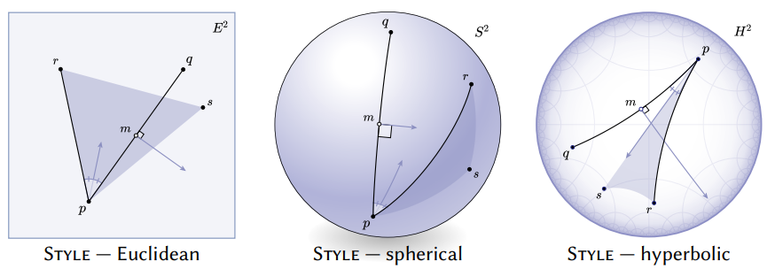
Example: Geometric Operations
Same content in 3 different styles

Slide 19
Example: Geometric Operations
Point p, q, r, s
Segment a := {p, q}
Segment b := {p, r}
Point m := Midpoint(a)
Angle theta := ∠(q, p, r)
Triangle t := {p, r, s}
Ray w := Bisector(theta)
Ray h := PerpendicularBisector(a)

Slide 20
Language Definition - Overview
A Penrose program involves three files:
Substance: The mathematical content of a specific diagram (not reusable)
Domain: Defines core element types for a given modeling domain e.g. a Graph domain would contain “vertex”, “edge”, “label” elements
Style: Defines the visual presentation of the elements from a domain
Relationship: Each substance file is defined with respect to a given domain. A single domain can support many styles, which can be swapped without changes to the substance file.

Slide 21
Language: Content (Abstract) Syntax
Core Language Elements (cf. expressions,statements,definitions)
Types: Penrose allows declaring and defining custom named types. Those types cannot have other types (or expressions) as arguments. This style of type system is called simple typing, i.e., one could create a type Vector but neither Vector<element_type> nor Vector<length>. There is a built-in Boolean type.
Functions: Functions have argument and return types, use standard syntax
Definition: Creates term of given type using functions, gives it a name
Declaration: Introduces a name and type, but leaves details undefined

Slide 22
Content (Abstract) Syntax, Annotated
Core Language Elements
Types
Functions
Definition (DFN)
Declaration (DCL)
DCL
Point p, q, r, s
Segment a := {p, q}
Segment b := {p, r}
Point m := Midpoint(a)
Angle theta := ∠(q, p, r)
Triangle t := {p, r, s}
Ray w := Bisector(theta)
Ray h := PerpendicularBisector(a)
DFN
DFN
DFN
DFN
DFN
DFN
DFN
Types
Functions

Slide 23
Style Syntax by Example
forall Vector u, VectorSpace U -- match any vector
where In(u, U) { -- in some vector space
u.arrow = Arrow {
startX : U.originX
startY : U.originY
endX : ?
endY : ?
color : Colors.mediumBlue
}

Slide 24
Toward Semantics: Automation Discussion
Penrose’s design is based on the assumption of two distinct user audiences: package developers want fine-grained control of domain and style, over visualization, but typical users wish to focus solely on content.
That is, typical users want style to be automated, but package developers want to help implement new automation
Supporting design decision: A content file formally defines an entire set of possible visualizations, and different styles can select different visualizations, even randomly, relying on built-in automation

Slide 25
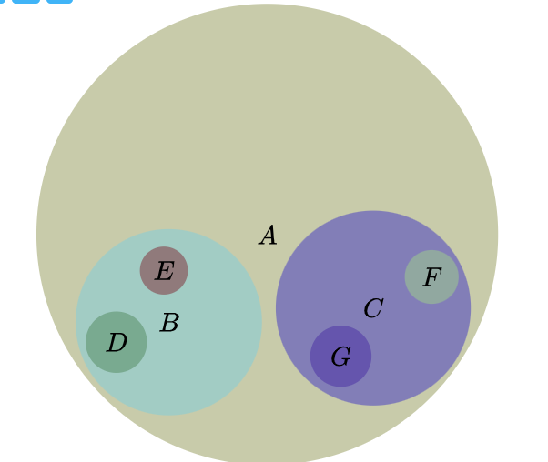
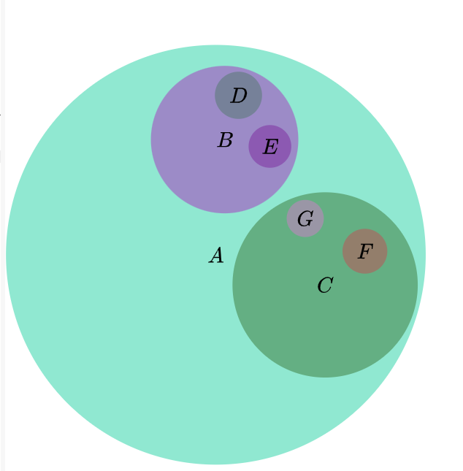
Automating Layout (Example)
Automatically generates reasonable layouts
Generates multiple layouts when compiled again
https://penrose.cs.cmu.edu/try/?examples=set-theory-domain%2Ftree-venn

Slide 26
Automating Layout (Example)
Set A, B, C, D, E, F, G
IsSubset(B, A)
IsSubset(C, A)
IsSubset(D, B)
IsSubset(E, B)
IsSubset(F, C)
IsSubset(G, C)
Not(Intersecting(E, D))
Not(Intersecting(F, G))
Not(Intersecting(B, C))
AutoLabel All
Automatically generates reasonable layouts
Generates multiple layouts when compiled again
How? Content code does not mention layout
https://penrose.cs.cmu.edu/try/?examples=set-theory-domain%2Ftree-venn

Slide 27
Constraint Satisfaction Programming
Style in Penrose uses (a broader PL paradigm called) constraint satisfaction programming (CSP)
In CSP, a program generates a set of constraints
Typically, the constraints belong to some decidable (or “decidable-ish”) set
The PL implementation then uses an external program called a constraint solver to generate data values which satisfy the constraints
Those data values are part of the program output
Example: Penrose style files define constraints on layout values such as positions, colors, and sizes. A solver generates values which satisfy these constraints, and the resulting values are used in the shown images.

Slide 28
Constrained Optimization
In Penrose, CSP takes a constrained optimization approach, where some constraints are hard, and others are soft (“optimization goal”).
A constrained optimization problem consists of variables to solve, constraints which must hold for every solution, and a numeric optimization goal which should maximized (or minimized) to create a “good” solution. Penrose example:
Variables: The position and size of every visual element Constraint: No two elements overlap Optimization goal: Minimize the size of the diagram

Slide 29
Activity
Spend 5-10 minutes experimenting with Penrose, starting from one of the built-in examples
https://penrose.cs.cmu.edu/

Slide 30
Section: More about CSP

Slide 31
Defining Audience?
CSP is not a specific language, but a programming paradigm, so it does not have a single specific audience.
Instead, we will highlight several example applications of CSP, especially answer set programming (one type of CSP), in order to highlight who might benefit from it.

Slide 32
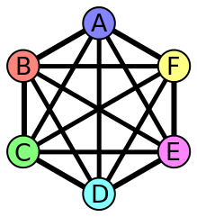
CSP Applications: Graph Coloring
col(r). col(g). col(b).color(X,C) : col(C) :- node(X).:- edge(X,Y), color(X,C), color(Y,C).
node(1..6).edge(1,2). edge(1,3). edge(1,4). edge(2,4). edge(2,5). edge(2,6). edge(3,1). edge(3,4). edge(3,5).edge(4,1). edge(4,2).edge(5,3). edge(5,4). edge(5,6). edge(6,2). edge(6,3). edge(6,5).
https://potassco.org/doc/videos/2016/09/20/the-asp-solving-process-via-graph-coloring.html Graph exact coloring | Openverse

Slide 33
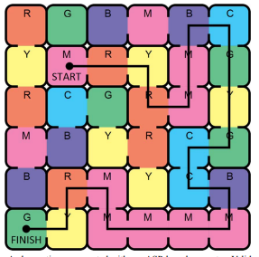
CSP Applications: Puzzles+Games
col(r). col(g). col(b).color(X,C) : col(C) :- node(X).:- edge(X,Y), color(X,C), color(Y,C).
1 {cell(C,X,Y):color(C)} 1:- dim(X),dim(Y). 1 {start(X,Y):dim(X):dim(Y)} 1. 1 {finish(X,Y):dim(X):dim(Y)} 1.
https://ieeexplore.ieee.org/stamp/stamp.jsp?arnumber=5783900

Slide 34
Bonus: PieceWork
https://users.wpi.edu/~rbohrer/pub/farm23.pdf
https://docs.google.com/presentation/d/1gH03QKh_T1BEz_L9oapTG9Vgih-srRXFkA6QwOtjzVU/edit?usp=sharing

