Slide 1
10 – Gender + Disability
Slides ©2023 Rose bohrer, used for cs 4536/536 at wpi. Educational Reuse permitted with credit

Slide 2
Announcements
User studies are on Tuesday:
End of Today: Find 1 partner for test run (don’t need to submit results yet)
Final exam (See Review material on Canvas)
On Oct 10th, you bring questions to in-class review session with Oliver
On Oct 13th , exam proctored in-class on laptops on Canvas
Extra time available in-person or through EPC (will set up by Monday)
If you do not have laptop access, contact my for options
Note policy: No notes, but open textbook (HCPL book)

Slide 3
Outline
Lecture structure
Gender
What, to a programming language, is a gender?
GenderMag
Limitations
Disability
Core concepts
Survey of design issues

Slide 4
Lecture Structure
This lecture talks about two social issues with significant implications for PL design: gender and disability
In CS classrooms, students may have a wide range of comfort level talking about themselves and their identities. We will
Spend much of the lecture covering concepts and case studies
Discuss technical questions surrounding this issues
I do not directly ask students to share personal stories

Slide 5
Ground Rules for Classroom Interactions
1. If somebody shares a vulnerable personal story, we should respond in a respectful way
2. If somebody asks a question that comes off the wrong way, we should assume they are trying to learn
I say this because I notice some students are anxious about asking good, honest questions. This is a learning space where questions are good.
Content note: I am about to show misogynistic and transphobic content for 1 slide to make a point. The remaining lecture content is unlikely to be triggering, e.g., no direct discussion of traumatic topics

Slide 6
Can a PL Spread Misogyny?
Though the discussion of PL design is rarely framed in these terms, it worth considering programs as media. Questions of this nature are frequently discussed for media
Citation: The instructor publishes research both in PL theory and in media-studies-for-HCI

Slide 7
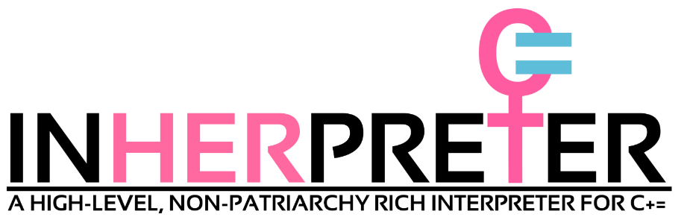
Misogynist PL: CPlusEquality
C+= is a PL design proposal by misogynistic 4chan trolls. Excerpts:
Constants are not allowed, as the idea of a lack of identity fluidity is problematic. … any numeric value is a variable, and is required to take on at least 2 values over the course of the program, or the inHERpreter er will throw a Trigger Warning.
A number can be an integer or a a double or a long if xir so identifies xirself.
Booleans are banned for imposing a binary view of true and false. C+= operates paralogically and transcends the trappings of Patriarchal binary logic. No means no, and yes could mean no as well.
private == privileged
printf(); == yell();
class Foo{}; == social_construct Foo{};
https://github.com/TheFeministSoftwareFoundation/C-plus-Equality

Slide 8
Misogynist PL: CPlusEquality
C+= is a PL design proposal by misogynistic 4chan trolls. Excerpts:
Constants are not allowed, as the idea of a lack of identity fluidity is problematic. … any numeric value is a variable, and is required to take on at least 2 values over the course of the program, or the inHERpreter er will throw a Trigger Warning.
A number can be an integer or a a double or a long if xir so identifies xirself.
Point: Although these trolls were from outside the PL community, if you search for gender and PL, you will find a troll instead of genuine research or curious discussion. It’s good for the health of our community if we provide a viable alternative to the trolls
Note: Men are good and nice. This is a pro-man space.
https://github.com/TheFeministSoftwareFoundation/C-plus-Equality

Slide 9
Part 1: Gender; Section 1: Philosophy

Slide 10
What Does PL Have to do with Gender?
PL is the medium through which programming occurs, so broader conversations on gender and computing occur in the medium of PL
Conversely, because PLs shape the experience of computing, they have the potential to shape gendered experiences
The nature and extent of PL-gender interaction depends on view:
Gender-blind vs. Gender-aware: Should gender be explicitly considered as a factor in design?
Structuralism vs. Post-structuralism: Is it more fruitful to view gender in broad categories and universal rules or to question categories and rules?
Humanist thinking: “Understand why they think that way,” not “Here is the only right way to think”

Slide 11
Gender-Blind
A gender-blind approach advocates against making gender an explicit factor in decision-making, and sometimes even for making gender markers invisible (e.g. real names vs. usernames)
Arguments for:
In online (e.g. open-source) communities, instances of interpersonal bias against gender minorities may decrease when other community members are unaware of a person’s gender
Many gender minorities have succeeded in gender-blind environments
Some gender minorities may prefer to focus on work, which they find inherently fulfilling, instead of negative life experiences
“A computer can’t hate a woman”

Slide 12
Gender-Aware
A aware approach advocates for making gender an explicit, visible factor in decision-making
Arguments for:
Because gendered experiences are multi-faceted (i.e., gender differences can come from multiple sources), they should be made visible in order to better understand the sources at play
It is common for different demographics to express different preferences in using software systems, and PLs are software systems
Gender and PL both have surprisingly deep roots in philosophy – an open-ended exploration of these roots can enrich our knowledge of both

Slide 13
Structuralist Philosophy in One Slide
Structuralism is a (largely historical) philosophical movement that tries to describe the world with broad categories and universal rules
Example:
Fregean Logic: “Universal truths can be described and verified by axiomatic manipulation of symbols”
Direct link with formal logic and PL theory: Frege -> Kripke + Russell -> half of formal logic -> PL theory

Slide 14
Types = Structuralist Success Story
Type systems divide all values into well-defined categories (types)
Typing rules and operational rules are universal properties of types
Deductive reasoning from assumed properties proves further universal properties of programs
“Rust programs have no memory errors”
“If it type-checks, it works”
Universalist guarantees help people in concrete ways
“Reality” (implementation) perfectly reflects the assumptions
Practitioner and Implementer both benefit from code guarantees

Slide 15
Post-Structuralist Philosophy in One Slide
Post-structuralism is the (historical and ongoing) movement to overturn structuralist assumptions
There is not one universal truth; multiple truths coexist under different interpretations, assumptions, and points of view
Social categories are constructed through social processes, by which they can also be deconstructed and analyzed
Foucault on Sexuality: The notion of “sexuality” is constructed through institutionalized restrictions on discourse (what we say)
Butler on Gender: Gender is socially constructed through performative statements
Technical sense: “The act of saying X makes X true”

Slide 16
Gender = Structuralist Fail Story?
The structuralist view of gender is of two immutable and exclusive categories male and female to which separate universal rules apply
Evidence against structuralist view:
Thousands of years of history reveal additional categories (hijra, eunuch, muxe, fa’afafine, takatapui)
History also reveals that membership in these groups is mutable
Contemporary social science consistently demonstrates levels of variation within each group substantially above the variation between groups -> No universal rules

Slide 17
Genders and Types Meet at Play
The act programming with types is an act of playing between structuralism and post-structuralism
Use the existing structure (type definitions) to attempt a programming task
When task fails, challenge the structure (change type definitions)
Much gender play likewise plays between post/structuralism
Using existing structures to communicate symbolism to an audience (e.g. in a performance, makeup ~ feminine, suit ~ masculine)
Perform displays that challenge structure: mix feminine + masculine elements, perform fluidity across categories, perform new extremes of gender
By playing between gender and type, understand both? Humanist: “I have no answers, only questions”

Slide 18
Playing Types -> Gender
An intersection type t1 ∧ t2 describes a single expression that simultaneously has type t1 and type t2. How does the concept of intersection type compare with the notion of intersectionality in gender? For example, intersection types can be used to model object-oriented programs and subtyping. What insights or questions would result from comparing them against concepts such as objectification and tokenization?

Slide 19
Playing Types -> Gender
An intersection type t1 ∧ t2 describes a single expression that simultaneously has type t1 and type t2. How does the concept of intersection type compare with the notion of intersectionality in gender? For example, intersection types can be used to model object-oriented programs and subtyping. What insights or questions would result from comparing them against concepts such as objectification and tokenization?
Choice is a common feature of type systems, e.g., through ADTs. Some type systems such as linear types divide choice further into internal choice t1 ⊕ t2 and external choice t1 & t2. For an internal choice, the implementer chooses whether to implement t1 vs t2; for an external choice, the client chooses whether they use a t1 vs t2. How do these competing notions of choice compare the notion of gender autonomy?
Type-based testing tools like QuickCheck generate sets of test data that reflect the diversity among values of a given type. Could a counterpart be developed which ensures designers explore the full impact of gender on software?
(Yes:) https://arxiv.org/pdf/2201.10643

Slide 20
Playing Gender -> Types
The set of people with a given gender changes as people are born, live, and die. How does one develop a type system where a type can gain new values over time? How does one develop a type system where a type can lose values over time?
For example, type exn in Standard ML

Slide 21
Playing Gender -> Types
The set of people with a given gender changes as people are born, live, and die. How does one develop a type system where a type can gain new values over time? How does one develop a type system where a type can lose values over time?
Not only does the set of people with a given gender change, but the set of genders that exist can change throughout the lives of individuals. How does one develop a static type system where the set of types can evolve throughout program execution?
How does the notion of performance in gender translate to the theory of programming languages? Can analogies be built between gender performance and the actor model of programming? Are programs better-suited to the notion of performance from gender studies, or the notions of performative and non-performative utterances from the philosophy of language?
e.g.: newtype in Haskell

Slide 22
Part 1: Gender; Section 2: HCI

Slide 23
GenderMag: Structuralist Gender in HCI
Average-case differences in experience of software between genders can be used to identify usability issues that have gendered impact
GenderMag is a usability design methodology which seeks to “exhaustively” test for “bugs” related to gendered differences
Identify aspects (facets) of a user which academic literature indicates differ by gender, on average (type system!!)
Develop a set of user personas that reflect different values of those facets (type-driven test suite!!)
Employ those user personas in the remaining stages of your design process

Slide 24
Review: Personas
Persona = fictional character used to answer: “Who are the users of the programming language?” e.g.
How educated are the programmers?
What informal knowledge do the programmers have?
What skills and operational knowledge do the programmers have? (i.e., what can they do?)
In what context are the programmers using the programming language?

Slide 25
Dimensions and Facets in GenderMag
In GenderMag, facets are type abstractions over dimensions Example dimensions: race, gender, gender modality, money, sexuality, disability, neurotype, native language
Challenge: That’s a lot of people! How do we test them all? O(2^n)?
Approach: Focus on facets which more directly affect interaction
Facets: Motivation, Computer Self-Efficacy, Attitude Toward Risk, Information Processing Style, Learning by Process vs. Tinkering O(2^5)
Bridge between narrow and broad styles of persona
Their words, not mine

Slide 26
Motivation
In general, different programmers have different motivations for why they program. The averages of motivation differ by gender
Intrinsic: Writing programs because using the PL is enjoyable
Extrinsic: Writing programs to accomplish given tasks
Design Questions:
What novel core language features are provided, which provide new opportunities for intrinsic enjoyment?
How do language designers create a language ecosystem which supports extrinsic enjoyment, e.g., by developing instructional materials featuring concrete practical applications or by developing libraries for major classes of applications?
In Rust: novel type system
In Rust: crates.io, Rust-By-Example

Slide 27
Computer Self-Efficacy
Self-efficacy: Belief in own ability to perform the tasks required to reach your goal. (Confidence, not competence)
Impact: Self-efficacy influences how programmers interpret and react to obstacles. Important because programming is full of them
Design Considerations:
Programming languages and their implementations differ in how early and frequently they present error messages to a programmer. In general, statically-typed languages present more compile-time error messages to programmers than dynamically-typed languages, in the hope of preventing runtime errors. If errors become obstacles, then frequent error messages have the potential of discouraging programmers who have low self-efficacy
Language implementations differ in their error messages, and thus in how they present the same underlying message to a programmer. Error messages can be engineered to provide concrete recommendations for how to resolve them. Beyond helping all programmers improve their programs, this has the potential to promote confidence. Language choice can also be modified to promote encouraging language, emphasizing that errors can be fixed, rather than their existence.
Connection: This is why we’ve said error messages matter since Lecture 2

Slide 28
Attitude Toward Risk
Risk attitudes range from risk-averse to risk-seeking
Risk-averse: Prefer low-risk choices
Risk-seeking Prefer high-risk, high-reward choices
Design Considerations:
If runtime errors are understood as risks, then dynamically-typed languages carry additional risk relative to statically-typed languages.
The choice of tools can be understood as a social risk. If a new programming language with a small user base is chosen for a new software project, there is potential risk that it would lack necessary community support, libraries, or tools. For a student, learning less popular programming languages could be viewed as a career risk. When developing new programming language features, these risks could be mitigated by integrating new features in existing languages or tools when possible.
See EDSLs, adoption research in software engineering

Slide 29
Information Processing Style
How much information do we collect before we act?
Comprehensive Style: Attempt to achieve complete knowledge before attempting a task
Selective Style: Attempt task after first promising information, then backtrack if needed
Design Considerations:
Static type systems arguably reflect a comprehensive processing style: the programming language implementation itself comprehensively explores the behavior of every branch of a program, before executing any part of the program. Dynamic type systems reflect selective information processing, where execution proceeds without comprehensive program analysis. If an error occurs in one branch of a program at runtime, it is handled selectively at runtime.
Developer documentation, including documentation, represents a sizeable collection of information which a programmer might process. Designers of documentation browsers could explore supporting both processing styles by allowing programs to either select detailed information on an individual function or object, or collect comprehensive information about a part of a library.

Slide 30
Learning by Process vs. Tinkering
How does the programmer prefer to learn new things?
Process: Follow a systematic process of study
Tinkering: Play and experiment with the material to learn
Design Considerations:
Tinkerers can be supported by tooling that supports immediate execution of code, such as interactive read-eval-print loops (REPLs).
Systematic learners can be supported by providing exhaustive educational resources, and by linking individual error messages back to systematic concepts.

Slide 31
Do We Care Who Is Who?
Social science research has determined which traits are more common among which binary* genders, but I did not tell you. Feel free to check later
Motivation: Intrinsic vs. Extrinsic Computer Self-Efficacy: High vs. Low Attitude Toward Risk: Averse vs. Seeking Information Processing Style: Comprehensive vs. Selective Preferred Learning Style: Process vs. Tinkering
*Emphasis on binary genders is due to available datasets
Why care who is who?: Provides context, motivation. Why not care?: A bug is a bug, no matter who it affects.

Slide 32
Limitations of GenderMag
Discuss?

Slide 33
Limitations of GenderMag
Discuss?
Reductionism: GenderMag emphasizes traits that can be measured quantitatively, but programmers may care about hard-to-quantify experiences as well
Facet Binarism: This approach emphasizes comparing two competing extremes, rather than all possible preferences
Gender Binarism?: Though the GenderMag authors are careful to avoid gender essentialism + binarism, readers may misinterpret

Slide 34
Part 2: Disability
Outline
Motivation – Infrastructure
Key Concepts
Issues in PL Design, by Disability Type

Slide 35
Section: Foundational Concepts

Slide 36
Infrastructure
Accessible PLs matter because PLs are the infrastructure of computing
Like transportation infrastructure, PLs are used by multiple people with multiple destinations and starting points
Three kinds of equity are key in infrastructure and PLs:
Access same destinations:
Buildings should have wheelchair-accessible entrances
Visually-disabled programmers should be able to extract same info as sighted
Access different destinations: Disabled programmers may have different development priorities than abled programmers
Equitable travel experience: Disabled programmers should have comparable level of comfort and respect throughout the experience

Slide 37
Material Impacts
Transportation infrastructure is a defining factor in economic access
Jobs, services, food, education
Full access to computing, including PL, has economic implications
Career prospects are a common motivation for learning to code. If programming languages are not accessible, disabled programmers are cut off from career opportunities
Without equitable access to programming, disabled programmers are also less-equipped to make computing in other careers accessible for them, as workers

Slide 38
Visibility
Disabled life has an inherent tension between invisibility/visibility
Why Visibility?
Enables self-advocacy, which increases chances of needed accommodations
Enables community-building, reducing social isolation
Why Invisibility?
Increased visibility means increased risk of visible discrimination, e.g., in housing, education, employment, and in street interactions
Invisibility is often an intentional measure to minimize these risks

Slide 39
Disability Spectrum
A key concept in disability studies is that of disability as a spectrum
A spectrum is not a one-dimensional line between least and most-disabled
Dynamic disabilities feature movement across the spectrum depending on time, luck, and circumstance
Spectrum is multidimensional: disability can include physical, sensory, neurodevelopmental, intellectual, and other components
Design Implications: This fluidity can be used to argue for designs that promote social integration between disabled and abled users. Such approaches need not be assimilationist, i.e., disabled users can retain distinct identity and usage patterns

Slide 40
Global South Perspectives
Studies in HCI (but outside PL) have explored differences in design priorities between disabled people of the Global South vs. North
Kenya: Visually impaired users suggested intelligent traffic lights that blend community education with functional accommodations
Jordan+Uganda: Prosthetic users highlighted the need to control their visibility to evade social stigma. In particular, it was essential for prosthetics to match wearers’ skin tones
Source: http://katta.mere.st/wp-content/uploads/2020/03/Individuality-over-function_revised.pdf

Slide 41
Section: Survey of Design Issues

Slide 42
Musculoskeletal Issues
Question: What is programmers’ greatest occupational hazard for injury and potentially disability?

Slide 43
Musculoskeletal Issues
Question: What is programmers’ greatest occupational hazard for injury and potentially disability?
Answer: Repetitive-strain injuries (RSI) including tendinitis, carpal-tunnel syndrome, and others
These are injuries to the musculoskeletal system, i.e., the combination of muscles and the skeleton
RSIs can be disabilities, and share many design implications with connective-tissue disabilities like Ehlers-Danlos and Marfan

Slide 44
Interfaces and Musculoskeletal Conditions
Recall the interface of PLs (input = keyboard, display = editor)
Accessibility for musculoskeletal conditions primarily means developing accessible input mechanisms
Keyboard: Design syntax based on ergonomics of typing
Speech: Programmers with severe RSI may need to rely entirely on speech-to-text for programming
Mechanical: Non-speaking programmers with musculoskeletal issues (seen, e.g., in muscular dystrophy) may need custom, low-bandwidth mechanical input devices
Source: Researchers in PL Theory who rely on these devices

Slide 45
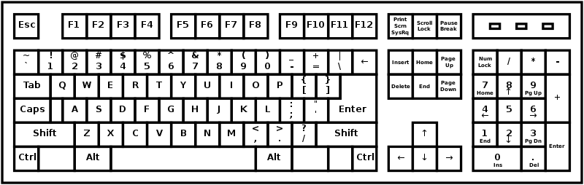
How Does Programming Differ?
Discuss: You are a designer and you want to make programming as ergonomic as possible. For your purposes, how does programming differ from other kinds of typing?
https://commons.wikimedia.org/wiki/File:QWERTY_keyboard_diagram.svg
Notes:
Cite Programmer Dvorak as an example why this matters for PL specifically

Slide 46
Visual Disability and Accessible Output
In contrast to musculoskeletal disabilities, accessibility support for visually-disabled programmers typically focuses on output
Screen magnifiers and large fonts are often used within standard UIs for low-sight programmers
Screen readers convert program text to speech
Tactile syntax is useful not only for deafblind programmers but for children in mixed-disability environments
Visual and hybrid-visual syntax need not exclude low-sight coders

Slide 47
Issue 1: Whitespace Sensitivity
Activity: All students except two, close your eyes. Two students: read code aloud

Slide 48
Issue 1: Whitespace Sensitivity
Activity: All students except two, close your eyes. Two students: read code aloud
if B1:
S1
if B2:
S2:
else:
S3
if B1:
S1
if B2:
S2
else:
S3
Discuss: What did you notice?

Slide 49
Issue 1: Whitespace Sensitivity
Discuss: What are the limitations of the following solution?
if B1:
S1
if B2:
S2
else:
S3
if B1 begin
S1
if B2 begin
S2
else
S3
end
end

Slide 50
Issue 2: Text-Audio Agreement
Question: If I am reading a program aloud to you and I make the sound “too,” what program am I speaking of?

Slide 51
Issue 2: Text-to-Speech Ambiguity
Question: If I am reading a program aloud to you and I make the sound “too,” what program am I speaking of?
Answers:
2
2.0
“2”
‘2’
two
“two”
Two
“Two”
too
“too”
Too
“Too”
to
“to”
To
“To”
tu
“tu”
Tu
“Tu”
->
..
..=
,
--
Note: There are many other correct answers not listed among these 25.
There are too many!

Slide 52
Issue 2: Text-to-Speech Ambiguity
Text-to-speech should make the following a theorem:
Injectivity: Let f : text -> speech be the text-to-speech function. For all x, y : text, if f(x) = f(y) then x = y.
The WeScheme editor for the PL Scheme supports this property
Examples:
2
“int two”
2.0
“float two point zero”
two
“variable two”
“two”
“string two”
Question: Can you find two example programs that break injectivity?

Slide 53
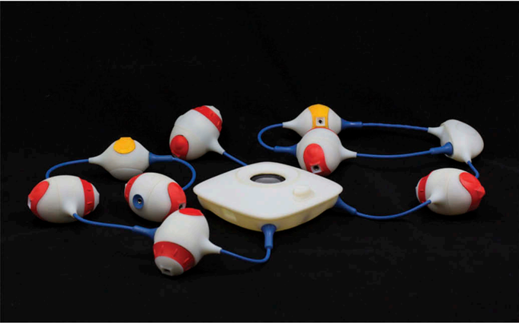
Issue 3: Social Integration Across Spectrum
The Torino programming language uses a tactile interface to help children with different levels of disability code together
Each bead performs one operation, such as producing sound, looping, taking input
Distinct shapes help children tell them apart
High-vision and low-vision children manipulated the beads in different ways, but could collaborate on a shared program
https://www.tandfonline.com/doi/full/10.1080/07370024.2018.1512413

Slide 54
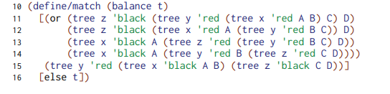
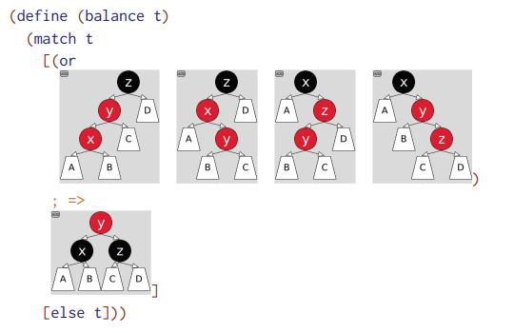
Issue 3: Social Integration Across Spectrum
Visual PL syntax is frequently used in educational and newcomer-focused PL design projects for accessibility (to them)
In isolation, visual syntax can be a barrier for accessibility for visual disability
Hybrid visual syntax, invented by a visually disabled PL researcher, allows the best of both words by freely converting between visual and textual program representation
https://www.proquest.com/docview/2719410129

Slide 55
Find Study Practice Partners
User studies are on Tuesday:
End of Today: Find 1 partner for test run (don’t need to submit results yet)
HW4 Written: Do not need to submit test run results, need to submit plan/materials that have been revised at least 1-2 times
HW5 Written: Submit analysis of all results

