Slide 1
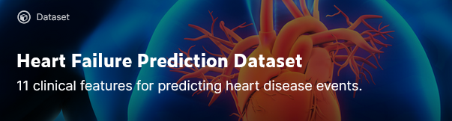
Ryan Bolduan
Coding Dojo - Data Science 8.30 Cohort
Nov 15, 2021
Data Source = Kaggle: https://www.kaggle.com/fedesoriano/heart-failure-prediction

Slide 2
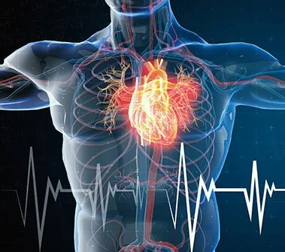
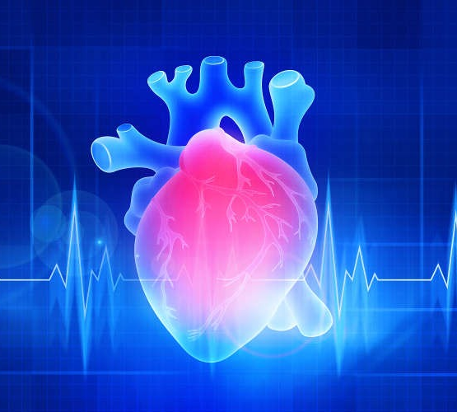
Intro and Data Dictionary Cardiovascular diseases (CVDs) are the number 1 cause of death globally 17.9 million lives each year 31% of all deaths worldwide
The Kaggle data set contains 11 features that can be used to predict a possible heart attack, including:
Age = age of patient
Sex = male or female
Chest Pain Type = type of chest pain
Resting BP = resting blood pressure
Cholesterol = serum cholesterol
Fasting BS = fasting blood sugar
Resting ECG = resting ECG results
Max HR = max HR achieved
Exercise Angina = exercised induced angina
Oldpeak = related to ECG score
ST_Slope = slope of peak exercise ST segment
https://www.kaggle.com/alimusabeyoglu/heart-failure-prediction-eda

Slide 3

Data Cleaning
Missing data
Duplicated data
Irrelevant Columns
Outliers
Incorrect inputs lead to incorrect outputs…

Slide 4
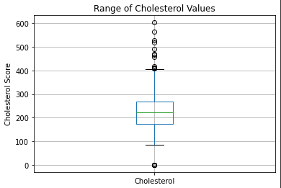
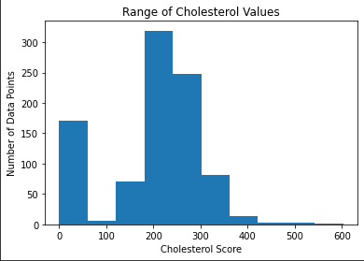
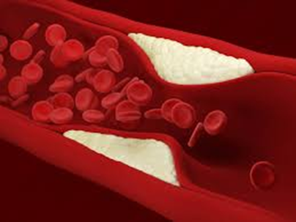
Cholesterol Data Visualization
Cholesterol data features demonstrate data challenges and outliers within the data set, including:
Several values (171) with a value of zero
Outliers that were much higher than the rest of the data set

Slide 5
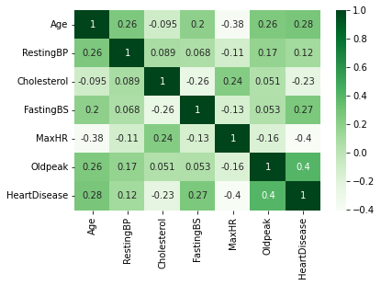
Heat Map – Looking for correlation
Low correlation between any one factor and heart disease
Turned to machine learning models to to combine the impacts of multiple factors in order to better predict heart disease

Slide 6

Modeling Techniques
To find the most accurate model, three different models were run.
Bagged Trees, Random Forests, Nearest Neighbors (KNN)
Model were refined to improve the results
The most accurate model ended up being a Nearest Neighbors (KNN) model
Initial model had an accuracy of 87%
Model accuracy was improved to 90.86%
https://www.kdnuggets.com/2019/07/classifying-heart-disease-using-k-nearest-neighbors.html/2

Slide 7
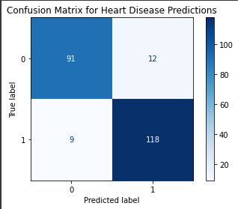
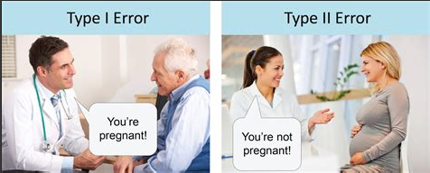
Confusion Matrix: What does it tell us?
The model was accurate 90% of the time
With a confusion matrix, accuracy is determined by adding the upper left (“True Negatives”) and the bottom right (“True Positive”) values, then dividing by the total number of predictions
Various models were tested, KNN model was the winner!
Oops… (when the model mis-diagnoses)
Undiagnosed heart disease =
False Negatives (Bottom left)
Diagnosis of heart disease that is not accurate = False Positives (Top right)
Image: Coding Dojo Learning Platform

Slide 8
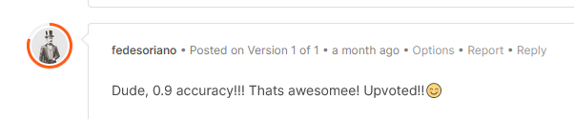

https://medicalcityhealthcare.com/blog/entry/how-to-prevent-your-own-heart-attack

