Slide 1
Smart Home

Slide 2
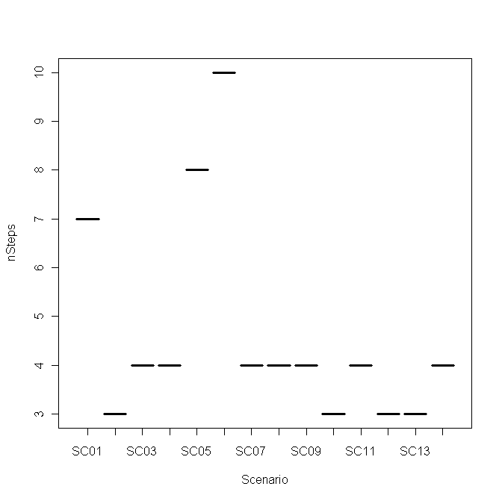
Number of Steps per Scenario
PLUSS
Min. Median Mean Max. St. Deviation
3.00 4.00 4.64 10.00 4.55

Slide 3
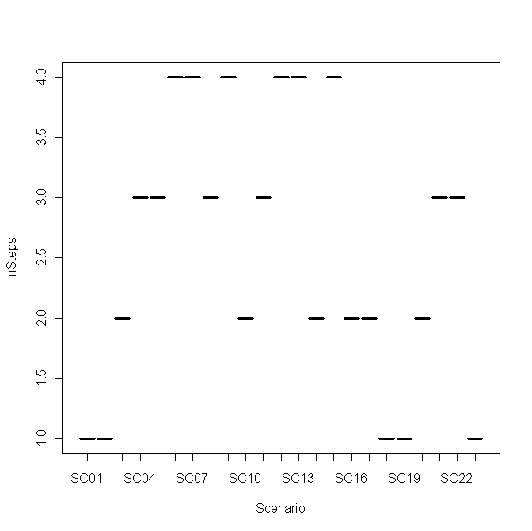
Number of Steps per Scenario
SVMC
Min. Median Mean Max. St. Deviation
1.00 3.00 2.565 4.00 1.256

Slide 4
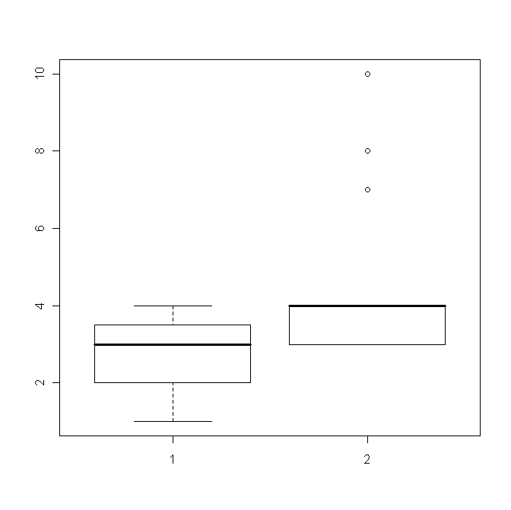
Number of Steps per Scenario
Boxplot
Notes:
boxplot (cc[[2]], pluss[[2]])

Slide 5
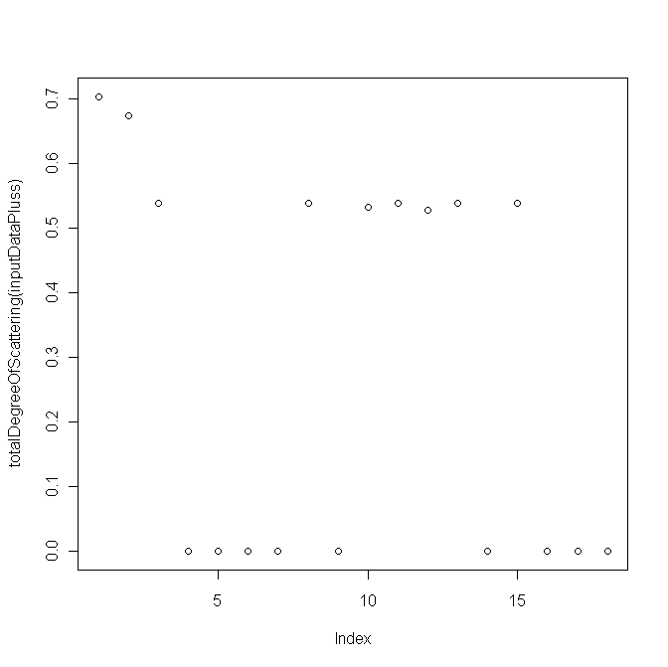
Degree of Scattering
PLUSS
Min. Median Mean Max. St. Deviation
0.00 0.263 0.284 0.703 0.088

Slide 6
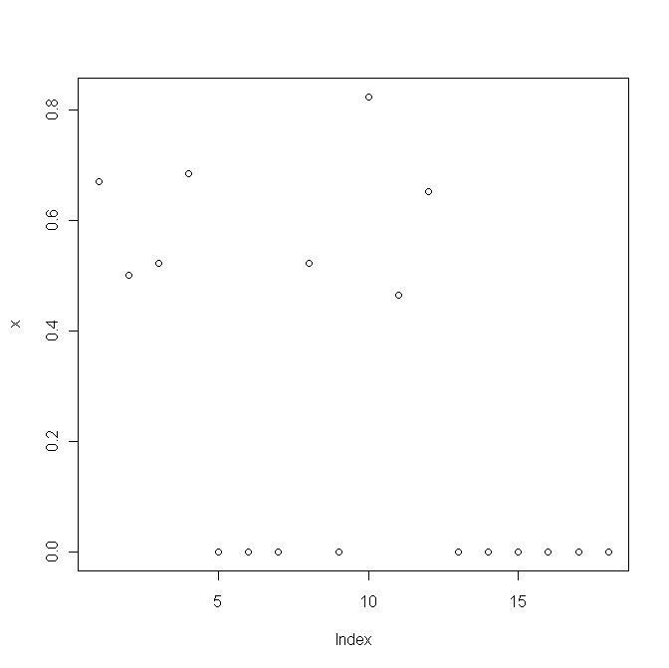
Degree of Scattering
SVMC
Min. Median Mean Max. St. Deviation
0.00 0.00 0.269 0.824 0.102

Slide 7
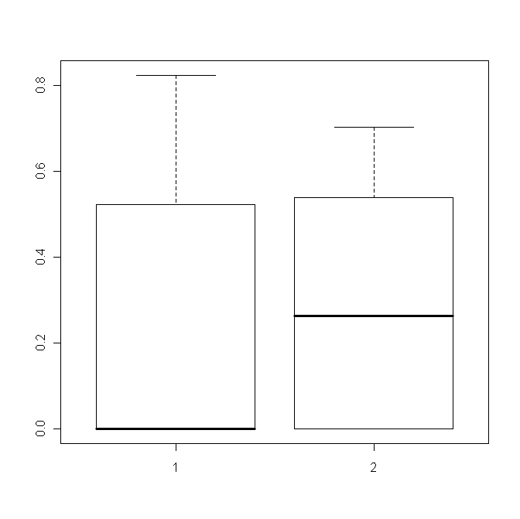
Degree of Scattering
Boxplot: Comparison

Slide 8
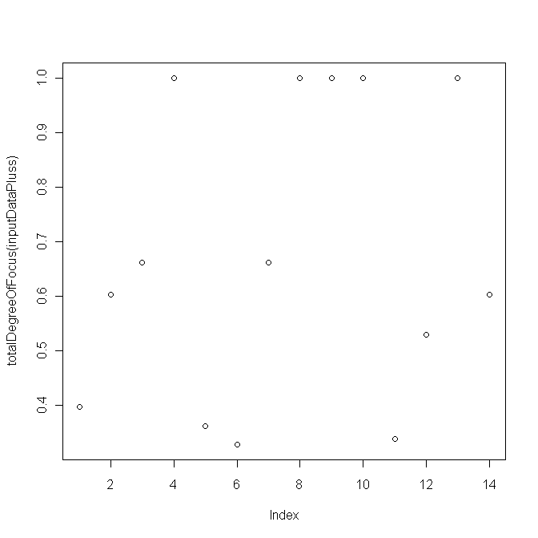
Degree of Focus
PLUSS
Min. Median Mean Max. St. Deviation
0.327 0.632 0.677 1 0.074

Slide 9
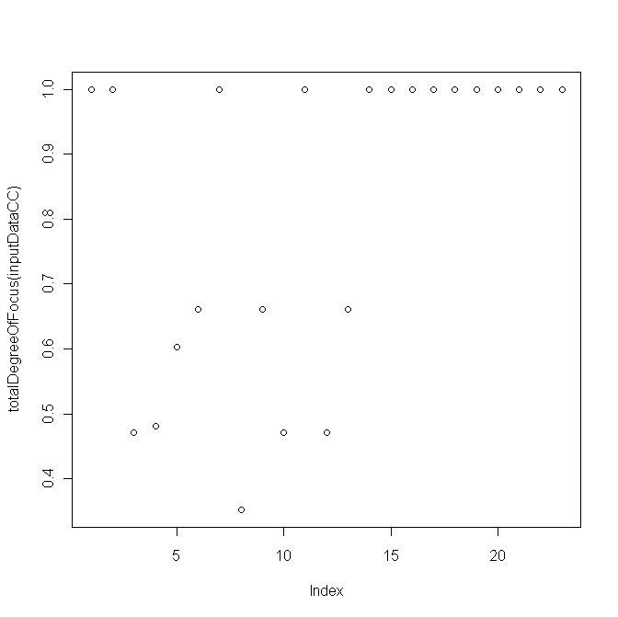
Degree of Focus
SVMC
Min. Median Mean Max. St. Deviation
0.351 1.000 0.8188 1 0.058

Slide 10
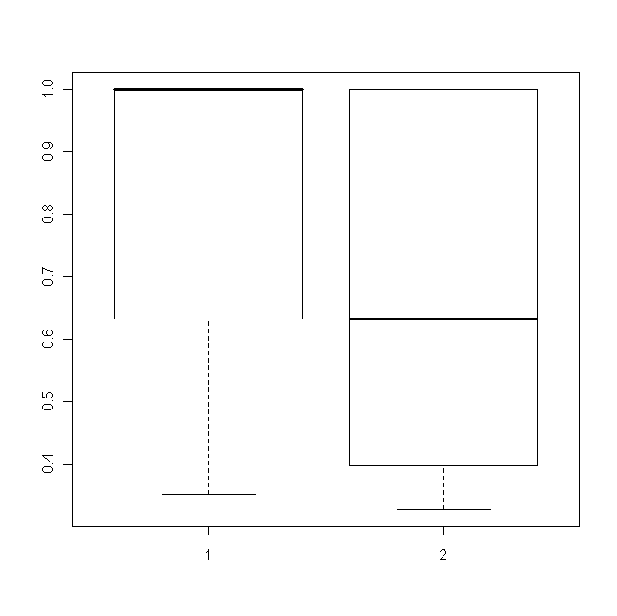
Degree of Focus
Boxplot

