Slide 1
On the Benefits of Variability
Management as Crosscutting
  March 31, 2008

Slide 2
Essence of the paper
Benefits of a clear separation between variability management artefacts and SPL use case scenarios
Three approaches for SPL scenarios were compared…
  Product Line Use Cases (PLUC)‏
  Product Line Use Cases for Systems and Software (PLUSS)‏
  Variability Management as Crosscutting
... using different evaluation techniques
  Design structure matrices
  A suite of metrics for quantifying modularity and complexity
  Analysis of the effort need to introduce SPL increments

Slide 3
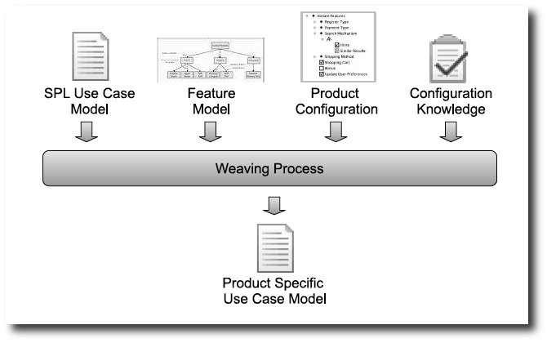
Essence of the paper
The clear separation was achieved by (formally) modelling variability management as a crosscutting mechanism

Slide 4
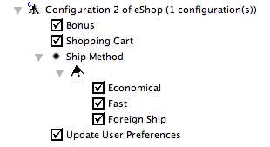
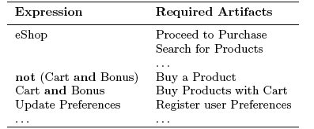
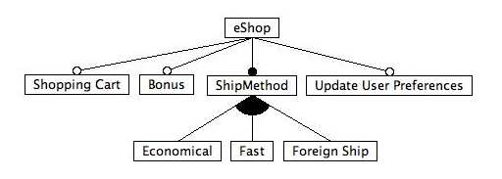
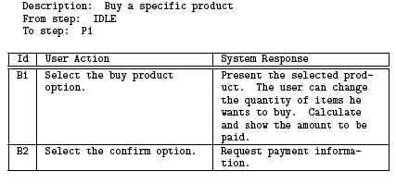
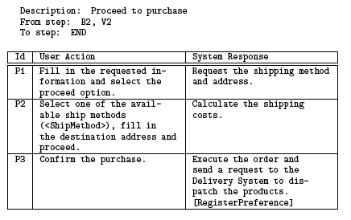
Example
Feature model
Feature model
Product configuration
Configuration knowledge
SPL use case scenarios
...

Slide 5
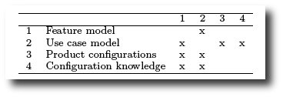
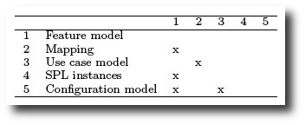
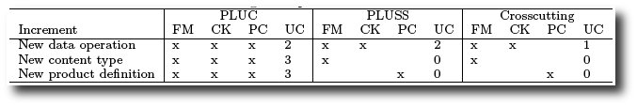
Results
DSMs
Effort needed to introduce SPL increments
PLUC
Crosscutting

