Slide 1
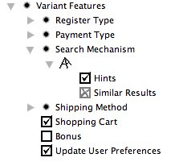



SPL Use Case
Model
Feature
Model
Product
Configuration
Configuration
Knowledge
Weaving Process
Product Specific
Use Case Model

