Slide 1
Smart Home

Slide 2
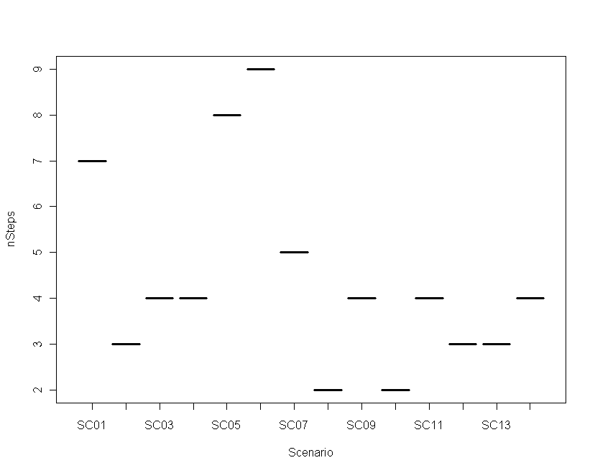
PLUSS
Number of Steps per Scenario
Min. Median Mean Max. St. Deviation
2.00 4.00 4.43 9.00 4.57

Slide 3
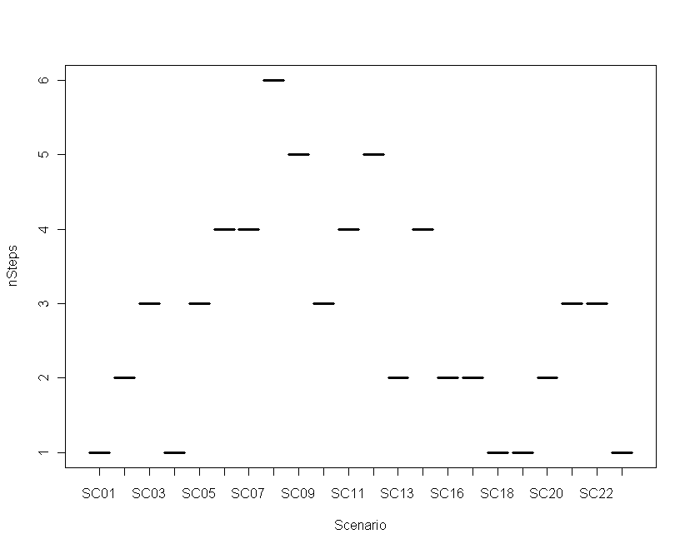
SVMC
Number of Steps per Scenario
Min. Median Mean Max. St. Deviation
1.00 3.00 2.81 6.00 2.15

Slide 4
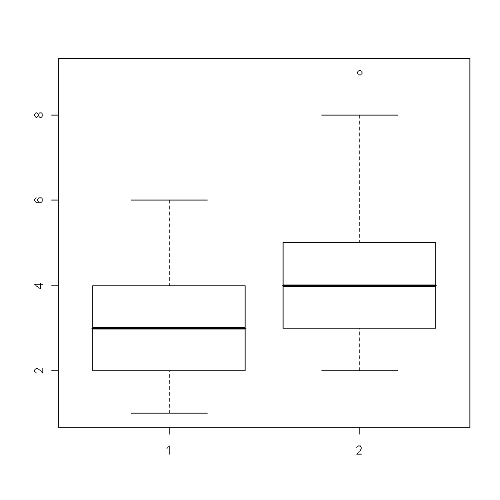
Comparison
Boxplot: Number of Steps per Scenario
Notes:
boxplot (cc[[2]], pluss[[2]])

