Slide 1
Configuration Knowledge
Alternative Designs
Rodrigo Bonifácio
Paulo Borba

Slide 2
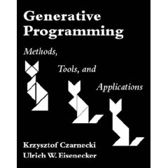
Configuration Knowledge
Czarnecki (2000)
Problem Space
Configuration Knowledge
Solution Space
Illegal feature combinations
Default settings
Default dependencies
Construction rules
Optimizations
Domain specific concepts
Generic components
Features
Maximum combinablity
Minimum redundancy

Slide 3
Czarnecki – Account example
template <class Generator>
class PersonalAccount
{ public:
typedef typename Generator::Config Config;
typedef typename Config::Owner Owner;
typedef typename Config::Currency Currency;
typedef typename Config::Date Date;
typedef typename Config::NumericType NumericType;
typedef typename Config::CounterType CounterType;
typedef typename Config::AccountNoType AccountNoType;
PersonalAccount(const Owner& own): owner_(own),
balance_(0),
transactions_(0)
Variation points
// Domain-specific language ////
enum AccountTypes
{ fixedTermDeposit,
shortNoticeDeposit,
checking,
openAccount,
savings
};
enum BalancingStrategies
{ thirtyDays,
sixtyDays,
quarter,
calendarYear
};
template< class Account = OpenAccount,class CurrencyType = DEM,
class AccNoType = PersistentNo, class NumType = double,
class CountType = int,class OwnerType = string,
class DateType = date
>
struct ACCOUNT_GENERATOR
{ // define a short name for the complete generator
Configuration
Knowledge
// create config
struct Config
{ typedef OwnerType Owner;
typedef CurrencyType Currency;
typedef DateType Date;
typedef NumType NumericType;
typedef CountType CounterType;
typedef AccNoType AccountNoType;
enum { AccountType = Account::accountType,
Balancing = withBalancing,
Credit = Account::creditStrategy,
Variability Space
(Embedded DSL)

Slide 4
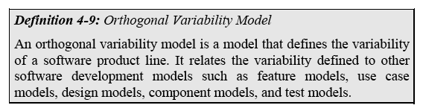

Configuration Knowledge
Klaus Pohl

Slide 5
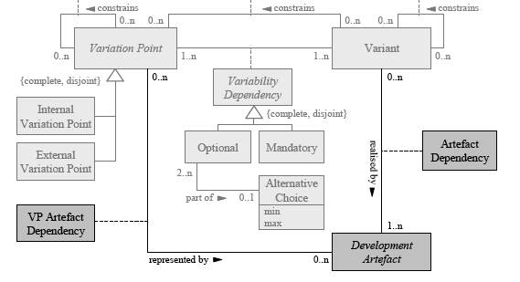
Configuration Knowledge
Klaus Pohl

Slide 6
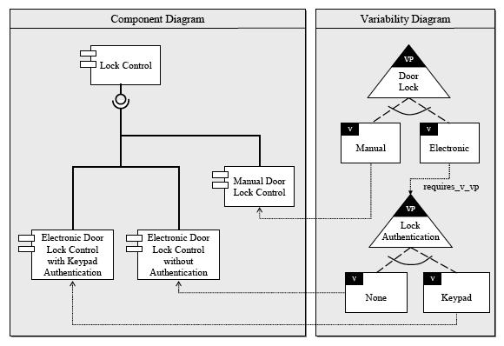
Configuration Knowledge
Klaus Pohl

Slide 7
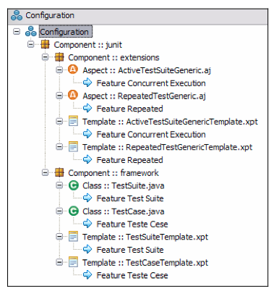
Configuration Knowledge
Cirilo, Kulesza, Lucena (GenArch)
“(model) responsible to define the mapping between features and implementation elements...”

Slide 8
Configuration Knowledge
Tools (gears, pure variants)
More expressive relationships between features and artifacts
Services:
- Select and modify artifacts
- Build customization
- ...

Slide 9
Variability as Crosscutting
First Representation
Feature expressions related to software artifacts
Three step configuration:
- Selection based on the Configuration Knowledge
- Scenario composition
- Parameterization

Slide 10
Variability as Crosscutting
First Representation
type ConfigurationKnowledge = [Configuration]
data Configuration = Configuration {
expression :: FeatureExpression,
artifacts :: [ArtifactId]
}
data FeatureExpression =
FeatureRef Id |
NotExpression FeatureExpression |
AndExpression FeatureExpression FeatureExpression |
OrExpression FeatureExpression FeatureExpression

Slide 11
Variability as Crosscutting
First Representation
generateProductSpecificModel fm fc ck ucm env =
if (typeChecker fm fc ck ucm env)
then
let selectedUCs = selectUseCases fc ck ucm
in bindParameters fc (scenarioComposition selectedUCs) env
else
...
Weavers
- selectUseCases
- scenarioComposition
- bindParameters

Slide 12
Variability as Crosscutting
First Representation
Simple representation
Easy to instantiate
Contribution of each model is made clear
New types of composition might require changes in the use case model
Question: how to differentiate variability in use from variability in products?

Slide 13
Variability as Crosscutting
Second Representation
Feature expressions related to model transformations
One step configuration?
- for each valid expression, the related functions are
applied

Slide 14
Variability as Crosscutting
Second Representation
class AbstractModel m where
emptyModel :: m -> m
type Model2Model model = (model -> model -> model)
type ConfigurationKnowledge model = [Configuration model]
data Configuration model = Configuration {
expression :: FeatureExpression,
transformations :: [Model2Model model]
}

Slide 15
Variability as Crosscutting
Second Representation
buildConfiguration :: (AbstractModel m) => m ->
FeatureConfiguration -> ConfigurationKnowledge m -> m
buildConfiguration im fc ck = applyAll im fc ck (emptyModel im)
applyAll im fc [] om = om
applyAll im fc (x:xs) om =
let t = (transformations x)
in if (eval fc (expression x))
then applyAll im fc xs (applyTransf im t om)
else applyAll im fc xs om
applyTransf im [] om = om
applyTransf im (x:xs) om = applyTransf im xs (x im om)

Slide 16
Variability as Crosscutting
Second Representation
generateProductSpecificUseCaseModel fm fc ck ucm =
if (typeChecker fm fc ck ucm)
then
buildConfiguration ucm fc ck
else
error ...
Weavers
- buildConfiguration
=> Model2Model functions?

Slide 17
Variability as Crosscutting
Second Representation
Model2Model functions
- arguments: SPL model and refined model
- returns: a new version of refined model
I guess that some transformations might not require two input models
- therefore: Model2Model = model->model

Slide 18
Variability as Crosscutting
Second Representation
Model2Model functions
- arguments: SPL model and refined model
- returns: a new version of refined model
I guess that some transformations might not require two input models
- therefore: Model2Model = model->model
No problem..... Haskell is “elegant”

Slide 19
Variability as Crosscutting
Second Representation
Model2Model functions
- Implemented by means of “curryied” functions
pow :: int -> int -> int
pow x y = y, if x == 1
y * (pow (x-1) y), otherwise
we can call “pow” with just one argument, such
as: sqr = pow 2 => return a new function (int->int)

Slide 20
Variability as Crosscutting
Second Representation
Model2Model functions (example)
addScenariosM2M :: [Id] -> UCModel -> UCModel -> UCModel
addScenariosM2M ids input output =
let ins = ucmScenarios input
name = ucmName output
in UCM name (addUseCaseM2M input output [s|s <- ins...])

Slide 21
Variability as Crosscutting
Second Representation
Model2Model functions (example)
addScenariosM2M :: [Id] -> UCModel -> UCModel -> UCModel
addScenariosM2M ids input output =
let ins = ucmScenarios input
name = ucmName output
in UCM name (addUseCaseM2M input output [s|s <- ins...])
x = addScenariosM2M ["1", "4"]

Slide 22
Variability as Crosscutting
Second Representation
Model2Model functions (example)
addScenariosM2M :: [Id] -> UCModel -> UCModel -> UCModel
addScenariosM2M ids input output =
let ins = ucmScenarios input
name = ucmName output
in UCM name (addUseCaseM2M input output [s|s <- ins...])
x = addScenariosM2M ["1", "4"]
conf0 = Configuration exp0 [x]

Slide 23
Variability as Crosscutting
Second Representation
Model2Model functions (example)
addScenariosM2M :: [Id] -> UCModel -> UCModel -> UCModel
addScenariosM2M ids input output =
let ins = ucmScenarios input
name = ucmName output
in UCM name (addUseCaseM2M input output [s|s <- ins...])
x = addScenariosM2M ["1", "4"]
applyTransf im (x:xs) om = applyTransf im xs (x im om)

Slide 24
Variability as Crosscutting
First Representation
More expressive representation (although more complex)
Not so easy to instantiate
Contribution of each model is not so clear
Too many responsibilities?
  selecting, composing, and resolving UCs parameters?
Question: how to differentiate variability in use from variability in products?

Slide 25
data M2M model =
M2M1 { fnModel1 :: model -> model -> model} |
M2M2 { fnModel2 :: model -> model} |
M2M3 { fnModel3 :: FeatureConfiguration -> model -> model -> model }

Slide 26
Configuration Knowledge
Alternative Designs
Rodrigo Bonifácio
Paulo Borba

