Slide 1
On the Construction of Ideal Queries for Patent Prior-art Search
^{Mona Golestan Far}
advisors: Scott Sanner, Gabriela Ferraro

Slide 2
Introduction
Patent prior-art search:
Find all relevant patents which
may invalidate the novelty of a patent.
Or, at least, have common parts with patent application and should be cited.
Users : Patent Examiners, Lawyers, Inventors, and etc.

Slide 3
Main Characteristics
The Query is as Long as a Patent Application
Recall-oriented Search: Not missing rel. documents is more important than placing a rel. document at top rank.
Unlike web applications, Authors are interested in hiding their work not to be easily found by search engines.

Slide 4
Why Standard IR Techniques Fails in Patent Domain?
Failure Analysis

Slide 5
Baseline Summary
Relevance Feedback
Pseudo Relevance Feedback
Patent Query
Top-100
IR System
TF-IDF
BM25
LM
Doc1
TP
FP
FP
.
.
.
.
TP
FP
IPC code
Doc2
Doc3
Title
.
.
.
.
Abs.
Desc.
IPC filter
Claims
Doc99
Data Collection
CLEF-IP 2010
2.6 million patents
Doc100

Slide 6
Term Analysis
Term Mismatch has been the Main Complain in Patent Retrieval[Roda et al., 2010][Lupu et al., 2011][Magdy, 2012][Mahdabi, 2013]
But our experiments showed Sufficient Term Overlap even in FNs.

Slide 7
Distribution of Term Overlap (1303 Queries)
TPs
FPs
FNs
%22
%1.8

Slide 8
Relevance Feedback to Identify Useful Words
, We calculate:

Slide 9
Ideal Query
We formulate the ideal query as follows:

Slide 10
Results for Ideal Query
Patent Query
Optimal Query
35% improvement in ‘MAP’
RF score as a
GOLDEN STANDARD
The Best MAP Reported in CLEF-IP 2010 was 0.27 [Lopez et al., 2010]

Slide 11
How Score Threshold Controls Performance ( ) ?
System is Oversensitive to Noisy Words
Adding Positive Scored Terms Helps Performance

Slide 12
How Query Size Controls Performance ?
Adding Right Words Up to 200 Performs best

Slide 13
Formulate a query by only RF Terms in Patent Query
The Answer is inside Patent Query, all We need is to Select Right Words!

Slide 14
Query Reduction is what we need!
Patent Query
Right Words + Noisy Words
MAP = 0.1618
Right Words
MAP = 0.44
✗ ✗ ✗ ✗ ✗ ✗ ✗ ✗ ✗ ✗ ✗ ✗ ✗ ✗ ✗ ✗ ✗ ✗ ✗ ✗ ✗ ✗ ✗ ✗ ✗ ✗ ✗ ✗ ✗ ✗ ✗ ✗ ✗ ✗ ✗ ✗ ✗ ✗ ✗ ✗ ✗ ✗ ✗ ✗ ✗ ✗ ✗ ✗ ✗ ✗✗
✗ ✗ ✗ ✗ ✗ ✗ ✗ ✗ ✗ ✗ ✗ ✗ ✗ ✗ ✗ ✗ ✗ ✗ ✗ ✗ ✗ ✗ ✗ ✗ ✗ ✗ ✗ ✗ ✗ ✗
✗ ✗ ✗ ✗ ✗ ✗ ✗ ✗ ✗ ✗ ✗ ✗ ✗ ✗ ✗ ✗ ✗ ✗ ✗ ✗ ✗ ✗ ✗ ✗ ✗ ✗ ✗ ✗ ✗ ✗
✓✓✓✓✓✓✓✓✓✓✓✓✓✓✓✓✓✓✓✓✓✓✓✓✓
✗ ✗ ✗ ✗ ✗ ✗ ✗ ✗ ✗ ✗ ✗ ✗ ✗ ✗ ✗ ✗ ✗ ✗ ✗ ✗ ✗ ✗ ✗ ✗ ✗ ✗ ✗ ✗ ✗ ✗ ✗ ✗ ✗ ✗ ✗ ✗ ✗ ✗ ✗ ✗ ✗ ✗ ✗ ✗ ✗ ✗ ✗

Slide 15
Standard Features for Query Reduction
Document Frequent Words (DF)
Query Frequent Terms
General Words in IPC Code Title
Pseudo Relevance Feedback (PRF)

Slide 16
(1) Document Frequent Terms
Hypothesis: frequent terms in top 100 documents are Noise.
We calculate DF score for each term in top-100 patents:
We remove words with

Slide 17
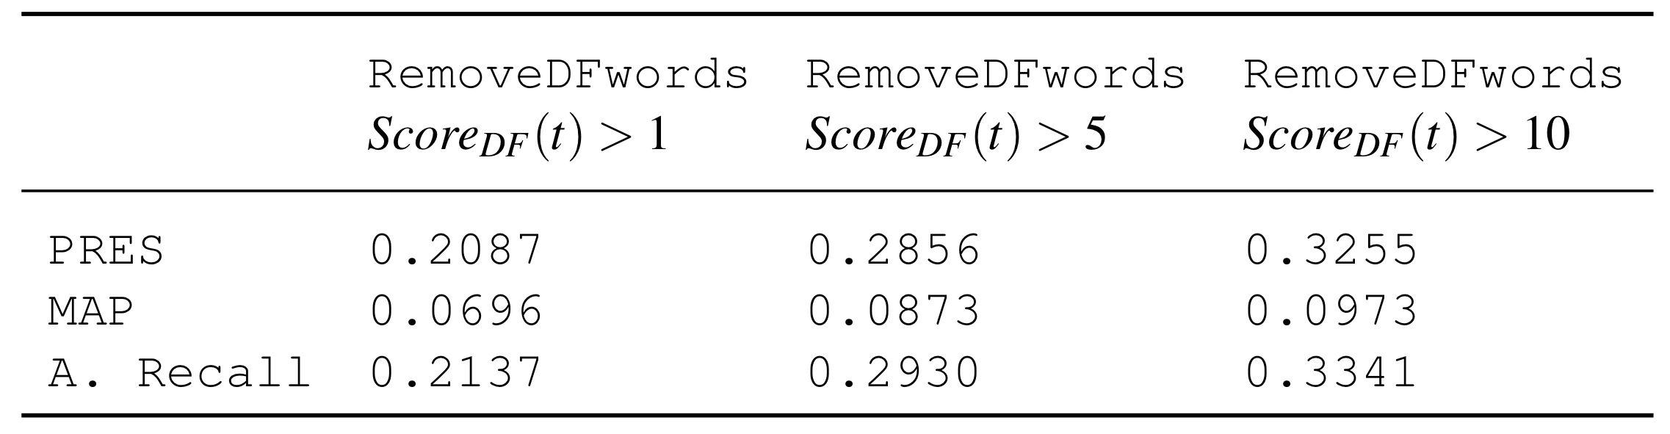
(1) Results: Low Performance

Slide 18
(2) Query Frequent Terms
Hypothesis: frequent query terms are important.
We removed DF words, but we kept query frequent terms :

Slide 19
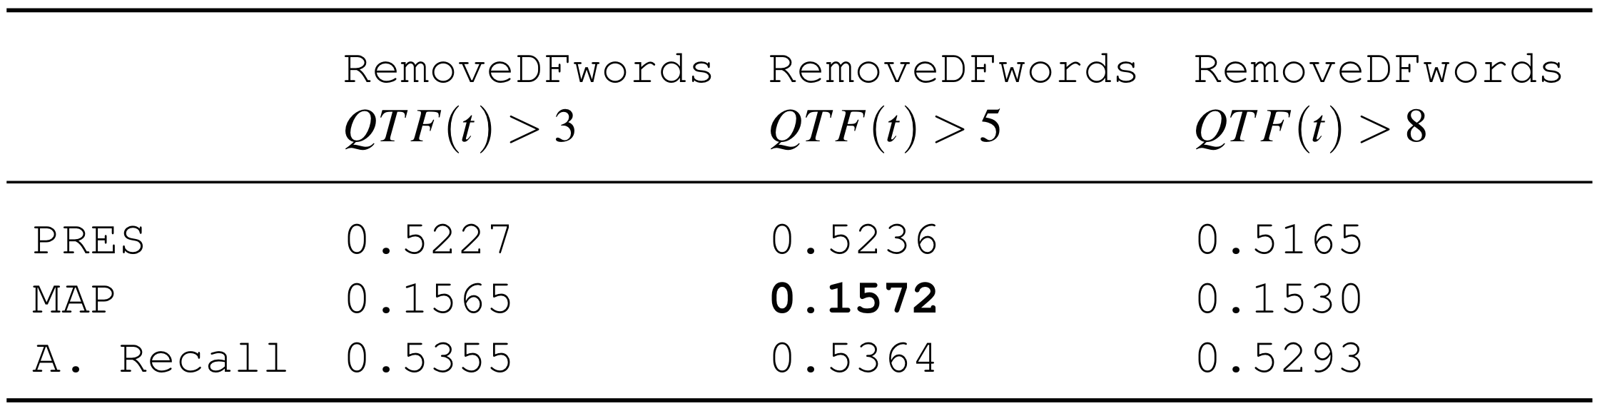
(2) Results:
Performed better but still lower than the baseline

Slide 20
Justify the Results:
Non-useful Terms
Useful Terms
QTF(t) > 5
Not Desired
Desired
Desired
Not Desired

Slide 21
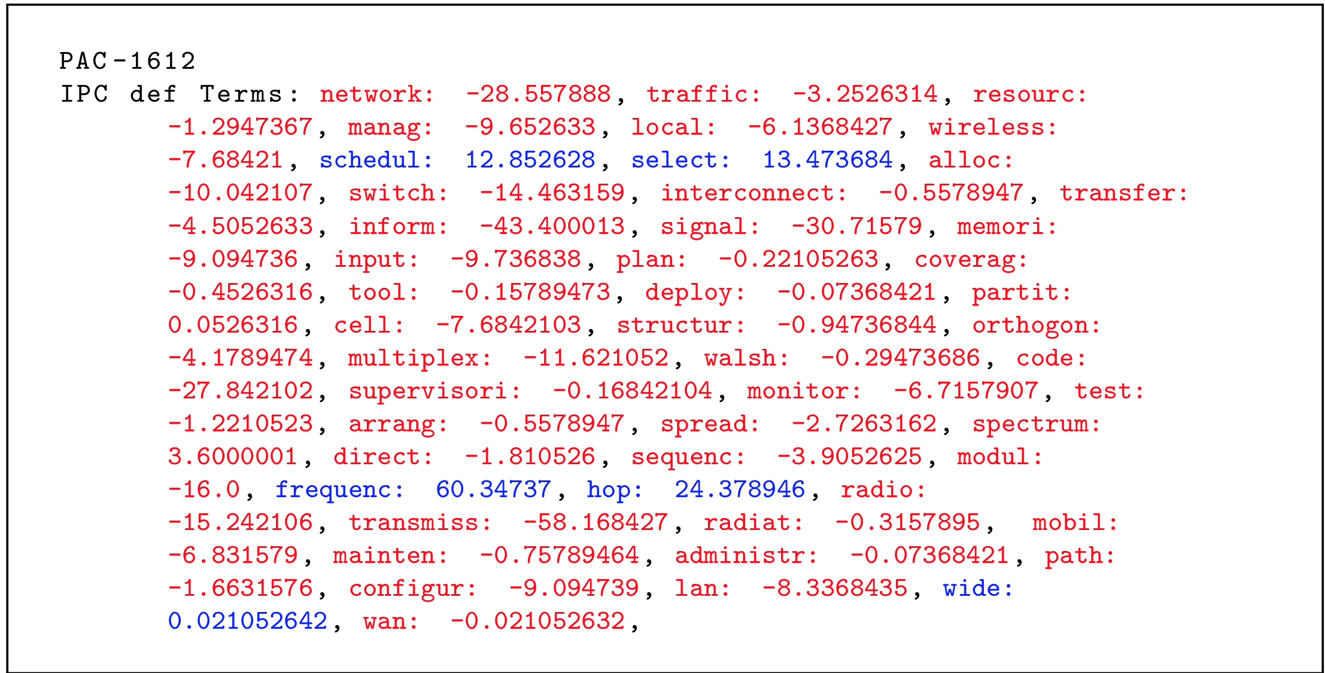
(3) Words in IPC Code Title
Most of them have negative RF score
Remove them as noisy terms? performance get worse
Removing few useful terms affect the performance

Slide 22
(4) Pseudo Relevance Feedback
Baseline

Slide 23
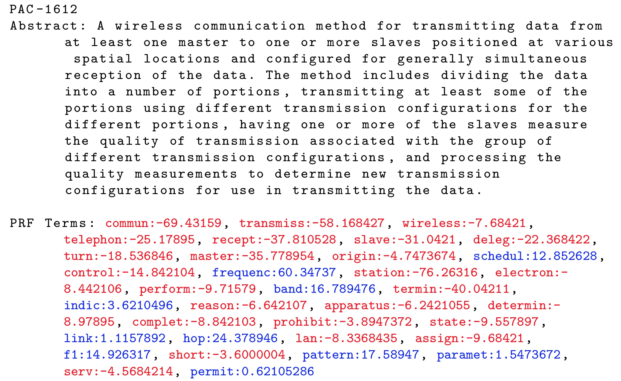
(4) Anecdotal Example

Slide 24
We Got Improved by the 1st ranked rel. doc.
Query Reduction Using RF Words, Identified by Only the 1st Rel. Document, Doubled MAP
Patent Query Term Selection
 | 1st Rel. Patent | 1st Three Rel. Patents
PRESS | 0.5016 | 0.5699
MAP | 0.3040 | 0.3879
Avg. Recall | 0.5090 | 0.5757

Slide 25
Minimum Effort: The 1st Ranked Patent can be easily Found at Top-10

Slide 26

Thank you

Slide 27
What to Take Home
The Main Cause of Failure is the Existence of Noisy Words inside Full Document not Term Mismatch.
Standard Ranking Algorithms are Extremely Sensitive to Small amount of Noisy Words.
The Best-Performed Query can be made from Patent Query.
Only the Highest Ranked Rel. Document can Double the ‘MAP’
Minimum Effort: Since they can be Found in Top-5 Documents

Slide 28
Term Analysis
Term Mismatch has been the Main Complain in Patent Retrieval[Roda et al., 2010][Lupu et al., 2011][Magdy, 2012][Mahdabi, 2013]

Slide 29
Distribution of Term Overlap (1303 Queries)
TPs
FPs
FNs
%22
%1.8

Slide 30
There is a Negative Correlation btw.
Non-useful Terms
Useful Terms
QTF(t) > 5
Not Desired
Desired
Desired
Removed :
But the performance is too Close to Baseline!
Not Desired

Slide 31
QTF, IPC Def. Words, and RF
Most IPC def. Words Have Negative RF Score
Removing IPC def. Words Deteriorates the Performance
So, Even Few Common Words in the Same IPC category are important!
It was quite Disappointing to Recognize Noisy Words Existing in Query without Knowing Relevant Documents!

Slide 32
We can still Get Improved by Minimum User Effort
RF Query by Identifying Only 1 or 3 Rel. Document(s)
RF Query
 | 1st Rel. Patent | 1st Three Rel. Patent
PRESS | 0.4674 | 0.5441
MAP | 0.2978 | 0.4338
Avg. Recall | 0.4741 | 0.5479

Slide 33
DF Words as Noisy Words
We calculate DF score for each term in top-100 patents:
RF score:

Slide 34
PRF did not Work!
Baseline

