Slide 1
Kaplan–Meier: Reading Time-to-Event Evidence
A lifelines Waltons example
InterviewCase Public

Slide 2
Kaplan–Meier

Slide 3
Learning goals
Explain what a Kaplan–Meier curve estimates.
Identify an event, time origin, duration, groups, and right-censoring.
Read confidence intervals and numbers at risk without overclaiming.

Slide 4
When time-to-event analysis fits
Use time-to-event methods when both whether an event occurs and when it occurs matter.
Examples: time to churn, failure, relapse, or adoption.
Include units with incomplete follow-up when the event has not yet been observed.
Define the event, time origin, follow-up duration, and censoring rule first.
KM alone does not adjust for other characteristics, establish causation, test a group difference, or handle competing events.

Slide 5
What the curve estimates
The survival function, (S(t)), estimates the probability of remaining event-free beyond time (t).
At an observed event time, the estimate steps down based on events among units still at risk.
A right-censored unit contributes follow-up up to its last observed time, but is not counted as an event.
Shaded confidence intervals show uncertainty; censor marks show censored times.
The at-risk row shows how many observations support each part of the curve.

Slide 6
The worked example
Element | Definition
Event | Death
Time origin | Birth
Time unit | Days (T)
Event indicator | E=1: death observed; E=0: right-censored
Groups | control and miR-137 genotype
The existing notebook uses the 163-observation Waltons dataset from lifelines.datasets.

Slide 7
The dataset documentation describes censoring when natural death is not observed, including accidental killing or escape before natural death.

Slide 8
Saved group summaries
Group | n | Deaths observed | Censored | Median | Follow-up through
control | 129 | 122 | 7 | 58 days | 75 days
miR-137 | 34 | 34 | 0 | 26 days | 62 days

Slide 9
Overall median in the saved notebook: 56 days. The median is when estimated event-free probability reaches 0.5.

Slide 10
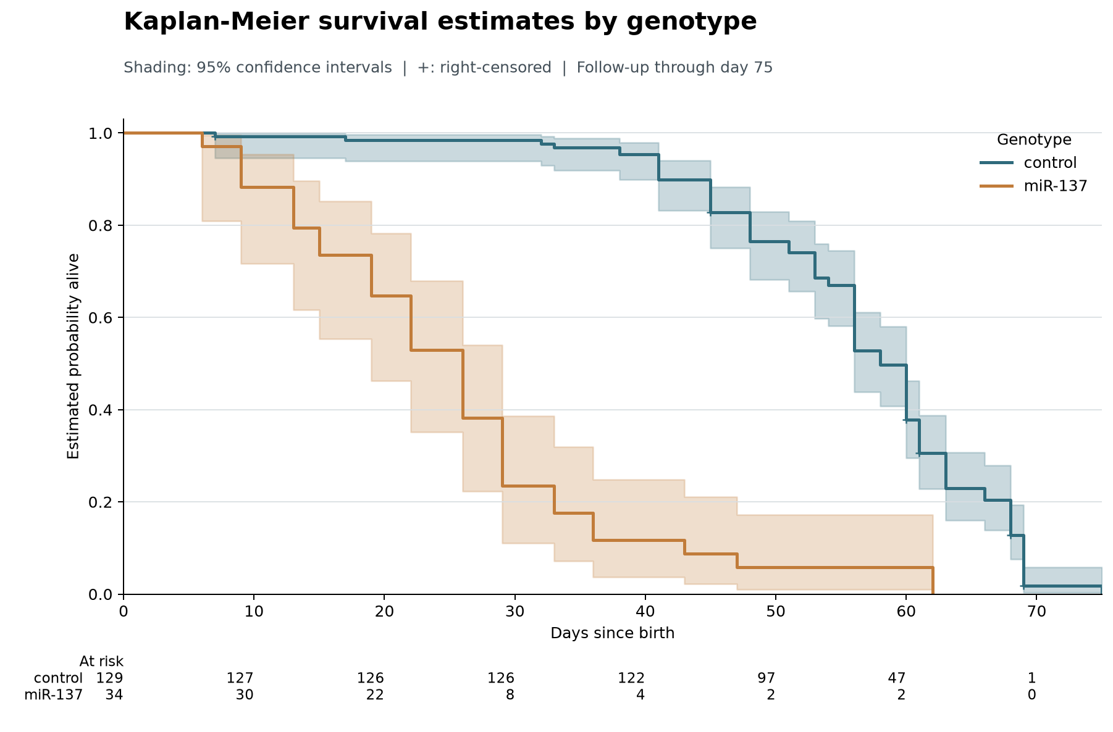

Slide 11
Check the number at risk
Day | control | miR-137
0 | 129 | 34
30 | 126 | 8
50 | 97 | 2
60 | 47 | 2
70 | 1 | 0
Counts transcribed from the saved figure:

Slide 12
Only two miR-137 flies remain at risk at day 60. Late estimates are therefore uncertain and should not be read as stable evidence.

Slide 13
Assumptions and limitations
Censoring should be sufficiently non-informative: it should not conceal systematically different event risk.
Event, time origin, and units must be consistent across groups.
Follow-up support differs here: control is observed through day 75, miR-137 through day 62; group sizes and censoring also differ.
KM is unadjusted. A curve or median difference alone is neither a causal conclusion nor a significance test.
These results apply only to the Waltons teaching example—not customer retention.

Slide 14
Takeaway
KM uses censored follow-up to estimate event-free probability over time. Read the curve together with its confidence bands, censor marks, and number at risk—and keep conclusions descriptive unless a suitable design and additional analysis support more.

Slide 15
References
KaplanMeierFitter API
lifelines datasets and Waltons data
Saved analysis and figure: kaplan_meier_waltons.ipynb and outputs/figures/waltons_kaplan_meier.png
Rendering these slides does not execute the notebook, run Python analysis, or regenerate the figure. Use the report-only commands in the project README.

