Slide 1

Read the F* Manual?
Write a better manual.
Rich Bowen
LinuxCon North America, 2016

Slide 2
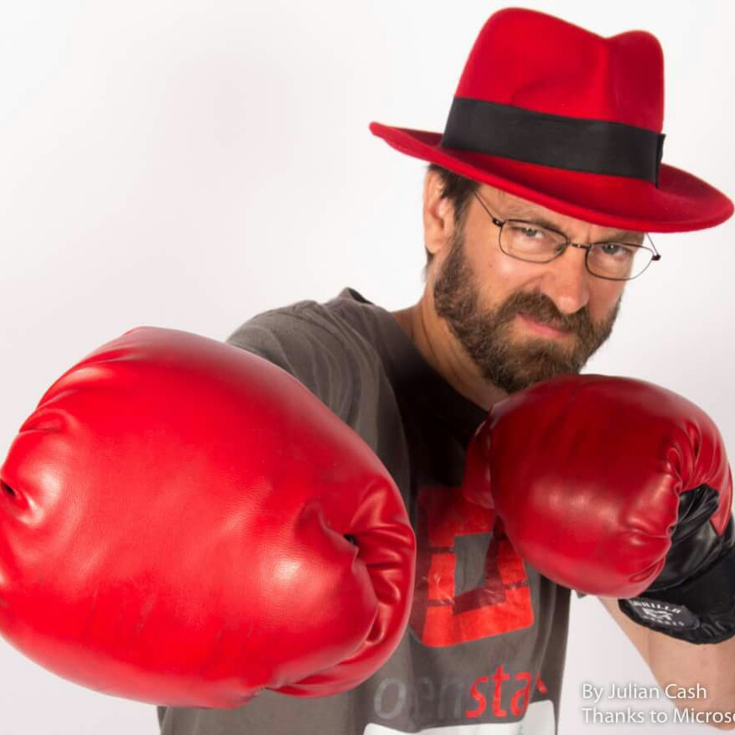
$> whoami
Docs guy on the Apache HTTP server for about 20 years
Written a few books about Apache httpd
Struggling with the question of “what makes good docs” for most of that time
Day Job: Community guy for OpenStack at Red Hat

Slide 3
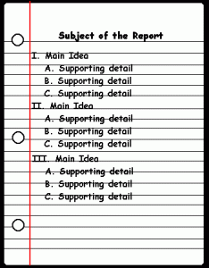
Outline:
Your community is your documentation
Know who your audience is
The customer is not an idiot
Be welcoming of new docs, but not too welcoming
Notes:
This presentation has had many incarnations, because there’s so many different things I want to say. So, I’ve tried to get it down to these points.

Slide 4

1) Your community is your documentation
Community > Code
Community > Docs

Slide 5
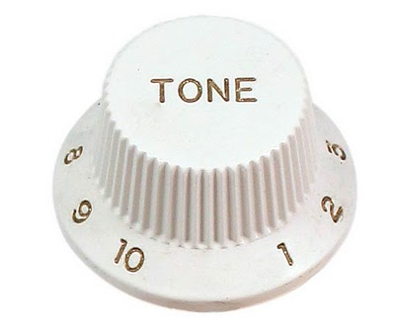
Setting the tone
Your community sets the tone of your documentation
Your documentation sets the tone of your community

Slide 6

Example: Perl
Academic language
Dedicated to elegant, but, more importantly clever, solutions to problems
Documentation is exhaustive and academic
Community attracts playful hubris
Reputation of unreadable code
Consider the feedback loop
Notes:
Perl
Playful, with lots of hubris - showing off clever solutions.
This leads to a community reputation for complex, byzantine code.
Which in turn attracts a community of people who like to solve problems in elegant, if not particularly transparent, ways.

Slide 7

Example: PHP
Web programming for everyone
Very solution-oriented (community and docs, both)
Lots of solution-specific examples in docs
Community attracts non-programmers, or, at least, people who want a solution and don’t care about academic correctness
Reputation of sloppy, insecure code
Consider the feedback loop
Notes:
PHP - web development for everyone. This leads to solutions-oriented documentation, with lots of user-contributed simple solutions. This, in turn, attracts a community of people that want to solve problems and don't care much about elegance, security, or best programming practice.

Slide 8
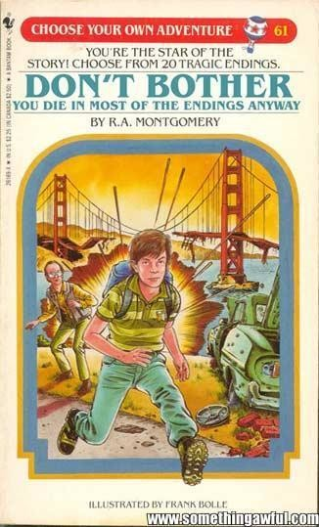
Choose your adventure
You have a lot of influence over your project’s culture
Choose wisely

Slide 9
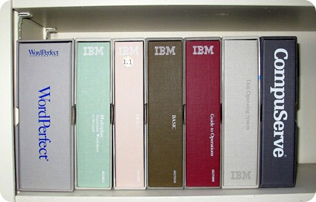
Definitions
Documentation is:
  Formal docs
  IRC conversations
  Mailing list conversations
  Conferences/Events/Meetups
  Third-party howto websites
Notes:
These things are increasingly further out of our control as the list proceeds. You get to decide how much you participate in each layer, and, thus, how much influence you exert over the culture.

Slide 10
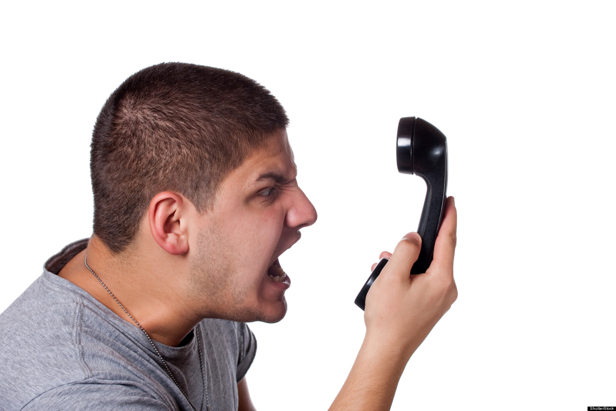
Definition
Customer
  Anybody that uses the product/project
  Not limited to people that paid for it
  Treating people like customers is about respect. Yes, we know you’re “just a volunteer.” Try to behave like they’re worth your time, anyways.

Slide 11
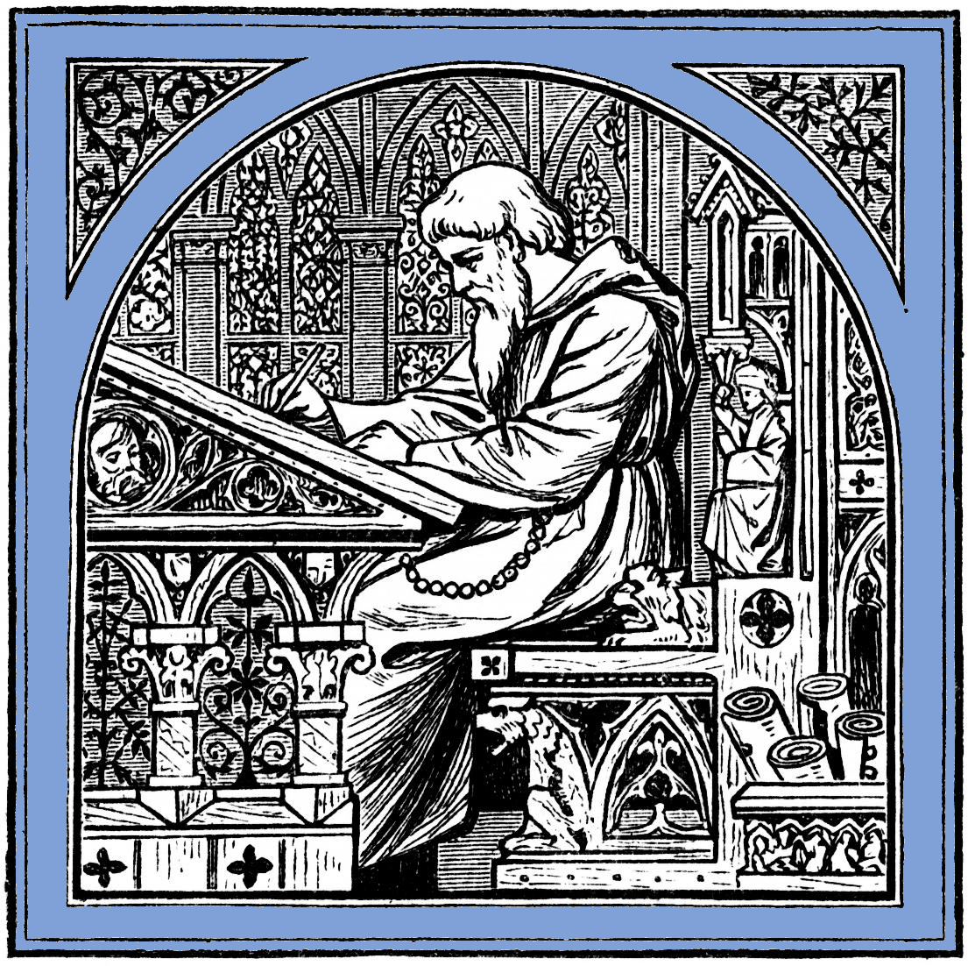
Community > Docs
Docs (as defined above) are delivered by a community, not by a writer working in his dark office
Insert tab A
into slot B

Slide 12

Choose your community
By who you choose to be, you pick who will come hang out with you
Don’t pick the jerks

Slide 13
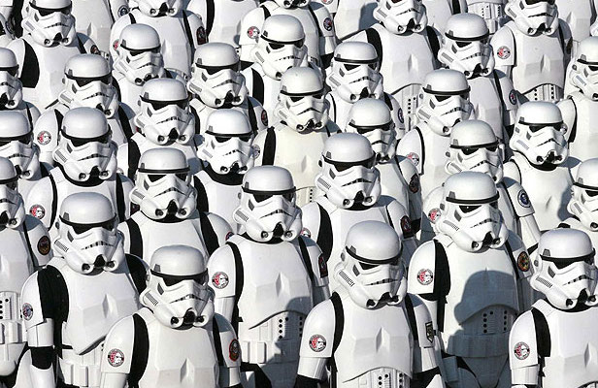
Let your community choose itself
WARNING: Don’t choose a community that’s all copies of you
That’s boring, and kills innovation
Notes:
Don’t choose you community by picking “the right people”. Rather, choose your community by being the right people.

Slide 14
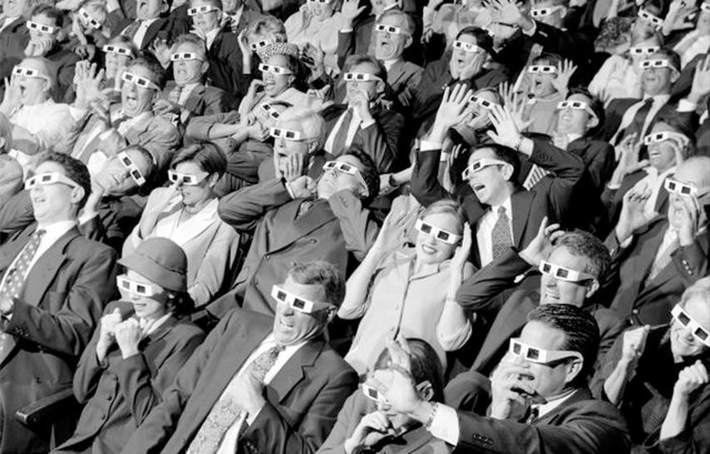
2) Know who your audience is

Slide 15
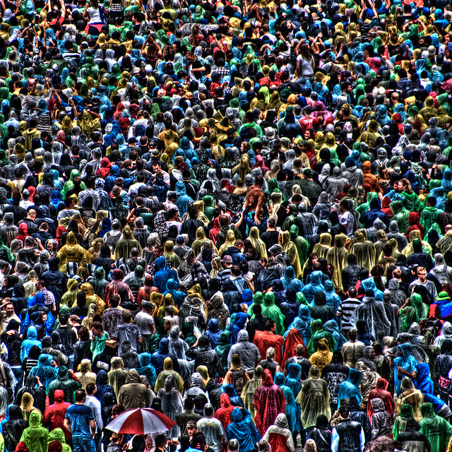
Personas
Detailed profiles of several of your audience
Consider their opinions when making documentation decisions
Actual user interviews help, if you have the time/budget

Slide 16
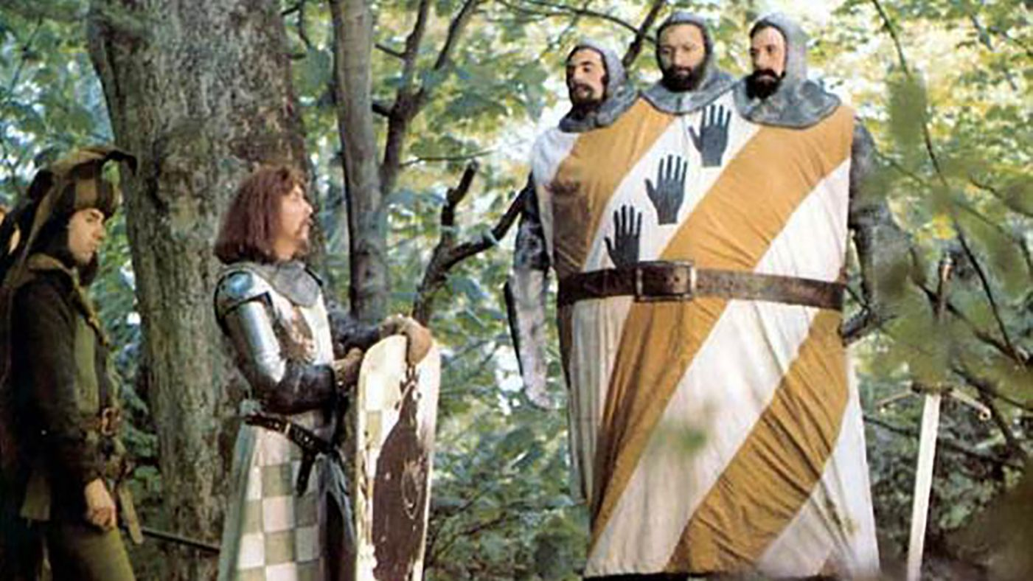
ドキュメント
Your audience is not all white English-speaking young men who grew up watching Monty Python skits.

Slide 17
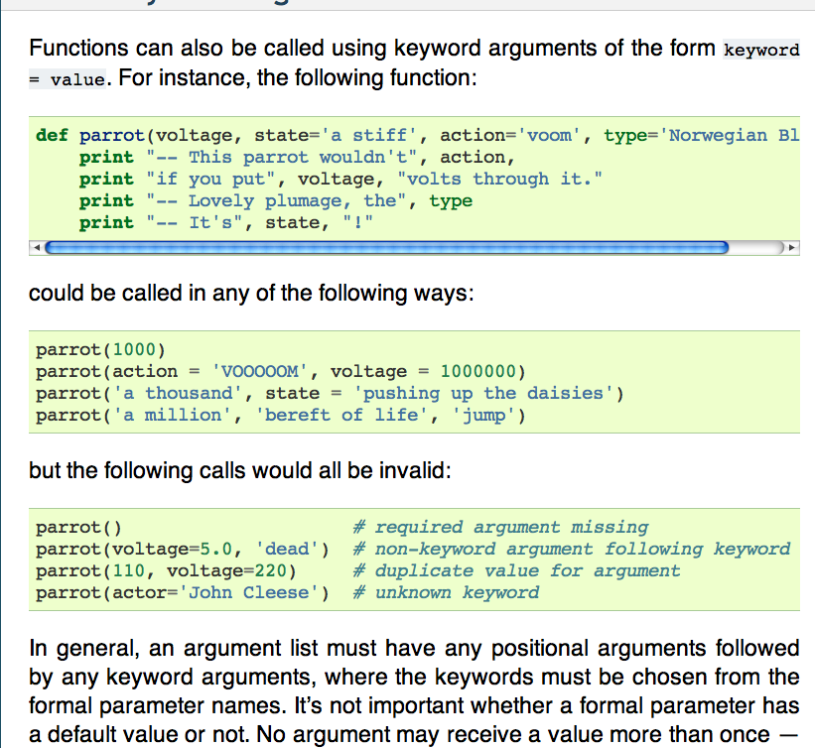
Eg:

Slide 18

Inside Jokes
Create/Reinforce a strong sense of community
Point out to others that they're not part of the community. (See also, “Othering”)
Tread carefully
Notes:
Othering: The process of perceiving or portraying someone or something as fundamentally different or alien.
It also makes it easier to dismiss someone’s opinions, or worthiness, if they are somehow not like us.
This suggestion has resulted in VERY strong responses from people who feel that I'm robbing the personality from their writing. Be warned.

Slide 19
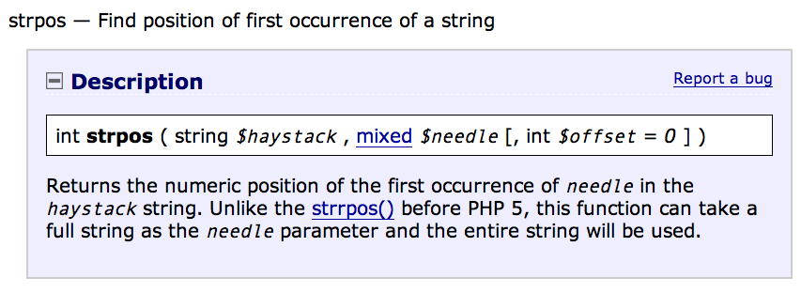
Colloquialisms

Slide 20
Colloquialisms
Make your documentation feel conversational and welcoming
Can alienate (or, at best, confuse) people who don't know what they mean
Tread carefully

Slide 21
What is your audience asking?
We may know what they need to know,
but only they can tell us what they
need to know.
Anne Gentle

Slide 22
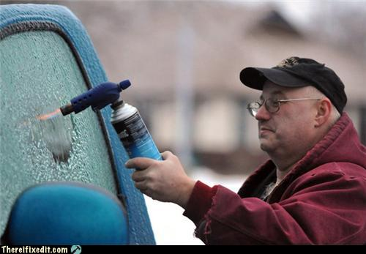
3) The customer is not an idiot
This seems to be the one that we have the hardest time with.

Slide 23
We find it hard to accept that the customer is not an idiot because:
We know that we are brilliant
We worked hard to achieve our brilliance
We do not know the context of the problem that they are trying to solve
We do not know what tools they have at their disposal
Their proposed solution is not the one that we would have come up with

Slide 24
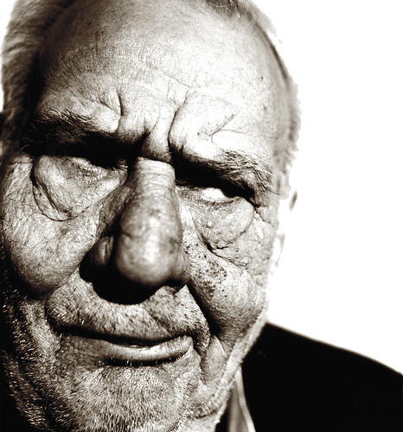
I walked five miles, uphill, through
the snow, every day to school!
Notes:
Most of us that are writing the docs had to work hard to achieve our knowledge. We taught ourselves, experimented, made mistakes, and learned from those mistakes. Now you come along and want to get all of that for free.
It’s not fair.

Slide 25
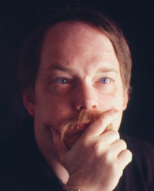
Also, conditioning
http://www.catb.org/esr/faqs/smart-questions.html
There is an ancient and hallowed tradition: if you get a
reply that reads “RTFM”, the person who sent it thinks
you should have Read The F***ing Manual. He or she is
almost certainly right. Go read it.
RTFM has a younger relative. If you get a reply that reads
“STFW”, the person who sent it thinks you should have
Searched The F*ing Web. He or she is almost certainly
right. Go search it. (The milder version of this is when
you are told “Google is your friend!”)

Slide 26
It’s ok to be rude, because we’re more important than you
http://www.catb.org/esr/faqs/smart-questions.html
Much of what looks like rudeness in hacker circles is
not intended to give offense. Rather, it's the
product of the direct, cut-through-the-bullshit
communications style that is natural to people
who are more concerned about solving problems
than making others feel warm and fuzzy.

Slide 27
I strenuously disagree
It is not a "hallowed tradition"
It's bad manners, and it's juvenile
It's time to grow up

Slide 28
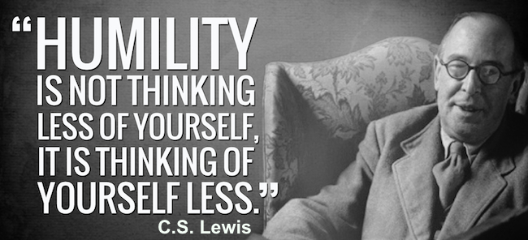
Humility
You don't know everything
The documentation isn't perfect yet
Remember that once you, too, were completely ignorant
Notes:
Try to remember that moment that you were a complete newbie, asking stupid questions. Cherish that moment. If you can't remember, then it's probably been too long since you learned something new.

Slide 29
RTFM!
The RTFM attitude is indicative of arrogance and impatience, whereas truly great documentation is the result of patience and humility.
(Yes, they should read the docs. Yes, they should do their homework first. But, no, you should not be rude about it.)

Slide 30
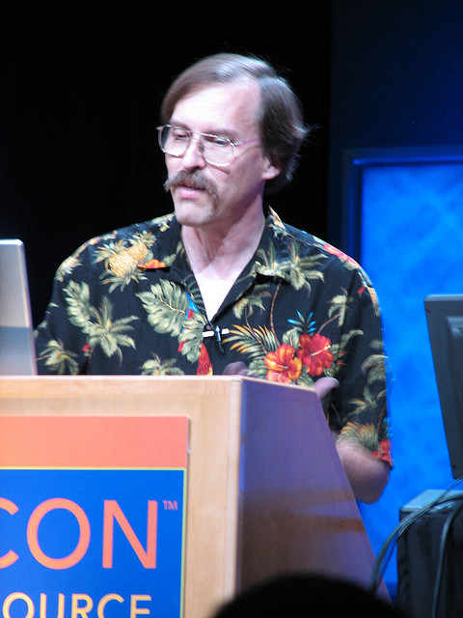
Three Virtues
Notes:
Three virtues of a programmer: Laziness, Impatience and Hubris
Three virtues of a human: Diligence, patience, and humility
Impatience with a question comes across as disrespect for the questioner. Perhaps it’s time to turn your talents elsewhere

Slide 31
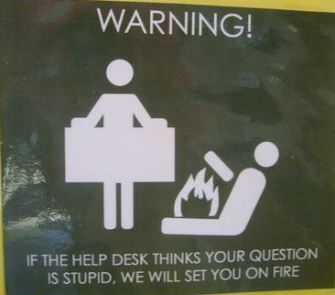
Stupid questions?
There is such a thing as a stupid question.
Your attitude towards stupid questions says a lot about you.
It's your job to guide them to the right question, and its answer.
Notes:
There is, of course, such a thing as stupid questions. However, be very cautious about classifying someone’s questions as stupid before you understand the context. Most people are primarily interested in solutions to actual problems.

Slide 32
Why
However, you must ask yourself WHY are they asking that stupid question?
(Hint: It’s almost never because they are an idiot.)

Slide 33
Solutions
End-users do not necessarily care about the
source of the information,or whether it was written
by a professional; they judge the information
solely on its ability to solve their problem.
Anne Gentle

Slide 34
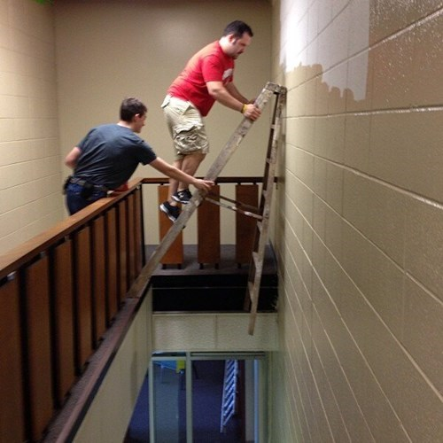
Solutions vs Best Practice
People want a quick solution NOW and aren’t, generally, thinking about maintainability or consequences

Slide 35
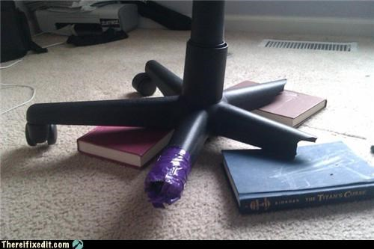
Even when they know ...
Even when they know it’s not the best solution, they have to work with the tools that they have available.

Slide 36
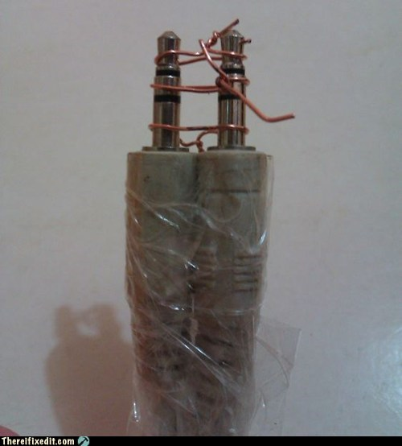
Your job:
Help them solve the immediate problem
Also, guide them towards the better long-term solution

Slide 37
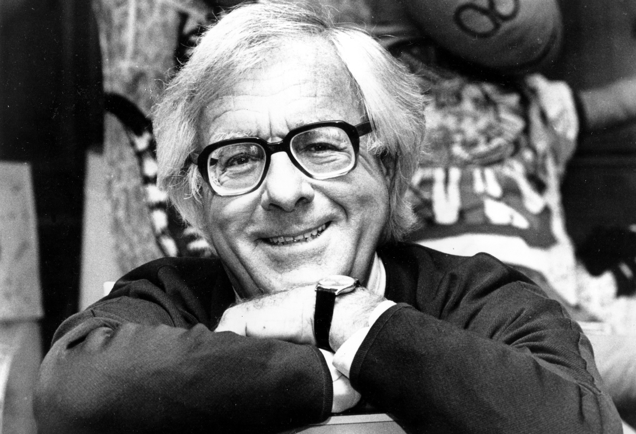
So, what do you write?
Technical docs require a lot of planning
Notes:
Bradbury: Just start writing
This works well for fiction, but does not work for technical documentation.
On the other hand, writing something – anything – every day, is a great way to make yourself a better writer, even of tech docs.

Slide 38
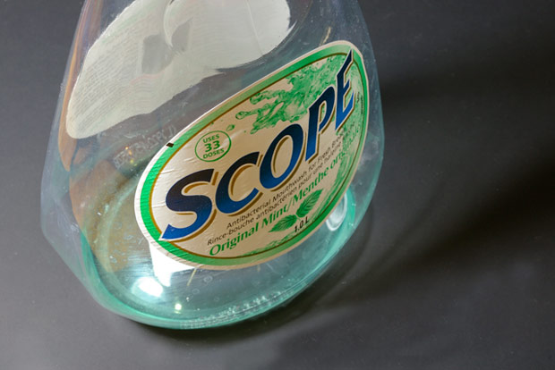
Scope
You must decide the scope of your documentation
Document your scope
Decide not to answer the wrong questions, but figure out where to send people for those answers
Be polite about it

Slide 39
Reference manual
Comprehensive and exhaustive
Correct
Consistent, predictable format
Best practice
Lots of tested examples

Slide 40
Correct
Software changes often. Stay on top of it
Feedback loop with the developers, to ensure that it remains correct
Feedback look with users, to ensure that everything actually works

Slide 41
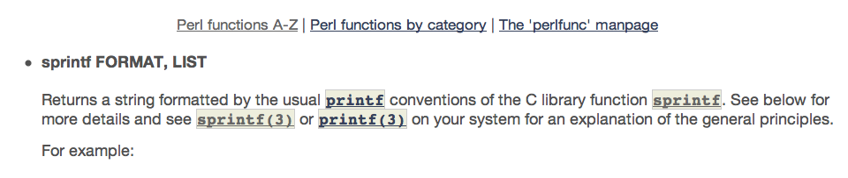
Comprehensive
Carefully consider what’s in scope, and then document it thoroughly

Slide 42
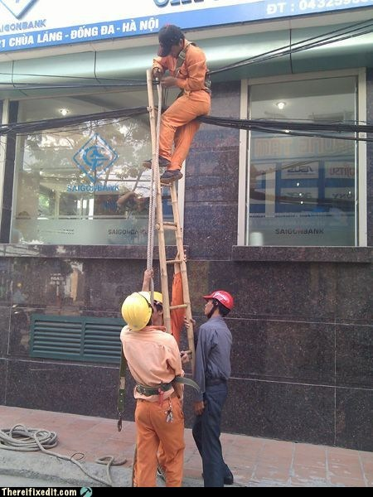
Best Practice
Scope and Comprehensive are in careful tension
Notes:
Beginners just want it to work, with as little effort as possible. Just because it works doesn’t mean it’s the right answer.
The *best* answer is often more complicated than the *good enough* answer
Doing it right now saves time and tears later
It's a balancing act between helping the person now in their crisis, or helping them long term in becoming an expert.

Slide 43
Howtos, tutorials, examples
Cover everything, even the trivial steps
Never say "easy", "trivial", "simple", "obvious", or "of course", or any other words or phrases that mean that. Your reader is there because it's not.
Test it. Repeatedly. On multiple systems.

Slide 44
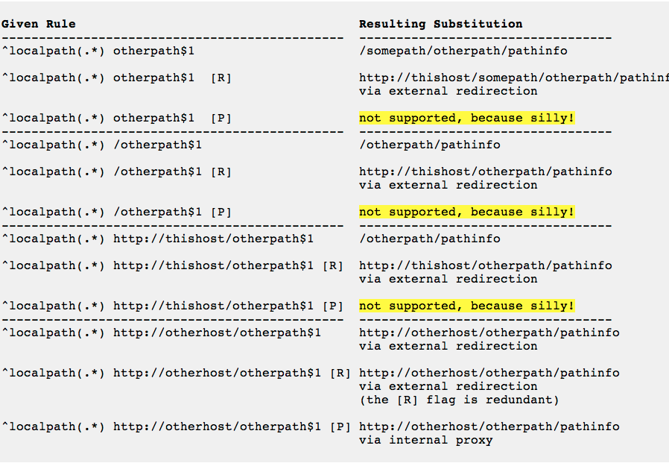
Don’t ridicule your reader
Notes:
As a teacher, the role of encouraging your reader is almost as important as the role of conveying information. Ridiculing, or belittling your reader, or, more subtly, telling them that things are hard, is a great way to undermine your own work.

Slide 45
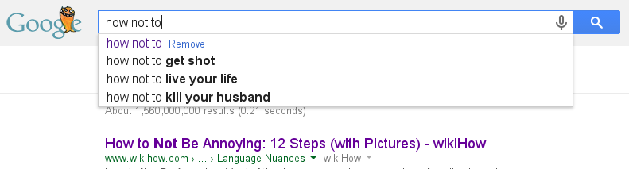
How not to
Despite your best intentions, everyone will copy/paste your example of how not to do it, then blame you when it doesn’t work.

Slide 46
4) Be welcoming of new doc contributions
Your docs are wrong
They’re incomplete
They’re difficult to understand
Someone knows more than you do
Make it easy for them to help
Notes:
All code has bugs. All code can be reduced by at least one line. Therefore, all code can be reduced to one line that doesn’t work.

Slide 47
The Common Wisdom
Documentation in Open Source is terrible
Nobody wants to do it
This is simply a reality of Open Source, and we have to put up with it

Slide 48

The Truth
Lots of people want to write docs. Many of them can even write a coherent sentence
We make it way too hard for them to participate
So, they flock to third-party forums, and Stack Overflow, where they share misconceptions and worst-practice "solutions" with one another

Slide 49
Better Docs
If we want better docs, we need to lower the barrier to entry for new docs authors.
We need to be willing to mentor these contributors, and help them get their changes through the system.
But … not too easy. Crappy documentation doesn’t actually help anyone. (Wikis require a LOT of babysitting.)

Slide 50
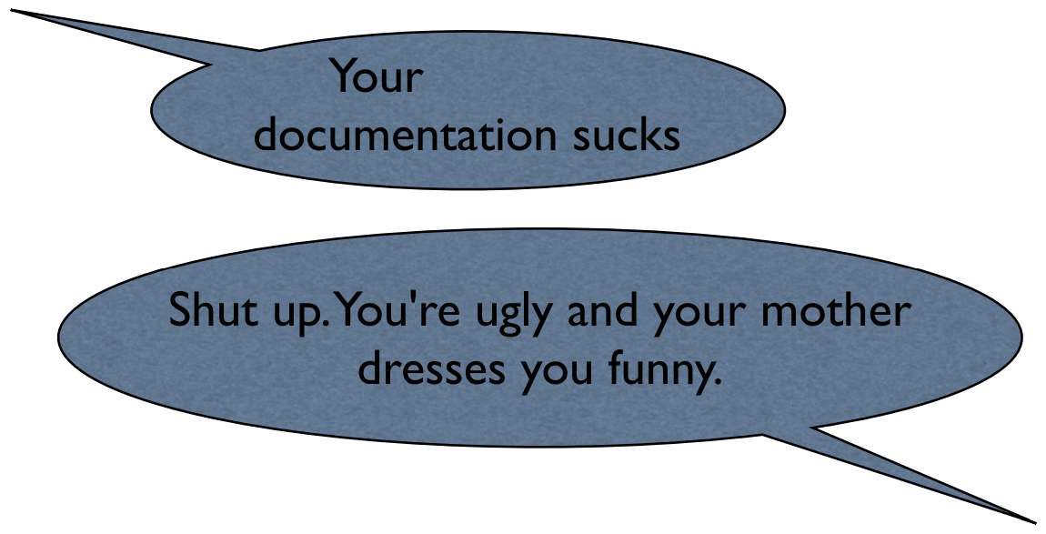
Wrong way:
Notes:
Result: Your documentation might get better, and, even if it doesn't, you've told one person that you care what your customers think.

Slide 51
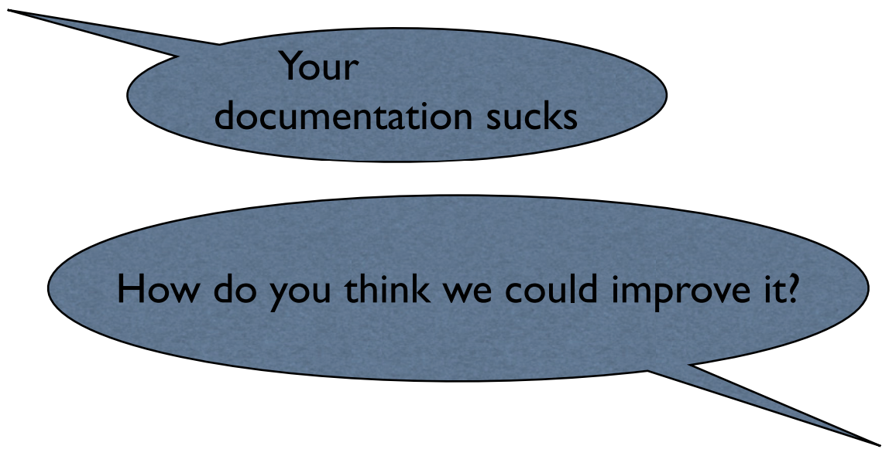
Right way:
Notes:
Result: Your documentation still sucks, and you've alienated someone who wanted, albeit misguidedly, to help.

Slide 52
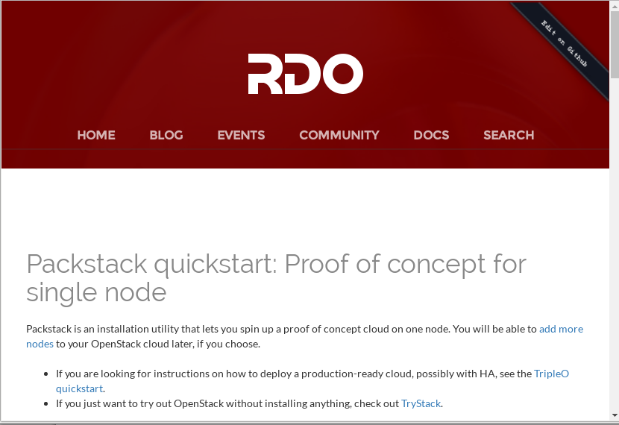
How to contribute
Github has made this absurdly easy. Take advantage of it

Slide 53
Revision Control
Your documentation/website should be in revision control, right next to the code
The contribution process should be identical
Tell me how to edit the doc, IN THE DOC
Don’t make me figure something out, or you will miss my contribution

Slide 54
… but not too welcoming
Setting the barrier high enough can help ensure quality
Setting this barrier, without being snobbish, is tricky
Different ways to contribute changes helps this

Slide 55
Wikis are a lot of work
If you make it easy for anyone to contribute, when you’ll get unwelcome contributions
… or at least contributions that will take a lot of work to accept
And, of course, there’s spam
Notes:
* Editing for grammar/content/correctness
* Testing examples
* Ensuring that things aren’t wall-of-text overdocumented
* There’s such a thing as too many examples
* Docs that are too domain-specific, or situation-specific, may not be helpful for a general user manual
In the 90s, we thought that wikis would usher in a new era of collaborative content creation. Spammers ruin everything for everyone. Thanks a lot, guys.

Slide 56
Treat your docs like you treat your code
Direct commit access to the docs should be earned, just like with the code
Set the barrier at a comparable level
You are entrusting your customer’s experience to this person. It’s ok to be a bit picky.

Slide 57

Too many projects ...
Create an account
Get a checkout
Subscribe to this list
Create a ticket in Bugzilla
Email a patch
Follow up on that list
Told you did it wrong, go back several steps and try again
... Give up and go away angry

Slide 58
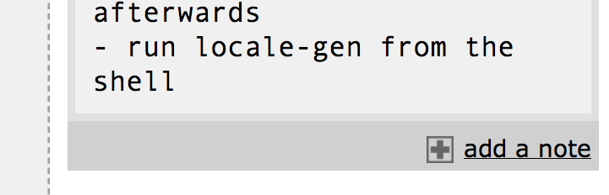
Docs Comments
See the “Add a note” link at the bottom of every page of the PHP docs
See also the Apache httpd docs
You have to actually do something about these comments for them to be useful
Notes:
On a related note, if you want to help out an open source documentation project, triaging the comments on either php or httpd project would be greatly appreciated.

Slide 59

Docs are a conversation
Which brings us back to my first point
  Community > Docs

Slide 60
Resources
WriteTheDocs.org
Conversation and Community, by Anne Gentle
BetterFM.org

