Slide 1
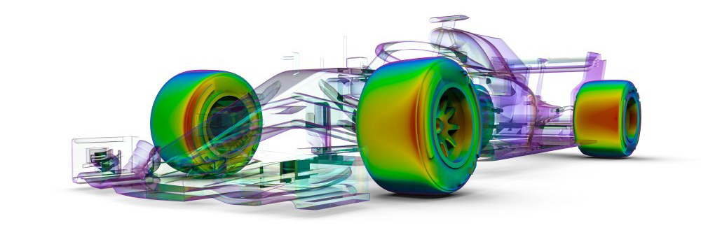
F1 Race Telemetry EDA
Analyst: Blake Powell

Slide 2
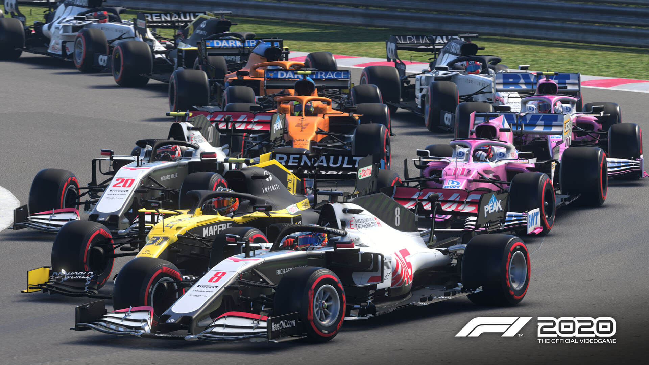
Overview
The following EDA aims to use python data analysis libraries to determine correlations between telemetry subsystems in simulated F1 race vehicles. We’ll also explore race outcomes that can be derived purely from telemetered data. For this analysis I'll be using simulated telemetry from the video-game F1 2020.

Slide 3
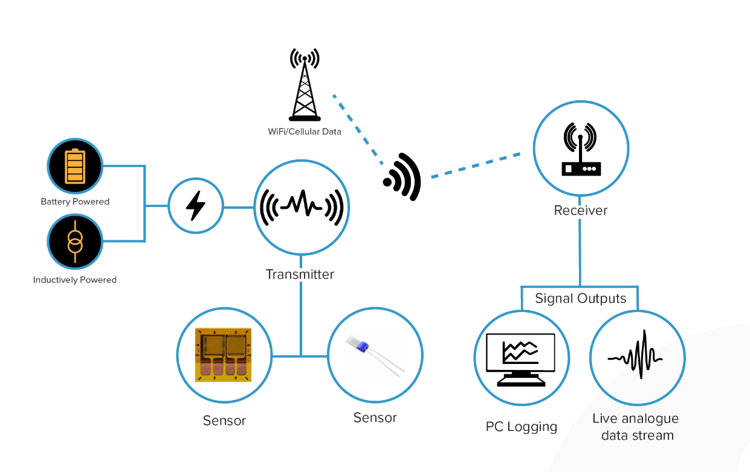
What is Telemetry?
The automatic measurement and wireless transmission of data from remote sources.¹
2

Slide 4
Data Set
This EDA examined 22 Individual race data sets. Each race data set contained 1,250,000+ records for 19 vehicles across 56 categories.
Concerns:
Does this simulated data set contain accurate correlations that will carry over to real world data?
Are mechanical failures generated and reflected in the simulated telemetry?

Slide 5
Customer Questions
Which vehicle subsystems are correlated?
Can vehicle telemetry indicate small tuning/performance issues?
Which telemetry characteristics are indicative of higher place finishes?

Slide 6
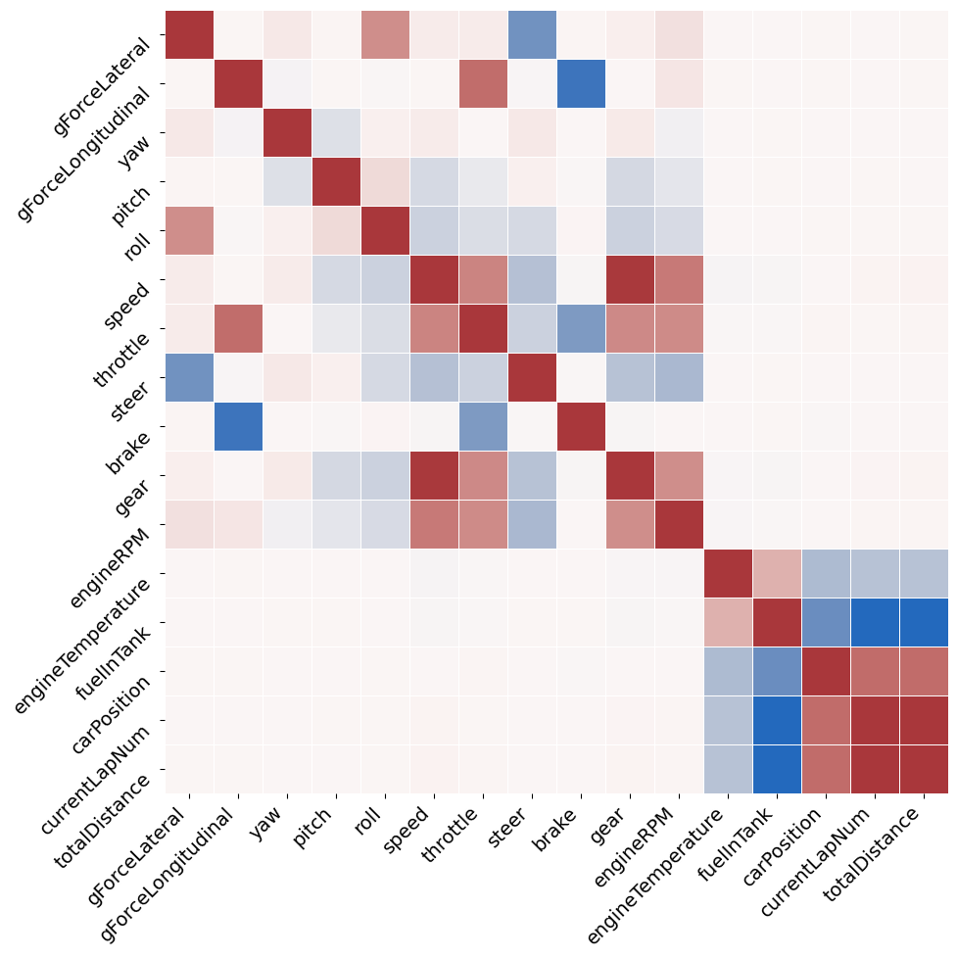
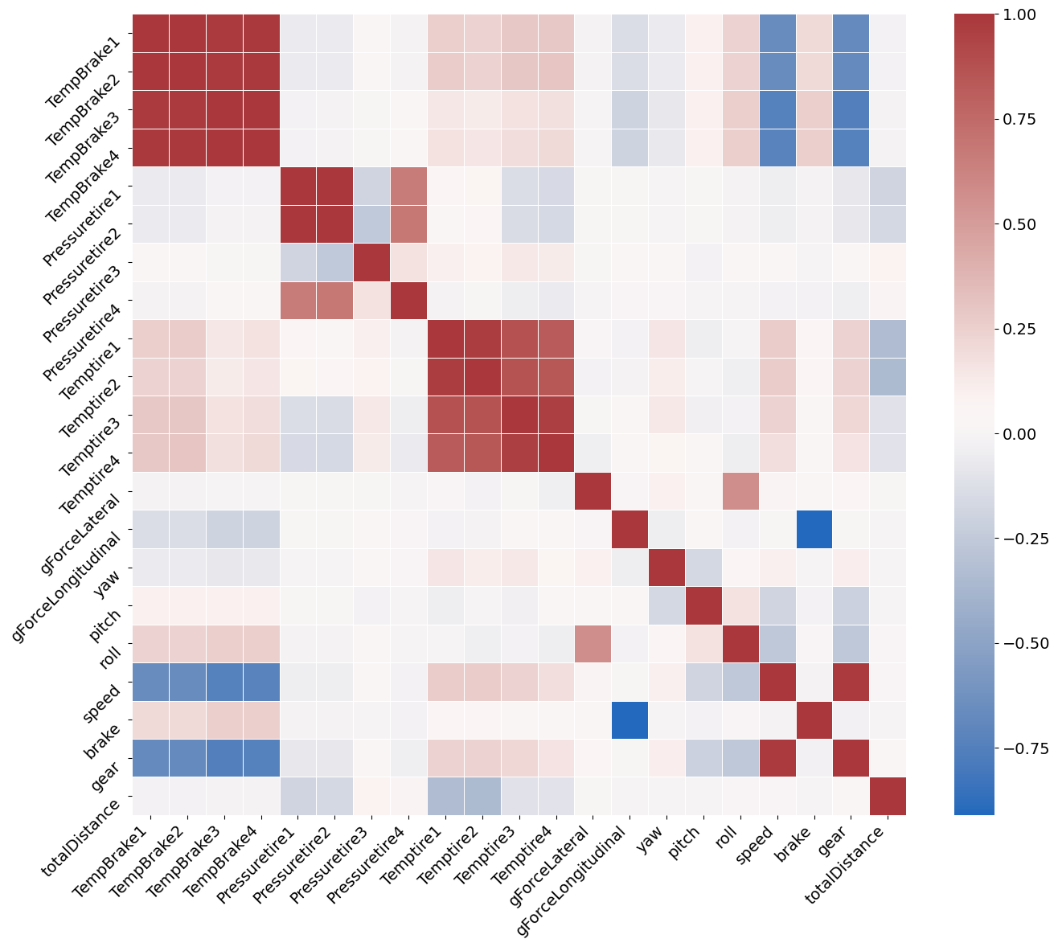
Which vehicle subsystems are correlated?

Slide 7
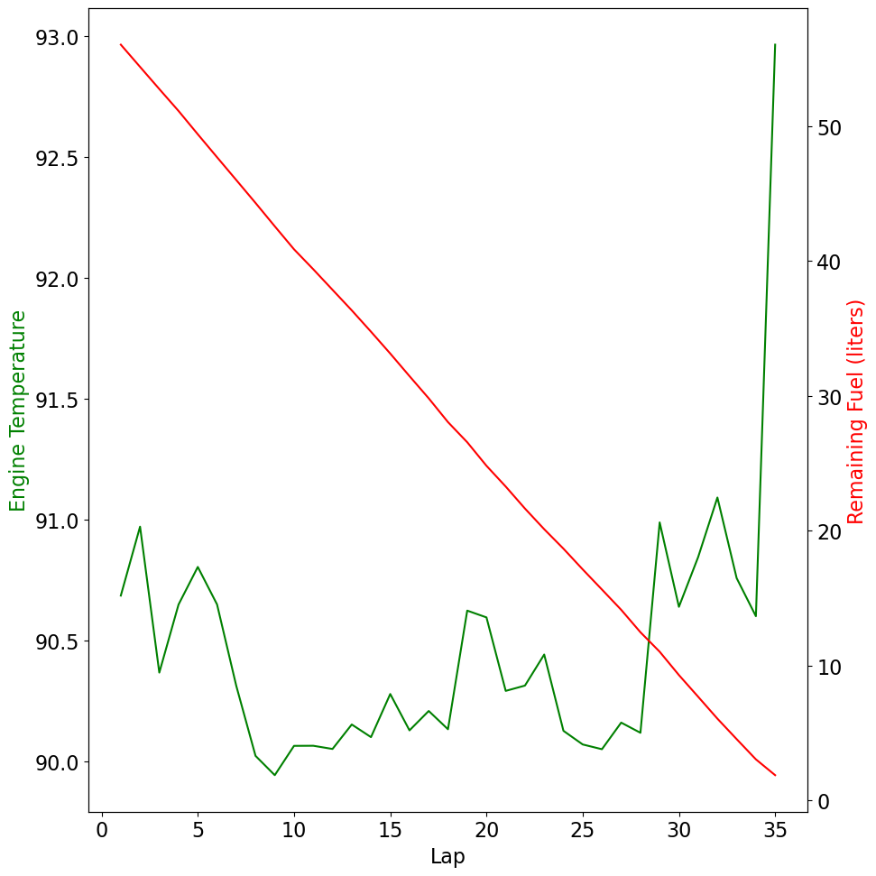
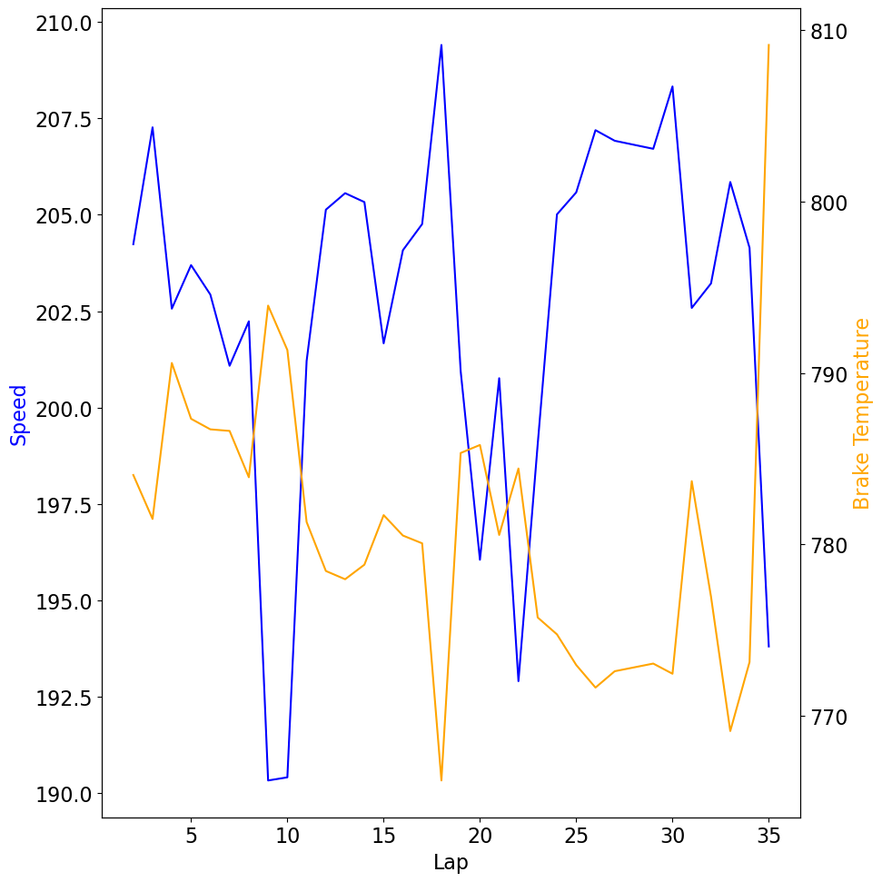
Engine Temp vs Fuel Brake Temp vs Speed

Slide 8
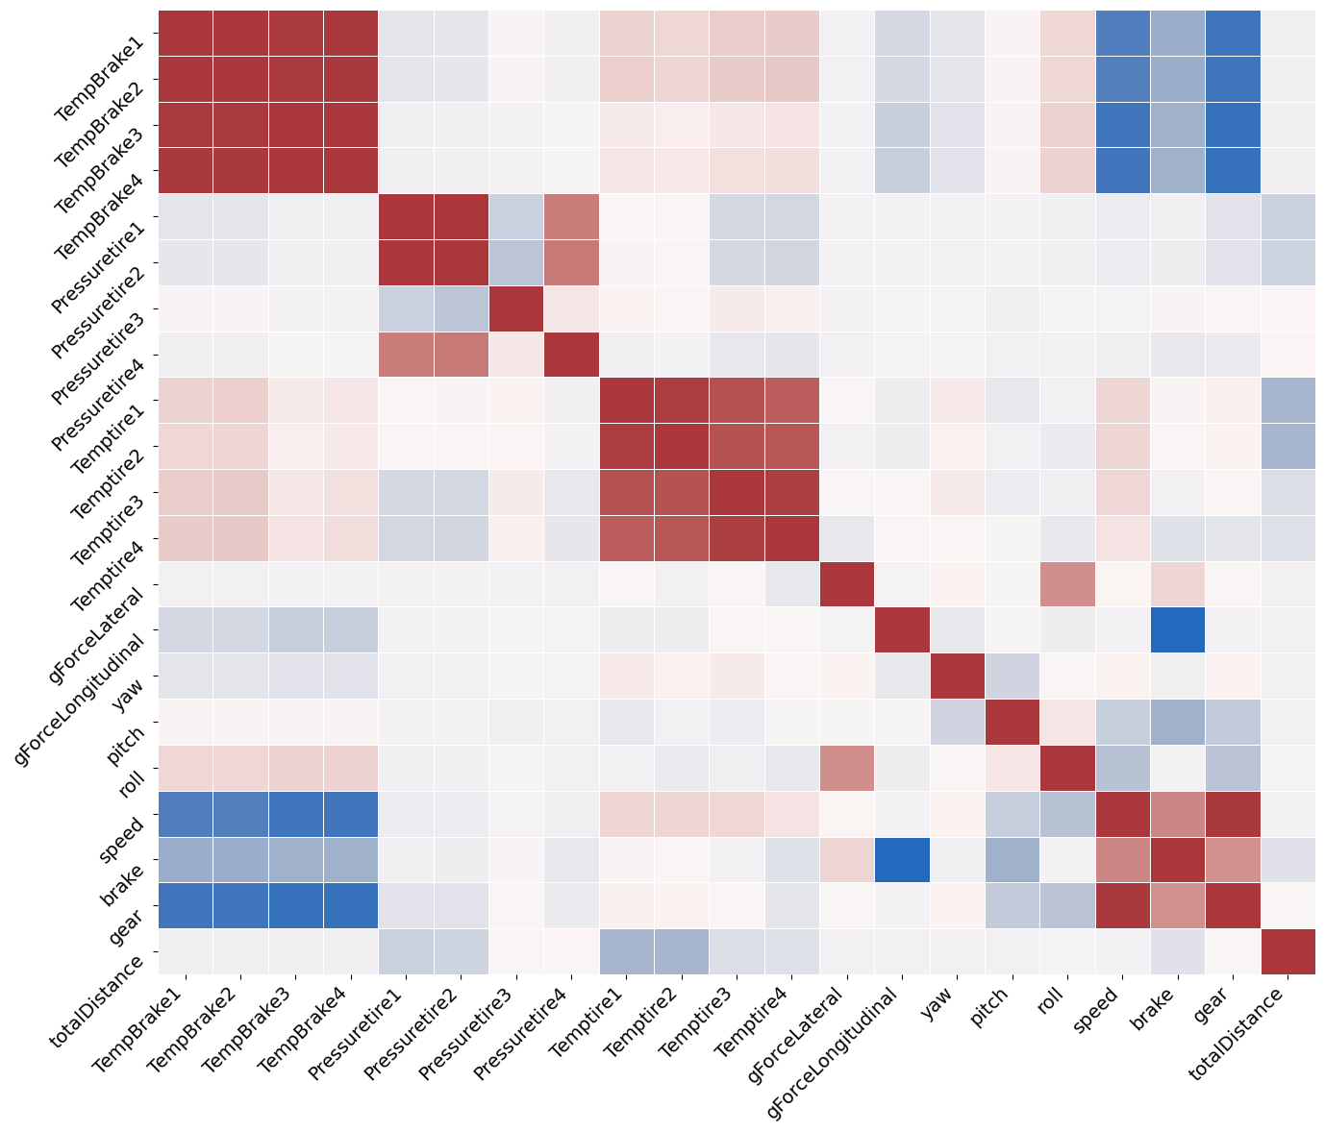
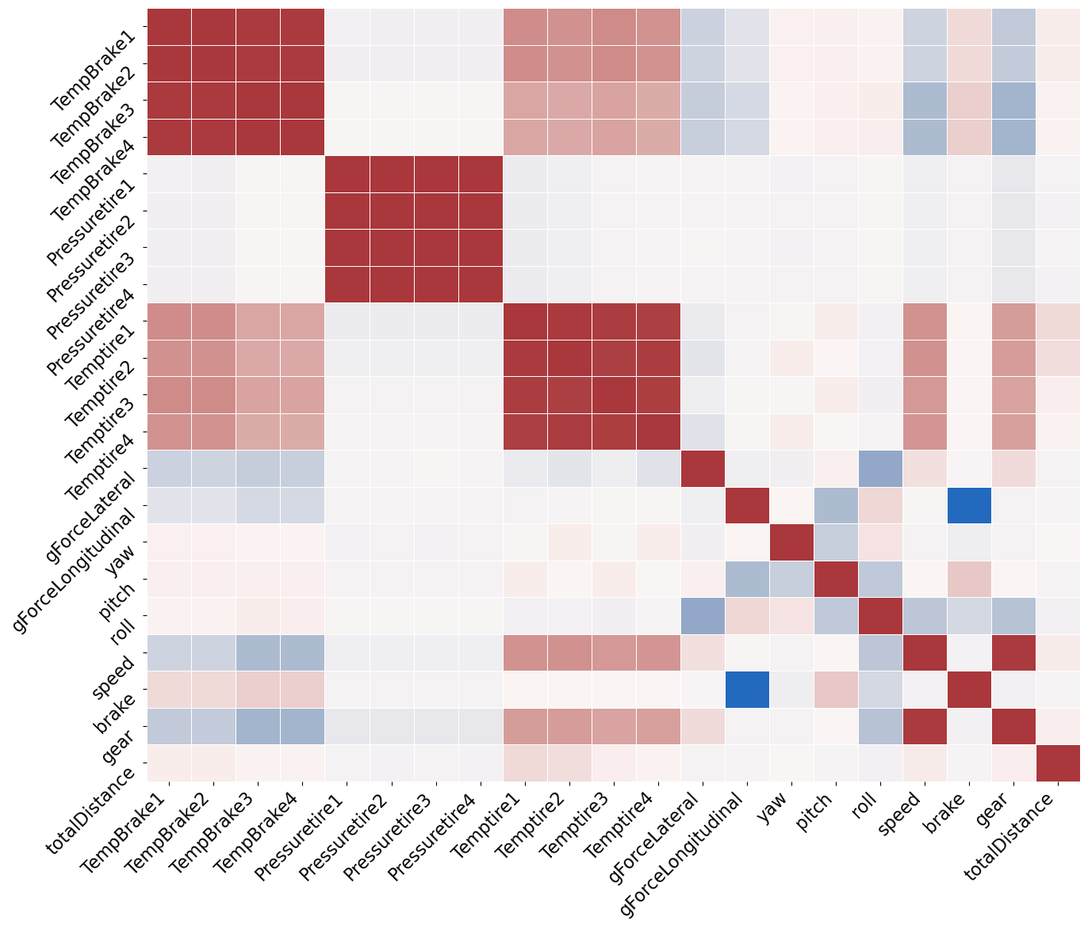
Non-Uniform Tire Pressure Correlation
Montreal
Red Bull Ring

Slide 9
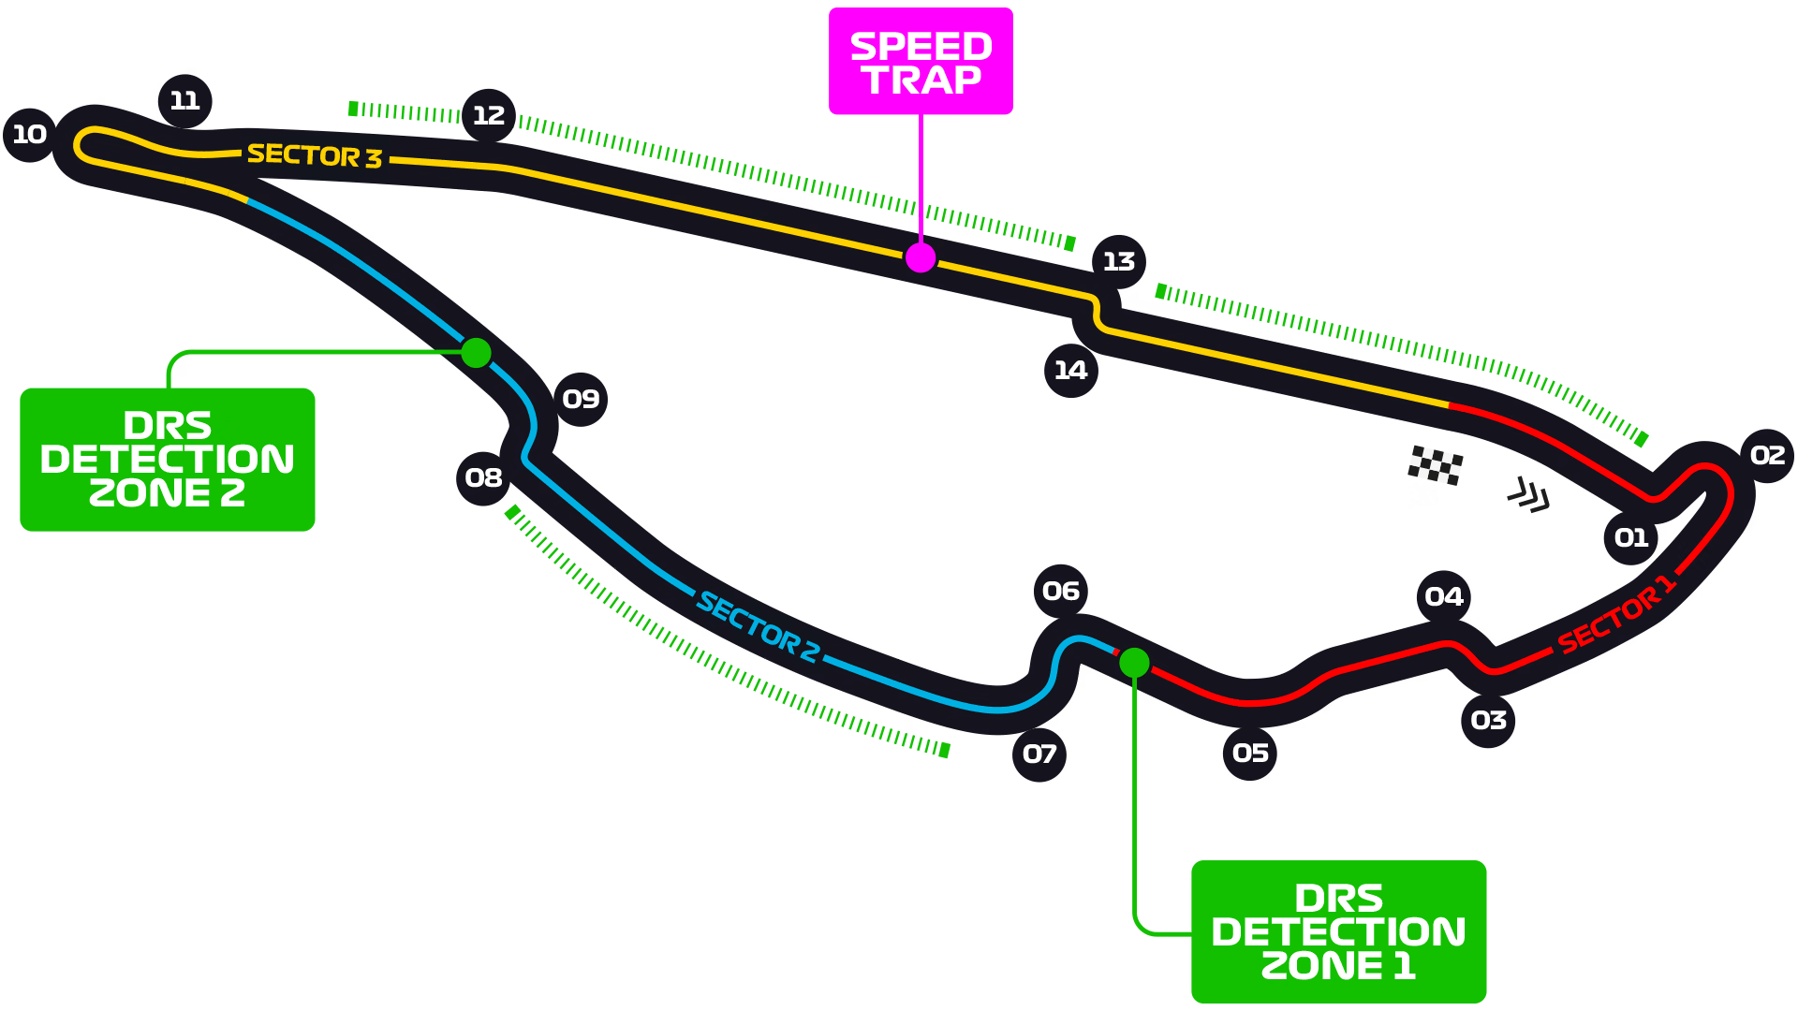
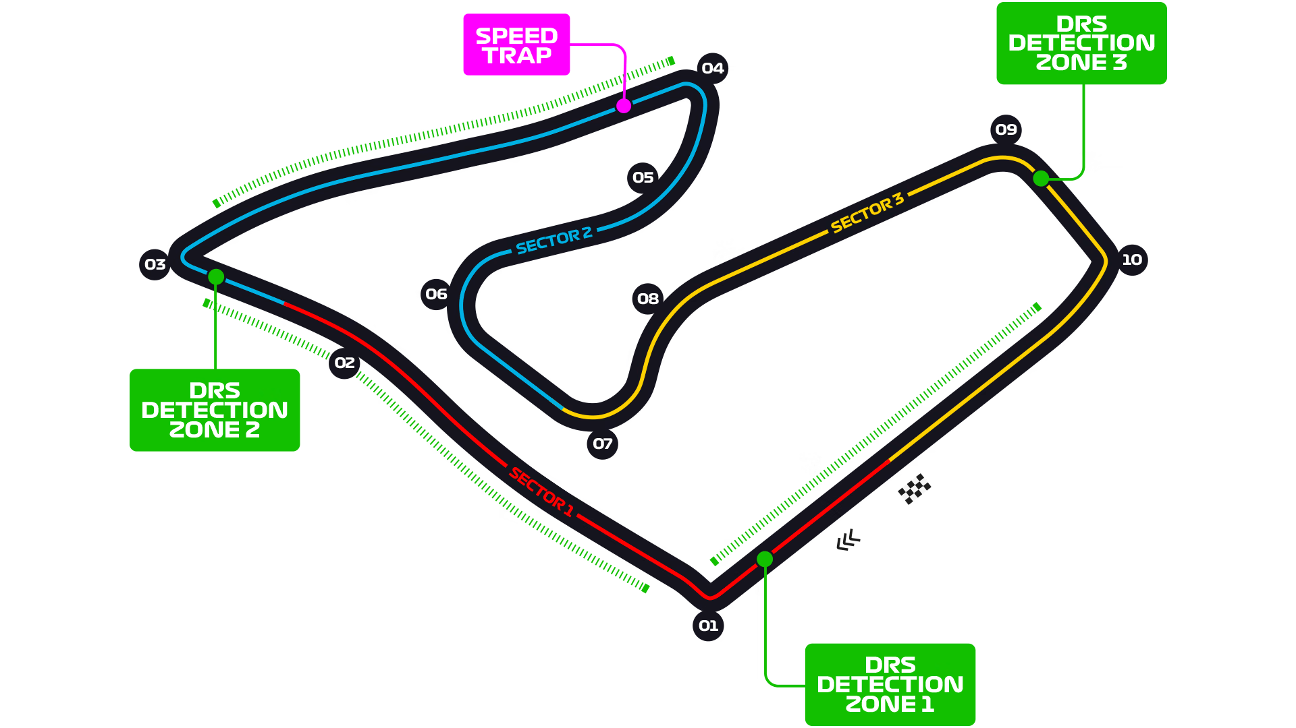
Non-Uniform Tire Pressure Correlation
Montreal
Red Bull Ring

Slide 10
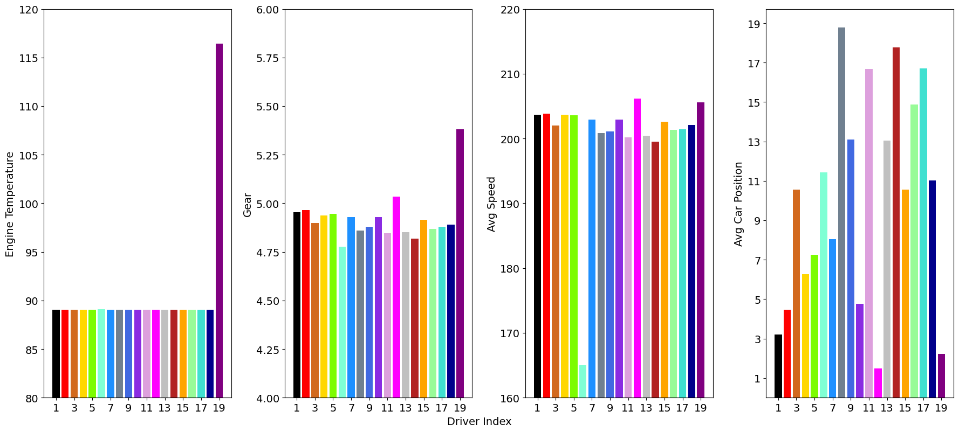
Tuning/Performance Indications

Slide 11
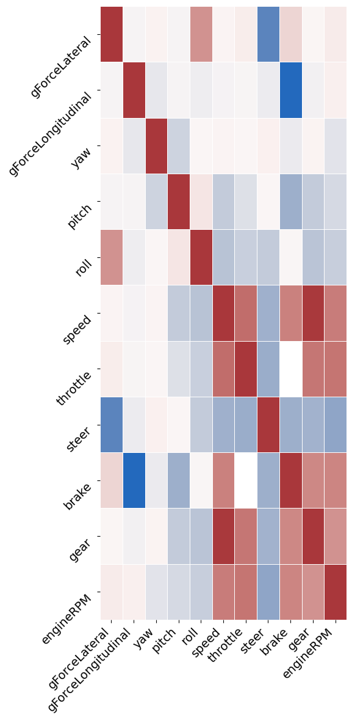
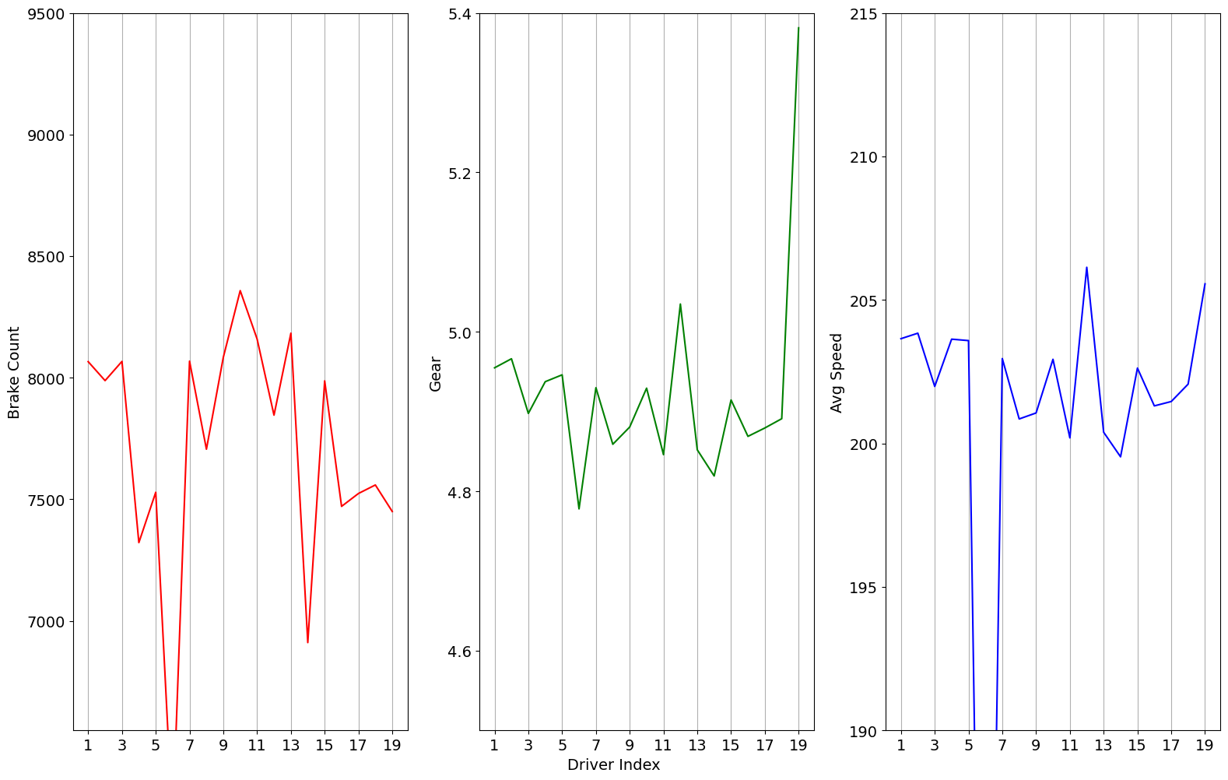
Higher Place Finish Characteristics

Slide 12
Conclusion
Which vehicle subsystems are correlated?
Usual suspects – gforce:throttle/brake, speed:gear, tire temps
Unsual – Non-uniform tire pressure, engine temp: remaining fuel
Can vehicle telemetry indicate small tuning/performance issues?
Yes, when driver stats are compared against other driver avg/min/max
Which telemetry characteristics are indicative of higher place finishes?
Average speed is the greatest indicator of car position. Higher gear averages and less brake use are indicators of higher average speed.

Slide 13
Sources
1. https://www.techtarget.com/whatis/definition/telemetry
2. https://www.transmissiondynamics.com/products/high-speed-advanced-wireless-telemetry/

