Slide 1
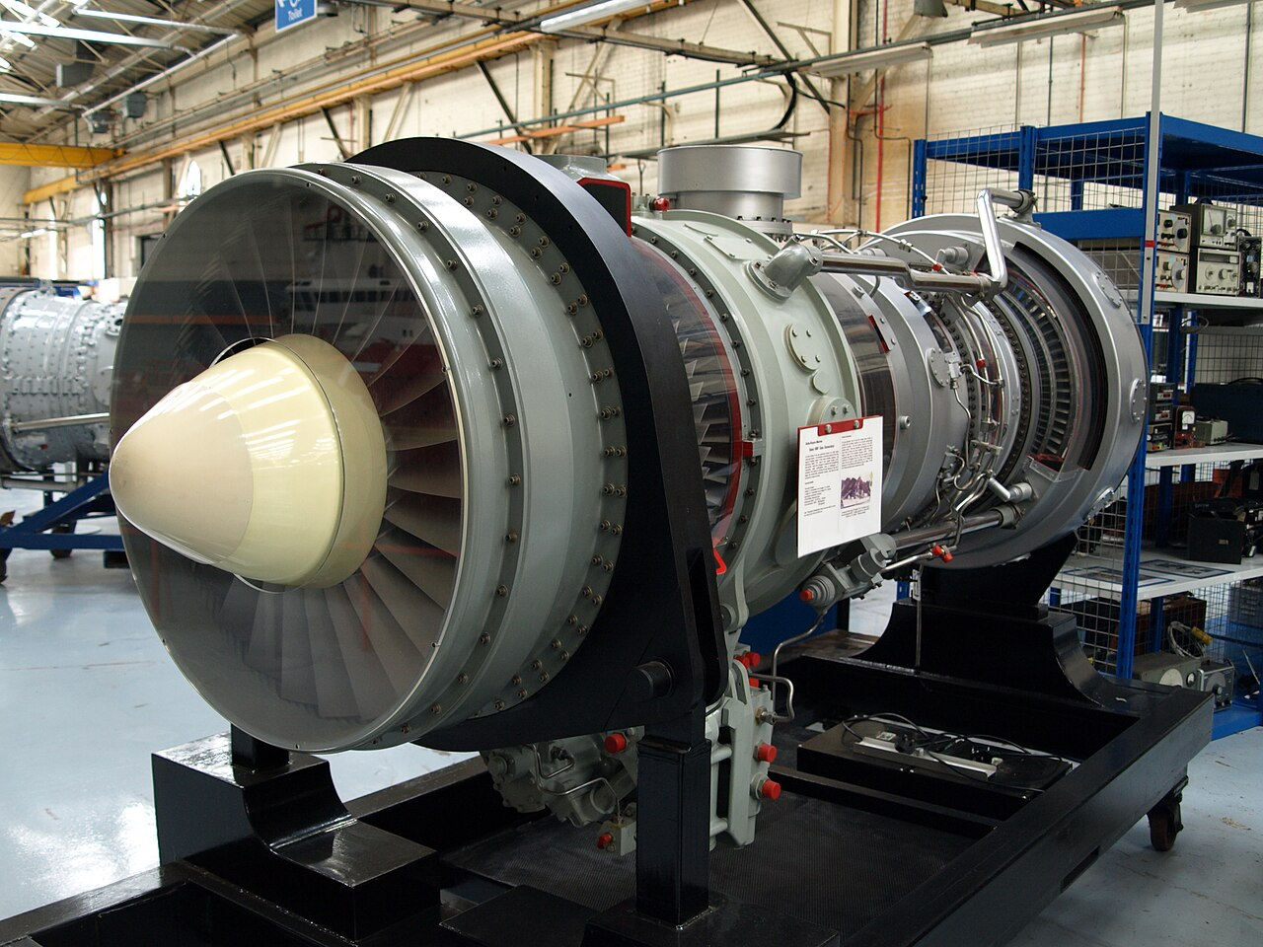
Naval Vessel Turbine Decay Model
TSgt Blake Powell

Slide 2
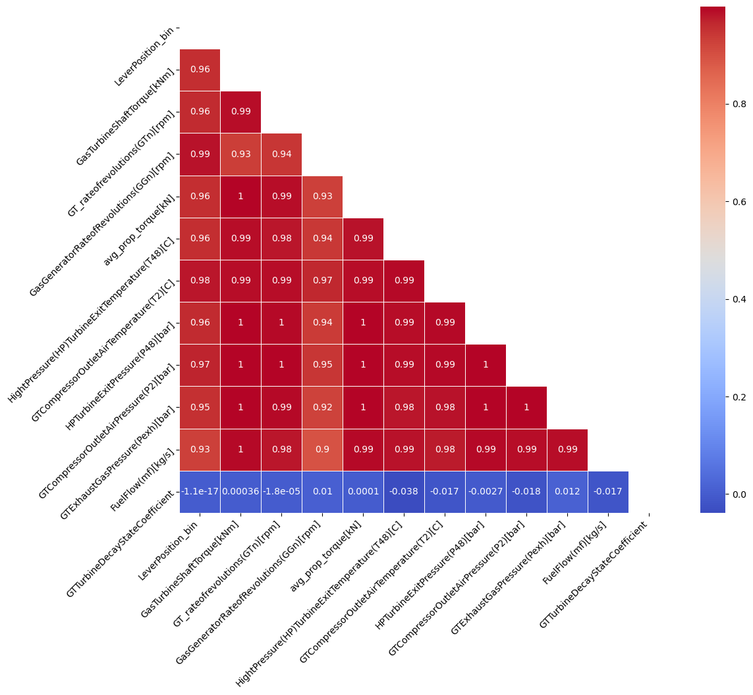
Dataset
Pulled from UC Irvine Machine Learning Repository
11934 Observations (Rows) of Naval Propulsion Plant Measurements
Extreme co-linearity between features, easy to over-fit
A combination of Principal Component Analysis (PCA) and Variance Inflation Factor were used to determine which features to combine, eliminate, or incorporate into the regression model.

Slide 3
Model – Ridge Regression
Linear regression with built in cost function
Reduces variance of the model by discouraging large coefficients
Prevents over-fitting and manages multicolinearity
Performance:
  Mean Absolute Percentage Error (MAPE): .305%
  R-Squared: .73
  Cross-Validation R-Squared: .67

