Slide 2
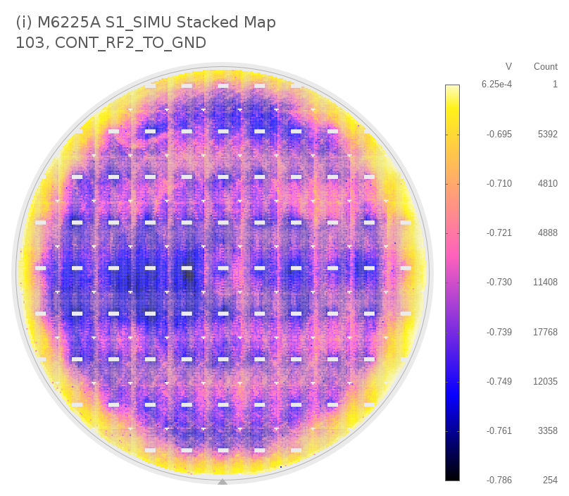
M6225A S1_SIMU Stacked Map 103, CONT_RF2_TO_GND

Slide 3
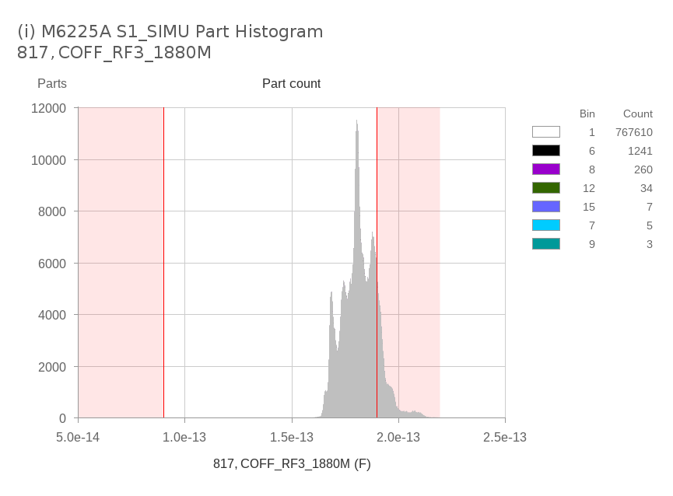
022__i_M6225A_S1_SIMU_Part_Histogram_817_COFF_RF3_1880M

