Slide 1

Positives Launch Planning
What we've built, what's changing, and what we need to decide
A guided conversation deck for moving from the legacy stack to an owned Positives platform.
Dr. Paul Jenkins + Ryan Bradshaw
1

Slide 2
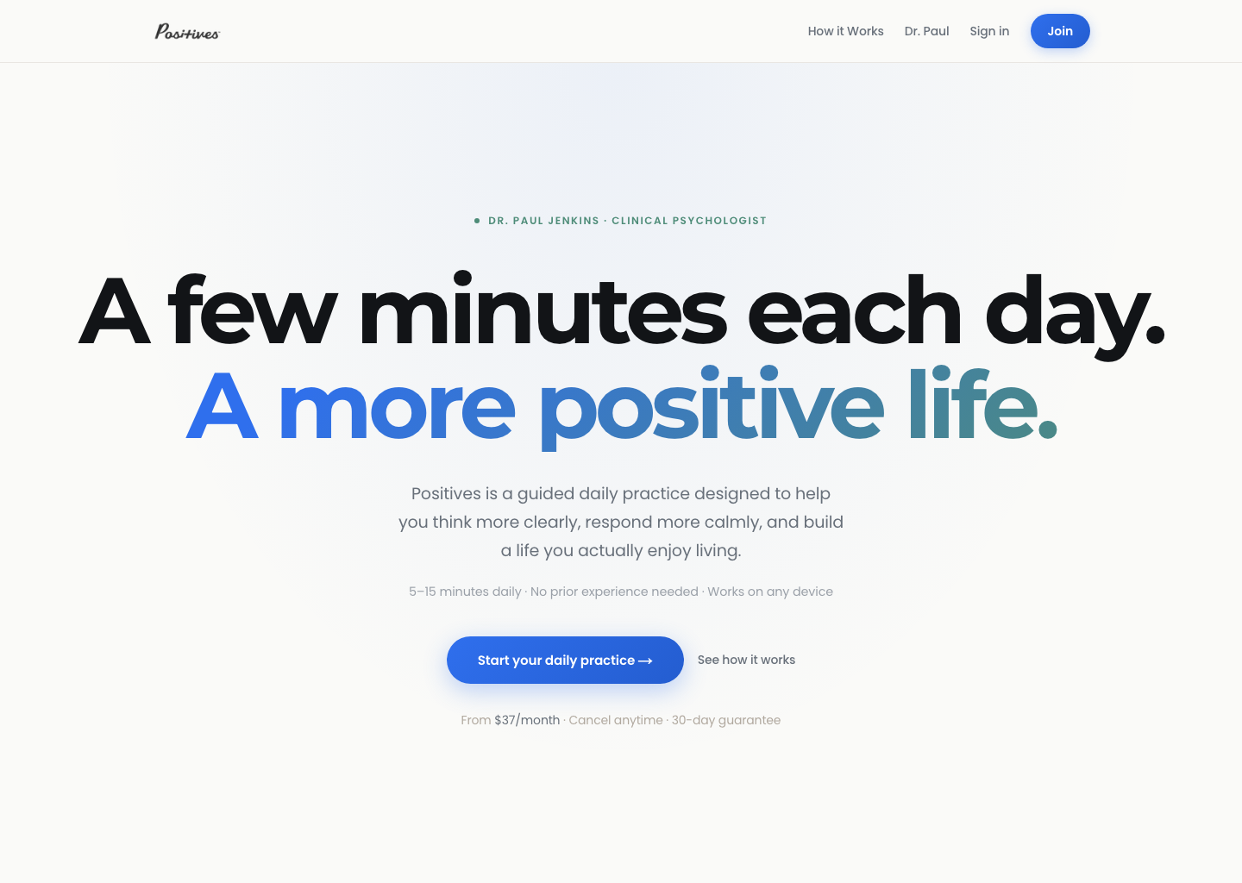
We've built a real platform
Positives is no longer just an idea. The core membership, billing, and admin foundation already exist.
Live production proof
• core membership experience exists
• billing foundation exists
• admin system exists
• launch decisions are now mostly business and migration decisions
Live now at `positives.life`
Positives • Monday strategy discussion
2

Slide 3
What's already built
Stripe checkout and billing portal
Daily practice member experience
Library, notes, and account area
Events and coaching surfaces
Admin content management
Affiliate / referral foundation
Public funnel and marketing pages
Positives • Monday strategy discussion
3

Slide 4
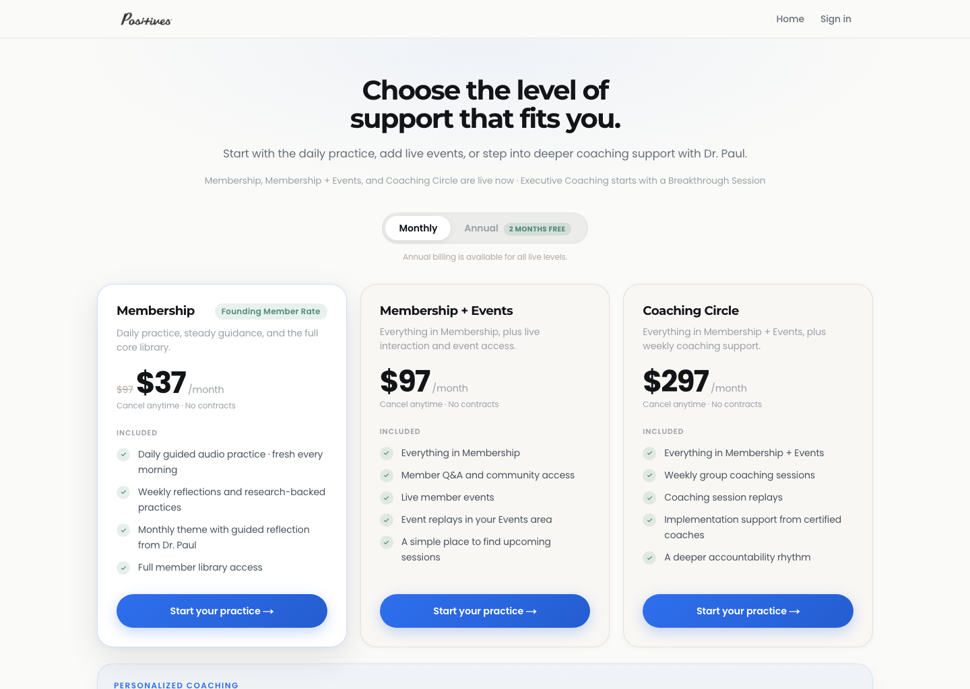
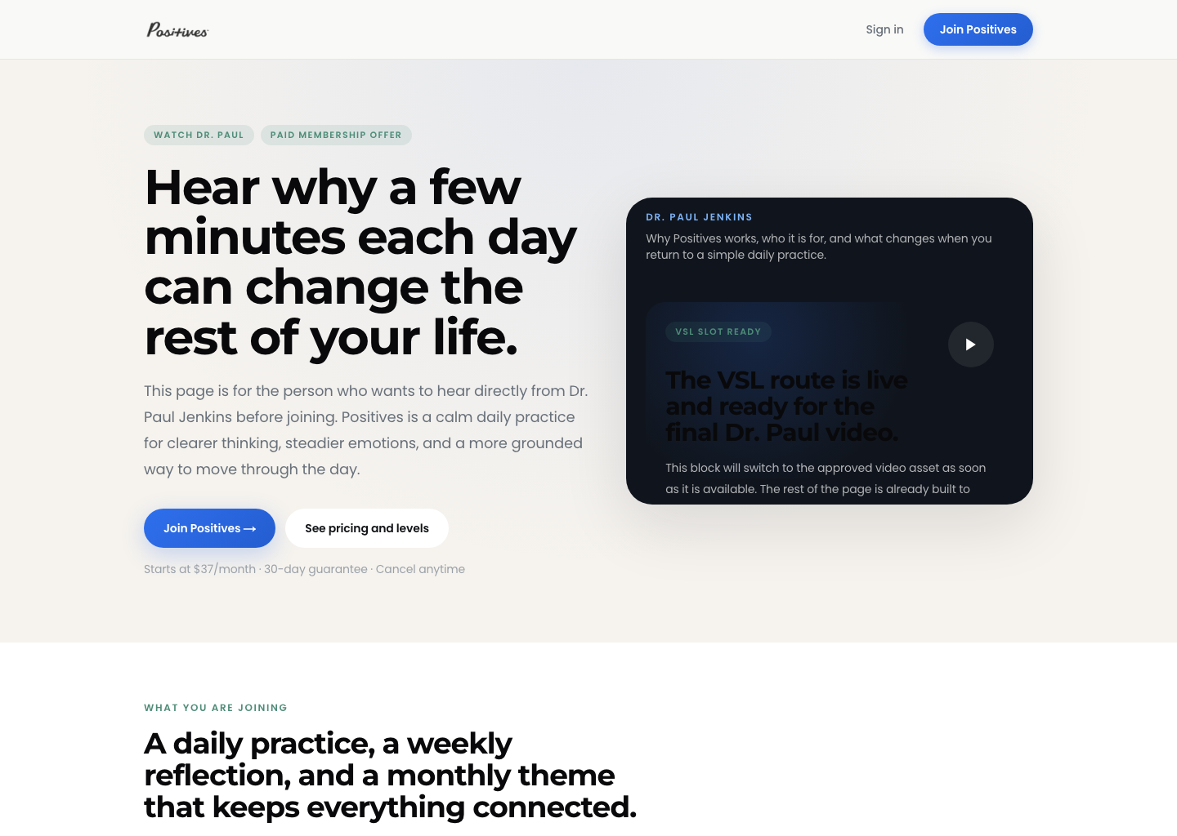
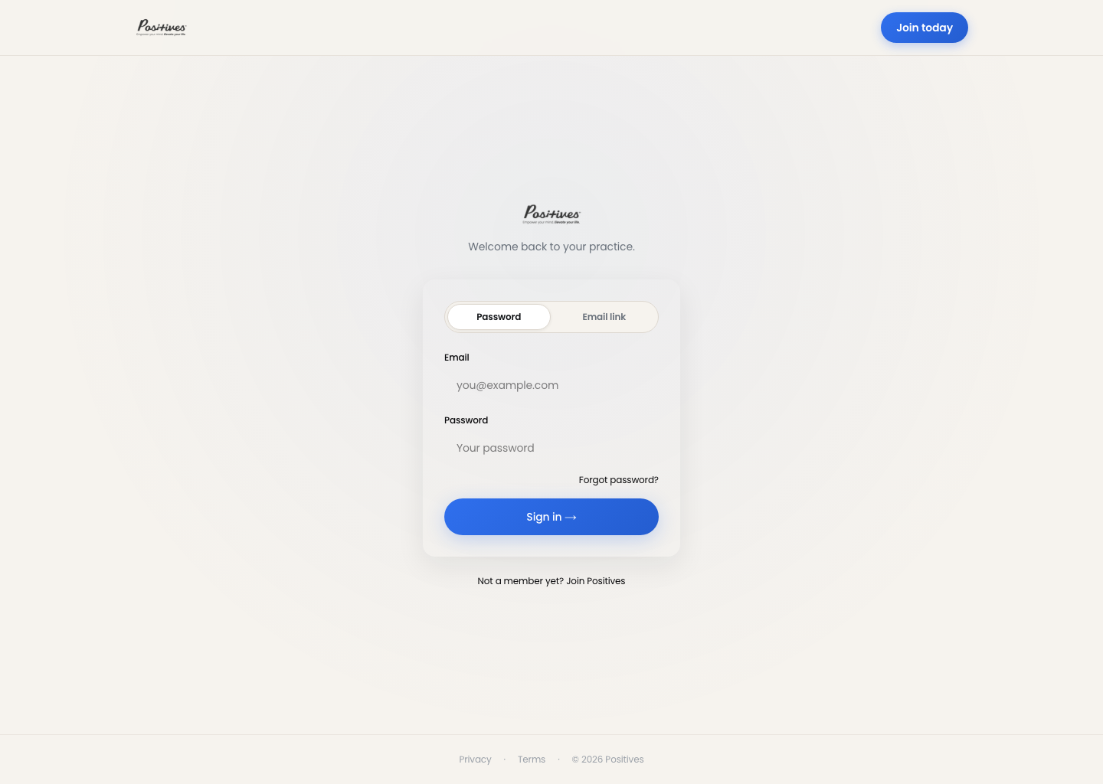
The new member experience is real
Homepage
Join page
Watch page
Login
Positives • Monday strategy discussion
4

Slide 5
This changes what's possible
The future no longer has to be defined by the old systems.
New members can join through the new platform.
Billing can move to Stripe over time.
The team can operate content directly.
The launch conversation can stay focused on transition and decisions, not whether the product exists.
Positives • Monday strategy discussion
5

Slide 6
From legacy stack to owned platform
Current world
Future world
• Infusionsoft / Keap
• Authorize.net
• ClickFunnels
• Liquid Web
• WordPress + plugin stack
• Stripe
• ActiveCampaign Pro
• Postmark
• Vercel
• Supabase
• FirstPromoter
• Vimeo
owned
Positives • Monday strategy discussion
6

Slide 7
What we need to decide today
1
what each membership tier should promise
2
whether Stripe is truly ready for live money
3
how we move existing members to Stripe
4
whether we approve the email-stack direction
5
how much of the old offer / funnel stack we carry forward
Positives • Monday strategy discussion
7

Slide 8
Keep the promise simple and truthful
Membership
Membership + Events
Coaching Circle
• daily audio
• weekly reflection
• monthly theme
• full core library
• everything in Membership
• live member events
• replay access
• everything in Membership + Events
• weekly live coaching
• coaching replays
Do not promise extra certified-coach support unless it is truly staffed.
Positives • Monday strategy discussion
8

Slide 9
Before we launch, Stripe must be real
This is about live readiness, not just sandbox readiness.
Decision lens
If anything material is still unresolved, we should treat that as a launch gating task.
The question is whether Positives is ready to accept live money with confidence and clarity.
bank account and payouts
business details
verification and tax requirements
right long-term owner
operational confidence before live money
Positives • Monday strategy discussion
9

Slide 10
Move existing members calmly, not all at once
1
3
5
announcement phase
try payment-data migration first
do not shut down the old system too early
2
4
new members to Stripe now
guided payment-update flows if needed
Positives • Monday strategy discussion
10

Slide 11
Simplify pricing over time
Current legacy cohorts include prices like 67, 47, and 07.
67 • 47 • 07
transition
37
Recommendation: move legacy cohorts toward the current 37 plan, with exceptions only when intentionally approved.
Positives • Monday strategy discussion
11

Slide 12
Phased rebilling protects revenue
Do not move the next wave until the last one is stable.
5
special cases and edge cases
4
annual members
3
legacy monthly cohorts
2
simple monthly members
1
new members already on Stripe
Positives • Monday strategy discussion
12

Slide 13
A cleaner email system
App
ActiveCampaign Pro
Postmark
triggers events
automation brain
transactional delivery
• ActiveCampaign becomes the automation brain
• Postmark becomes the transactional delivery layer
• essential account emails still send
• marketing emails stay unsubscribable
Positives • Monday strategy discussion
13

Slide 14
We do not need to move everything
Now
Later
Maybe never
• membership-critical experience
• highest-value supporting offers
• priority funnels
• long-tail courses
• old campaigns
• lower-value legacy funnel sprawl
• anything that no longer fits the future Positives direction
Positives • Monday strategy discussion
14

Slide 15
The overlap is temporary. The simplification is the point.
Target Positives stack
Legacy stack to retire
Overlap period
• ActiveCampaign Pro
• Postmark
• Vercel
• Supabase
• Stripe
• Vimeo
• Keap
• ClickFunnels
• Liquid Web
• legacy plugin stack
• costs more for a while
• temporary dual-system period
• cleaner operating model afterward
Long-term goal: a cleaner, lower-friction system with less legacy dependence.
Positives • Monday strategy discussion
15

Slide 16
The outcome we want today
approved membership promise
Meeting goal
clear Stripe readiness path
Leave with real decisions, a clear transition path, and named next owners.
phased rebilling approved
ActiveCampaign Pro + Postmark approved
membership-first migration scope approved
Support the conversation. Do not try to narrate every detail.
owners for follow-up
16

