Slide 1
Database Design
Video Rental Store
R. Brandon Miracle
May 7, 2021

Slide 2
Conceptual Design: Requirements Analysis
The client is seeking a system to assist in with managing various aspects of the business for a small video rental store.
This system will focus primarily on tracking movies and customers, but as we will explore in the coming slides these entities (especially movies) are complex and will require multiple supplemental entities to fully maintain and manage.
First, we will take a look at the exact requirements provided by the client, in order to identify preliminary entities, attributes, and relationships upon which we can start to build our conceptual design.

Slide 3
Conceptual Design: Requirements Analysis
I’m the owner of a small video rental store. We have over 3,000 movies that we need to keep track of. Each of our movies has a DVD or VHS tape number. For each movie, we need to know its title and category (e.g., comedy, suspense, drama, action, war, or sci-fi).
Yes, we do have multiple copies of many of our movies. We give each movie a specific ID, and then track which DVD or VHS contains the movie. A movie can be either DVD or VHS format.
We always have at least one DVD or VHS tape for each movie we track, and each DVD or VHS tape is always a copy of a single, specific movie.
Our DVDs and VHS tapes are very long. We don’t have any movies that require multiple DVDs or VHS tapes.
We are frequently asked for movies starring specific actors. Mel Gibson and Julia Roberts are always popular. So we’d like to keep track of the star actors appearing in each movie. Not all of our movies have star actors. Customers like to know each actor’s “real” birth name and date of birth. We track only actors who appear in the movies in our inventory.
We have lots of customers. We rent videos only to people who have joined our 'video club.' For each club member, we’d like to keep their first and last name, current phone number, and current address. And, of course, each club member has a membership number.

Slide 4
Conceptual Design: Requirements Analysis
We will go through this requirements statement and highlight entities and attributes. We will also attempt to highlight any relationships that are obvious, but many relationships will have to be inferred from our knowledge of how the company’s systems work.
Entities and attributes will be derived from nouns in the requirements statement. We will highlight entities in blue and attributes in yellow. Some attributes may eventually become their own entities, if the database design requires it.
Relationships will be derived from verbs in the requirements statement. We will highlight relationships in pink. Aspects of those relationships will be highlighted in lighter pink.

Slide 5
Conceptual Design: Requirements Analysis
I’m the owner of a small video rental store. We have over 3,000 movies that we need to keep track of. Each of our movies has a DVD or VHS tape number. For each movie, we need to know its title and category (e.g., comedy, suspense, drama, action, war, or sci-fi).
Yes, we do have multiple copies of many of our movies. We give each movie a specific ID, and then track which DVD or VHS contains the movie. A movie can be either DVD or VHS format.
We always have at least one DVD or VHS tape for each movie we track, and each DVD or VHS tape is always a copy of a single, specific movie.
Our DVDs and VHS tapes are very long. We don’t have any movies that require multiple DVDs or VHS tapes.
We are frequently asked for movies starring specific actors. Mel Gibson and Julia Roberts are always popular. So we’d like to keep track of the star actors appearing in each movie. Not all of our movies have star actors. Customers like to know each actor’s “real” birth name and date of birth. We track only actors who appear in the movies in our inventory.
We have lots of customers. We rent videos only to people who have joined our 'video club.' For each club member, we’d like to keep their first and last name, current phone number, and current address. And, of course, each club member has a membership number.

Slide 6
Conceptual Design: Entities
From the requirements, we know that we will need the following entities:
MOVIE
COPY
FORMAT
ACTOR
CUSTOMER
We also can see that the attribute CATEGORY will be best implemented as its own entity, since it itself is categorical and will contain many different values, but only specific values.
CATEGORY
Lastly, we will need some intermediary entities to handle many-to-many relationships. A customer can rent multiple copies, and multiple customers can rent a copy. So we will need an entity for RENTALS. Similarly, actors can star in many movies, and a movie can feature multiple actors. So we will need an entity for CASTINGS.
RENTAL
CASTING

Slide 7
Conceptual Design: Entities
Finally, we need to convert FORMAT into two child entities (DVD and VHS), which are children of the COPY entity. This will leave us with our final list of entities for now.
COPY
CATEGORY
CUSTOMER
MOVIE
DVD
ACTOR
CASTING
RENTAL
VHS
While not mentioned in the requirements statement, we should also inquire with the client about obvious other entities or attributes that the business may want to track/manage. For example, entities related to Purchases (groups of rentals purchased by one at the same time) or attributes for movies like Release Date may be important for future development. These are not essential to the design of the system described in the requirements statement, but could easily be added after the fact if the client does require this functionality.

Slide 8
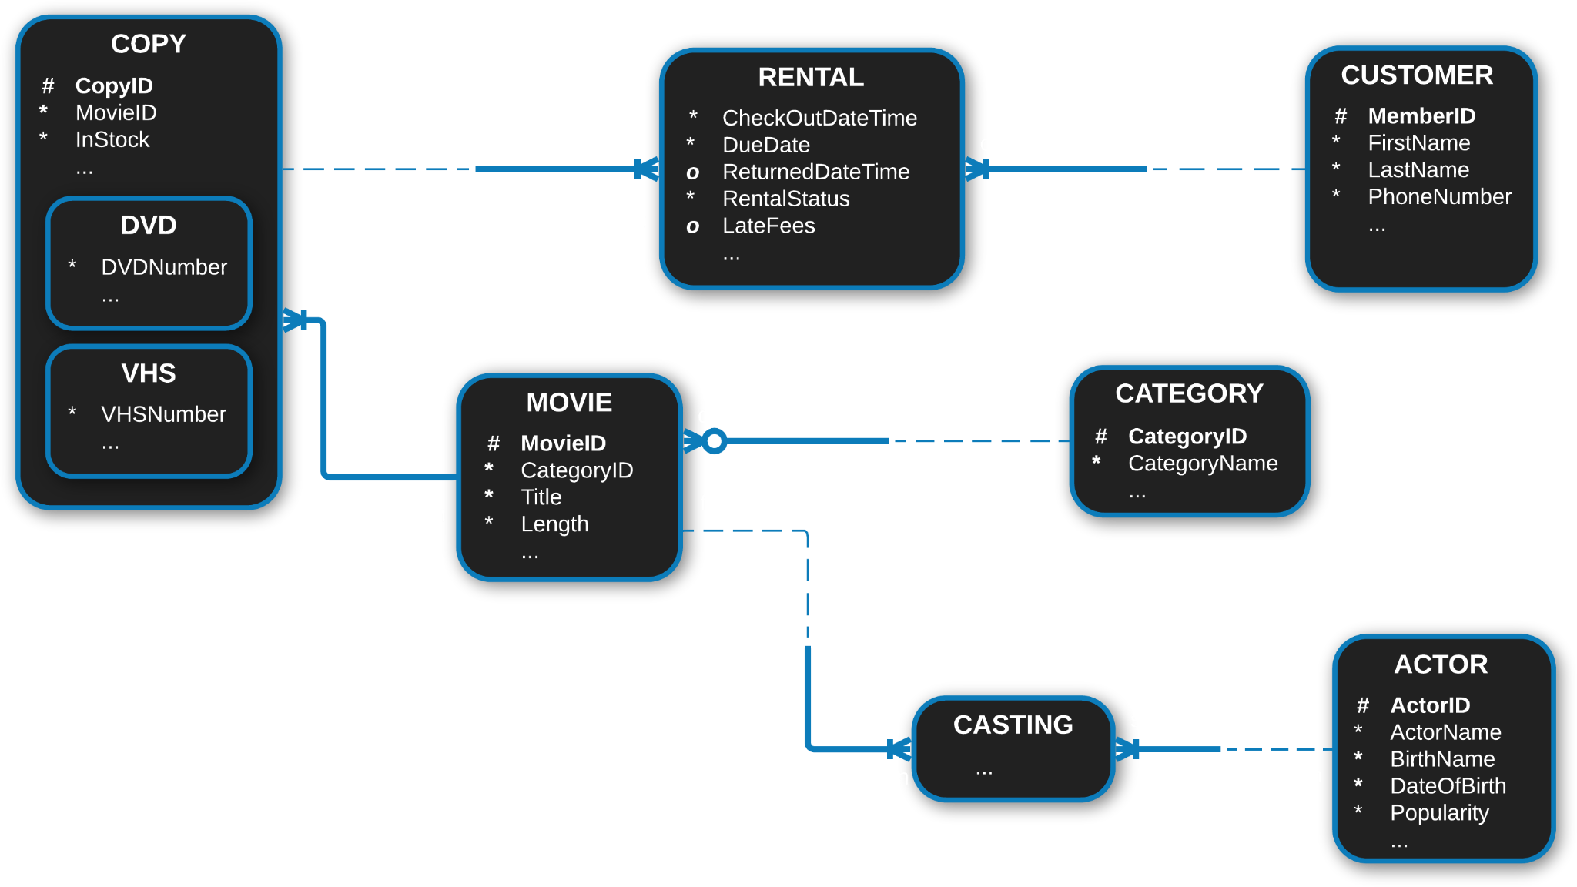
Conceptual Design: Entity Relationship Diagram

Slide 9
Conceptual Design: Relationship Descriptions
Each COPY may be included in one or more RENTALS. Each RENTAL must include one and only one COPY.
Each CUSTOMER may check out one or more RENTALS. Each RENTAL must be checked out by one and only one CUSTOMER.
Each COPY must contain one and only one MOVIE. Each MOVIE must be stored on one or more COPIES.
Each MOVIE must be described by one and only one CATEGORY. Each CATEGORY may describe one or more MOVIES.
Each MOVIE must feature one or more CASTINGS. Each CASTING may be featured in one and only one MOVIES.
Each CASTING must star one and only one ACTOR. Each ACTOR may star in one or more CASTINGS.

Slide 10
Conceptual Design: Relationship Matrix
 | COPY | MOVIE | CATEGORY | CASTING | ACTOR | RENTAL | CUSTOMER
COPY |  | Contains |  |  |  | Included In
MOVIE | Stored On |  | Described By | Features
CATEGORY |  | Describes
CASTING |  | Featured In |  |  | Stars
ACTOR |  |  |  | Stars In
RENTAL | Includes |  |  |  |  |  | Checked Out By
CUSTOMER |  |  |  |  |  | Checks Out

Slide 11
Logical Design: Table Instance Charts
Entity Name: COPY
Attribute Name | CopyID | MovieID | InStock | DVDNumber | VHSNumber
Key Types | PK | FK
Data Type | INT | INT | BOOLEAN | INT | INT
Optionality Tags | *, # | * | * | o | o
Sample Data | 1 | 56 | 0 | 1
 | 2 | 120 | 1 |  | 1
 | 405 | 1043 | 0 | 223
 | 2364 | 81 | 1 |  | 104

Slide 12
Logical Design: Table Instance Charts
Entity Name: RENTAL
Attribute Name | CopyID | MemberID | CheckoutDateTime | DueDate | ReturnedDateTime | RentalStatus | LateFees
Key Type(s) | PK, FK1 | PK, FK2
Data Type | INT | INT | DATETIME | DATE | DATETIME | VARCHAR(16) | MONEY
Optionality Tags | * | * | * | * | o | * | o
Sample Data | 36 | 69121893 | 2019-12-8 16:51:04 | 2019-12-15 | 2019-12-13 16:13:22 | Returned
 | 4 | 24451736 | 2020-6-16 11:12:40 | 2020-6-23 | 2020-6-26 11:12:40 | Returned | $4.00
 | 457 | 18663258 | 2021-1-30 9:20:59 | 2021-2-6 |  | Overdue | $15.00
 | 2126 | 88107045 | 2021-3-25 20:45:20 | 2021-4-1 |  | Checked Out

Slide 13
Logical Design: Table Instance Charts
Entity Name: MOVIE
Attribute Name | MovieID | CategoryID | Title | Length
Key Types | PK | FK
Data Type | INT | INT | VARCHAR(50) | TIME
Optionality Tags | *, # | * | * | *
Sample Data | 1 | 1 | The Dark Knight | 2:32:04
 | 8 | 4 | Pulp Fiction | 2:34:58
 | 61 | 3 | The Matrix | 2:16:43
 | 758 | 3 | Star Wars: Episode V - The Empire Strikes Back | 2:04:20

Slide 14
Logical Design: Table Instance Charts
Entity Name: CATEGORY
Entity Name: CASTING
Attribute Name | CategoryID | CategoryName
Key Types | PK
Data Type | INT | VARCHAR(24)
Optionality Tags | * | *
Sample Data | 1 | Action
 | 2 | Comedy
 | 3 | Science Fiction
 | 12 | Drama
Attribute Name | MovieID | ActorID
Key Types | PK, FK1 | PK, FK2
Data Type | INT | INT
Optionality Tags | * | *
Sample Data | 1 | 22
 | 45 | 65
 | 268 | 1
 | 1204 | 108

Slide 15
Logical Design: Table Instance Charts
Entity Name: ACTOR
Attribute Name | ActorID | ActorName | BirthName | DateOfBirth | Popularity
Key Types | PK
Data Type | INT | VARCHAR(50) | VARCHAR(50) | DATE | DEC
Optionality Tags | *, # | * | * | * | *
Sample Data | 22 | Mel Gibson | Mel Columcille Gerard Gibson | 1956-1-3 | 6.2
 | 65 | Julia Roberts | Julia Fiona Roberts | 1967-10-28 | 8.0
 | 1 | Denzel Washington | Denzel Hayes Washington Jr. | 1954-12-28 | 9.4
 | 108 | Natalie Portman | Natalie Hershlag | 1981-6-9 | 7.7

Slide 16
Logical Design: Table Instance Charts
Entity Name: CUSTOMER
Attribute Name | MemberID | FirstName | LastName | PhoneNumber
Key Types | PK |  |  | IX
Data Type | INT | VARCHAR(24) | VARCHAR(24) | VARCHAR(15)
Optionality Tags | *, # | * | * | *
Sample Data | 69121893 | John | Donahue | 19198763020
 | 24451736 | Anne | Williams | 12527440993
 | 18663258 | Ahmed | Farhid | 17048915629
 | 88107045 | Bella | Talous | 13439467313

Slide 17
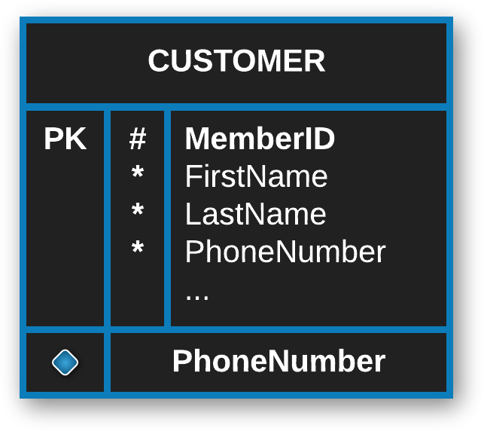
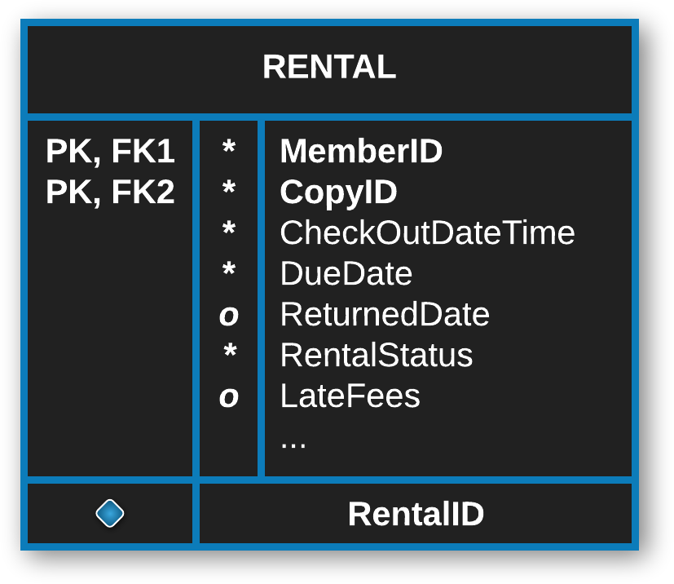
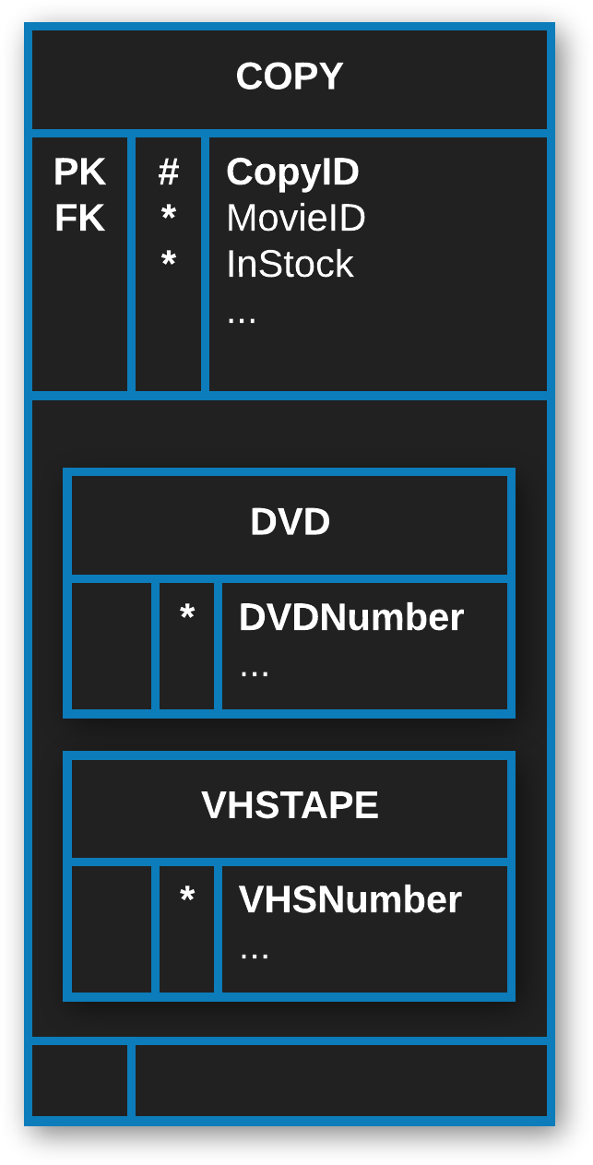
Logical Design: Key Relationships and Indexes
We will want to create an additional index on PhoneNumber (CUSTOMER) since it will be rarely altered, often queried, and contain unique values.
MemberID (CUSTOMER) and CopyID (COPY) will be combined to create a composite primary key, PK_Rentals (RENTAL).

Slide 18
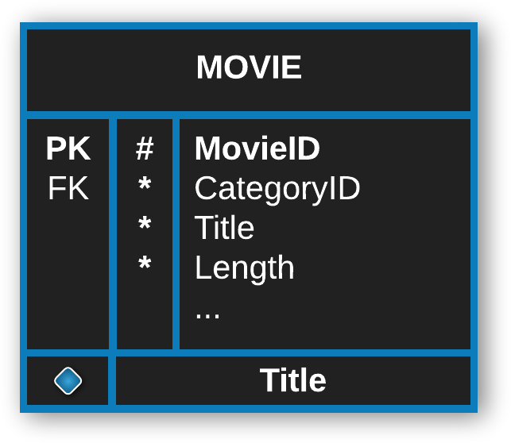
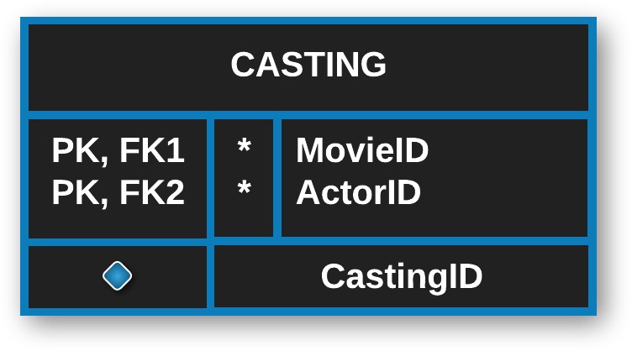
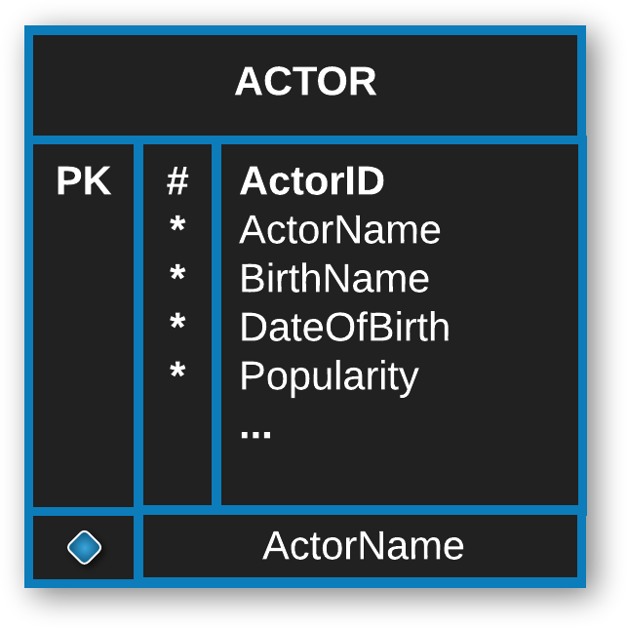
Logical Design: Key Relationships and Indexes
MovieID (MOVIE) and ActorID (ACTOR) will be combined to create a composite primary key, PK_Casting (CASTING).
We will want to create indexes for Title (MOVIE) and ActorName (ACTOR), since these columns will be rarely altered, often queried, and contain unique values.

Slide 19
Logical Design: Key Relationships and Indexes
MovieID (MOVIE) will be a foreign key for the COPY entity.

Slide 20
Logical Design: Database Build Code
Sample SQL Code: Customers Table
** Full code for all tables included in notes below, and also as attached as a separate .sql file. **
-- Table creation DROP TABLE Customers;
CREATE TABLE Customers(
MemberID INT NOT NULL
PRIMARY KEY,
FirstName VARCHAR(24) NOT NULL,
LastName VARCHAR(24) NOT NULL,
PhoneNumber VARCHAR(15) NOT NULL,
);
CREATE INDEX IDX_Customers_PhoneNumber
ON Customers (PhoneNumber);
-- Insert test data
INSERT INTO Customers
VALUES (69121893, 'John', 'Donahue', 19198763020);
INSERT INTO Customers
VALUES (24451736, 'Anne', 'Williams', 12527440993);
INSERT INTO Customers
VALUES (18663258, 'Ahmed', 'Farhid', 17048915629);
INSERT INTO Customers
VALUES (88107045, 'Bella', 'Talous', 13439467313);
Notes:
DROP TABLE Customers;
CREATE TABLE Customers(
MemberID INT NOT NULL,
FirstName VARCHAR(24) NOT NULL,
LastName VARCHAR(24) NOT NULL,
PhoneNumber VARCHAR(15) NOT NULL,
CONSTRAINT CustomersPK
PRIMARY KEY (MemberID)
);
CREATE INDEX IDX_Customers_PhoneNumber
ON Customers (PhoneNumber);
DROP TABLE Actors;
CREATE TABLE Actors(
ActorID INT NOT NULL
PRIMARY KEY,
ActorName VARCHAR(50) NOT NULL,
BirthName VARCHAR(50) NOT NULL,
DateOfBirth DATE NOT NULL,
Popularity DECIMAL NOT NULL
);
CREATE INDEX IDX_Actors_Name
ON Actors (ActorName);
DROP TABLE Categories;
CREATE TABLE Categories(
CategoryID INT NOT NULL
PRIMARY KEY,
CategoryName VARCHAR(50) NOT NULL,
);
CREATE INDEX IDX_Categories_Name
ON Categories (CategoryName);
DROP TABLE Movies;
CREATE TABLE Movies(
MovieID INT NOT NULL,
CategoryID INT FOREIGN KEY REFERENCES
Categories(CategoryID),
Title VARCHAR(50) NOT NULL,
Length TIME NOT NULL
);
CREATE INDEX IDX_Movies_Title
ON Movies(Title);
DROP TABLE Castings;
CREATE TABLE Castings(
MovieID INT NOT NULL
FOREIGN KEY REFERENCES
Movies(MovieID),
ActorID INT NOT NULL
FOREIGN KEY REFERENCES
Actors(ActorID),
CONSTRAINT PK_Castings
PRIMARY KEY (MovieID, ActorID)
);
DROP TABLE Copies;
CREATE TABLE Copies(
CopyID INT NOT NULL
PRIMARY KEY,
MovieID INT NOT NULL
FOREIGN KEY REFERENCES
Movies(MovieID),
InStock BOOLEAN NOT NULL,
DVDNumber INT,
VHSNummber INT
);
DROP TABLE Rentals;
CREATE TABLE Rentals(
CopyID INT NOT NULL
FOREIGN KEY REFERENCES
Copies(CopyID),
MemberID INT NOT NULL
FOREIGN KEY REFERENCES
Customers(MemberID),
CheckoutDateTime DATETIME NOT NULL,
DueDate DATE NOT NULL,
ReturnedDateTime DATETIME,
RentalStatus VARCHAR(16) NOT NULL,
LateFees MONEY,
CONSTRAINT PK_Rentals
PRIMARY KEY (CopyID, MemberID)
);
-- Insert into Customers
INSERT INTO Customers
VALUES (69121893, 'John', 'Donahue', 19198763020);
INSERT INTO Customers
VALUES (24451736, 'Anne', 'Williams', 12527440993);
INSERT INTO Customers
VALUES (18663258, 'Ahmed', 'Farhid', 17048915629);
INSERT INTO Customers
VALUES (88107045, 'Bella', 'Talous', 13439467313);
-- Insert into Actors
INSERT INTO Actors
VALUES (22, 'Mel Gibson', 'Mel Columcille Gerard Gibson', '1956-1-3', 6.2);
INSERT INTO Actors
VALUES (65, 'Julia Roberts', 'Julia Fiona Roberts', '1967-10-28', 8.0);
INSERT INTO Actors
VALUES (1, 'Denzel Washington', 'Denzel Hayes Washington Jr.', '1954-12-28', 9.4);
INSERT INTO Actors
VALUES (108, 'Natalie Portman', 'Natalie Hershlag', '1981-6-9', 7.7);
-- Insert into Categories
INSERT INTO Categories
VALUES (1, 'Action');
INSERT INTO Categories
VALUES (2, 'Comedy');
INSERT INTO Categories
VALUES (3, 'Science Fiction');
INSERT INTO Categories
VALUES (4, 'Crime');
-- Insert into Movies
INSERT INTO Movies
VALUES (1, 1, 'Lethal Weapon', '1:49:04');
INSERT INTO Movies
VALUES (8, 2, 'Pretty Woman', '1:59:58');
INSERT INTO Movies
VALUES (61, 1, 'The Book of Eli', '1:58:43');
INSERT INTO Movies
VALUES (758, 3, 'Star Wars: Episode I - The Phantom Menace', '2:16:20');
-- Insert into Castings
INSERT INTO Castings
VALUES (1, 22);
INSERT INTO Castings
VALUES (8, 65);
INSERT INTO Castings
VALUES (61, 1);
INSERT INTO Castings
VALUES (758, 108);
-- Insert into Copies
INSERT INTO Copies
(CopyID, MovieID, InStock, DVDNumber)
VALUES (1, 65, 0, 1);
INSERT INTO Copies
(CopyID, MovieID, InStock, VHSNummber)
VALUES (2, 8, 1, 1);
INSERT INTO Copies
(CopyID, MovieID, InStock, DVDNumber)
VALUES (405, 61, 0, 223);
INSERT INTO Copies
(CopyID, MovieID, InStock, VHSNummber)
VALUES (2364, 758, 1, 104);
-- Insert into Rentals
INSERT INTO RentalStatus
(CopyID, MemberID, CheckoutDateTime, DueDate, ReturnedDateTime, RentalStatus)
VALUES
(405, 69121893, '2019-12-8 16:51:04', '2019-12-15', '2019-12-13 16:13:22', 'Returned');
INSERT INTO RentalStatus
(CopyID, MemberID, CheckoutDateTime, DueDate, ReturnedDateTime, RentalStatus, LateFees)
VALUES
(2, 24451736, '2020-6-16 11:12:40', '2020-6-23', '2020-6-26' '11:12:40', 'Returned', 4.00);
INSERT INTO RentalStatus
(CopyID, MemberID, CheckoutDateTime, DueDate, RentalStatus, LateFees)
VALUES
(2364, '18663258', '2021-1-30 9:20:59', '2021-2-6', 'Overdue', 15.00);
INSERT INTO RentalStatus
(CopyID, MemberID, CheckoutDateTime, DueDate, RentalStatus)
VALUES
(1, '88107045', '2021-3-25 20:45:20', '2021-4-1', 'Checked Out');
SELECT * FROM Rentals;
SELECT * FROM Copies;
SELECT * FROM Movies;
SELECT * FROM Customers;
SELECT * FROM Categories;
SELECT * FROM Castings;
SELECT * FROM Actors;

