Slide 1

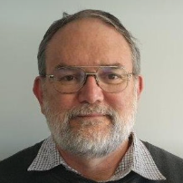
Aotearoa Azure Meetup
Microsoft Entra Agent ID
General
Rory Braybrook
Independent Idemtity Contractor
& MVP
The Session will be recorded and posted on YouTube aka.ms/AotearoaAzure/YouTube

Slide 2
Build Stats
520 sessions
295 around Copilot
412 around AI
96 around Agentic (the word has been used since the 2010s, gaining prominence in 2024 )
247 around Azure
284 could be viewed online / on demand
8 on Identity – 3 were Seattle only
Aotearoa Azure Meetup

Slide 3
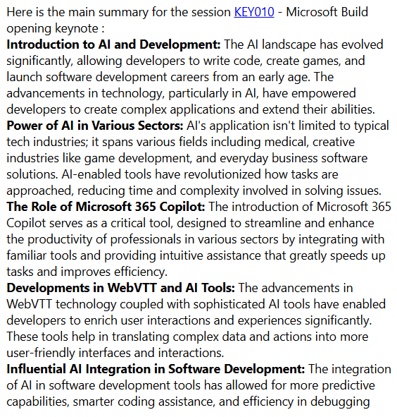
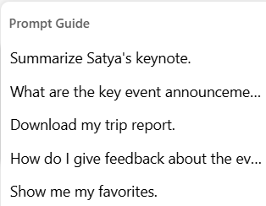
Copilot for Build

Slide 4
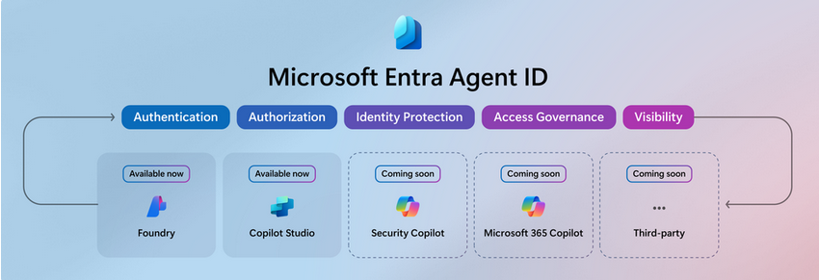
Microsoft Entra Agent ID
A unified directory of all agent identities created across Microsoft Copilot Studio and Azure AI Foundry
Aotearoa Azure Meetup

Slide 5
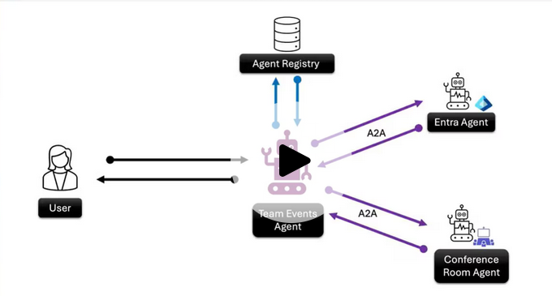
Agent Identity
Agents need a new type of Identity – they are not human, not managed, not service principal but agents.
To commnunicate they need a new protocol – A2A – Agent to Agent

Slide 6
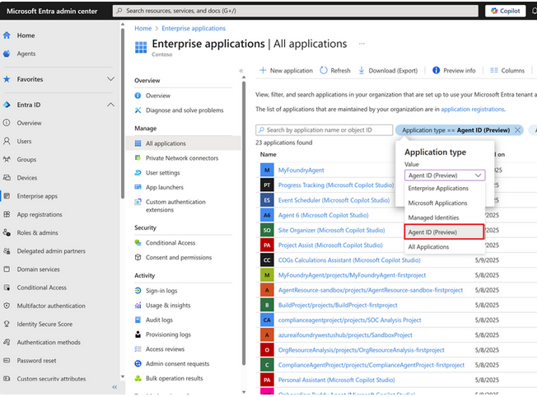
Navigation
Aotearoa Azure Meetup

Slide 7
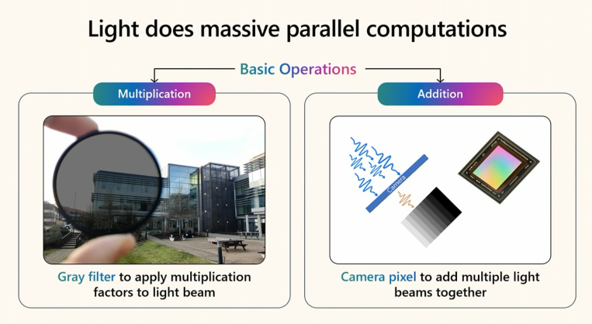
Optical computing
Aotearoa Azure Meetup

Slide 8

AOC
Aotearoa Azure Meetup

Slide 9
