Slide 1
Entra CIAM and Entra Verified ID
Rory Braybrook
Identity Architect and Consultant
Microsoft MVP – Security
Blog: https://authory.com/RoryBraybrook

Slide 2
Entra CIAM
CIAM is integrated with Entra ID (Azure AD)
e.g. Groups / Roles are now first-class citizens
Entra External ID is B2B and B2C (CIAM)
Entra portal

Slide 3
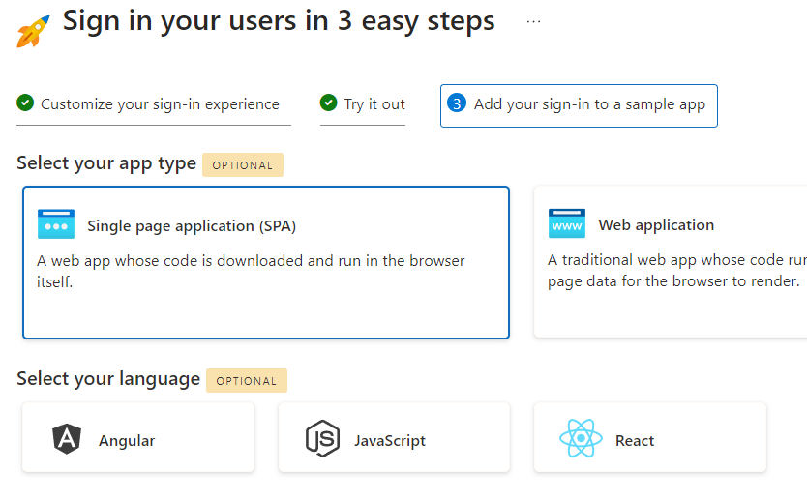
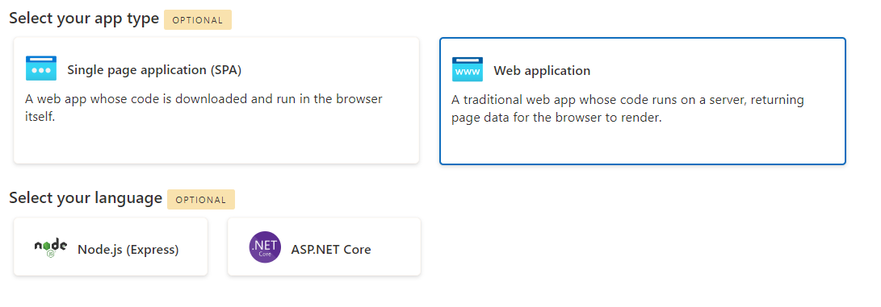
CIAM App. Type

Slide 4
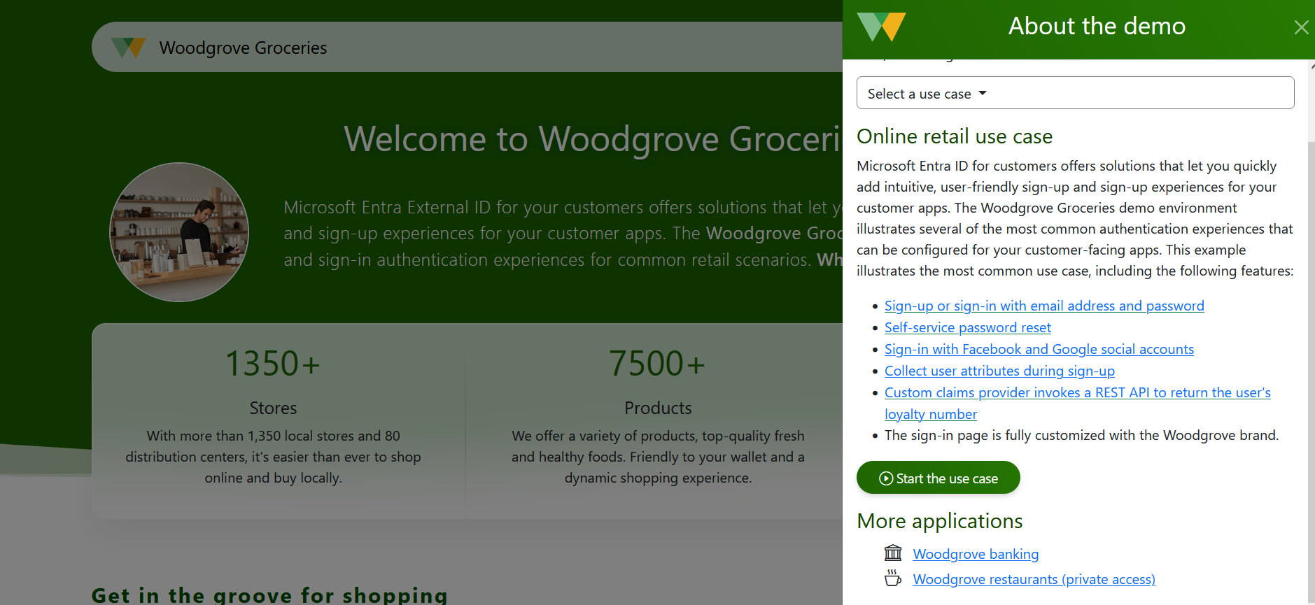
Sample CIAM Application

Slide 5
Entra CIAM
So what about Azure AD B2C?
And custom policies?
And migration?
When should you use CIAM?
Questions?

Slide 6
Entra Verified ID
Verified ID - own your own Identity

Slide 7
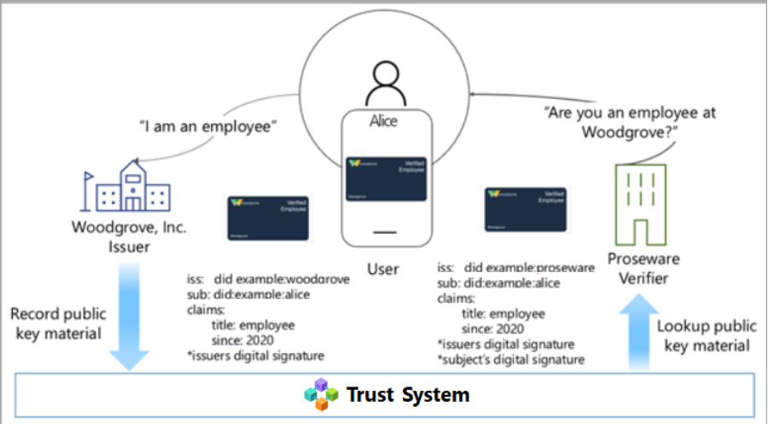
VC sample scenario

Slide 8
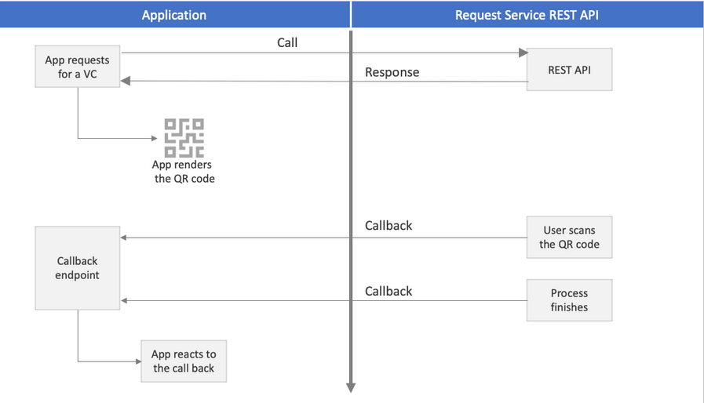
VC REST API Flow

Slide 9
References
https://woodgrovedemo.com/
https://developer.microsoft.com/en-us/identity/customers
https://woodgroveemployee.azurewebsites.net/landing
https://learn.microsoft.com/en-us/azure/active-directory/verifiable-credentials/
https://learn.microsoft.com/en-us/azure/active-directory/verifiable-credentials/get-started-request-api

