Slide 1
A lap around Entra External ID Rory Braybrook MVP (Security – Iam)

Slide 2
Note
This session will concentrate on the CIAM solution (B2C)
We are not looking at B2B (guest accounts)
But B2B is now in the EEID space!

Slide 3
Why Entra External ID
B2C had to be built outside of Entra because of the large number of customers that had to be supported
This meant that Entra features had to be ported to B2C
Entra External ID is built inside Entra, so it inherits all the Entra goodness ☺ , e.g. groups
New features are being added
Supported features

Slide 4
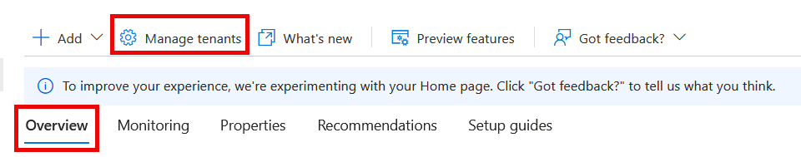
In Entra ID
entra.microsoft.com

Slide 5
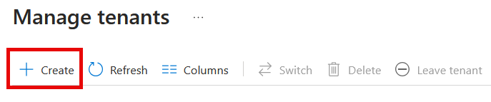
In Entra ID

Slide 6
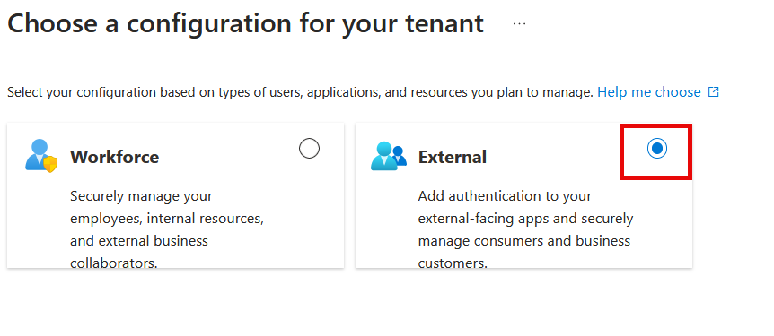
In Entra ID

Slide 7
In Entra ID

Slide 8
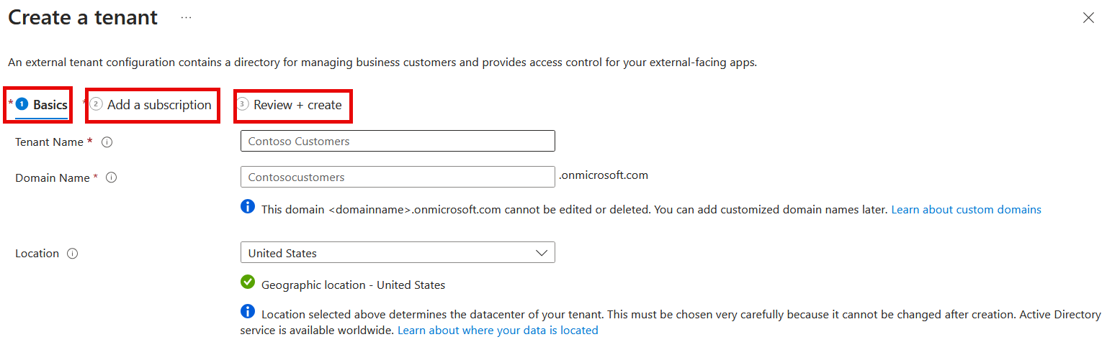
In Entra ID

Slide 9
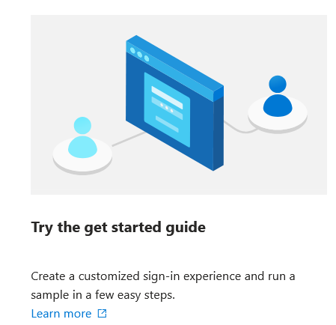
In Entra ID

Slide 10

Users

Slide 11
Applications

Slide 12
User flows

Slide 13
Branding

Slide 14
Authentication Methods

Slide 15
MFA with Conditional Access

Slide 16
External Identity Providers

Slide 17
Custom Authentication Extensions

Slide 18
Native Authentication

Slide 19
Pricing

Slide 20
Some points
B2B collaboration external guests in workforce tenants. UserType property is set to Guest
External users. MAU billing applies to all users in an external tenant regardless of their UserType setting
Billing is based on monthly active users (MAU), (the count of unique external users who authenticate within a calendar month). MAUs from all workforce and external tenants that are linked to a subscription are combined
0-50,000 MAUs - Free
Plus MFA (SMS) per verification attempt

Slide 21
And finally
B2C questions !!!!

Slide 22
Some points
Cannot create new B2C tenants after 1st May if you have never created one
If you already have one, no worries; you can create more
Support until at least 2030
No custom policies in Entra External ID
Migration plans to EEID be announced
“Hybrid” version

Slide 23
References
Introduction to Microsoft Entra External ID
Native authentication API reference
My blog
Woodgrove EEID demo.
Using Azure AD B2C custom policies with Entra External ID

Slide 24
References
Gotchas with configuring EEID
Supported features in workforce and external tenants
Restrictions for Identity Protection
EEID pricing

Slide 25

Thank you
Rory Braybrook
rbrayb@gmail.com

Slide 26

Product benefits
Online store and market swap

Slide 27
Product overview
Unique
First to market
Tested
Authentic
Only product specifically dedicated to this niche market
First beautifully designed product that's both stylish and functional
Conducted testing with college students in the area
Designed with the help and input of experts in the field

Slide 28

Growth strategy
Feb 20XX: roll out product to high profile or top-level participants to help establish the product
May 20XX: release the product to the public and monitor press release and social media accounts
Oct 20XX: gather feedback and adjust product design as necessary

Slide 29
Market overview
Opportunity to build
Fully inclusive market
Total addressable market
Freedom to invent
Selectively inclusive market
Serviceable available market
 | Clients | Orders | Gross revenue | Net revenue
20XX | 10 | 1100 | $10,000 | $7,000
20XX | 20 | 200 | $20,000 | $16,000
20XX | 30 | 300 | $30,000 | $25,000
20XX | 40 | 400 | $40,000 | $30,000

Slide 30
Solution
Our product makes consumer lives easier, and no other product on the market offers the same features
Gen Z (18-25 years old)
Reduce expenses for replacement products
Simple design that gives customers the targeted information they need
Close the gap
Target audience
Cost savings
Easy to use

Slide 31
Financials
 | Year 1 | Year 2 | Year 3
Income
Users | 50,000 | 400,000 | 1,600,000
Sales | 500,000 | 4,000,000 | 16,000,000
Average price per sale | 75 | 80 | 90
Revenue @ 15% | 5,625,000 | 48,000,000 | 216,000,000
Gross profit | 5,625,000 | 48,000,000 | 216,000,000

Slide 32
Our competition
Our product is priced below that of other companies on the market
Design is simple and easy to use, compared to the complex designs of the competitors
Affordability is the main draw for our consumers to our product
Company A product is more expensive
Companies B & C product is expensive and inconvenient to use
Companies D & E product is affordable, but inconvenient to use

Slide 33
About us
At Contoso, we empower organizations to foster collaborative thinking to further drive workplace innovation. By closing the loop and leveraging agile frameworks, we help business grow organically and foster a consumer first mindset.

Slide 34

Company overview

Slide 35

Product overview
First beautifully designed product that's both stylish and functional

Slide 36
Problem
Market gap: few, if any, products on the market help customers like we do
Customers: 66% of US consumers spend money on multiple products that only partially resolves their issue
Financials: millennials account for about a quarter of the $48 billion spent on other products in 2018
Costs: loss of productivity costing consumers thousands of dollars
Usability: customers want something easy to use that helps make their life easier

Slide 37
Thank you
Brita Tamm
502-555-0152
brita@firstupconsultants.com
www.firstupconsultants.com

