Slide 1
Claims-Based Identity

Slide 2
Introduction
Rory Braybrook
Twitter @rbrayb
Architect / Tech. Lead / Claims evangelist for I & AM team
I & AM team has three main areas
Microsoft claims-aware applications / SSO
ADFS / WIF (today’s topic)
Identity Manager – self service / DA / role provisioning
OpenAM
Open source successor to Sun’s AM and OpenSSO
Forefront Identity Manager (FIM)
Synchronisation of passwords / provisioning, replication and transformation from one repository to another / GALSynch

Slide 3
Claims-Based Identity The core Microsoft technologies
Active Directory Federation Services (ADFS) 2.0
The newest version of AD FS
The version included with Windows Server 2008 is ADFS 1.0
Windows Identity Foundation (WIF) 1.0
Set of .NET classes
Azure Access Control System (ACS)
Allows authentication by Facebook, Google, Yahoo etc.

Slide 4
What is Identity?
An identity is a set of information about some entity, such as a user
Most applications work with identity
Identity information drives important aspects of an application’s behavior, such as:
Determining what a user is allowed to do
Controlling how the application interacts with the user

Slide 5
Defining the Problem Working with identity is too hard (1)
But it appears so easy – a login screen with two textboxes ☺ How hard can that be?
The iceberg scenario – users only see the 10 % “above the surface”
Applications must use different identity technologies in different situations:
Active Directory (Kerberos) inside a Windows domain
Username / password on the Internet
WS-Federation and the Security Assertion Markup Language (SAML) between organizations
Developers don’t understand security – take short cuts
Applications use different identity repositories – AD / LDAP / DB/ Excel!
Developers have to understand AD – LDAP query string structure
Results in multiple identities

Slide 6
Defining the Problem Working with identity is too hard (2)
Many different ways to access the identity repository – the “I can do better syndrome”
Reinventing the wheel
Different applications use different naming standards for the same identity attribute
Makes security reviews very complex
Why not define one approach that applications can use in all of these cases?
Claims-based identity allows this
It can make life simpler for developers - allows them to concentrate on the business requirements
Outsources authentication and coarse-grained authorisation
Once configured, the claims-based application can handle multiple Identity Providers without requiring any coding changes

Slide 7
Tokens and Claims Representing identity on the wire
A token is a set of bytes that expresses information about an identity
This information consists of one or more claims
Each claim contains some information about the entity to which this token applies
Token
Example Claims
Claim 1
Claim 2
Name
Indicates who created this token and guards against changes
Group
Claim 3
. . .
Age
Claim n
Signature

Slide 8
Identity Providers and STSs
An identity provider (or issuer) is an authority that makes claims about an entity
Example identity providers today:
On your company’s network: Your employer
On the Internet: Windows Live ID
An identity provider can implement a security token service (STS)
It’s software that issues signed tokens
Requests for tokens are made via WS-Trust
Many token formats can be used
The SAML format is popular
ADFS is an example of a STS
A STS with its own credential store is an Identity Provider (e.g. ADFS ⬄ AD)
A STS without its own credential store is a Service Provider (e.g. SP 2010)
The application which is “bound” to a STS is a Relying Party

Slide 9
Getting a Token Illustrating an identity provider and an STS
Identity Provider
2) Get information
Security Token Service (STS)
Account/ Attribute Store
3) Create and return token
1) Authenticate user and request token
Token
Browser or Client
User

Slide 10

Passive Client
User
Claims-aware app
ADFS STS
Active Directory
App trusts STS
Browse app
Not authenticated
Redirected to STS
Authenticate
Return Security Token
ST
Query for user attributes
Send Token
ST
Return page and cookie

Slide 11
Why Claims Are an Improvement
In today’s world, an application typically gets only simple identity information
Such as a user’s name
To get more, the application must query:
A remote database, e.g. a directory service
A local database
With claims-based identity, each application can ask for exactly the claims that it needs
The STS puts these in the token it creates
Easy to see what applications get what data
Claims provide a framework that can be consumed by all applications regardless of their location
Allows the identity token to carry more information than just the user and group memberships

Slide 12
How Applications Can Use Claims Some examples
A claim can identify a user
A claim can convey group or role membership
A claim can convey personalization information
Such as the user’s display name
A claim can grant or deny the right to do something
Such as access particular information or invoke specific methods
A claim can constrain the right to do something
Such as indicating the user’s purchasing limit

Slide 13
Claims Rule Language
LINQ like language
Claims have formal URI structure e.g. email address is:
http://schemas.xmlsoap.org/ws/2005/05/identity/claims/emailaddress
E.g. to create an email claim
c:[Type == "http://schemas.microsoft.com/ws/2008/06/identity/claims/windowsaccountname", Issuer == "AD AUTHORITY"]
issue(store = "Active Directory", types = ("http://schemas.xmlsoap.org/ws/2005/05/identity/claims/emailaddress"), query = ";mail;{0}", param = c.Value);
Generated by point and click GUI

Slide 14
Claims-Based Identity for Windows
5) Use claims in token
Identity Providers
AD FS 2.0
Application
STS
STS
STS
Windows Identity Foundation
1) Access application and learn token requirements
Token
4) Submit token
Token
3) Authenticate user and get token for selected identity
Browser or Client
2) (Optionally) select an identity that matches those requirements (smartcard)
User

Slide 15
Demo
Claims-based .NET application
Use Fedutil to bind to ADFS
FedUtil changes to web.config
Look at token with ASP.NET control
Federated sign-out
Quick lap around ADFS

Slide 16
Identity Across Organizations Describing the problem
A user in one Windows forest must access an application in another Windows forest. Kerberos is generally not an option.
A user in a non-Windows world must access an application in a Windows forest (or vice-versa)

Slide 17
Identity Across Organizations Possible solutions
One option: duplicate accounts
Requires separate login, another password to remember, extra administration, requires knowledge of external personnel (leaving, changing roles etc.)
A better approach: identity federation
One organizations accepts identities provided by the other
No duplicate accounts
Single sign-on for users

Slide 18
Identity Federation (1)
Organization X
Organization Y
Active Directory Domain Services
AD FS 2.0
STS
STS
Token
5) Use claims in token
3) Get token for selected identity
4) Submit token
Token
Application
Browser or Client
WIF
1) Access application and learn token requirements
2) (Optionally) select an identity that matches those requirements
Trusted STSs:
Organization Y
Organization X
User

Slide 19
Identity Federation (2)
Organization X
2) Access Organization Y STS and learn token requirements
Organization Y
Active Directory Domain Services
AD FS 2.0
Token for STS Y
STS
STS
5) Request token for application
Trusted STSs:
Organization X
Token
Token for STS Y
6) Issue token for application
8) Use claims in token
4) Get token for Organization Y STS
7) Submit token
Token
Application
Browser or Client
WIF
1) Access application and learn token requirements
3) (Optionally) select an identity that matches those requirements
Trusted STSs:
Organization Y
User

Slide 20


ADFS Federation in Action
Contoso
(Users)
E-Company Store
(Resource)
A. Datum
Account Forest
Fabrikam
(Resource)
Microsoft
(Users)
Trey Research
Resource Forest
Federation Trust

Slide 21
Federation Metadata
During the establishment of the issuer / relying party trust, both parties will require configuration which includes
End-points for communication
Claims offered by issuer
Claims accepted by replying party
Public keys for signing and encryption
This information can be manually configured or automatically via the exchange of federation metadata
Federation metadata can be automatically updated

Slide 22
Demo
Federation with Azure ACS
Federation with simpleSamlPhp and PHP
Going direct to Azure ACS

Slide 23
Active Directory Federation Services 2.0 A summary (1)
AD FS 2.0:
Only authenticates against AD
Can authorise against AD / LDAP / SQL Server out the box
Supports custom attribute stores
Supports both active (web service) and passive (browser) clients
Provides an STS
Supports both WS-Federation and the SAML 2.0 protocol
Has a claims rules language to pass through, transform, add, update and delete claims
Use the SAML token standard
Beware: The ADFS in Windows server 2008 Roles is ADFS 1.0. Download ADFS 2.0

Slide 24
Active Directory Federation Services 2.0 A summary (2)
AD FS 2.0:
Two types of trust relationships
Claims provider (another STS)
Relying Party (a claims-enabled application)
Three certificates
Service communications (normally the IIS SSL certificate) (CA)
Token decrypting (CP trust) (self-signed)
Token signing (RP trust) (self-signed)
Supports auto certificate rollover for self-signed
Supports multiple endpoints
SAML 2.0 / WS-Federation protocol
WS-Trust 2005 (22 web service bindings)
WS-Trust 1.3 (22 web service bindings)
SAML 1.1 & 2.0 tokens

Slide 25
Windows Identity Foundation A summary
The goal: Make it easier for developers to create claims-aware applications
WIF provides:
Support for verifying a token’s signature and extracting its claims
Support for encoding token with RP certificate (in addition to SSL)
Classes for working with claims
“Binding” to STS via FedUtil wizard
Visual Studio project types
An STS for development and testing
Support for creating a custom STS
Only supports WS-Federation (but uses SAML tokens!)
WIF CTP available for SAML 2 (future uncertain?)
Available as a NuGet package and via Web Platform Installer

Slide 26
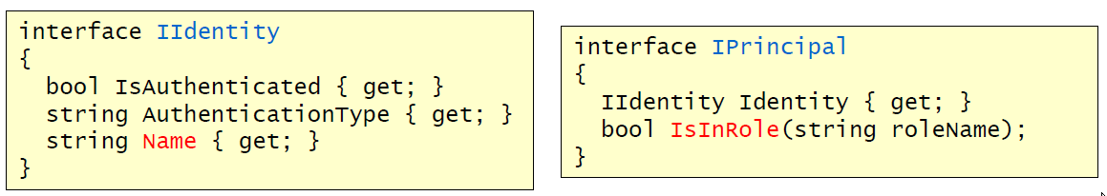
Before claims IIdentity and IPrincipal

Slide 27
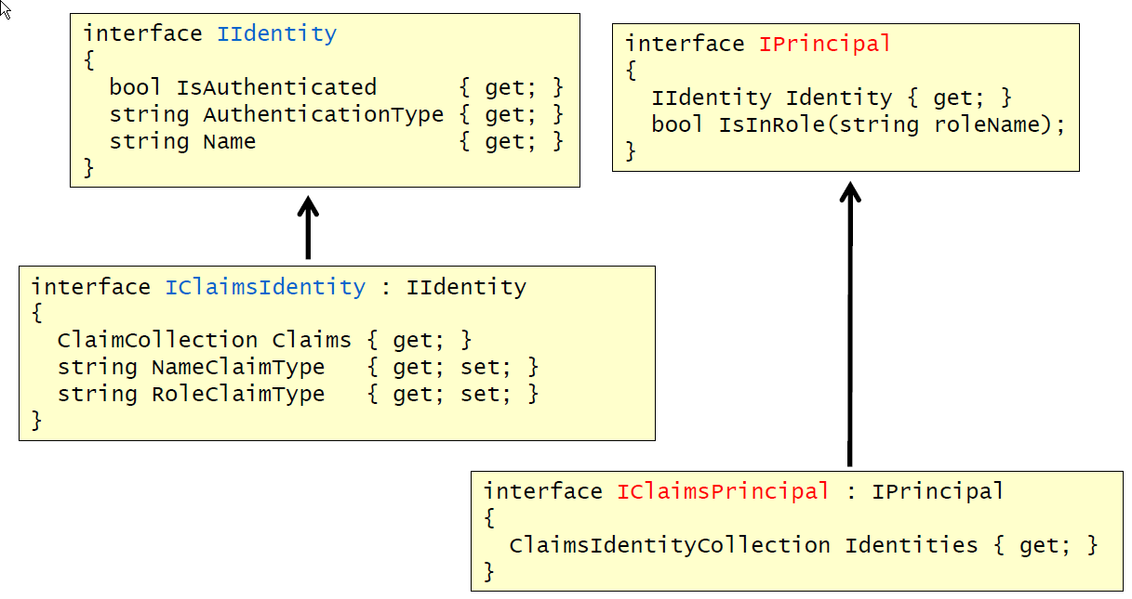
After claims IClaimsIdentity and IClaimsPrincipal

Slide 28
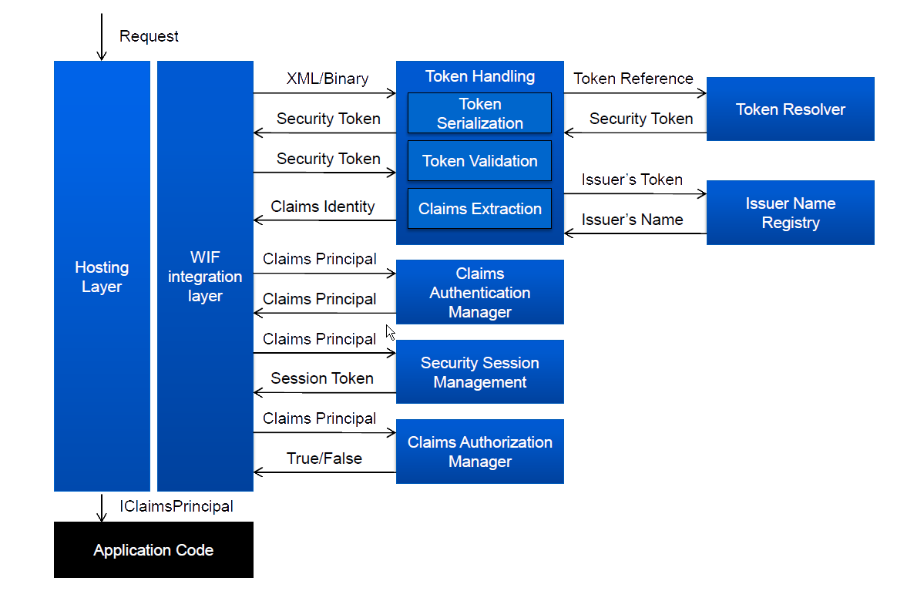
WIF pipeline

Slide 29
Windows Identity Foundation HttpModules
HTTPModule(s) in the ASP.NET pipeline of the app
They take care of exposing policy, manage protocol redirects, establish sessions…
WSFederationAuthenticationModule
Implements the WS-Federation redirects protocol
SessionAuthenticationModule
Takes care of handling sessions (regardless of the sign-in protocol)
ClaimsPrincipalHttpModule
Provides a hook for injecting claims in the current principal

Slide 30
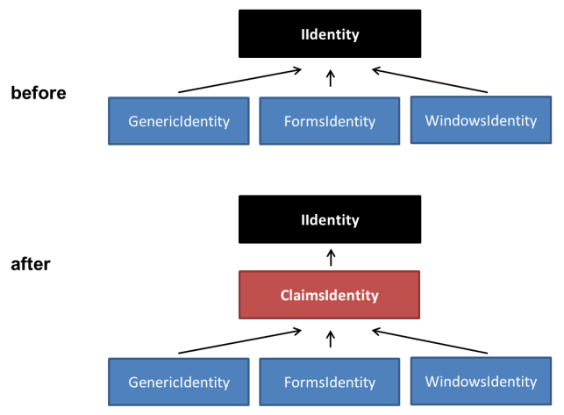
.NET 4.5 Claims Hierarchy

Slide 31
.NET 4.5 / Windows Server 2012 / VS 2012
WIF baked into the framework – no separate download
Can modify common settings directly from the tooling UI without the need to edit the web.config.
New tooling UI to speed up ADFS and ACS integration
Tools like SelfSTS now part of WIF
ADFS is V2 and baked in to Windows Server – no separate download
New wizard – same code under the hood

Slide 32
Conclusions
Changing how applications (and people) work with identity is not a small thing
Widespread adoption of claims-based identity will take time
All of the pieces required to make claims-based identity real on Windows are here:
AD FS 2.0
Windows Identity Framework
Microsoft support for claims
SharePoint 2010 +
CRM Dynamics 2011 +
Office 365
.NET applications
Windows 8 Metro style applications
Azure ACS
Many thanks to David Chappel, Dominick Baier and the Channel 9 TechEd presentations

Slide 33
Resources
Steve Peschka http://blogs.technet.com/b/speschka/
Vittorio Bertocci http://blogs.msdn.com/b/vbertocci/
Matias Woloksi http://blogs.southworks.net/mwoloski/
Dominick Baier http://www.leastprivilege.com/
Steve Syfuhs http://www.syfuhs.net/
Travis Spencer http://travisspencer.com/
Identity Developer Training Kit
Claims Based Identity & Access Control Guide
Channel 9
TechNet Wiki
Books

Slide 34
Thank you!
This has been
Claims-Based Identity
Rory Braybrook
@rbrayb
Questions ?

